Slide 1

Nanopore Sequencing – Data analysis practical session
Alba Sanchis-Juan & Nick Gleadall
Ouwehand Research group

Slide 2
Aims
Overall: How to take Oxford Nanopore Technology (ONT) data from raw signal to called variants
In this part of the session:
Learn about data format
Basecalling
Basic sequence QC

Slide 3

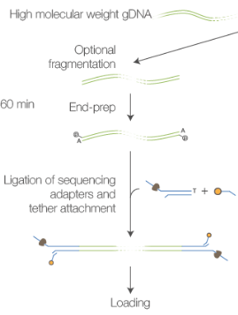
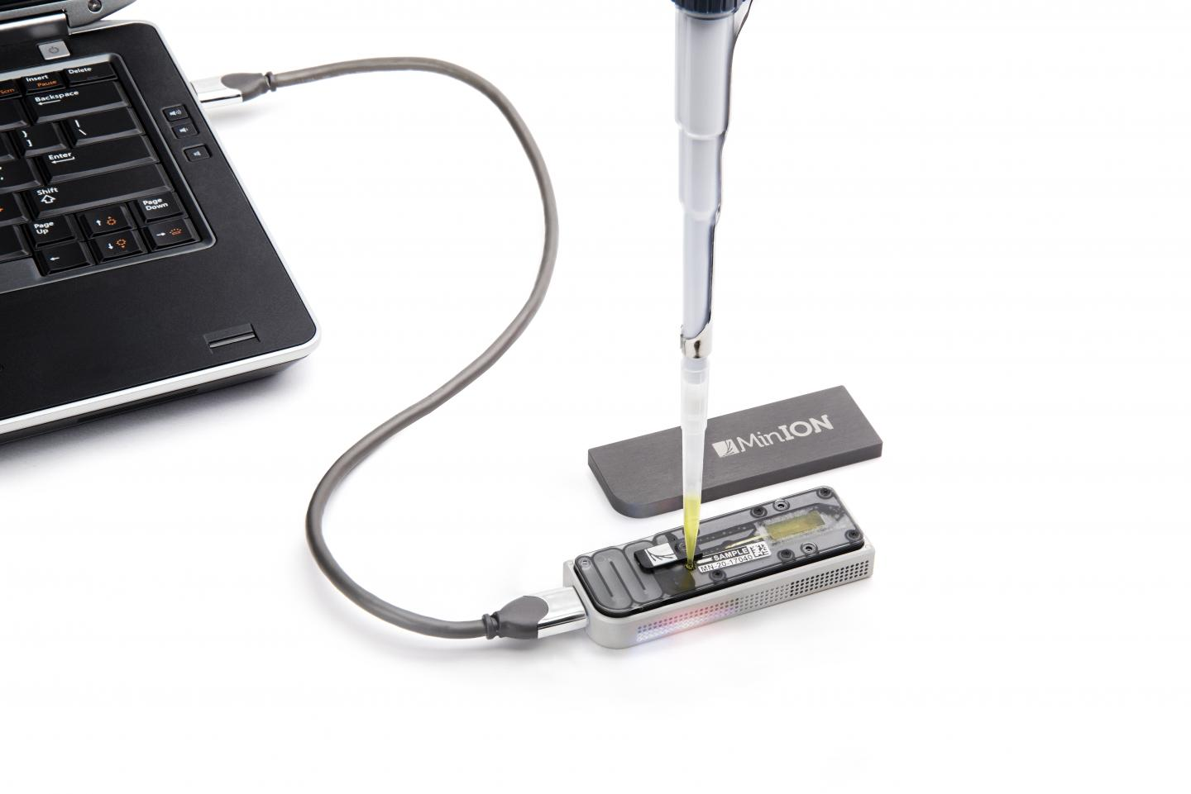
Starting point
Raw Data
DNA
Library Prep
Sequence

Slide 4
Raw reads
All data is written to a run specific directory
$cd ~/data/nanopore_example_run/
$ls reads/
You will see two directories ( 0/ and 1/)
ONT machines write reads in batches (here batch size = 4,000)
This is to keep the number of files in each directory reasonable for the computers filesystem
$ls reads/0/

Slide 5
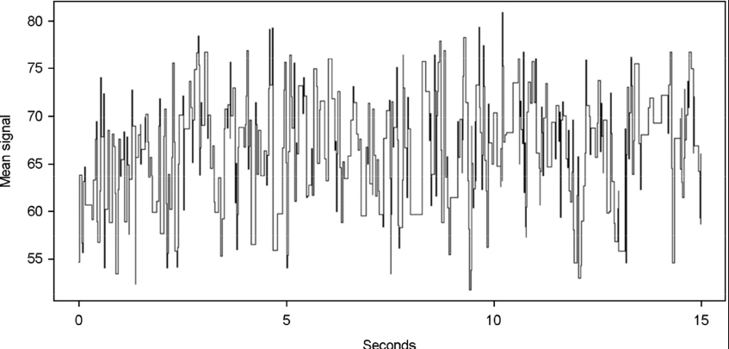
FAST5 files
Nanopore writes read data to a file format they call FAST5
FAST5 is in actual fact a HDF5 file
These are compressed binary files which store data in a structured way
This allows for random access to subsets of the data
This is where electronic signal data is storred

Slide 6
FAST5 files
Lets look at a FAST5 structure (using h5ls)
$h5ls reads/0/GXB01206_20180518_FAH88225_GA50000_sequencing_run_CD3_92236_read_10011_ch_258_strand.fast5
This shows the top level data keys, lets look recursively through the file to see the subkeys
$h5ls -r reads/0/GXB01206_20180518_FAH88225_GA50000_sequencing_run_CD3_92236_read_10011_ch_258_strand.fast5
We can also dump the entire contents of a FAST5
$h5dump reads/0/GXB01206_20180518_FAH88225_GA50000_sequencing_run_CD3_92236_read_10011_ch_258_strand.fast5 | less
(HINT: press q to exit less)

Slide 7
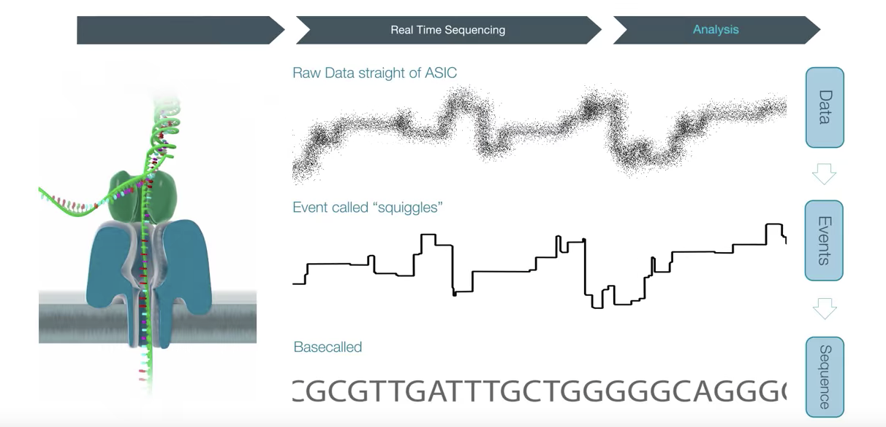
Basecalling
This is the process of translating raw electrical signal from an ONT sequencer to DNA sequence
Critical step in data analysis – it is can make data good or bad
Many basecaller’s are out there but we will use a ALBACORE v2.3.3 one of ONT’s in-house basecallers
It is important to know which flow cell and library kit were used. To see all combinations run:
$read_fast5_basecaller.py –l
Lets basecall
$mkdir basecalled_reads
$read_fast5_basecaller.py --flowcell FLO-MIN106 --kit SQK-PCS108 --input reads/ --recursive --worker_threads 4 --save_path basecalled_reads/

Slide 8
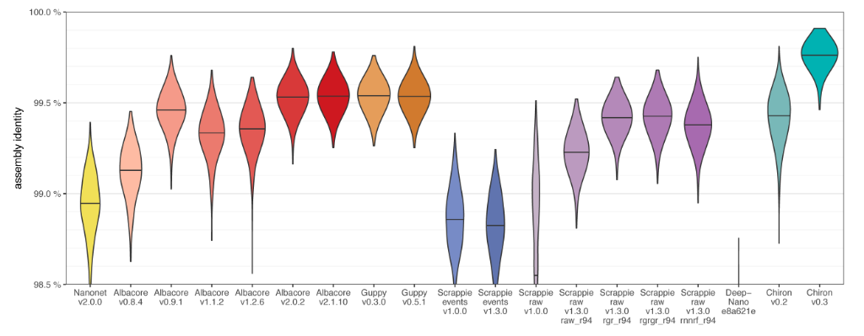
Basecallers – Assembly Identity
Assembly identity (%)
We don’t care about read identity if overall assembly identity is good

Slide 9
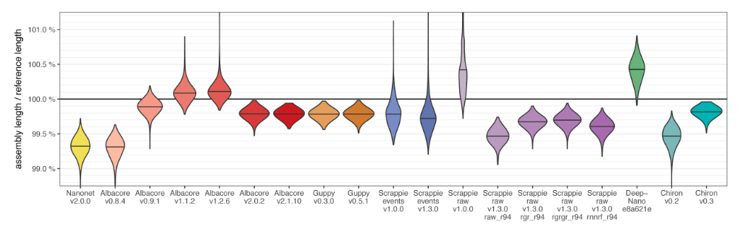
Basecallers – Assembly length bias
Assembly Length / Reference Length
This lets us see if an assembler is prone to reference insertions/deletions

Slide 10
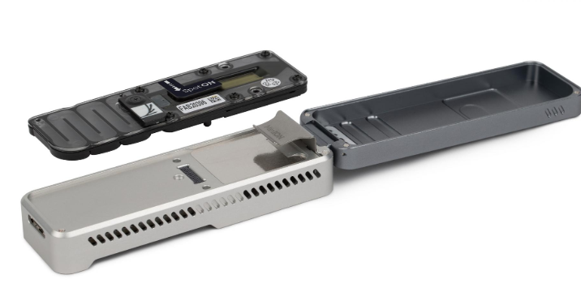

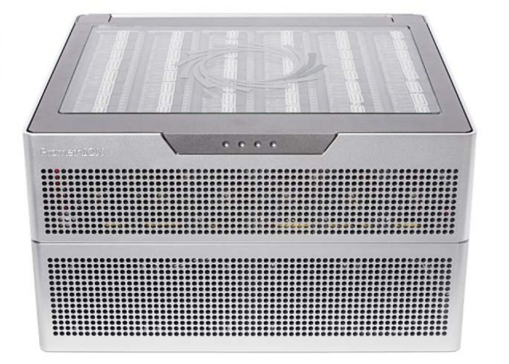
Recommended workflows
MinION
GridION
PromethION
Transfer data to analysis computer
Onboard GPU Basecalling using latest Guppy
Basecall using latest Albacore or Chiron 0.3
Transfer data to analysis computer

Slide 11
Basecalling results
Lets take a look inside the new basecalled_reads directory
$ls basecalled_reads
Important directory: workspace/
$ls basecalled_reads/workspace/
Contains pass/ and fail/ directories. These contain standard fastq seuqence files.
pass/ contains reads in fastq useable in further analysis.
Important file: sequencing_summary.txt
This file can be used to plot basic run QC statistics (rather than digging through fast5 files)

Slide 12
Plotting basic sequence run QC
Much easier to process this data in R
Open RStudio and load the following script:
~/data/nanopore_example_run/scripts/basic_sequence_qc.r

Slide 13
Plotting basic sequence run QC
Much easier to process this data in R
Open RStudio and load the following script:
/data/nanopore_example_run/scripts/basic_sequence_qc.R
This was a VERY basic overview of plotting
Check out the poRe library for more advanced plotting
https://sourceforge.net/p/rpore/wiki/Home/

Slide 14
Experimental workflow
DNA extraction & Library prep
Sequence
Basecall Fast5’s
Plot basic QC
Alignment
Polish
(Alignment correction)
Call variants and
Analyse data

Slide 15
List of tools used
h5ls , h5dump
ALBACORE v2.3.3
RStudio & R – any version
MinMap2 – (BWA for long reads - https://github.com/lh3/minimap2)

