Slide 1
Big Data

Slide 2
Learning objectives
Understand “big data” and “platforms” in big data platforms
Capture high-level views of big data platforms and understand the role of big data platforms
Understand key aspects in studying big data platforms

Slide 3
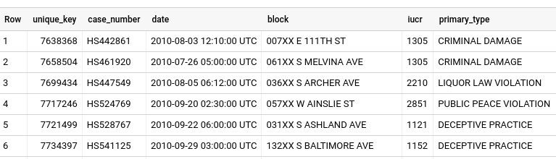
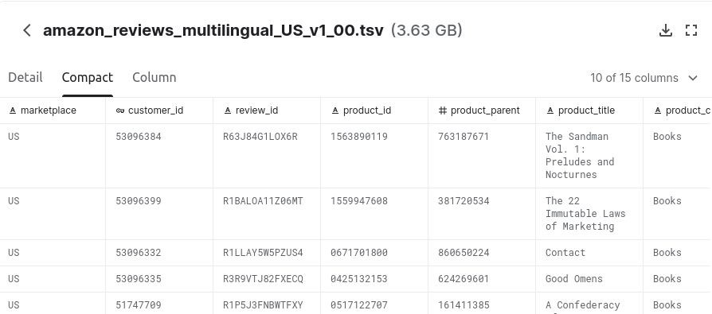

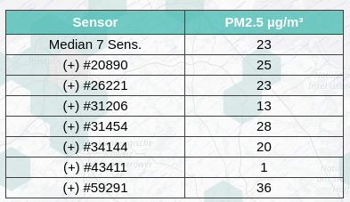
Data: facts, responses, events, measurements, etc.
Source: Chicago Crime, BigQuery
Source: https://www.kaggle.com/cynthiarempel/amazon-us-cu stomer-reviews-dataset
Source: https://maps.sensor.community/#8/52.917/8.817

Slide 4
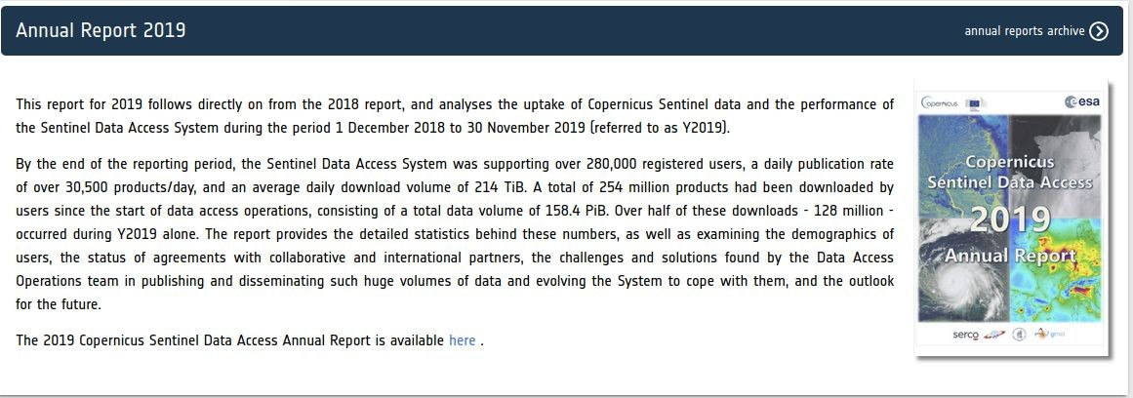
Is it big ?
From earth observation/remote sensing
Source: https://scihub.copernicus.eu/twiki/do/view/SciHubWebPortal/AnnualReport2019

Slide 5
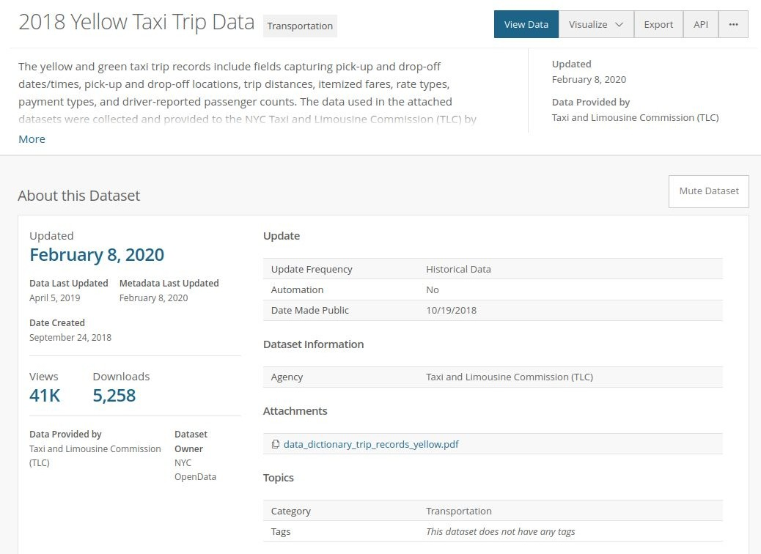
Is it big
e.g., 112M rows (2021 check)
“As of today we have 60 PB of query-able event data stored in an S3 based data lake and about 10 PB of raw data is being scanned every day using Presto.”
Source: Aug, 2019 https://eng.lyft.com/presto-infrastructu re-at-lyft-b10adb9db01
Snapshot from: https://data.cityofnewyork.us/Transportation/2018-Yellow-Taxi-Trip-Data/t29m-gskq

Slide 6
Is it big?
From a network infrastructure monitoring
5M sensors/monitoring points with
~1.4B events/day~ 72GB/day

Slide 7
Big Data
Extremely large, complex data sets
  they need to be handled with new techniques
Individual data items can be small or big
  e.g., simple sensor events versus high quality satellite images
Often characterized by V*
  e.g., Volume, Variety, Velocity, and Veracity

Slide 8
Characterize big data with V*
Volume:
  big size, large data set, massive of small data
Variety:
  complex, different formats, types of data and their links
Velocity:
  generating speed, data movement speed
Veracity:
  quality is very different (timeliness, accuracy, etc.)

Slide 9
Why do we have big data now?
Social media data generated by human activities
  Meta/Facebook, TikTok, Twitter, Instagram, etc.
Internet of Things (IoT)/Machine-to-Machine (M2M)/Industry 4.0
  data generated from monitoring of equipment, infrastructures and environments
Advanced sciences data generated by advanced instruments
  Earth observation from satellites/telescopes (Sentinel, James Webb)
Personal and disease information (e.g., healthcare)
Business-related customer data
Asset management and lodging (e.g., cars, homes)
Software systems (e.g., tracing, logs and test results)

Slide 10
Big “operational” and “analytical” data
Operational data
  for business/system operations, reads/writes (update), OLTP (online transaction processing)
Analytical data
  for understanding and optimization of business/subjects/systems/behaviors, historical/integrated data, write once/read many (no update) , OLAP (online analytical processing)
We face both types of data
  methods/techniques will be different

Slide 11
Why do we need to care?
Because of the values of data!
  Current hot: Large-Language models (LLMs)/Gen-AI
Top-down: Data economy
more data ⇒ more insights ⇒ better decision making ⇒ more business successes
Bottom-up
  understanding ⇒ optimizing ⇒ saving cost/creating new values
“The Unreasonable Effectiveness of Data” principle ⇒ with more data, the same algorithm performs much better!
Alon Halevy, Peter Norvig, and Fernando Pereira. 2009. The Unreasonable Effectiveness of Data. IEEE Intelligent Systems 24, 2 (March 2009). http://static.googleusercontent.com/media/research.google.com/en//pubs/archive/35179.pdf

Slide 12
What are platforms?

Slide 13
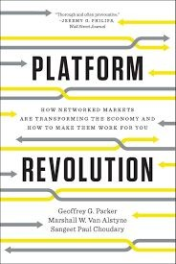
Example of platforms
Let us see from the business viewpoint from “Platform Revolution”:
Disruptive platforms: Airbnb, Amazon, Uber, Alibaba, Instagram, Meta/Facebook, Youtube, etc.
https://www.amazon.com/Platform-Revolution-Networked-Markets-Transforming/

Slide 14
The “Platform Revolution”s definition of a platform (from a business viewpoint)
“A platform is a business based on enabling value-creating interactions between external producers and consumers. The platform provides an open, participative infrastructure for these interactions and sets governance conditions for them. The platform’s overarching purpose: to consummate matches among users and facilitate the exchange of goods, services, or social currency, thereby enabling value creation for all participation”
Source: Geoffrey G. Parker, Van Alstyne, Marshall W. Van Alstyne , Sangeet Paul Choudary, Platform Revolution: How Networked Markets Are Transforming the Economy - and How to Make Them Work for You, March 28, 2016

Slide 15
Our interpretation of platforms for big data
Being large-scale service platforms, e.g.
  On-demand computing platforms for data-centric products
  On-demand analytics service platforms
  On-demand data management platforms
Enabling interactions between big data producers and big data consumers
  Integration, management, analysis, optimization
Facilitating the exchange of big data and products centered around data
Not just a database or data marketplace (even they are big!)

Slide 16
Platforms support data as “asset” and “product” perspectives
Known views about data
  “data as an asset”
  “data as a product”
“Data as an asset” (see “Design data governance”)
  something is very valuable that must be managed and exploited for the benefit of the owner
“Data as a product” (see “Data mesh” )
  product thinking for how one should process, manage and produce data to be used and satisfied by the data user
[“Data as an asset”]: Vijay Khatri and Carol V. Brown. 2010. Designing data governance. Commun. ACM 53, 1 (January 2010), 148–152. https://doi.org/10.1145/1629175.1629210
[“Data as a product”]: Zhamak Dehghani, Data Mesh, 2022

Slide 17
Big data platforms
Data-centric services
  a lot of data with different types and added continuously
  complex governance and technological infrastructures
Extensibility
  allowing new services, components to be added and integrated
With diverse types of stakeholders
  data consumers, data providers, and data integrators
  service consumers, service providers and service integrators
  regulators/auditors, etc.

Slide 18




Big data platforms: Onion architecture
Data-centric Virtualized Infrastructures
Middleware Platforms: building,
deploying, operating and scaling reliable big data services and applications
Big data services & applications
Big data platforms
consumers and producers: Sensors, Things, Equipment, Industrial Processes, People

Slide 19


























Analytics and big data platforms
Data sources from
different tenants
The core part of Big Data Platforms
Consuming applications
Things
Core services
Applications
In-Store Realtime Data
Data Ingest
Data Store
...
Applications
Transport Systems
Data Processing
Data Query
B2B-B2C
Market Data
Other (big data) Platforms &Services
Data Analytics Algorithms/Pipelines
Algorithms & Pipelines
....

Slide 20

Core principles/techniques for Big Data Platforms
Data management models, languages,tools, and methodologies
Programming models, languages and frameworks
You
(“the big data platform expert“)
(Service-based) Large-scale computing Platforms
Provisioning, automation and analytics
Processes

Slide 21
Focuses in studying big data platforms
Design/Development vs Operation
Data-centric vs Service-centric vs Platform-centric activities
High-level SQL-style analytics vs programmatic data processing models and workflows/processes
Quality and governance

Slide 22
Target goals for the study
As a user: able to use and program atop big data platforms
As a provider: able to operate big data platforms
As a designer/architect: able to design new (solutions for) big data platforms
As a developer: able to develop services/applications in big data platforms

Slide 23




Business models vs data platform engineering
Distinguish between engineering and business models
Business Models
Engineering: design, operation and governance
Business models: stakeholder management, pay-per-use, pricing, tenant models
Engineering Solutions
We mainly focus on engineering
  Business aspects are reflected in requirements for the engineering

Slide 24
Concepts/techniques vs Technologies
Concepts/Techniques versus Technologies
  concepts: e.g., NoSQL data models, sharding techniques, coordination for scalable datastores
  technologies: e.g., Cassandra, Hadoop, Apache Spark, Airflow
We still focus mainly on concepts/techniques
  technologies can be very complex or “everything is behind an API”
  but don’t forget key concepts and techniques
  implement key concepts with state-of-the-art technology in a limited but realistic scenarios

Slide 25


Build your story
Services/Platforms Design
Build “Your own Big Data Platform”
Data Governance and Quality of Analytics
Core concepts, methods and technologies
Data Integration/Management
Focus on foundations & explore your strengths/interests
Data Analytics/Processing

Slide 26
Design and implementation mainly reflect activities of platform developers/providers in the lifecycle of a big data platform based on
real-world data sets and scenarios

Slide 27



Example of a typical big data machine learning pipeline (hot area!)
Data Collection
Pre-processing
Training
Inference
Big data storage/ingestion
Big data processing

Slide 28
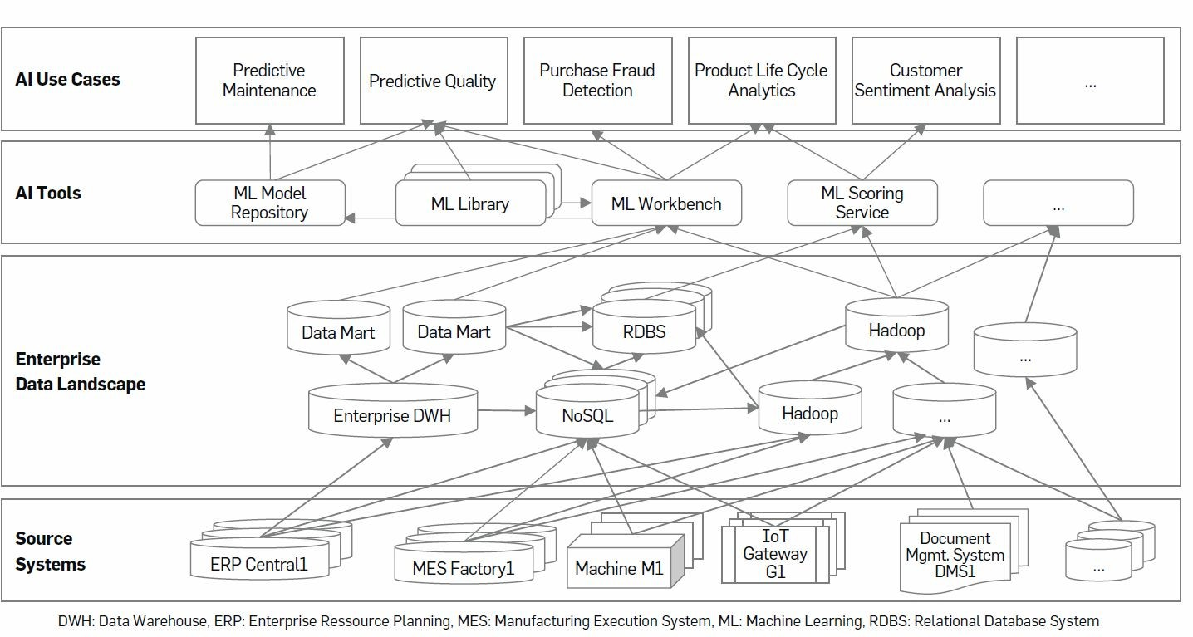
“No AI Without Data”
Figure source: There Is No AI Without Data, by Christoph Gröger, Communications of the ACM, November 2021, Vol. 64 No. 11, Pages 98-108, 0.1145/3448247

Slide 29

Big data processing in our story: we are not just “data scientist” or BA
Machine Learning with Jupyter Notebook
Big Data Business Intelligence Platform with Dashboard
User (scientists, engineers) Provider User (business analyst)
Our learning goals: tasks in systems and applications
Understand the user/developer needs
Understand how to build platforms to support the users/developers

Slide 30
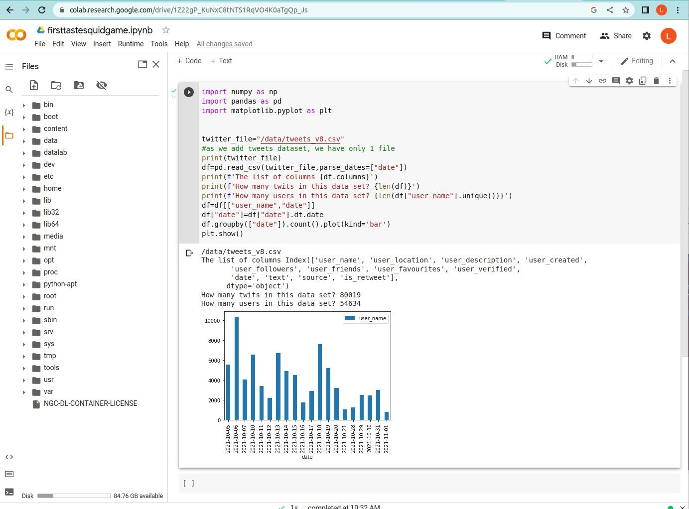
Using Jupyter Notebook to do data analytics

Slide 31
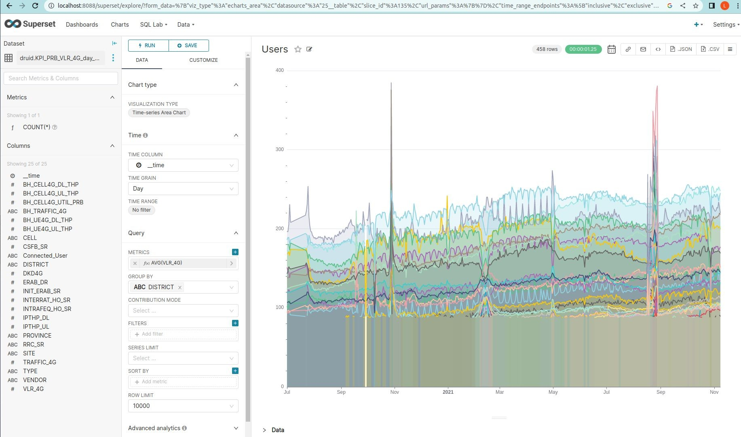
Business intelligence analytics style with Superset
Data source: network data from Mobifone, Vietnam

Slide 32

Related concepts/techniques
Distributed systems and cloud computing
  Virtualized environments and cloud deployment, concurrency, consistency/availability/fault management, application protocols
Databases and data management
  Data modeling, ETL/data pipeline, data partitioning, databases
Algorithms and programming models
  Parallel/concurrent programming, workflows, streaming processing
Service and software engineering
  Service engineering & microservices
Basics of big data

Slide 33
Summary: the importance of big data platforms
Foundations and backbones for various “hot” research/development areas
  LLMs/Machine Learning/AI
    Data management, feature storage, data preparation pipelines, …
  Data Science
    Data and data management, computational models, statistics and algorithm
  Enterprise computing
    360-degree analytics of customers
  Industrial IoT/Manufacturing/Predictive maintenance
    Monitor machines and optimizing machines through real-time and predictions
  Smart cities and sustainability

Slide 34
Summary: the importance of big data platforms for industries and businesses
Wide range application domains
  Business, healthcare, manufacturing, sustainability, and science
Examples of key industries for infrastructural and platform services for big data
  Amazon, Microsoft, Google, IBM, Alibaba, Huawei, Snowflake, Databricks, etc.
Big data and large-scale data analytics are fundamental in most companies/organizations doing digital business

Slide 35
Your big data platform story - an evolving scenario
“Your team has to build a big data platform for X types of data. Data will be generated/collected from N data sources. We expect to have 10+ GBs/day of data to be ingested into our platform. We will have to serve K thousands of requests for different types of analytics – to be determined. Our response time for an analytics request should be in t milliseconds. Our services should not be …”

Slide 36
You may have several questions?
Do we have to support multiple types of data?
How do data pipelines and data load look like?
How to enable different data processing models?
Which runtime parameters must be monitored? Which service level and data metrics must be guaranteed?
To where we should distribute/deploy our components?
Which part of the platform we must manage by ourselves and which part will be fully managed by other providers?
How to design elastic big data infrastructures?
Etc.

Slide 37
Your Big Data Platform story starts with Big Data Platform architectures!
To architect the platform centered around big data and data intensive activities!

Slide 38
Underlying computing infrastructures is for data intensive tasks
Computing resources and services
  many machines, virtual infrastructures, different types of services
Distributed infrastructures from different administrative domains
  in multiple data centers, locations and countries
  with different security and network policies
Diverse service level objectives (SLO) and service level agreements (SLAs)
  performance, service failure, cost, privacy/security …
  data and data governance

Slide 39


















Understanding the underlying infrastructures for big data platforms
large-scale distributed infrastructures ⇒ hybrid and or multi cloud/edge
Data Center dc1 (on-premise)
Data Center dcn
Node
Rack 1
Node
Rack R
Task
Task
Physical
MachPinheysical
Machine
Data Center dc2
Data partition
Data partition
Node
Node
Node
Node
several data intensive tasks are optimized with rack/topology awareness

Slide 40
Data-centric development & operations
Data ingestion and ETL (Extract, Transform, Load)
  from various data sources we move data into the platform
Data storing and management
  ingested data stored and managed using different types of storages and databases
Data analysis and (Machine) learning
  data processed, analyzed and learned, finding insights and creating ML models
  data at rest vs data in motion
Reporting and visualization
  patterns/insights in data will be interpreted and presented for making decisions, reporting, and creating stories
Data Governance at very large-scale

Slide 41








Big Data Pipelines
Multiple big data pipelines can be constructed atop a big data platform (and across distributed infrastructures)
Data source
Ingestion
Data Store
Machine
Learning
Visualization
Data source
Ingestion
Data Store (raw data)
Data Analysis
Data Store
(analytical, resulting data)
Big Data Platform

Slide 42
Handling multiple types of data
Hardly to avoid the support for multiple types of data
  tenant requirements and application needs, given data as “products”/”assets”
Multiple types of data
  different characteristics and values
Any elastic solution that ensures minimum changes to support generalization and extensibility
  multi-model databases, microservices of multiple of databases or data lake
  new workloads, new types of customers

Slide 43
Data governance: concerns & SLAs
Key common problems:
  data quality, data lineage,
Ingesting data: ingestion of data under V*
  mapping and transforming data, data validation/quality control
Storing data
  data sharding and consistency, data backup, retention, etc.
  the impact of the rights to remove data
SLA multitenancy versus single tenancy
  security, privacy, performance, reliability and maintenance?
The volume of data is increasing but its usefulness may not because of the bad data quality

Slide 44







Data concerns: example
data
....
.... Analysis
result
Ingestion, Querying, Data Management, etc.
Quality of data?
Privacy problem?
Located in US/China?
price?
free?
Service quality? data lineage
redistribution?
Ethical consequences?
Regulation-compliant platforms: e.g., GDPR

Slide 45






Fast/slow reliable processing
big data but not near real-time, e.g., take customer transaction files from companies and move to data centers for analytics
Data
Ingestion
Data Store
Batch Processing
Visualization
source
fast, small IoT data in near real-time flows, e.g. position of cars
Data Message
source Broker
Streaming
Processing
Visualization

Slide 46
Software services design goals
For dealing with V*
Responsive: guarantee quality of services
Resilient: deal within failures
Elastic: deal with different workload and quality of analytics
Loosely coupling: support reusability, composition, and extensibility

Slide 47
Designs must address various aspects for big data
Responsive:
  distributed computing, multi layer optimization
Reactive systems
Resilient:
Respon sive
replication, containment, isolation
Elastic:
  sharding, replication, load balancing, scale up/out
Message-driven:
  loosely coupling with messages, non-blocking protocols, location-independent
Elastic
Resilient
Message- Driven
Source: https://www.reactivemanifesto.org/

Slide 48






Efficiency and sustainability
Highly efficient might not be good for sustainability
Sustainability within big data platforms
  energy consumption, reusability, extensibility
Design and implementation
Reliability
Resilience
Elasticity
Sus. goal
Platform design
Concrete techniques
Verification
Sustainability
How to have it for

Slide 49
Distributed systems of components are used to manage, ingest data and process data

Slide 50
Partitioning: splitting functionality & data
Breakdown the complexity
  easy to implement, replace and compose
  deal with performance, scalability, security, etc.
  support teams in DevOps
  cope with technology changes
Many things are related to the current trend of microservices and domain-driven designs
But tradeoffs with management w.r.t data resources

Slide 51
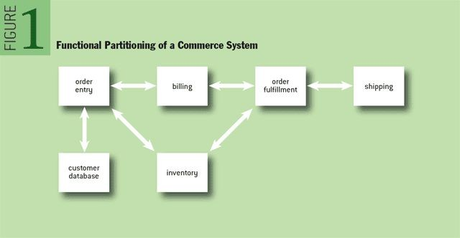
Example of functional and data partitioning
Service-oriented components
Microservices and domain-oriented microservices for data
Serverless functions/function as-a service
Figure source: http://queue.acm.org/detail.cfm?id=1971597

Slide 52
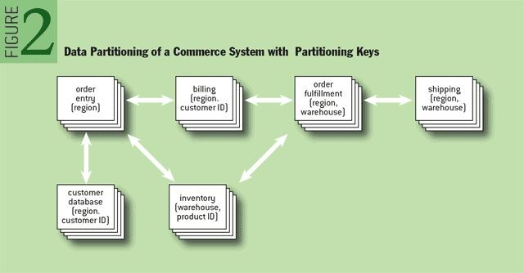
Example of functional and data partitioning
Data sharding
Multi data spaces Multi data services
Multiple data infrastructures
Figure source: http://queue.acm.org/detail.cfm?id=1971597

Slide 53


Interaction: multiple models
Protocols
  REST, gRPC, Message Passing, Stream-oriented Communication
Models
  One-to-many, many-to-one, many-to-many
  Synchronous/asynchronous calls
  Internal data exchange versus open/external exchange
Client Client
^{get} delete
Transformer
function Trigger
Data Producer
Messaging
Systems
Analyzer
Internal Client
put
Data Service
Ingestor
Amazon S3/MongoDB

Slide 54
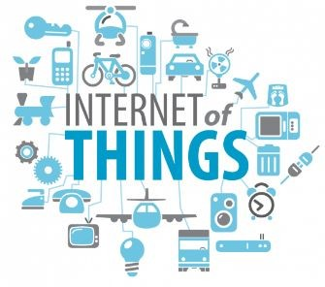
Coordination: Orchestration and Reactiveness/Choreography
Energy Optimization Analytics
Sensor Data
Analytics
Emergency Service
Orchestration
Equipment Predictive Maintenance Forecasting
Near Realtime Analysis/ML
Reactiveness/ Choreography
Sensors
Broker
Historical Time series Data Archiving

Slide 55






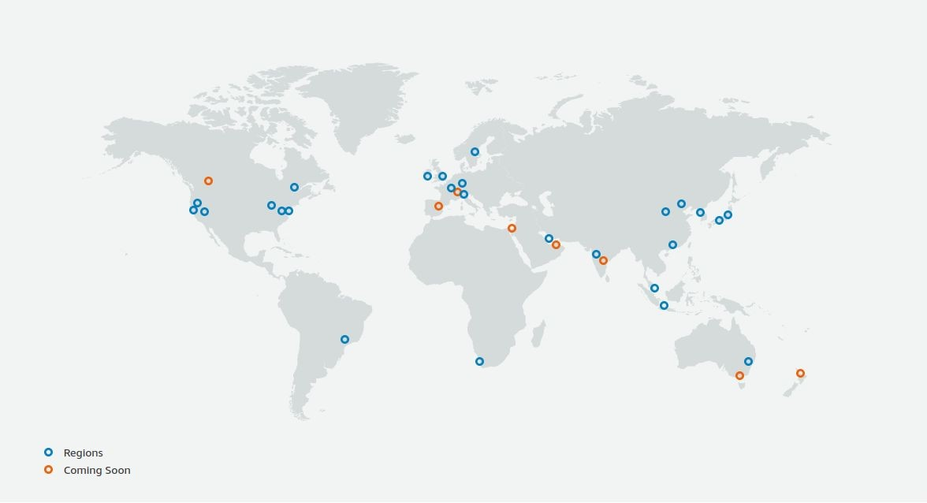
Distribution: Edge or Data Centers?
Platform A Platform B
Big data & components components can be distributed in different places!
- performance, security, regulation, energy efficiency
Global deployment or not?
Move analytics/work or move data?
Map of AWS infrastructure (08.01.2022)
Source: https://aws.amazon.com/about-aws/global-infrastructure/
An outage can lead to a huge problem. Example: https://www.thousandeyes.com/blog/aws-outage-analysis-dec-7-2021

Slide 56
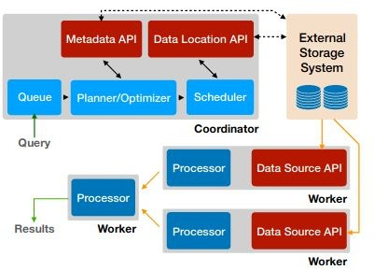
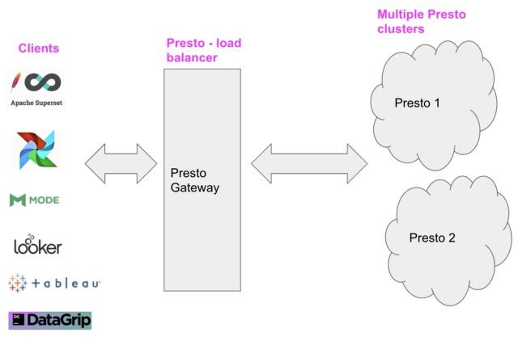
Scalability & elasticity
Lyft Presto Gateway
“As of today we have 60 PB of query-able event data stored in an S3 based data lake and about 10 PB of raw data is being scanned every day using Presto”
Presto: https://prestodb.io/
Figure source: Presto: SQL on Everything https://ieeexplore.ieee.org/stamp/stamp.jsp?tp=&arnumber=87315 47&tag=1
Figure and text source:
https://eng.lyft.com/presto-infrastructure-at-lyft-b10adb9db01

Slide 57
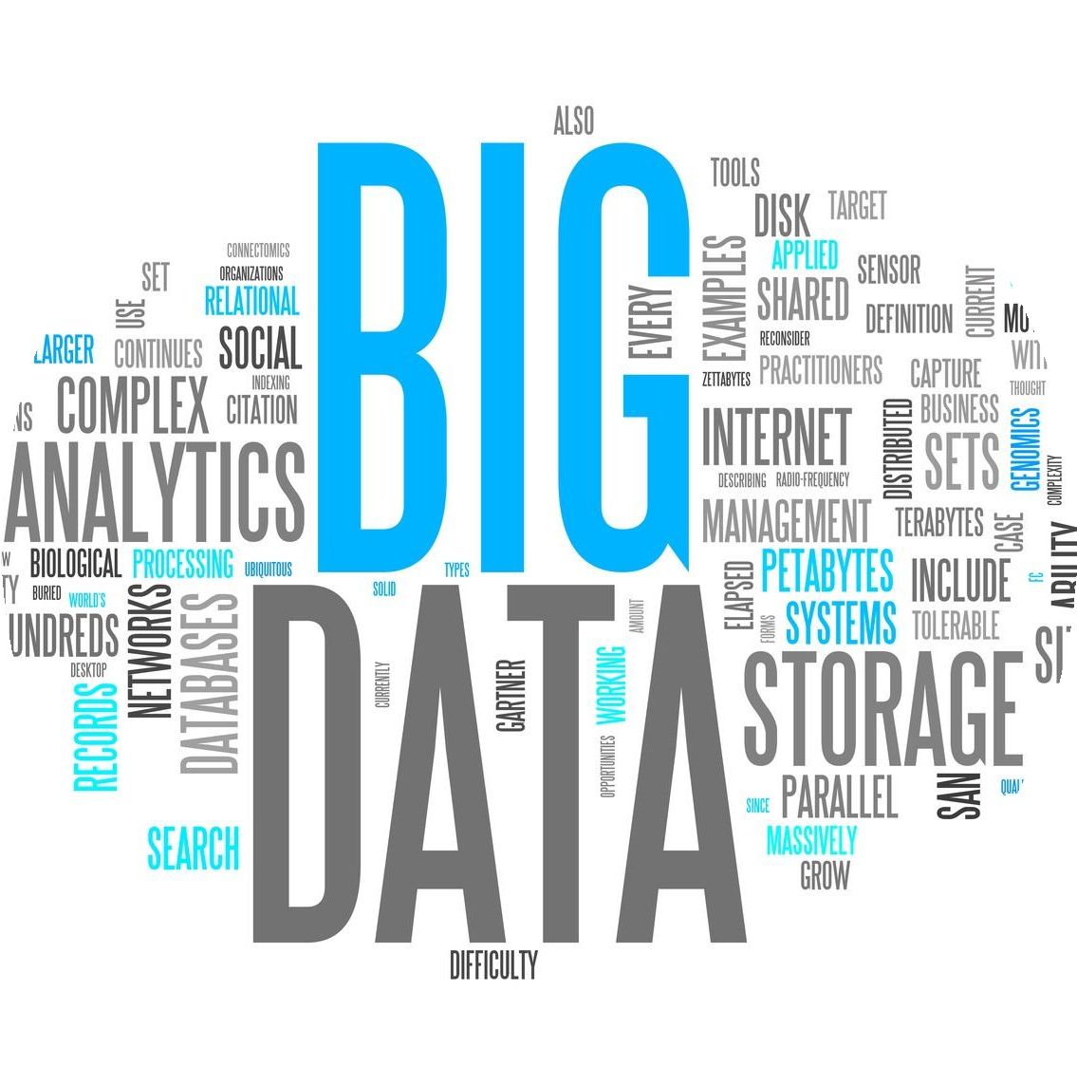


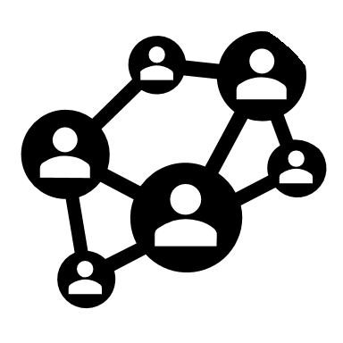
API for Platform as a Service
A P I
APIs are key! Why?
enable customers access to data and analysis functions from your big data platforms without worrying about changes within your platforms
RawData
Analytics
enable virtualization and management (hide internal, control access, throttling)
establish protocols for data exchanges
Notification

Slide 58
Delivery data as “asset”/”product”
FAIR principles (https://www.nature.com/articles/sdata201618)
  Findable, Accessible, Interoperable and Reusable
Product/asset characteristics
Consequences for the platform
  Metadata and governance
  Service-level objectives and quality controls for data
  Search
  Access control policies

Slide 59
Common, high-level architecture view with popular state-of-the art technologies for our study

Slide 60
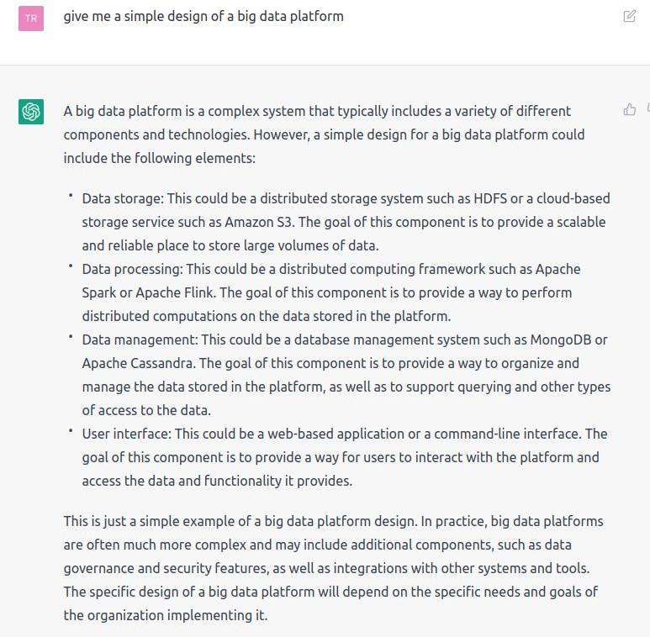
Your big platform suggested by ChatGPT
dated: 03.12.2022

Slide 61








Our big data at large-scale: the big
picture in this course
Operation/Management/ Business Services
Data sources (sensors, files, database, queues, log services)
Messaging/Ingest systems (e.g., Kafka, Pulsar, AMQP, MQTT, Kinesis, Nifi, Google PubSub, Azure IoT Hub)
Stream processing/ML systems
(e.g. Flink, Kafka KSQL, Spark, Redpanda, Google Dataflow)
Warehouse Analytics (e.g., Presto, Kylin, BigQuery,Redshift)
Storage/Database/Data Lake (S3, Minio, HDFS, CockroachDB, Cassandra, MongoDB, Elastic
Search, InfluxDB, Druid, Hudi, etc.)
Batch data processing/ML systems
(e.g., Hadoop, Airflow, Spark)
Elastic Cloud Infrastructures
(VMs, dockers, Kubernetes, OpenStack elastic resource management tools, storage)

