Slide 1
Models for Distributed Systems & Cloud Computing

Slide 2
Distributed System Models
Client-Server
Peer-to-Peer
Services provided by multiple servers
Proxy servers and caches
Mobile code and mobile agents
Thin clients and mobile devices
Event Driven Architechture

Slide 3
1. Client-Server Model:
Clients request services, servers provide them.
Examples: Web applications, database servers.

Slide 4
2. Peer-to-peer Systems
All nodes are equal and share resources directly.
Examples: BitTorrent, blockchain.

Slide 5
3. A Service by Multiple Servers
Presentation tier, application tier, data tier.
Widely used in web applications.
Notes:
Load sharing
Redundancy

Slide 6
4. Web Proxy Server
A web proxy server is an intermediary server that sits between a client (e.g., a browser) and the internet. It processes client requests by forwarding them to the intended server and then returning the server's response to the client. Web proxies enhance privacy, security, and performance.
Notes:
Benefits of a Web Proxy Server
Privacy:
Masks the client’s IP address and hides browsing activities.
Security:
Filters malicious traffic and adds an additional layer of security.
Caching:
Stores frequently accessed resources to improve response times and reduce bandwidth usage.
Content Filtering:
Blocks inappropriate or restricted content (e.g., in schools or workplaces).
Access Control:
Restricts access to certain websites or services based on rules.
Load Balancing:
Distributes client requests across multiple servers to ensure availability.

Slide 7
5. Web Applets

Slide 8
6. Thin Clients and Compute Servers
Compute server
Network computer or PC
Thin
network
Application
Client
Process
A thin client is a lightweight computing device that depends heavily on a server for computational power, applications, and data storage.
Minimal hardware requirements. No local storage or minimal local processing. Connects to a central server or cloud to perform tasks.
Web browsers as thin clients for SaaS applications.
Devices in virtual desktop infrastructure (VDI).

Slide 9
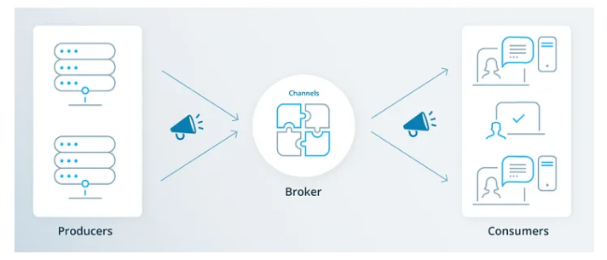
7. Event Driven Architecture
Asynchronous communication based on events.
Examples: IoT systems, real-time analytics.

Slide 10
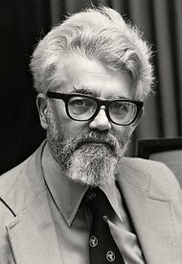
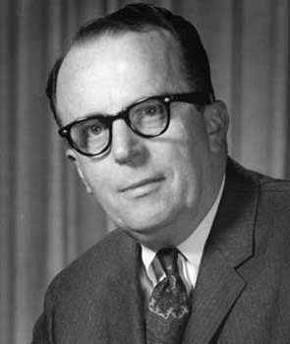

Cloud Computing: Origins
Computer Scientist John McCarthy in 1961: “If computers of the kind I have advocated become the computers of the future, then computing may someday be organized as a public utility just as the telephone system is
... The computer utility could become the basis of a new and important industry.”
  1963: J.C.R. Licklider, a director at Advanced Research Projects Agency (ARPA), introduced the concept of Intergalactic Computer Network.
1960 Leonard Kleinrock (@ARPANET): “As of now, computer networks are still in their infancy. But as they [...] become more sophisticated, we will probably see the spread of computer utilities.”

Slide 11
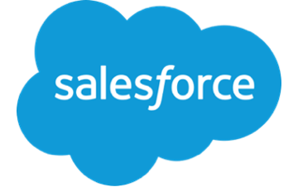
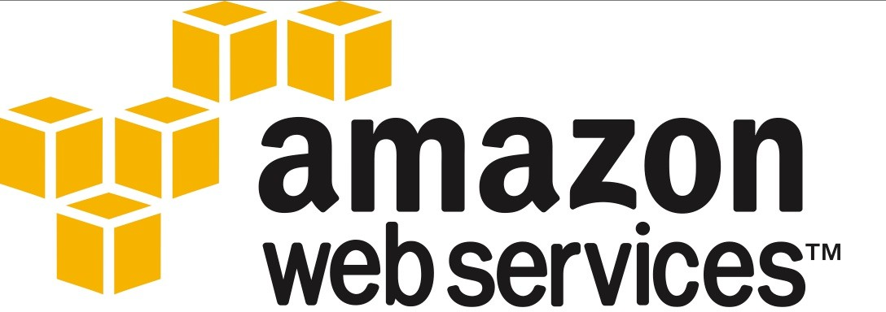

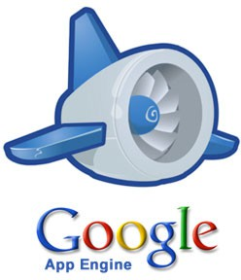
Cloud Computing: Origins
(Fast Forward 30 years):
Late 1990s: Salesforce.com pioneered remotely provisioned services.
2002 Amazon.com launched Amazon Web Services (AWS) platform.
2006: The term Cloud Computing emerged commercially. Amazon launched Elastic Compute Cloud (EC2).
2009: Google offered Google App Engine.

Slide 12
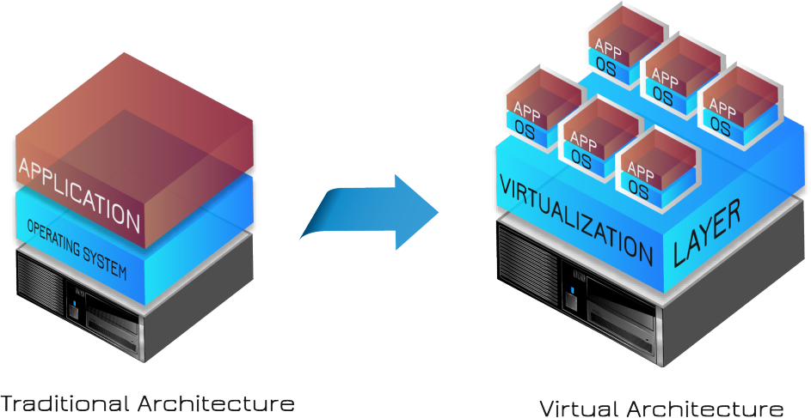
Technology Innovations that inspired Cloud Computing
Virtualization: enabled to decouple applications from the underlying hardware, drivers, OS. Enabled sharing of the underlying processing capabilities by multiple users that need their own platform/hardware requirement. Enabled maintaining images for a standardized service and spawning as many copies of them as demanded, . . .

Slide 13
Essential Characteristics of
Cloud Computing
NIST lists 5 essential chatacteristics (defining properties) for cloud computing:
Ubiquitous (Broad) Network Access
On-demand Self-Service
Rapid Elasticity or Expansion
Resource Pooling
Measured Service

Slide 14
Essential Characteristics
Ubiquitous Network Access:
The property that the cloud service (the IT resource that it provides) be widely accessible.
This requires the cloud to support a range of transport protocols, interfaces, and security technologies.

Slide 15
Essential Characteristics
On-demand Self-Service:
The property that the cloud consumer can access and scale the offered cloud-based resources independently (through a graphical or command-line interface) and be able to control them at will, with no need for any decision-input/approval by the cloud provider or any disruptive impact on the cloud’s operation.
The cloud should also have the option to automate the process of resource provisioning whenever needed (at the runtime).

Slide 16
Essential Characteristics
Rapid Elasticity:
Elasticity (scalability):
the degree to which a system is able to adapt to workload changes by provisioning and de-provisioning resources in an autonomic manner, such that at each point in time the available resources match the current demand as closely as possible.¹
There are two types of scaling:
Horizontal: Allocation/Releasing of resources of the same type, e.g. nodes, servers, instances, etc.
Vertical: Adding/removing capacity to/from (or replacing) an existing IT resource.
.
¹Herbst, Nikolas Roman; Samuel Kounev; Ralf Reussner.
Elasticity in Cloud Computing: What It Is, & What It Is Not ICAC 2013.

Slide 17
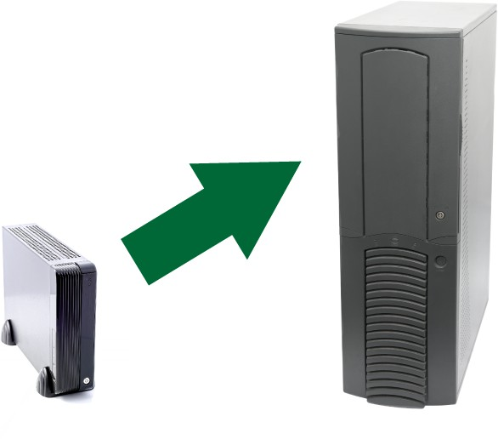
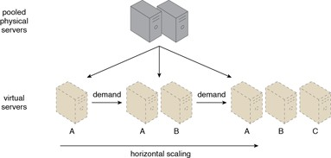
Essential Characteristics
Horizontal Scaling: Scaling Out / Scaling In
Vertical Scaling Scaling Up / Scaling Down

Slide 18
Essential Characteristics
Resource Pooling:
Aggregation of computing resources such as storage, processing, memory, and network bandwidth across different physical machines so that they can be used by multiple users and dynamically assigned and released per demand.

Slide 19
Essential Characteristics
Measured Service:
Cloud systems transparently monitor, control and report the usage of resources (e.g., storage, processing, bandwidth, and active user accounts) according to the abstraction level of the service, providing transparency to both the provider and consumer of the service.

Slide 20
Useful terminologies
Q: What are IT resources?
A: Any asset that provides an IT service. This includes physical/virtualized resources like
Servers (computers where applications reside), Databases (computers where data resides in a structured way), Workstations or Clients (where the applications to communicate with and use the servers reside), network devices (access points, switches, routers, bridges, backbone, backhaul), or software (firmware, Drivers, OS, middleware, Applications), or human resources (IT/mgmt expertise)
Q:What’s the opposite of a cloud-based resource?
A: On-Premise: in contrast to the “cloud”–based resources are remotely provisioned, and are scalable and measured, the conventional non-cloud based resources are called on-premise (in that they are located on the “premises” of the IT enterprise).

Slide 21
Cloud Service Models
NIST lists out three service (delivery) models based on the abstraction level:
Infrastructure as a Service (IaaS)
Platform-as-a-Service (PaaS)
Software-as-a-Service (SaaS)

Slide 22
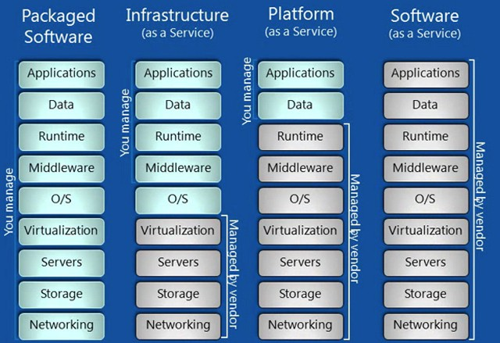
Main Service Models

Slide 23
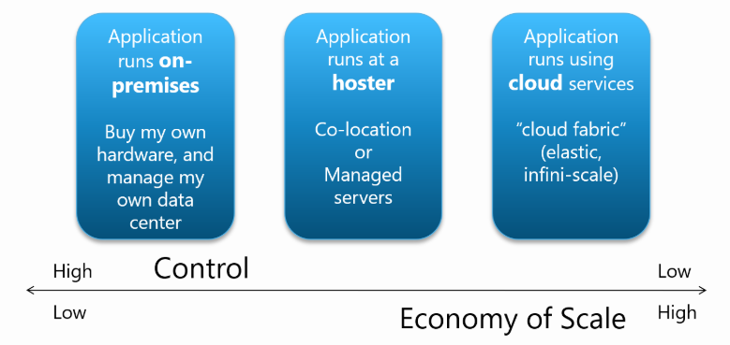

Slide 24
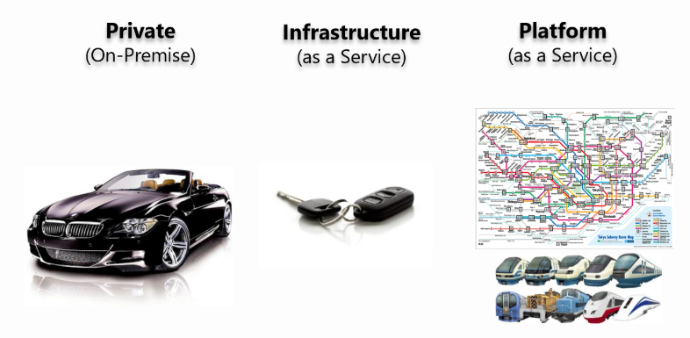
Notes:
The high-level talking points for this analogy were:
On-premises: is like owning your cars - you can go anywhere you want at anytime (full control), in a car make/model/color/trim of your choice, but you own the car and you’re responsible for its maintenance
IaaS: is like a car rental service - you still can go anywhere you want at anytime, with some limits in car choices, but you don’t have to maintain the vehicles; just take the keys and go
PaaS: is like public transportation - you can go to places as defined/limited by available routes and schedules, but it’s easy to use and pay-per-use (full economies of scale)

Slide 25
Main Service Models: IaaS
The NIST definition of Infrastructure as a Service (IaaS):
“The capability provided to the consumer is to provision processing, storage, networks, and other fundamental computing resources where the consumer is able to deploy and run arbitrary software, which can include operating systems and applications. The consumer does not manage or control the underlying cloud infrastructure but has control over operating systems, storage, and deployed applications; and possibly limited control of select networking components (e.g., host firewalls).”
²Mell, Peter, and Tim Grance. ”The NIST definition of cloud computing.” (2011): http://nvlpubs.nist.gov/nistpubs/Legacy/ SP/nistspecialpublication800-145.pdf

Slide 26
Main Service Models: IaaS
So the main resources being provided:
Servers (with CPU, Cache, RAM, etc)
Disk Storage
Networking.
In particular, the consumer has to install the OS, the application server (database server, the web server), job scheduling, resource usage governance, scaling, auto-scaling, caching,
middle-ware (messaging between applications), distributed computing, compilers/builders, deployment and integration tools, all the necessary runtime libraries, add-ons and plug-inns, and of course, their applications (including their application security/API/admin/etc).
What they get is a virtually “infinite” pool of computing resources that they can use-per-need and pay-per-use.

Slide 27
Main Service Models: IaaS
Instagram: a success story of IaaS:
Three programmers on a bootstrap budget launch a photo-sharing application, 25,000 sign up the first day, 40 million in less than 2 year, when facebook acquired it for ∼ 1$ Billion.³
Another good-use example:
When a consumer wants to build and deploy different server configurations, “test” and decide among them (even as an on-premise solution). So instead of hundreds of thousands of pounds this can be done in couple of tens.
³As of Sep 2017 it was about 600 million active users monthly:
https://www.statista.com/statistics/253577/ number-of-monthly-active-instagram-users/

Slide 28
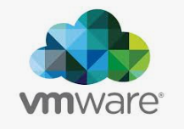
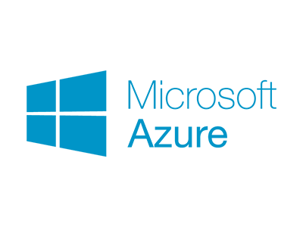
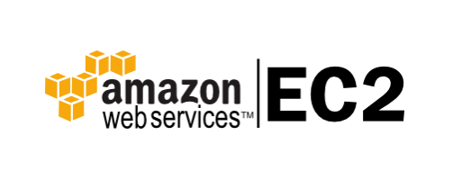
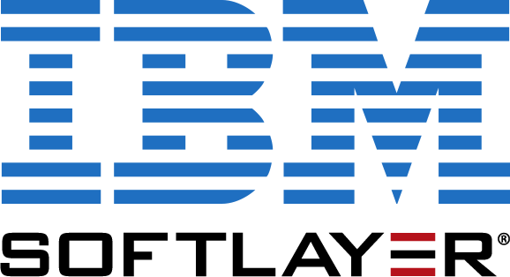
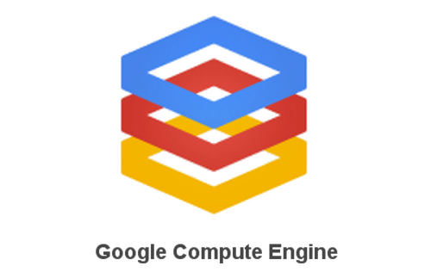
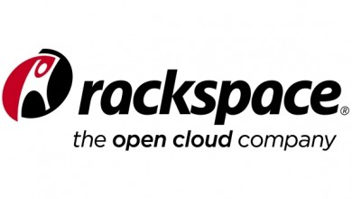

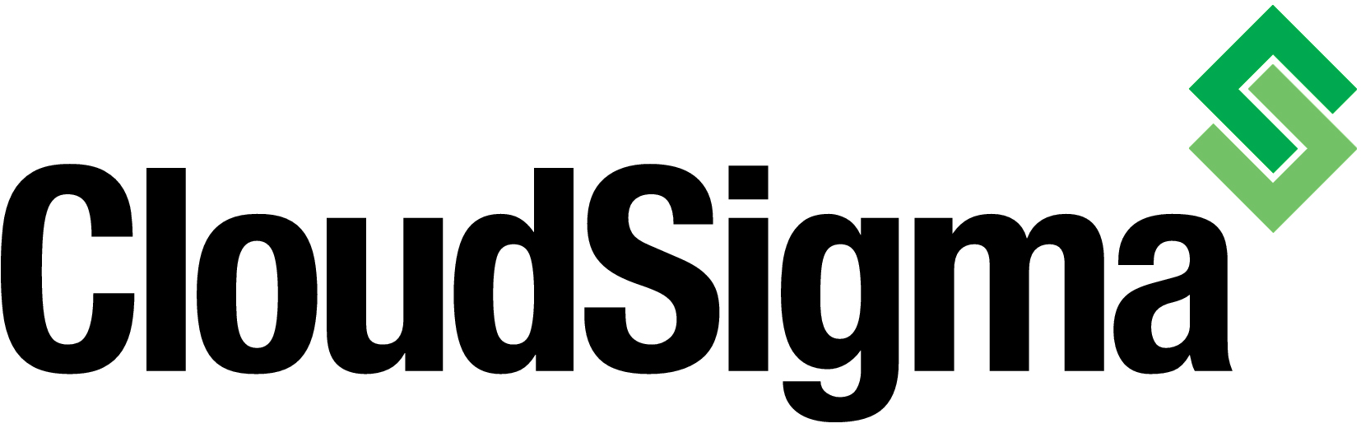

Main Service Models: IaaS
Some currently well-known IaaS vendors:
Amazon Elastic Compute (EC2), Microsoft Azure, IBM Softlayer, Google Compute Engine, RackSpace Cloud Servers, vmware, CloudSigma, GoGrid, Joyent
But consumers can also build their own IaaS capabilities in-house (i.e., a private cloud) using OpenStack (say, to avoid vendor lock-in)

Slide 29
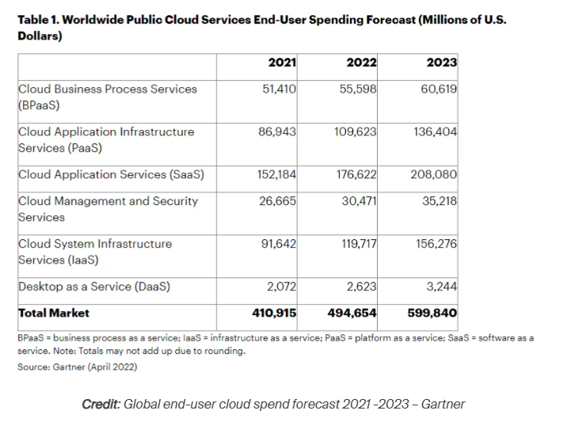

Slide 30
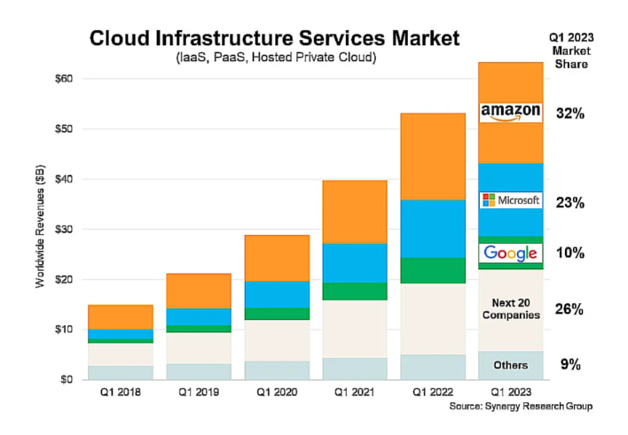

Slide 31
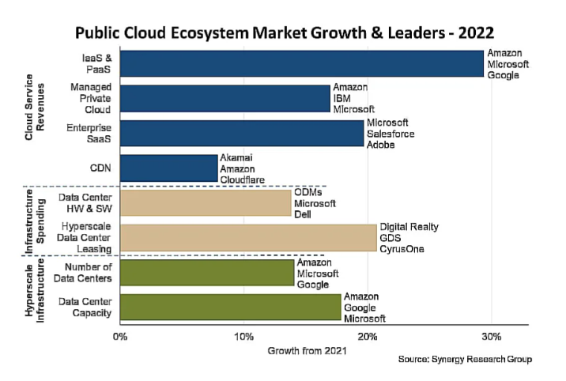

Slide 32
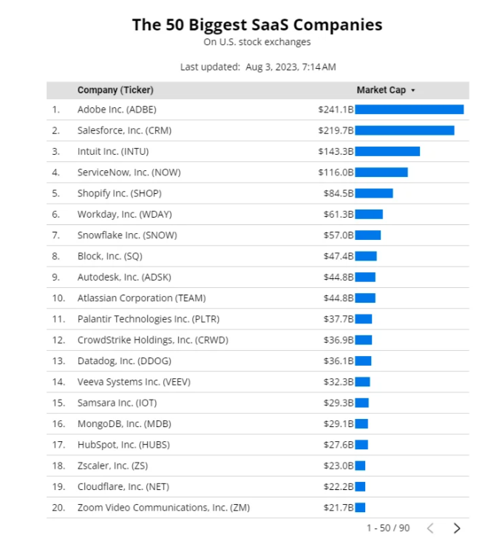

Slide 33
Main Service Models: PaaS
NIST’s definition of PaaS:⁴
“The capability provided to the consumer is to deploy onto the cloud infrastructure consumer-created or acquired applications created using programming languages,
libraries, services, and tools supported by the provider. The consumer does not manage or control the underlying cloud infrastructure including network, servers, operating systems, or storage, but has control over the deployed applications and possibly configuration settings for the application-hosting environment.”
⁴Mell, Peter, and Tim Grance. ”The NIST definition of cloud computing.” (2011): http://nvlpubs.nist.gov/nistpubs/Legacy/ SP/nistspecialpublication800-145.pdf

Slide 34
Main Service Models: PaaS
PaaS provides a platform to build, run, deploy and manage applications on the cloud.
Unlike in IaaS, the PaaS vendors take care of tasks like:
automatic scaling based on traffic/usage load (scaling up/down and/or scaling out/in), which involves mechanisms like caching, asynchronous messaging, database scaling, etc., as well as providing the OS,
the compilers/builders, the web/database servers, runtime libraries, testers, backups, deployment tools, etc.,
so that the consumers (developers) focus on the business logic and not re-inventing the wheel in implementing these IT-“plumbing” requirements.

Slide 35
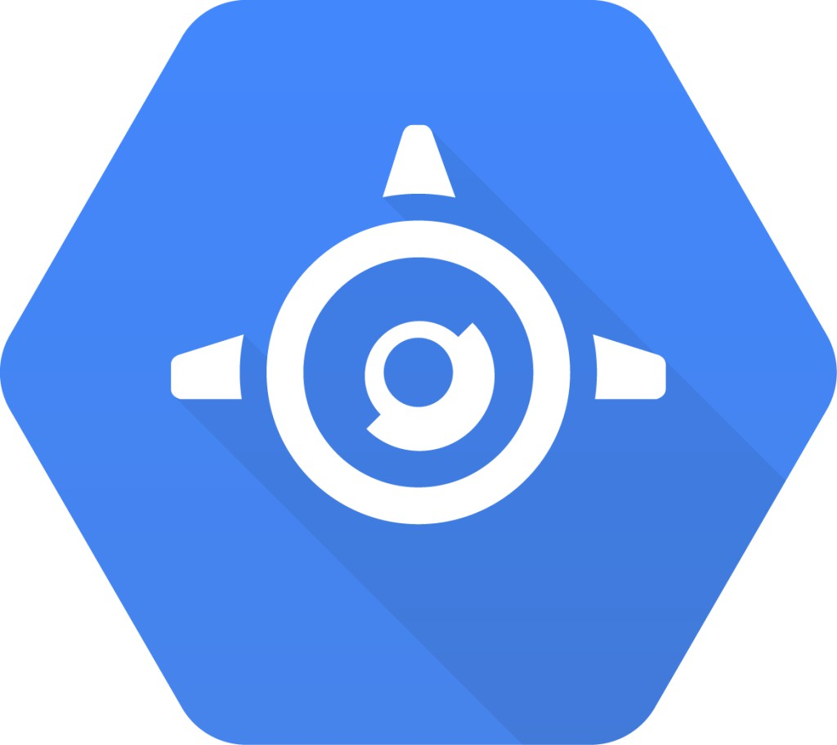


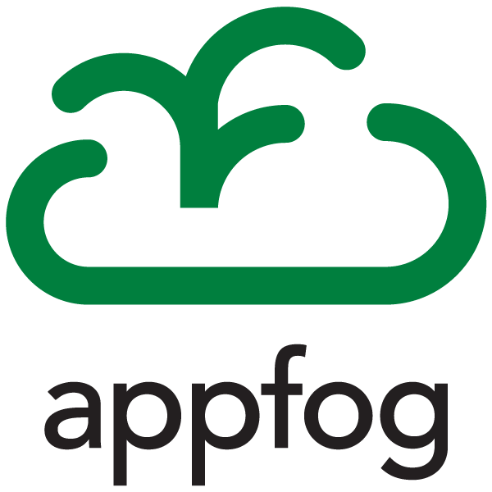


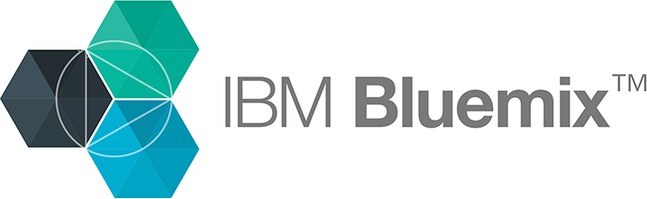
Main Service Models: PaaS
Some famous PaaS providers (vendors):
Amazon Web Services (AWS), Redhat OpenShift, Microsoft Azure, , Google App Engine, Heroku Enterprise, Forece.com and AppExchange by salesforce, SAP Hana, CloudBees, Engine Yard, Centurylink AppFog, IBM Bluemix. . .
Besides these, tools like Dokku and OpenShift allow enterprises to build their own private PaaS.

Slide 36
Main Service Models: PaaS
In return for agility and speed to market, consumers are constrained by the tools and software stacks that the vendor offers.
They also give up a degree of control: e.g., they cannot manage memory allocation, stack configuration, number of threads, amount of cache, patch levels, etc.
This means, e.g., that scalability is not as flexible as an IaaS solution (e.g. in the case of Instagram, they went with AWS, although the famous platform for Python was Google Apps Engine).
Mature PaaS vendors also offer third-party add-ons (plug-ins, or extensions). These frees the developers from re-invent the wheel or obtaining and renewing licenses, install, patch, etc. and only pay-per-use:
Logging, Monitoring, Security, Caching, Search, E-mail, Analytics, Payments, etc.

Slide 37
Main Service Models: SaaS
NIST’s definition of SaaS:⁵
“The capability provided to the consumer is to use the provider’s applications running on a cloud infrastructure.
The applications are accessible from various client devices through either a thin client interface, such as a web browser (e.g., web-based email), or a program interface (API).
The consumer does not manage or control the underlying cloud infrastructure including network, servers, operating systems, storage, or even individual application capabilities, with the possible exception of limited user-specific application configuration settings.”
⁵Mell, Peter, and Tim Grance. ”The NIST definition of cloud computing.” (2011): http://nvlpubs.nist.gov/nistpubs/Legacy/ SP/nistspecialpublication800-145.pdf

Slide 38
Main Service Models: SaaS - popular
Low initial cost: If you want to develop your custom software, it is definitely going to cost you a fortune and will burn your pockets deep if you were to add some complex functionalities.
Reduced Time:- SaaS applications can save a tremendous amount of your time because all the updates and improvisations are offloaded to the provider. So, you can focus on your core business without being worried about the recent technological advancements.
Scalability:- This is another imperative feature of the SaaS model for small businesses that face frequent transitions in their process. As all SaaS applications are subscription-based, you have the flexibility to change your plan according to your needs.
Try and use:- Most of the premium brands and providers always offer a free trial to use their SaaS app first. Hence, pay only if it solves your problem and satisfies your needs, else just move away and find the alternative without wasting a single penny, as simple as that.

Slide 39
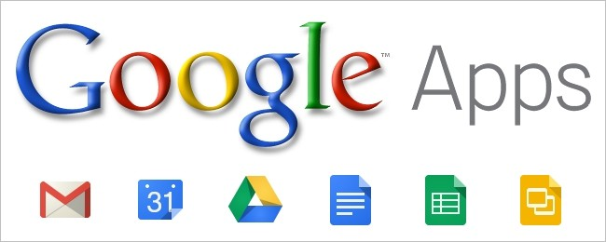
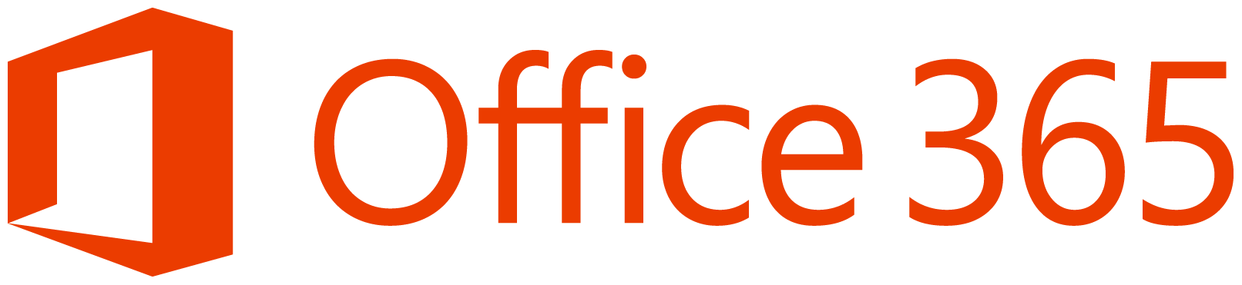
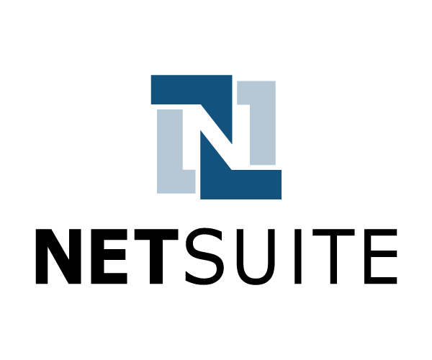
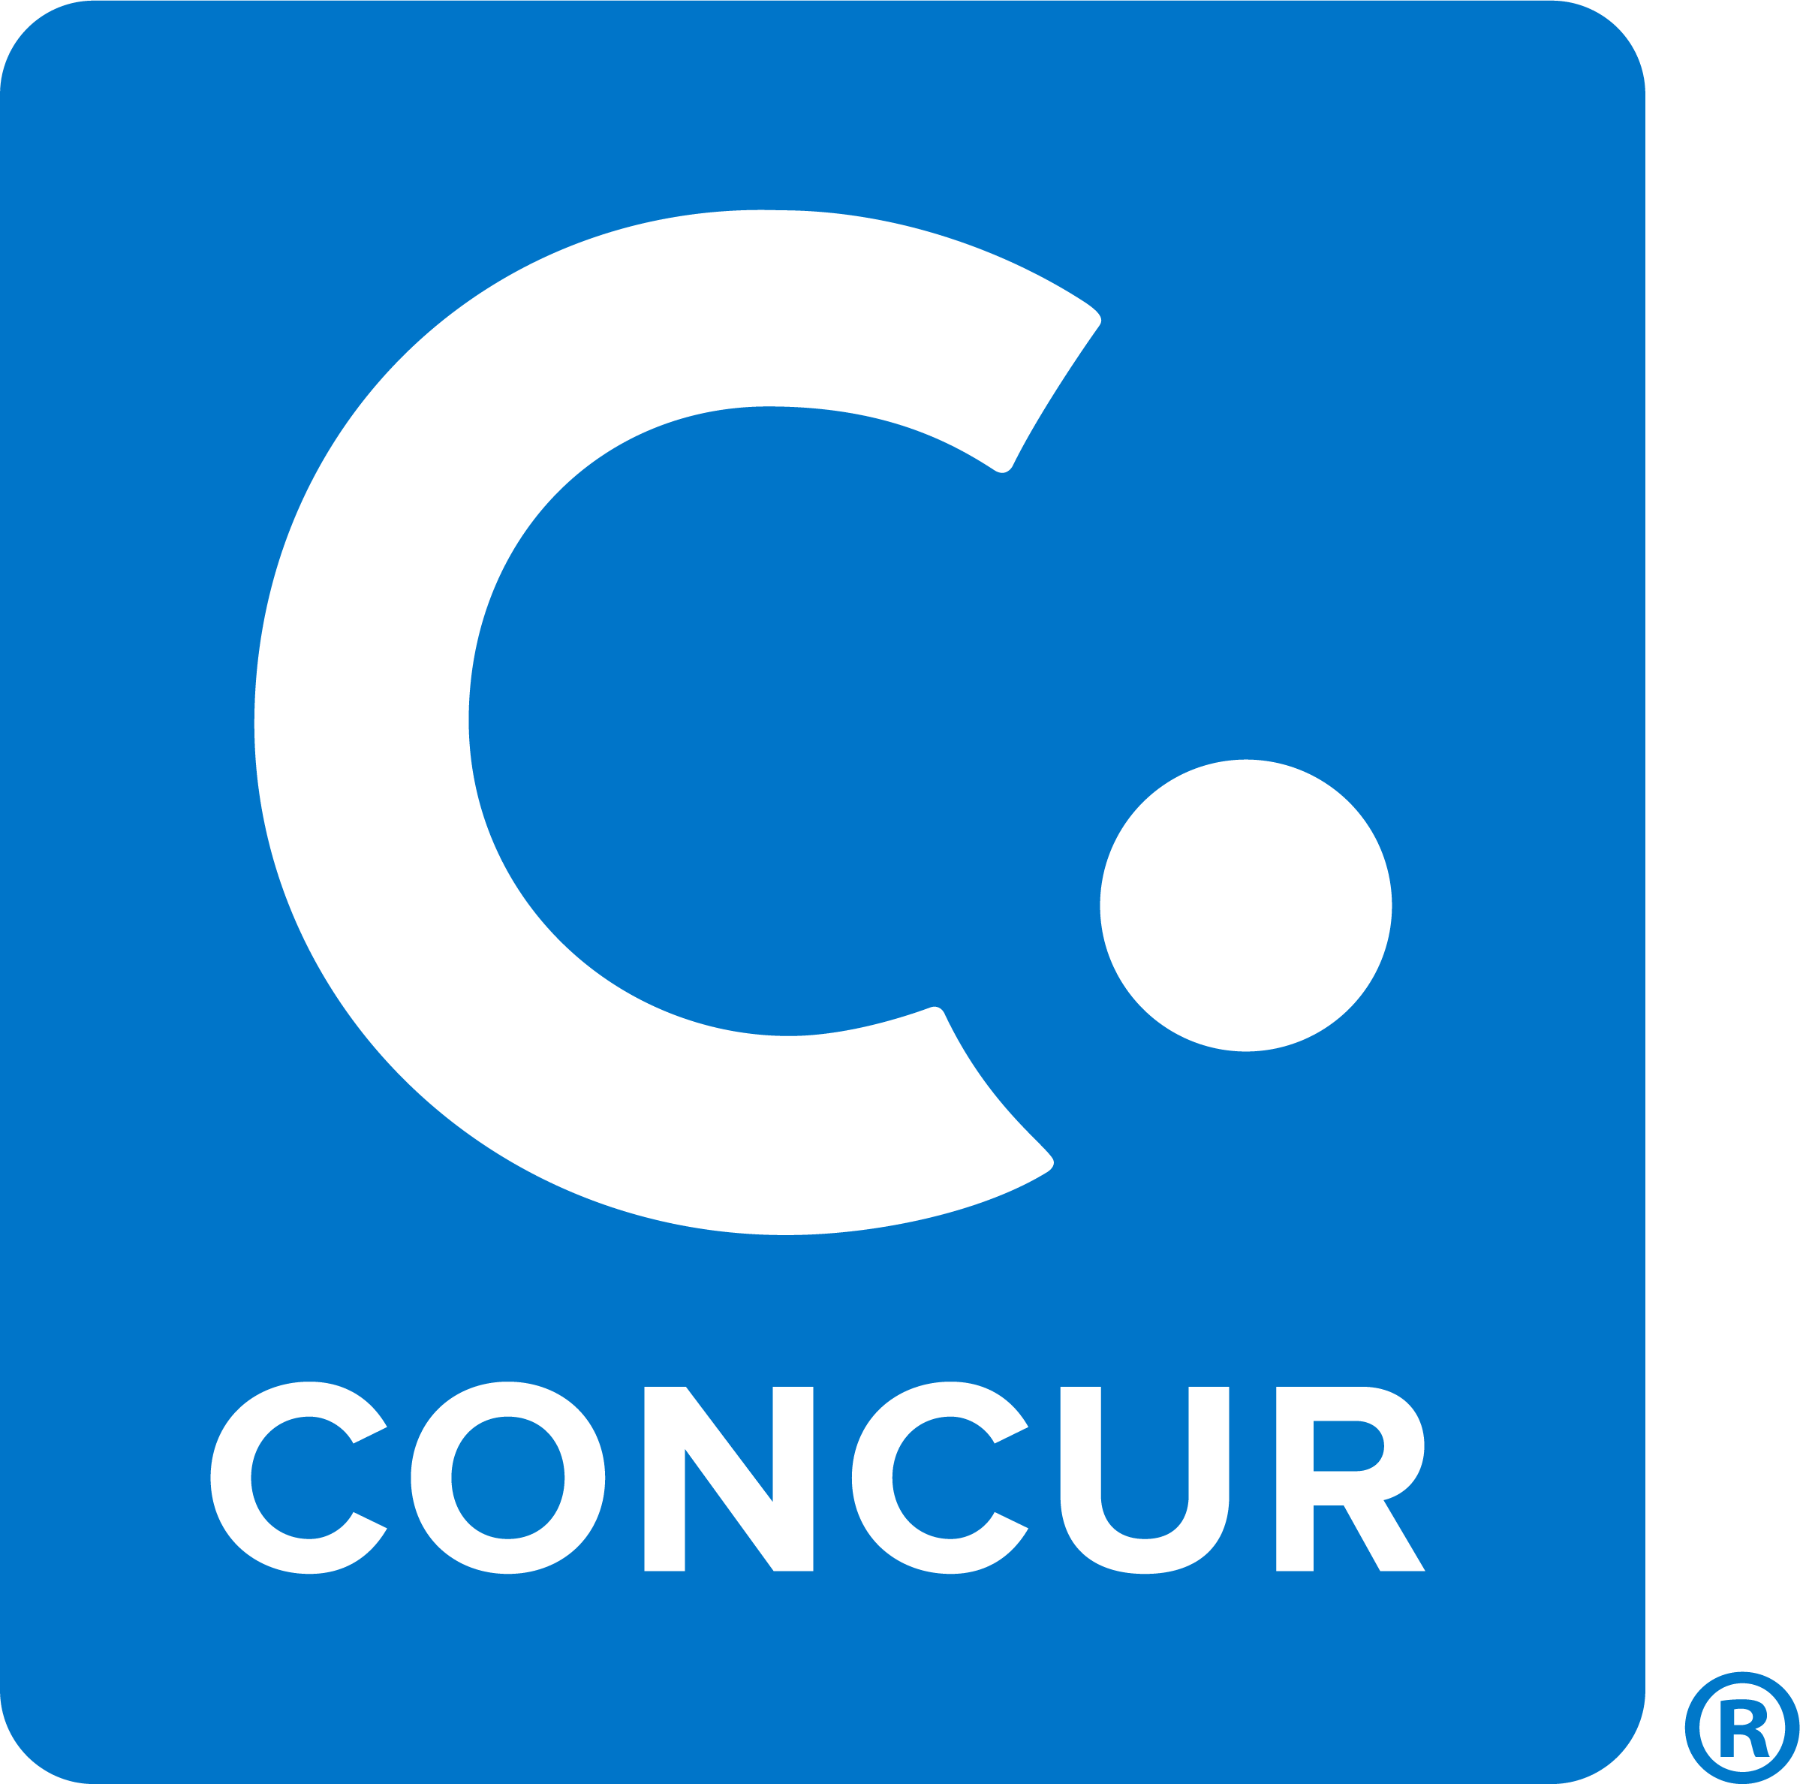
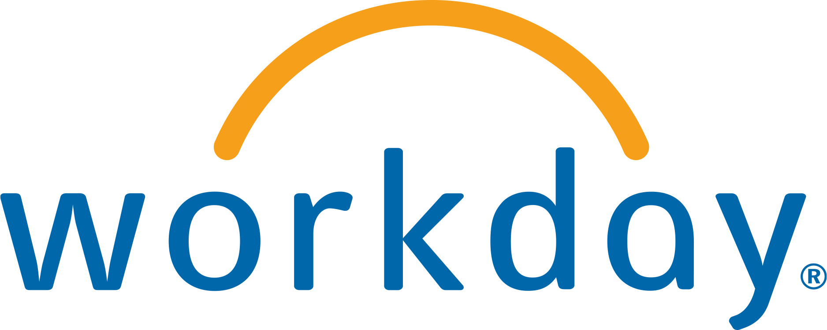
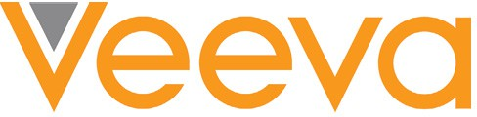
Main Service Models: SaaS
Some very common SaaS applications are: Customer Relationship Management (CRM), Enterprise Resource Planning (ERP), payroll, accounting, video-conferencing, emails, etc.
There are thousands of SaaS providers, but the big money-makers serve enterprises.

Slide 40
Other Cloud Service Models
These main service models need to be updated, as new models are invented:
Container-as-a-Service (CaaS)
Business Process as a Service (BPaaS)
Information-as-a-Service (InaaS)

Slide 41
Deployment Models
NIST lists the following 4 deployment models:⁶
Private: The cloud infrastructure is provisioned for exclusive use by a single organization comprising multiple consumers (e.g., business units). It may be owned, managed, and operated by the organization, a third party, or some combination of them, and it may exist on or off premises.
Q: Which enterprises are likely to use a private cloud? And why?
⁶Mell, Peter, and Tim Grance. ”The NIST definition of cloud computing.” (2011)

Slide 42
Deployment Models
NIST lists the following 4 deployment models:⁶
Private: The cloud infrastructure is provisioned for exclusive use by a single organization comprising multiple consumers (e.g., business units). It may be owned, managed, and operated by the organization, a third party, or some combination of them, and it may exist on or off premises.
Q: Which enterprises are likely to use a private cloud? And why?
A: Those with deep pockets and concern for security/privacy or strict regulations (government, finance, healthcare), e.g. Data Protection Act (DPA), Service Organization Control (SOC), Payment Card
Industry Data Security Standard (PCI DSS), etc.
⁶Mell, Peter, and Tim Grance. ”The NIST definition of cloud computing.” (2011)

Slide 43
Deployment Models
Community: The cloud infrastructure is provisioned for exclusive use by a specific community of consumers from organizations that have shared concerns (e.g., mission, security requirements, policy, and compliance considerations). It may be owned, managed, and operated by one or more of the organizations in the community, a third party, or some combination of them, and it may exist on or off premises.
Examples of such communities: all banks of a financial zone, all hospitals of a city, all universities of a country, etc.

Slide 44
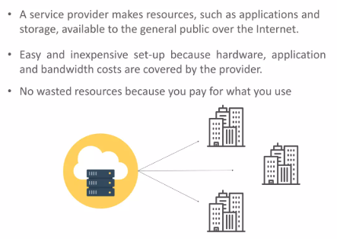
Deployment Models
Public: The cloud infrastructure is provisioned for open use by the general public. It may be owned, managed, and operated by a business, academic, or government organization, or some combination of them. It exists on the premises of the cloud provider.

Slide 45
Deployment Models
Hybrid: The cloud infrastructure is a composition of two or more distinct cloud infrastructures (private, community, or public) that remain unique entities, but are bound together by standardized or proprietary technology that enables data and application portability (e.g., cloud bursting for load balancing between clouds).

Slide 46
