Slide 1
Spark

Slide 2
Learning objectives
Leaning objective
Be familiar with big data processing models using multiple nodes/clusters
Understand the Spark programming model for big data processing
Able to perform practical programming features with Apache Spark

Slide 3
Outline
Why Spark ?
Spark Architecture and Spark Core
RDD and its operations
Lazy evaluation in Spark
Spark vs. Hadoop
Spark Use Cases
Spark Programming

Slide 4
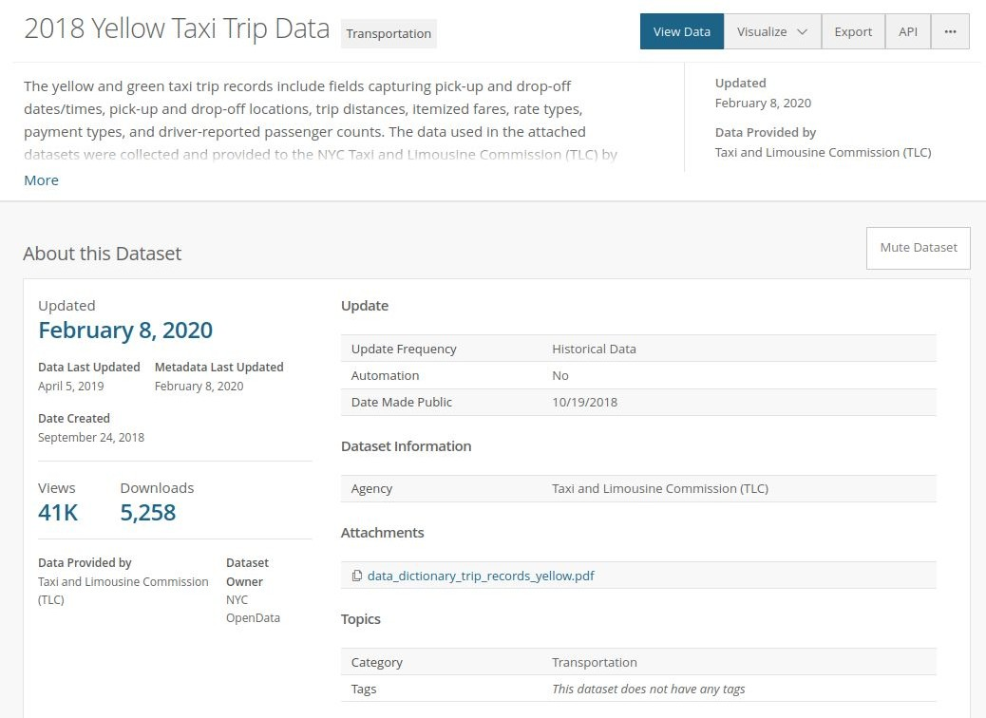
Is it big
Is it big ?
e.g., 112M rows (2021 check)
a 5.31GB CSV file containing data on taxi rides (fare amount, number of passengers, pickup time, and pickup and dropoff locations)
Snapshot from: https://data.cityofnewyork.us/Transportation/2018-Yellow-Taxi-Trip-Data/t29m-gskq

Slide 5
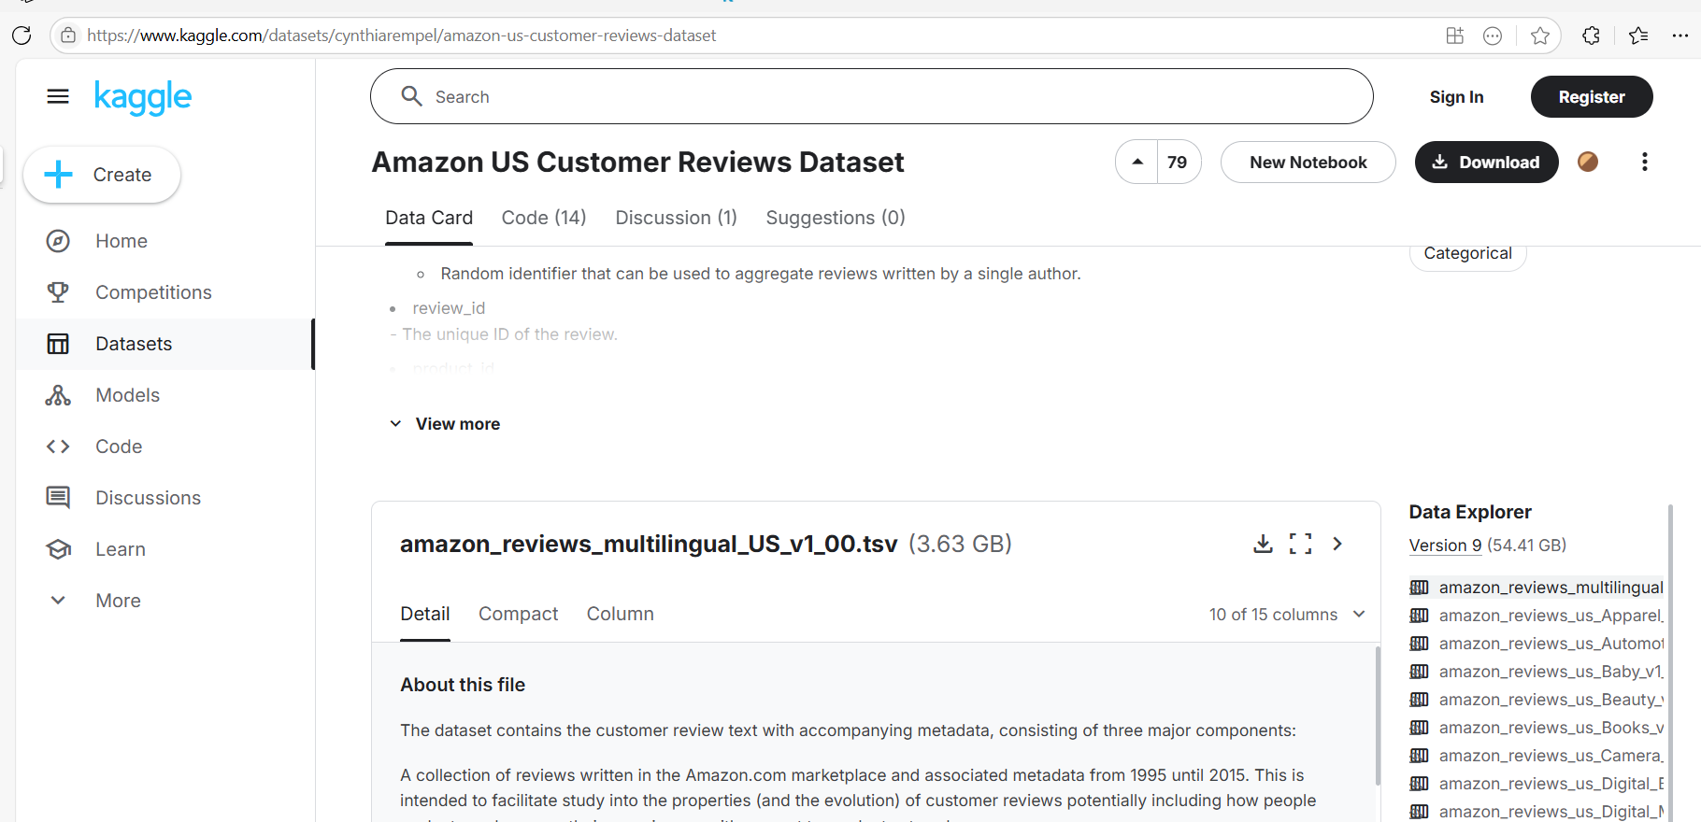
Is it big ?
Notes:
Source: https://www.kaggle.com/cynthiarempel/amazon-us-cu stomer-reviews-dataset

Slide 6
Is it big
Question ?
What happen if we use traditional tools such as Panda to read a big dataset ?
Pandas loads the entire dataset into RAM, which is fine for small datasets but fails for large ones.
If the dataset is larger than the available memory, Python will either:
  Crash with a MemoryError.
  Start swapping (using disk as memory), which slows performance significantly.
Pandas is single-threaded by default, meaning it doesn’t take full advantage of multiple CPU cores.
Large datasets cause slow processing and high CPU usage.
Notes:
https://medium.com/analytics-vidhya/reading-large-datasets-using-pandas-ec2d99465887
In this case your system will run out of RAM/memory while reading such a huge amount of data. This also might lead to kernel shutdown in jupyter notebook or system crash.

Slide 7




Better than Pandas ?
DuckDb
  columnar-vectorized engine
Polars
  parallelization of DataFrame from the beginning
  Rust-based with Python bindings, which has outstanding performance comparable to C
  Lazy evaluation: plan (not execute) the query until triggered
Vaex
Modin
Notes:
https://chengzhizhao.com/4-faster-pandas-alternatives-for-data-analysis/

Slide 8
Motivations / History
MapReduce began to show it’s downsides:
  It isn’t fast enough
  It’s inefficient on iterative workloads
  It relies too heavily on on-disk operations - Most of the Hadoop applications, they spend more than 90% of the time doing HDFS read-write operations
Research group at UC Berkeley develop Spark
  Started in 2009
  Initial versions outperformed MapReduce by 10-20x
Notes:
Về cơ chế hoạt động của MR: input data được đọc từ HDFS (component phụ trách việc lưu trữ trong Hadoop) → xử lý bằng các thao tác chỉ định → output được ghi vào HDFS → data tiếp tục được load → thao tác tiếp theo được thực hiện → output tiếp tục ghi vào HDFS … chuỗi các step [read-process-write] đó được lặp cho đến khi hoàn thành công việc. Vì input được chia thành các block độc lập với nhau, các task map-reduce được thực hiện song song, nên về cơ bản nó hữu ích để xử lí những bộ dữ liệu lớn.
Tuy nhiên, MR vẫn còn những tồn tại là quá trình xử lý không thực sự hiệu quả trong trường hợp phải lặp lại nhiều step, vì mỗi step cần thiết phải ghi output vào HDFS trước khi step tiếp theo được thực hiện → việc này tạo ra các vấn đề trong việc lưu trữ và replicate, tăng độ trễ xử lý do phần lớn thực hiện trên Disk vốn có hiệu suất I/O không cao. Bên cạnh đó là việc develop, debug với MR có phần khó khăn vì code dài dòng.

Slide 9

Apache Spark
Open Source, Distributed general-purpose computing framework.
Managed by Apache Foundation
Written in Scala
Robust high-level APIs for different languages
Allows iterative computations
- Graph algorithms, ML, and more
Notes:
Spark is a general-purpose, in-memory, fault-tolerant, distributed processing engine that allows you to process data efficiently in a distributed fashion.
Applications running on Spark are 100x faster than traditional systems.
You will get great benefits from using Spark for data ingestion pipelines.
Using Spark we can process data from Hadoop HDFS, AWS S3, Databricks DBFS, Azure Blob Storage, and many file systems.
Spark also is used to process real-time data using Streaming and Kafka.
Using Spark Streaming you can also stream files from the file system and also stream from the socket.
Spark natively has machine learning and graph libraries.
Provides connectors to store the data in NoSQL databases like MongoDB.

Slide 10
Computational Framework
You write framework code, as distinct from “normal code”
Code that tells the framework what to do, not how to do it
  The framework can handle optimization / data transfer internally
Other computational frameworks:
  Tensorflow, Caffe, etc.

Slide 11
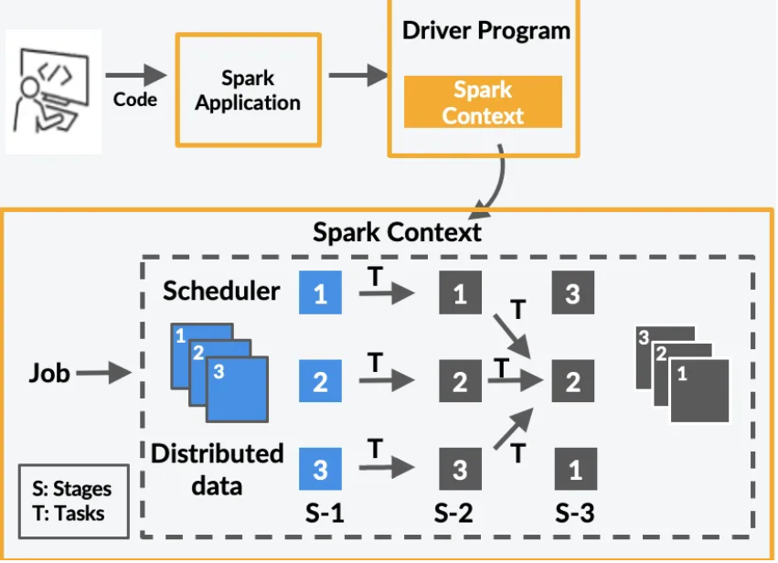
Computational Framework

Slide 12
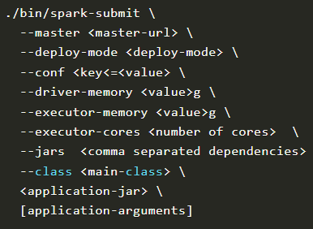
Spark submit
The spark-submit command is a utility to run or submit a Spark or PySpark application program (or job) to the cluster by specifying options and configurations

Slide 13
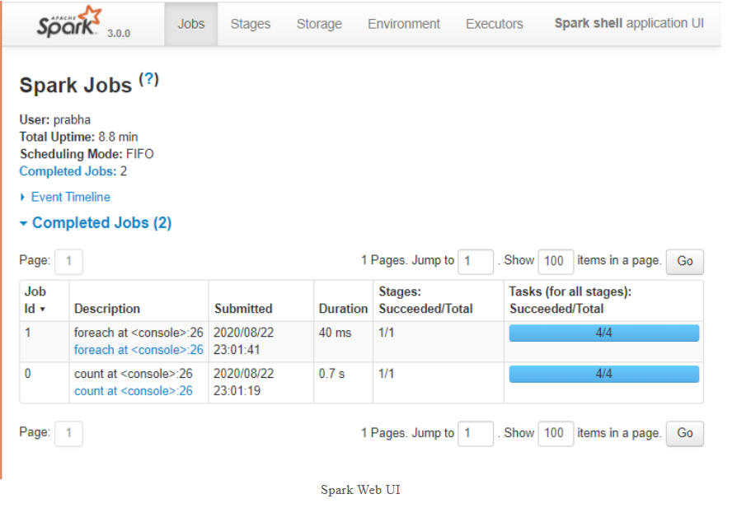
Spark UI
Apache Spark provides a suite of Web UIs (Jobs, Stages, Tasks, Storage, Environment, Executors, and SQL) to monitor the status of your Spark application

Slide 14
Architecture
Worker
Executor
CACHE
TASK
TASK
Executor
CACHE
TASK
TASK
Driver SparkContext
 |  | Cluster Manager
Application
Worker
Executor
CACHE
TASK
TASK

Slide 15
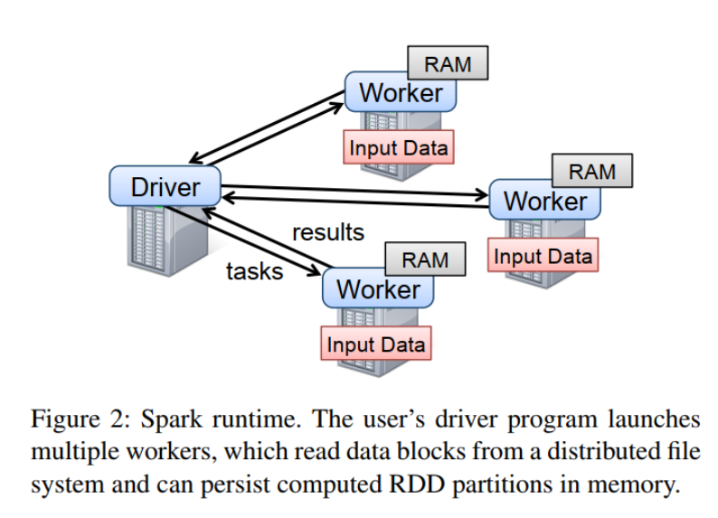

Slide 16
Architecture
Driver
  One per job, where the job is submit to
  Handles DAG scheduling, schedules tasks on executors
  Tracks data as it flows through the job
  Failure recovery and retries
Executor: JVM processes launched on worker nodes.
  Possibly many per job, Possibly many per worker node
  Stores RDD data in memory
  Performs tasks (operations on RDDs), and transfers data as needed

Slide 17
Executor Allocation
Traditional Static Allocation
  Create all Executors at beginning of job
  Executors are online until end of job
  Only option in early versions of Spark
Dynamic Executor Allocation
  Jobs can scale up/down number of executors as needed
  More efficient for clusters running multiple apps concurrently
  The cluster manager must support dynamic allocation (e.g., YARN, Kubernetes, Mesos, standalone cluster manager with an external shuffle service)

Slide 18
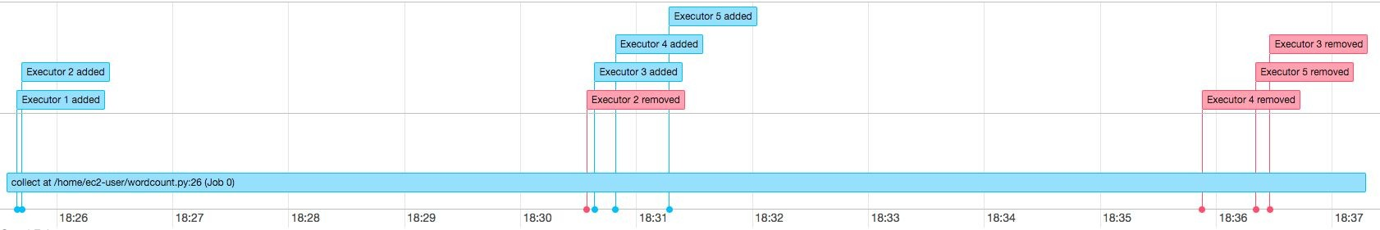
Dynamic Executor Allocation

Slide 19
Resilient Distributed Dataset (RDD)
Data Abstraction in Spark.
Resilient
  Fault-tolerant using a data lineage graph
  RDDs know where they came from, and how they were computed
Distributed
  Data lives on multiple nodes
  RDDs know where they’re stored, so computation can be done “close” to the data
Dataset
  A collection of partitioned data
Notes:
https://avinash333.com/rdd/
Cơ chế hoạt động của Spark: khắc phục những tồn tại của Hadoop MapReduce, Spark đưa ra một khái niệm mới RDD - Resilient Distributed Dataset đóng vai trò như 1 cấu trúc dữ liệu cơ bản trong Spark, RDD được định nghĩa là trừu tượng cho một tập hợp các phần tử bất biến (bản chất là được lưu trên các ô nhớ read-only), được phân vùng có thể được chia sẻ, tác động song song. Qua đó, input data từ storage system chỉ cần load 1 lần duy nhất, các step thực hiện biến đổi, xử lý input data được lên kế hoạch, optimize và thực hiện một cách liên tục cho đến khi output được trả khi kết thúc công việc. Toàn bộ quá trình đó được diễn ra trên bộ nhớ RAM (khi hết RAM sẽ được chuyển sang xử lý trên Disk) tận dụng được hiệu suất I/O cao từ đó có thể giảm thời gian thực thi nhỏ hơn 10-100 lần Hadoop MapReduce.

Slide 20
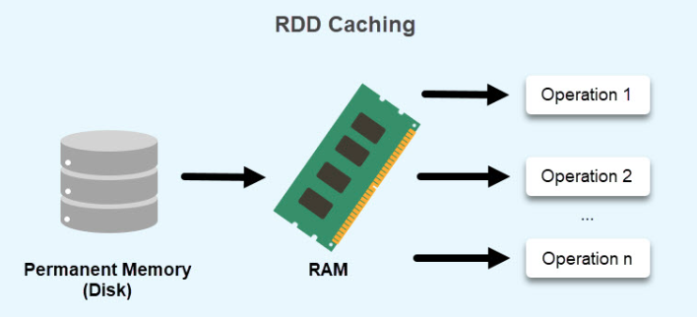
Resilient Distributed Dataset (RDD)
What does an RDD look like?
  A large set of arbitrary data (tuples, objects, values, etc)
Features of RDDs:
  Stored in-memory, Cacheable
    Stored on executors
Immutable
  Once created, cannot be edited
  Must be transformed into a new descendent RDD
Parallel via partitioning
  Similar to how Hadoop partitions map inputs

Slide 21




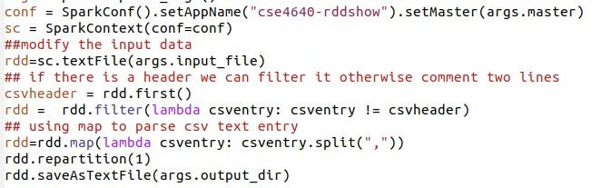
Example with RDD
VendorID,tpep_pickup_datetime,tpep_dropoff_datetime,passenger_count,trip_distance,RatecodeID,store_and_fwd_fl ag,PULocationID,DOLocationID,payment_type,fare_amount,extra,mta_tax,tip_amount,tolls_amount,improvement_sur charge,total_amount
2,11/04/2084 12:32:24 PM,11/04/2084 12:47:41 PM,1,1.34,1,N,238,236,2,10,0,0.5,0,0,0.3,10.8
2,11/04/2084 12:32:24 PM,11/04/2084 12:47:41 PM,1,1.34,1,N,238,236,2,10,0,0.5,0,0,0.3,10.8
2,11/04/2084 12:25:53 PM,11/04/2084 12:29:00 PM,1,0.32,1,N,238,238,2,4,0,0.5,0,0,0.3,4.8
as a text file

Slide 22
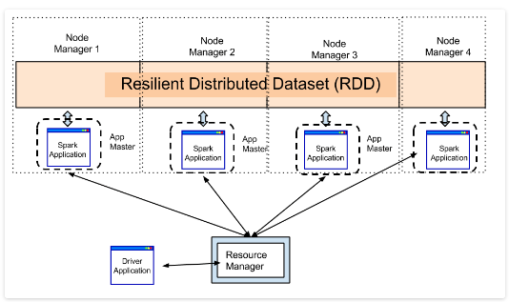
Notes:
RDDs are sort of like big arrays that are split into partitions, and each executor can hold some of these partitions.

Slide 23
RDD transformations and actions
RDD Transformations and Actions
Transformations - create a new RDD/DataFrame without immediately executing
Actions – trigger execution and returns result
map
filter
sample
intersection
groupByKey
join
reduce()
collect()
count()
write()
take()
saveAs…File()
Notes:
RDDs support two types of operations: transformations, which create a new dataset from an existing one, and actions, which return a value to the driver program after running a computation on the dataset.

Slide 24
Spark Application Components
Job
  An application can have multiple jobs
  a complete computation triggered by a RDD action (e.g. collect, count, show)
Stage
  A group of potentially many operations, e.g. a set of tasks that can be executed without shuffle dependencies.
  Many executors work on tasks in a single stage
  Narrow transformations (like map, filter, select) are pipelined into a single stage.
  Wide transformations (like groupBy, reduce, join) create shuffle boundaries, resulting in additional stages.
Task
  The “simplest unit of work” in Spark
  One operation on a partition of an RDD
  Fully parrallel
Notes:
Job: Represents the high-level action requested by the user (e.g., collect()).
Stage: Subdivides the job into units of work between shuffle boundaries. The boundary between two stages is drawn when transformations cause data shuffling across partitions.
Task: A unit of execution within a stage, processing a single partition of data.
By using the Spark UI or logs, you can trace how jobs, stages, and tasks interact to optimize your application's performance.

Slide 25
The Spark Flow
JA Spark job is submitted to Spark for processing.
The job is divided into stages based on the transformations and dependencies in the computation.
Each stage consists of multiple tasks that can be executed in parallel.
Tasks are assigned to worker nodes, which perform the required computations on the data partitions assigned to them.
Intermediate and final results are produced as tasks complete their computations.
The overall job completes when all stages and tasks finish execution

Slide 26

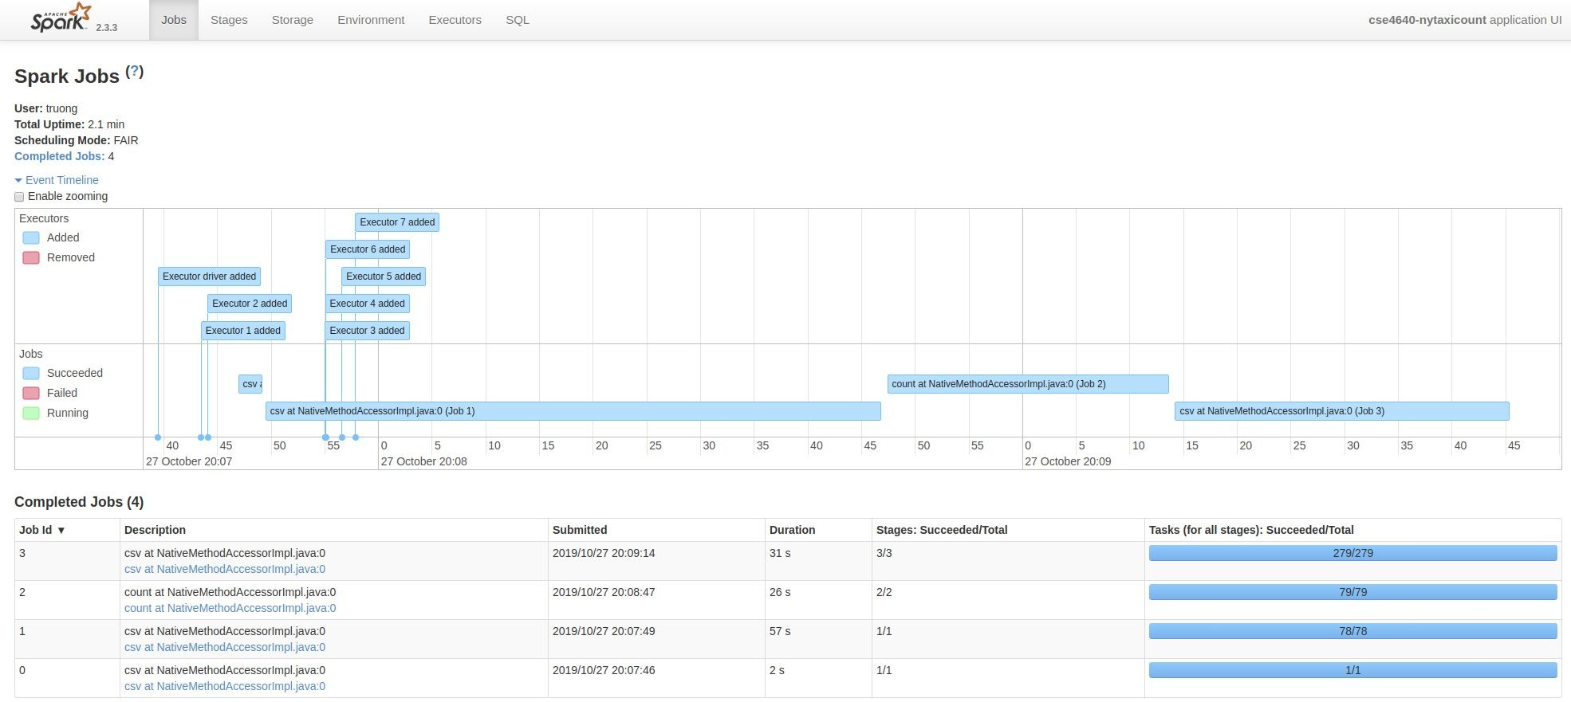
Monitoring Spark: Executors and tasks

Slide 27

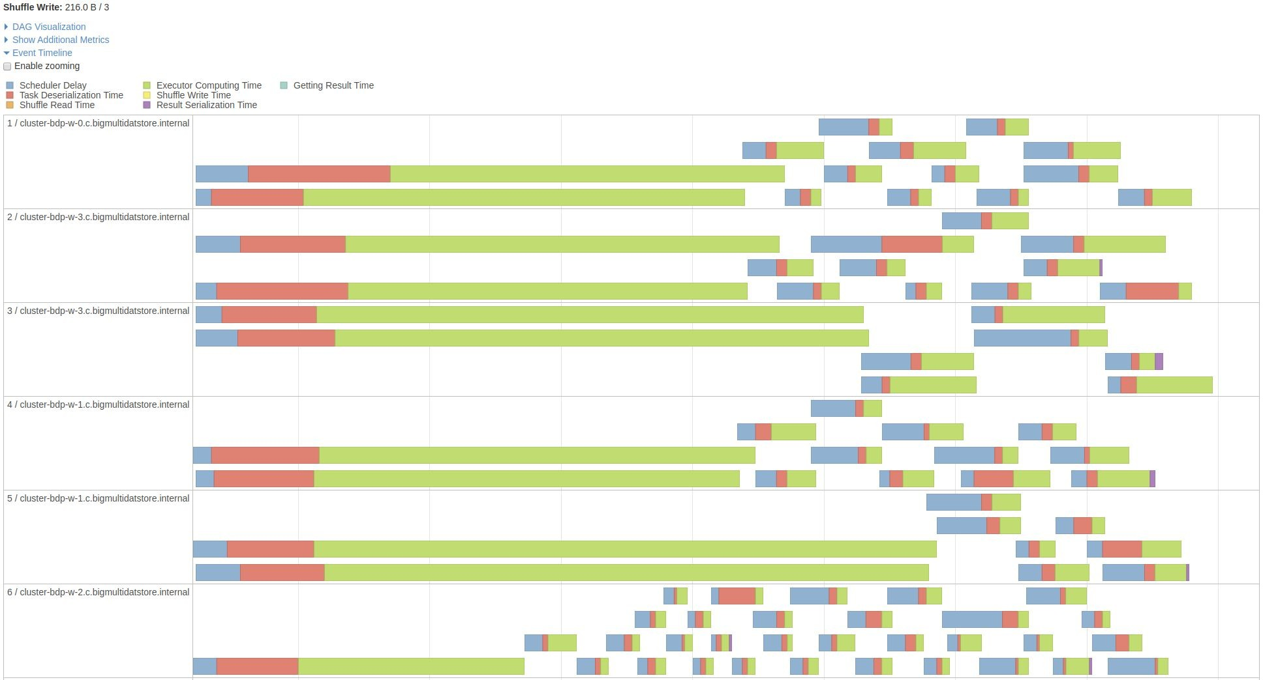
Executors and tasks

Slide 28
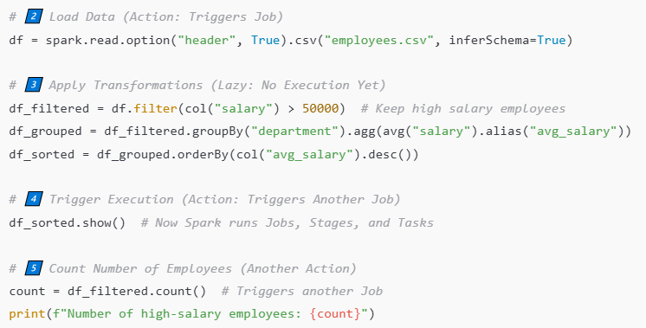
RDD operations
Notes:
Job 1 - 3 Stages (Read → GroupBy Shuffle → Sort)
- Triggered by df_sorted.show() (Action)
Transformations Applied:
filter() → Removes employees with salary ≤ 50,000 (Narrow Transformation, no shuffle).
groupBy() → Aggregates by department (Wide Transformation, triggers a shuffle).
orderBy() → Requires sorting (Shuffle stage).

Slide 29
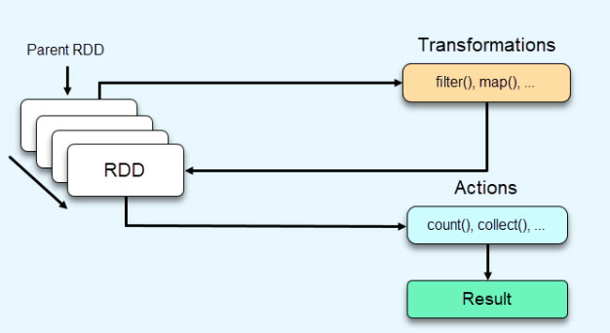
RDD Operations
Transformations
  The process of taking an input RDD, doing some computation, and producing a new RDD
  Done lazily (only ever executed if an “action” depends on the output)
  i.e. Higher order function like Map, ReduceByKey, FlatMap
Actions
  Triggers computation by asking for some type of output
  i.e. Output to text file, Count of RDD items, Min, Max,
  Collect, show, save
Notes:
RDDs support two types of operations: transformations, which create a new dataset from an existing one, and actions, which return a value to the driver program after running a computation on the dataset.

Slide 30
Lazy evaluation in Spark
is a fundamental concept that optimizes data processing by delaying the execution of transformations until an action is performed.
Deferred Execution
  Transformations (e.g., map, filter) are not executed immediately
  Spark records these transformations as a logical plan
  analyzes and optimizes the logical plan before execution, combining or reordering operations
  Only when an action (e.g., count, collect, save) is called does Spark execute the transformations
Notes:
Khi thực thi, việc gọi các transformations, Spark sẽ không ngay lập tức thực thi các tính toán mà sẽ lưu lại thành 1 lineage, tức là tập hợp các biến đổi từ RDD này thành RDD khác qua mỗi transformation. Khi có 1 action được gọi, Spark lúc này mới thực sự thực hiện các biến đổi để trả ra kết quả.

Slide 31
DAGScheduler
What does it do?
Computes an execution DAG
Determines the preferred locations (Executors) to run each task
Handles failure due to lost shuffle output files
Performs operation optimizing
  Groups multiple operations (e.g. maps and filters) into the same stage

Slide 32
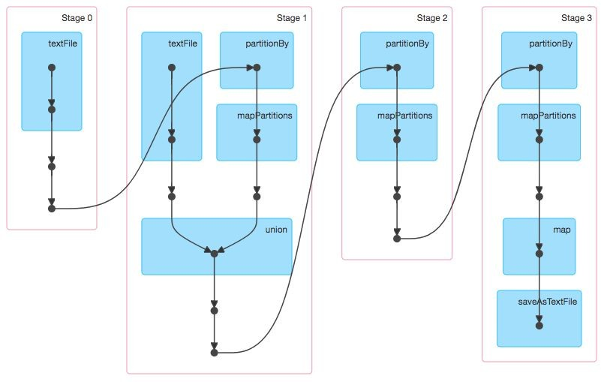
DAGScheduler - Directed Acyclic Graph Scheduler

Slide 33
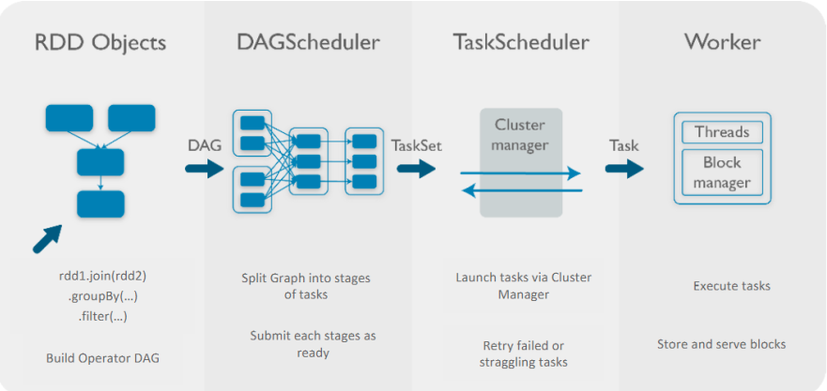
RDD Workflow

Slide 34
Storage for Spark
Again, much more flexibility.
HDFS
S3
Cassandra
HBase
Etc.
While Hadoop (mostly) limited to HDFS, Spark can bring in data from anywhere

Slide 35
RDD Operations - Cache
Persistence:
  cache() uses default storage level, i.e., MEMORY_ONLY.
  persist() can be provided with any of the possible storage levels memory/disk
  When an RDD is persisted, each node in the cluster stores the partitions (of the RDD) in memory (RAM).
  When there are multiple transformations or actions on an RDD, persistence helps to cut down the latency by the time required to load the data from file storage to memory.
Notes:
By default, each transformed RDD may be recomputed each time you run an action on it. However, you may also persist an RDD in memory using the persist (or cache) method, in which case Spark will keep the elements around on the cluster for much faster access the next time you query it.

Slide 36
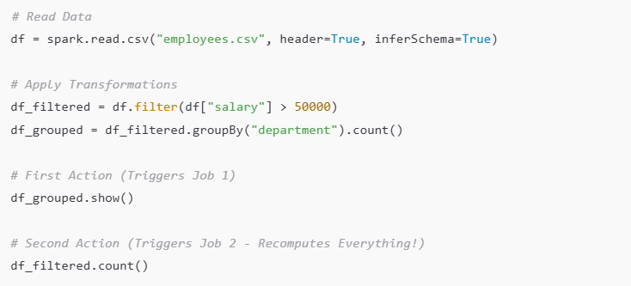
Example – Without Cache

Slide 37
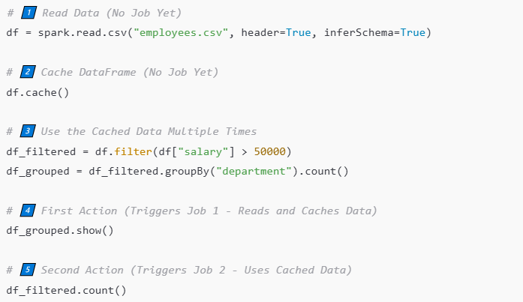
Example – With Cache

Slide 38
Resource managers for Spark
Allocating resources (CPU cores, memory, or GPUs) to the tasks and jobs submitted to the cluster
Job/task scheduling
Reassigning tasks from failed jobs etc.

Slide 39
Resource managers for Spark
Standalone Cluster Manager
Apache Hadoop YARN (Yet Another Resource Negotiator)
Apache Mesos
Kubernetes (K8s)

Slide 40
Spark deployment modes - Local mode
Executing a program on your laptop using single JVM. It can be java, scala or python program where you have defined & used spark context object, imported spark libraries and processed data residing in your system
Spark runs the driver and workers in the same JVM
  both the Master and Worker(s) run as threads within a single Java Virtual Machine process
Notes:
Apache Spark supports different deployment modes based on where the driver program runs and how tasks are scheduled.

Slide 41
Spark deployment modes - Cluster mode
Standalone: Master -> Workers
  Spark distribution comes with its own resource manager also. When your program uses spark's resource manager, execution mode is called Standalone. There are multiple JVMs
YARN/Mesos/K8s – ResourceManager + NodeManager +
  In reality Spark programs are meant to process data stored across machines. Executors process data stored on these machines. We need a utility to monitor executors and manage resources on these machines( clusters).
Notes:
https://spark.apache.org/docs/latest/cluster-overview.html#cluster-manager-types

Slide 42
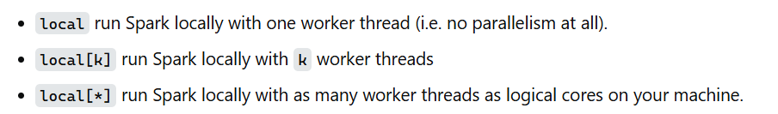
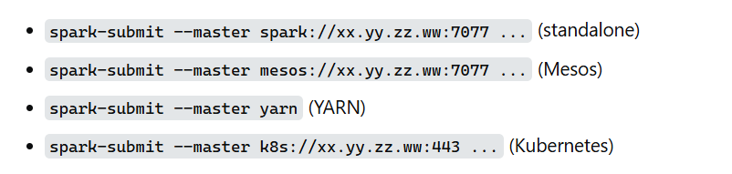
Deployment modes submit commands

Slide 43
Much more flexibility than Hadoop
Library/Application Layer
SQL
Streaming
MLlib
GraphX
Framework Layer
Spark Core
Infrastructure Layer
Spark Standalone
YARN
MESOS
Aims for easy and interactive analytics
Distributed Platform for complex multi-stage applications, (e.g. real-time ML)
Notes:
Spark Core: là engine thực thi chung làm nền tảng cho Spark. Tất cả các chức năng khác được xây dựng dựa trên base là Spark Core. Nó cung cấp khả năng tính toán trên bộ nhớ RAM và cả bộ dữ liệu tham chiếu trong các hệ thống external storage.Spark SQL: là một thành phần nằm trên Spark Core, giới thiệu một khái niệm trừu tượng hóa dữ liệu mới gọi là SchemaRDD, cung cấp hỗ trợ cho dữ liệu có cấu trúc và bán cấu trúc.
Spark Streaming: tận dụng khả năng lập lịch memory-base của Spark Core để thực hiện streaming analytics. Nó lấy dữ liệu theo mini-batches và thực hiện các phép biến đổi RDD (Bộ dữ liệu phân tán có khả năng phục hồi) trên các mini-batches dữ liệu đó.
MLlib (Machine Learning Library): là một framework machine learning phân tán trên Spark tận dụng khả năng tính toán tốc độ cao nhờ distributed memory-based của kiến ​​trúc Spark.
GraphX: ​​là một framework xử lý đồ thị phân tán. Nó cung cấp một API để thực hiện tính toán biểu đồ có thể mô hình hóa các biểu đồ do người dùng xác định bằng cách sử dụng API đã được tối ưu sẵn.

Slide 44
Related Frameworks
Spark Core is tightly integrated with several key libraries
SQL
Streaming
MLlib
GraphX
Spark Core

Slide 45
Related Frameworks
Spark Streaming
  Stream live data into Spark cluster
  Send it out to databases or HDFS
Spark SQL
  Integrates relational database programming (SQL) with Spark
Spark MLlib
  Large-Scale Machine Learning
GraphX
  Graph and graph-parallel computations
Interactions between the frameworks allow multi-stage data applications.

Slide 46
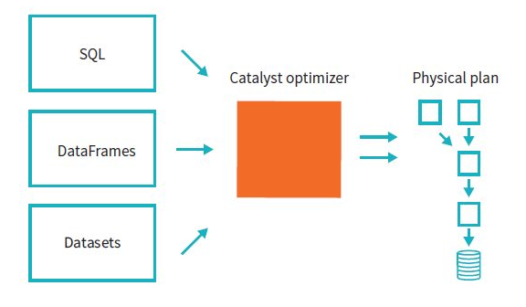
Catalyst Optimizer in Spark SQL
Optimizes logical plans for DataFrames and Datasets.
Performs rule-based and cost-based optimization.

Slide 47
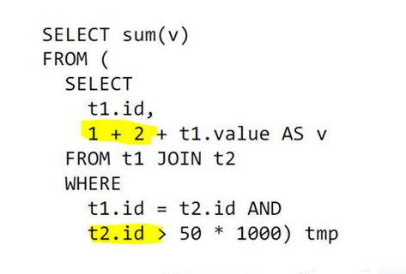
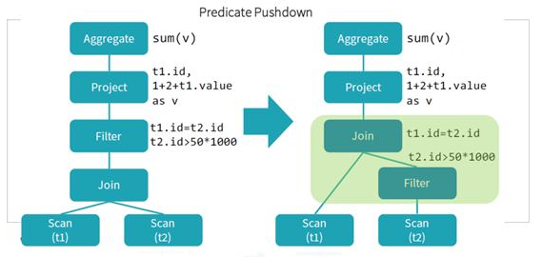
Catalyst Optimizer in Spark SQL
Not calculate 1 + 2 for all
Filter t2.id > 50 before JOIN
Notes:
https://www.facebook.com/legacy/notes/806633973073541/

Slide 48
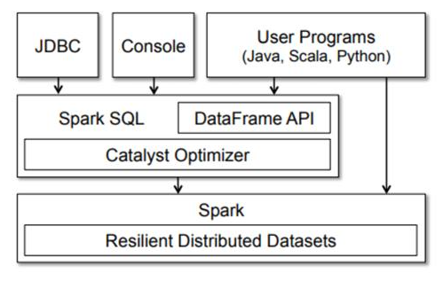

Slide 49
Outline
Spark Overview
Spark Core
Related Framework
Spark vs. Hadoop
Spark Use Cases
Spark Programming

Slide 50
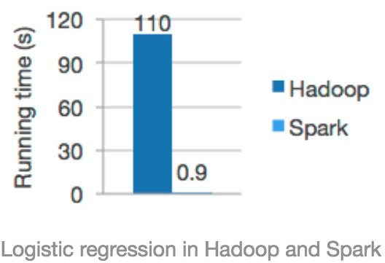
Hadoop vs. Spark
Spark can be more than 100x faster, especially when performing computationally intensive tasks.

Slide 51
Hadoop vs. Spark
Step 1. Build something
Step 2. Prove its 100x faster than Hadoop Step 3. ???
Step 4. Profit!

Slide 52
Hadoop + Spark
Spark on HDFS
What can they bring to the table for each other?
Hadoop
  Huge Datasets under control by commodity hardware.
    Low cost operations
Spark
  Real-time, in-memory processing for those data sets.
    High-speed, advanced analytics to a multiple stage operations.
Spark cannot yet completely replace Hadoop.
Notes:
Tính năng và cũng là ưu điểm của Spark có thể kể ra:
Advanced Analytics: Spark không chỉ hỗ trợ "Map" và "Reduce ", nó còn hỗ trợ Spark truy vấn SQL, Streaming data, Machine learning (ML) và các thuật toán xử lý đồ thị đóng vai trò như một bộ công cụ phân tích dữ liệu cực kì mạnh mẽ.
Speed: Spark giúp chạy một ứng dụng với tốc độ rất nhanh. So với Hadoop cluster, Spark Application nến chạy trên bộ nhớ nhanh hơn tới 100 lần và nhanh hơn 10 lần khi chạy trên đĩa. Điều này có được nhờ giảm số lượng các hoạt động đọc / ghi vào ổ đĩa.
Supports multiple languages: Spark cung cấp built-in APIs phổ biến từ Java, Scala đến Python, R. Do đó, có thể code Spark applications với nhiều lựa chọn về ngôn ngữ lập trình. Bên cạnh đó Spark còn cung cấp rất nhiều high-level operators cho việc truy vấn dữ liệu...
Nhược điểm:
Spark không có hệ thống Filesystem riêng, do đó, nó phụ thuộc vào một số nền tảng khác như Hadoop hoặc một nền tảng dựa trên đám mây (S3, Google Cloud Storage,...).
Apache Spark đòi hỏi rất nhiều RAM để chạy trong bộ nhớ, do đó chi phí của Spark khá cao.
Spark Streaming không thực sự real-time
Việc tối ưu hóa, tinh chỉnh để phù hợp với các bộ dữ liệu cụ thể cần có kinh nghiệm và vẫn cần thực hiện thủ công.

Slide 53
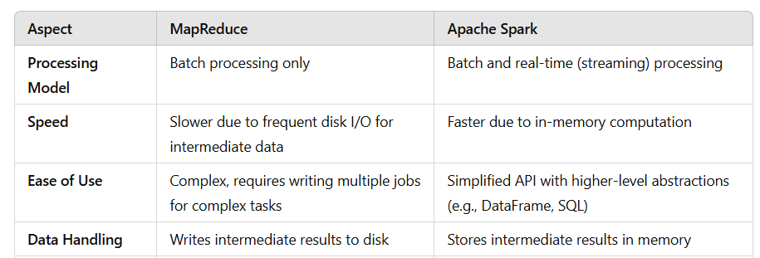

Slide 54
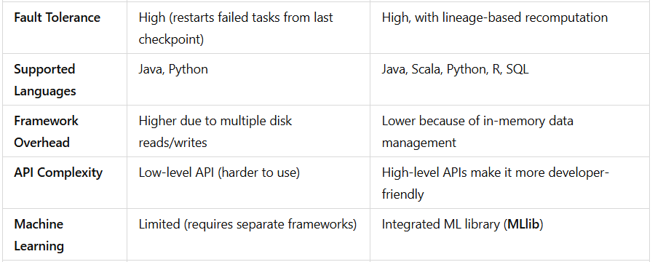

Slide 55
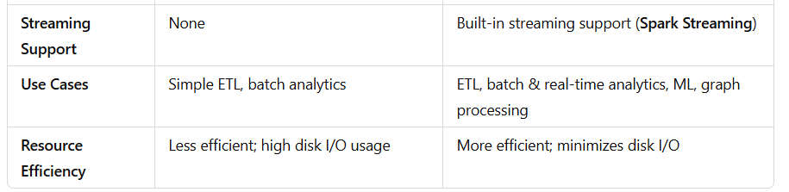

Slide 56
Outline
Spark Overview
Spark Core
Related Framework
Spark vs. Hadoop
Spark Use Cases
Deploying Spark

Slide 57
When to use Spark
Building a data pipeline
Interactive analysis and multi-stage data application.
Allows real-time interaction / experimentation with data
Streaming Data : Spark Streaming
Machine Learning: Spark MLlib

Slide 58
Spark in Industry
  Commerce Industry
    eBay
      Provide targeted offers, enhance customer experience, etc.
      eBay runs Spark on top of YARN.
- 2000 nodes, 20,000 cores, and 100TB of RAM
    Alibaba
      Feature extraction on image data, Aggregate data on the platform
      Millions of Merchant-User Interaction is represented in graphs.

Slide 59
Spark in Industry
Finance Industry
Real-Time Fraud Detection (stolen credit card swipe or stolen card number)
  Check with previous fraud footprint
  Triggers call center, etc.
  Validate incoming transactions
Risk-based assessment
  Collecting and archiving logs
  Spark can easily be combined with external data source and pipelines.

Slide 60
Outline
Spark Overview
Spark Core
Related Framework
Spark vs. Hadoop
Spark Use Cases
Spark Programming

Slide 61
What Does Spark Code Look Like?
count = len([line for line in \ open('file.txt') \
if 'pattern' in line]) print(count)
file = sparkContext.textFile("file.txt") matcher = lambda x: x.contains("pattern") count = file.filter(matcher).count() print(count)

Slide 62
Example
Sentient Spark Object
Transformation Function
file = sparkContext.textFile("file.txt")
matcher = lambda x: x.contains("pattern") count = file.filter(matcher).count() print(count)
Action
Transformation

Slide 63
Word Count Example
# Load data
textData = sparkContext.textFile("input.txt")
# Split into words
WORD_RE = re.compile(r"[\w']+")
words = textData.flatMap(lambda line: WORD_RE.findall(line))
# Get count by word
counts = words.map(lambda w: (w, 1)).countByKey()
print(counts.collect())

Slide 64
Join Example
favColors = sc.parallelize([('bob', 'red'), ('alice', 'blue')])
favNumbers = sc.parallelize([('bob', 1), ('alice', 2)])
joined = favColors.join(favNumbers) joined.collect()
# [('bob', ('red', 1)), ('alice', ('blue', 2))]

Slide 65
ReduceByKey Example
nums = sc.parallelize([('a', 1), ('b', 2), ('a', 3), ('b', 4)]) reduced = nums.reduceByKey(lambda v1, v2: v1 + v2) reduced.collect()
# [('b', 6), ('a', 4)]

