Slide 1
Spark
Streaming

Slide 2
Outline
Streaming Overview
Spark Streaming
Spark Streaming Programming
Final Project Announcement
Notes:
https://github.com/InterruptSpeed/streaming-lab
https://github.com/stream-processing-with-spark/notebooks
https://github.com/ibm-watson-data-lab/spark.samples/tree/master/streaming-twitter

Slide 3
Streaming
Why streaming?
  Lots of data is not fixed, in practice
  We have new data coming in all the time; it makes sense to respond in real time
What is streaming?
  Clients push “events” in real time to an interface with our streaming system
  The streaming system distributes input across the cluster (like batch processing)
  Some resultant data is generated, which can be saved or streamed out of the system

Slide 4
Batch Processing vs Stream Processing
 | Batch Processing | Stream Processing
Data Size | Large batches of data; Most data in a data set | “An event”; Micro-batches of records
Nominal Latency | Minutes to Hours | In the order of milliseconds
Analysis | Complex Algorithm/Analytics | Simple functions, aggregation, rolling metrics

Slide 5
Application of Streaming Data
Real-Time Machine Learning
  e.g. Twitter’s “trending” topics, disaster monitoring, etc.
Tracking changes in the finance markets in real-time
Processing sensor data in large industrial settings
  (Also scientific settings)

Slide 6
Stream Sources
File System
Internet of Things
Network Traffic
Embedded devices on a radio frequency

Slide 7

Apache Storm - A pure streaming system
Purpose-built for real-time stream computation
Three main concepts:
  “Stream”: An unbounded sequence of tuples (like an infinite RDD)
  “Spout”: A source of tuples
  “Bolt”: A transformation operation on a stream

Slide 8
Apache Storm - A pure streaming system
Spouts, Bolts, and Streams define a “Topology”
Stream
Bolt
Spout
Bolt
Bolt
Stream
Output
Spout
Bolt
Stream

Slide 9
Apache Storm
Powerful language-agnostic tool/framework
Open-sourced by Twitter
  Used to power Twitter’s real-time tweet analytics
  Now Twitter uses Heron
Handles fault tolerance
  Keeps track of which tuples have been fully processed
  If a “Bolt” fails, unprocessed / partially processed tuples are reprocessed

Slide 10
Outline
Streaming Overview
Spark Streaming
Spark Streaming Programming
Final Project Announcement

Slide 11
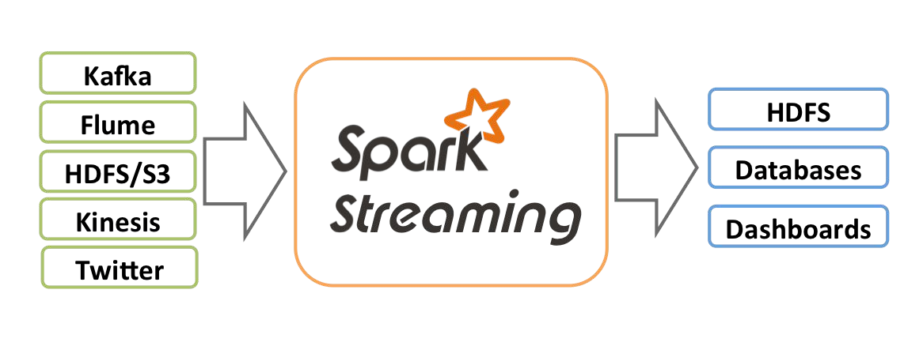
Spark Streaming

Slide 12
Spark Looks a lot like Apache Storm...
Apache Storm
Bolt
Stream
Spout
Bolt
Bolt
Stream
Output
Spout
Bolt
Stream

Slide 13
Spark Looks a lot like Apache Storm...
Spark Streaming
Transformation
RDD
Data Source A
Transformation
Transformation
Action
RDD
Output
Data Source B
Transformation
RDD

Slide 14
How Spark Handles Streaming
Spark Core has a robust way for creating computation graphs on batch data
How can we extend this to streaming data?

Slide 15
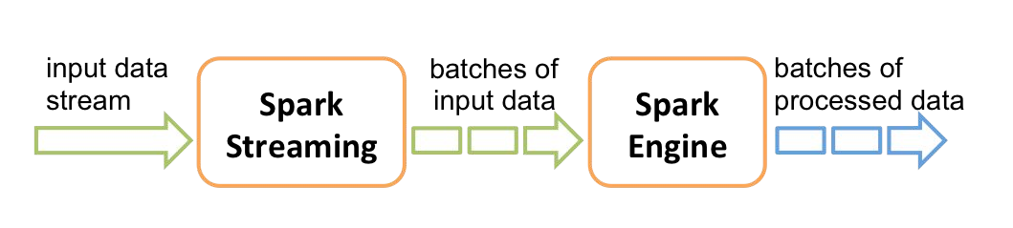
How Spark Handles Streaming

Slide 16
How Spark Handles Streaming
Transformation
DStream
Stream Source
Transformation
Transformation
Action
DStream
Output
Stream Source
Transformation
DStream

Slide 17
How Spark Handles Streaming
DStream
Transformation
RDD (t=1)
Stream Source
Transformation
Transformation
Action
RDD (t=1)
Output
DStream
Stream Source
Transformation
RDD (t=1)
DStream

Slide 18
How Spark Handles Streaming
DStream
Transformation
RDD (t=2)
Stream Source
RDD (t=1)
Transformation
Transformation
Action
RDD (t=2)
Output
RDD (t=1)
DStream
RDD (t=1)
Stream Source
Transformation
RDD (t=2)
DStream

Slide 19
How Spark Handles Streaming
DStream
Transformation
RDD (t=3)
Stream Source
RDD (t=2)
Transformation
Transformation
Action
RDD (t=3)
Output
RDD (t=2)
RDD (t=1)
DStream
RDD (t=2)
Stream Source
Transformation
RDD (t=3)
DStream

Slide 20
How Spark Handles Streaming
DStream
  “Discretized Stream” which represents an infinite stream of data
  In actuality, it’s a (endless) sequence of RDDs
Spark Streaming Context
  Similar to the Spark Context, except it handles DStreams
  Has a user-defined batch interval
    Defines the window size for RDDs
Job Processing
  Executed in multiples of the batch interval

Slide 21
Spark Stream Sources
Built-in Data Sources
  File Stream - Load new files in a given directory
  Socket Stream - Listen on a TCP connection for new data
Additional Supported Stream Sources
Kafka
Flume
Kinesis
(Apache)
(Apache, in the Hadoop ecosystem) (AWS)

Slide 22
Outline
Streaming Overview
Spark Streaming
Spark Streaming Programming
Final Project Announcement

Slide 23
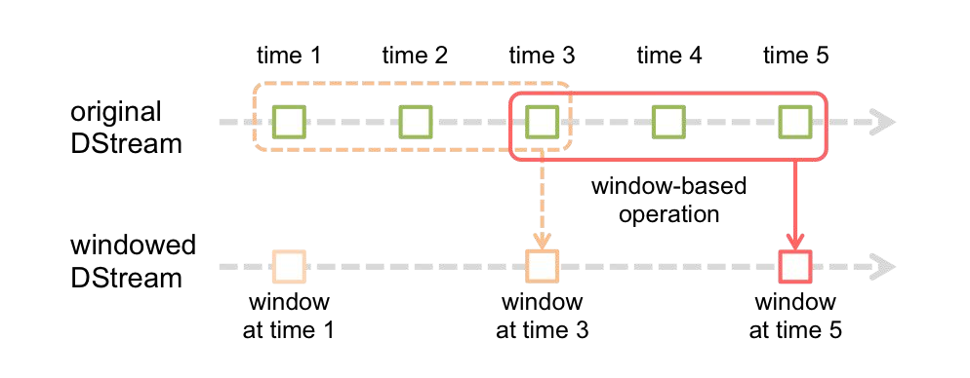
Spark Streaming Programming
Transformations
  Operations on DStreams (mostly) identical to RDDs
  Functions: Map, Filter, Join, etc.
Windowed Operations
  Applied transformation on a time-based window of data
  Functions: CountByWindow, ReduceByWindow, etc.

Slide 24
Spark Streaming Programming
Stateful Operations
  So far, we’re limited to “seeing” data within our current window
  What if we need arbitrary state?
  Functions: “UpdateStateByKey”
    Uses an RDD to keep a persistent state
The “Transform” Function
  Allows you get access to the underlying DStream RDD
  Used for “combining” DStream data with arbitrary RDDs
    i.e. Join streamed data on precomputed data

Slide 25
Spark Streaming Programming Example
from pyspark import SparkContext
from pyspark.streaming import StreamingContext
# local streaming context with two threads
sc = SparkContext("local[2]", "NetworkWordCount")
ssc = StreamingContext(sc, 1) # batch interval of 1 second
# DStream that pulls from localhost:8888
lines = ssc.socketTextStream("localhost", 8888)

Slide 26
Spark Streaming Programming Example
# We can use the lines DStream almost like a normal RDD filtered = lines.filter( lambda l: 'cloud' in l).flatMap( lambda key_on_word = filtered.map( lambda w: (w, 1))
x: x.split()
# Count in window lengths of 30 seconds, evaluated every 10 seconds windowed = key_on_word.countByValueAndWindow(30, 10)
# We can call an action on DStreams like RDDs windowed.pprint()
# Start stream processing ssc.start()

