Slide 1
Spark SQL

Slide 2
Outline
Traditional Databases
SQL
  Optimizations
Spark SQL

Slide 3
Outline
Traditional Databases
SQL
  Optimizations
Spark SQL

Slide 4
RDBMS
Relational Database Management Systems
  Systems that deal with relational data (data that points to other data)
A database management system manages how the data is stored and retrieved. Usually the data is modified with SQL
E.g: MySQL, PostgreSQL, OracleDB, etc

Slide 5
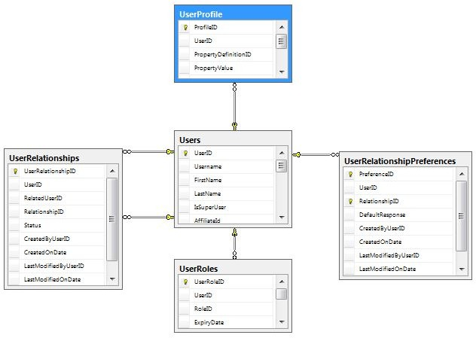
http://www.mytecbits.com/wp-content/uploads/RDBMS.png

Slide 6
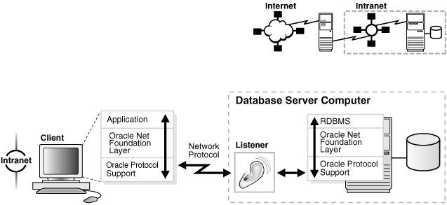
Other Features
RDBMS handles data backups, logically storing data, distributing data to leader followers, permissions, data integrity, handling and load balancing queries, and optimization.
RDBMSs do all of this “under the hood” (mostly)
https://docs.oracle.com/cd/B28359_01/network.111/b28316/img/netag089.gif

Slide 7
RDBMS Types of Data
RDBMSs like simple data: INTEGERS, STRINGS, etc
  They don’t like handling JSON, HASHMAP, LISTS
  Complex data types are more difficult for the SQL engine to optimize against
If you think you need advanced data type functionality:
Seriously rethink your application design
If you are absolutely sure that you need it:
  You should probably use another application server.

Slide 8
Outline
Traditional Databases
SQL
  Optimizations
  Spark SQL

Slide 9
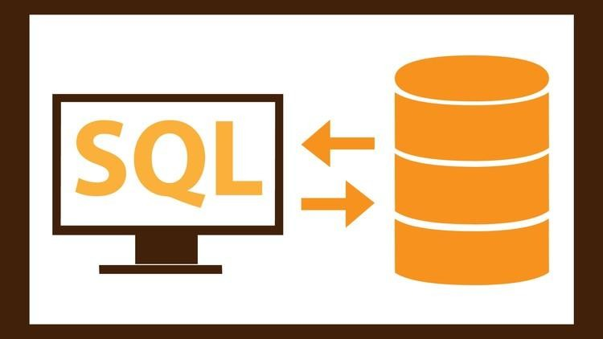
Structured Query Language
Most of you have had some interaction with SQL
SQL was made for both programmers and for accountants who were used to spreadsheets
We can imagine taking data from spreadsheets, join from different sheets etc
https://udemy-images.udemy.com/course/750x422/743174_8046_5.jpg

Slide 10
Basic Commands - Data Definition Language (DDL)
DDL lets you create, destroy, alter, and modify constraints on data
You can think of them as operations that set up where data will go
CREATE TABLE (
id INTEGER, name VARCHAR(255), location VARCHAR(255)
);
ALTER TABLE ADD status INTEGER;
ALTER TABLE ADD blah INTEGER NOT NULL;
DROP TABLE;

Slide 11
Data Modification Language - DML
This adds, deletes, selects, and updates data (basic CRUD operations)
This lets you put data into the database tables
INSERT INTO table (col1, col2, ..) VALUES (v1, v2, ..), ..
DELETE FROM table where col1 = …
UPDATE table SET col1=’asdf’ WHERE col2=’asd’
SELECT * FROM table

Slide 12
Data Modification Language Extensions
The data modification language also lets you do more powerful things when retrieving data
  We can have data GROUP BY a certain column(s)
  Have data ORDER BY some column(s)
  We can JOIN multiple spreadsheets based on a column
We can have SQL calculate functions or aggregations on the fly
Usually RDBMSs are optimized for read-heavy workloads

Slide 13
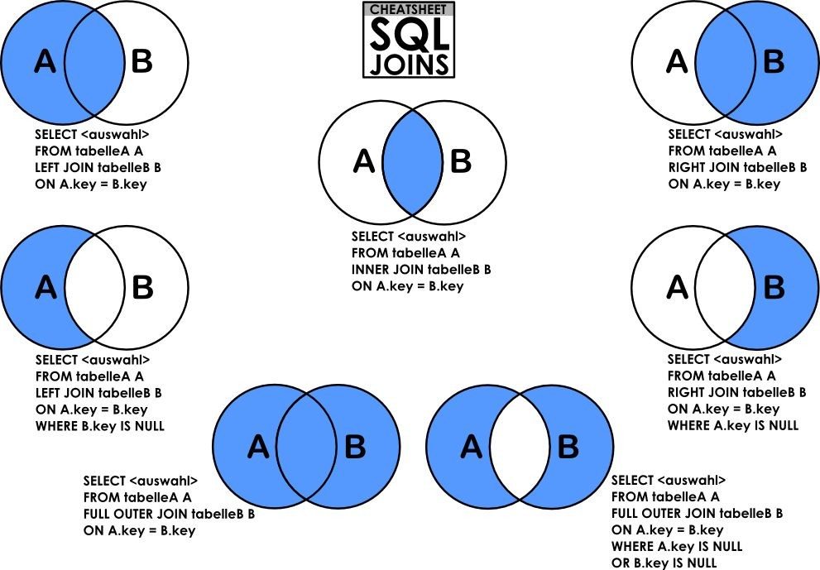
https://dsin.files.wordpress.com/2013/03/sqljoins_cheatsheet.png

Slide 14
SQL Prepared Statements
Actual interactions with the database.
  INSERT INTO table VALUES (`+userid+`);
What if userid = “1; SELECT * FROM table WHERE col1 NOT IN (“?
  INSERT INTO table VALUES (1); SELECT * FROM table WHERE col1 NOT IN ();
  This will give us back all the results from the database!

Slide 15
SQL Prepared Statements
To avoid this, we have prepared statements
INSERT INTO table VALUES (?) and, send userid separately
This avoids the injection problem but doesn’t let SQL server optimize database queries

Slide 16
Outline
Traditional Databases
SQL
  Optimizations
Spark SQL

Slide 17
SQL Turing Completeness
Every SQL statement (in ANSI SQL) will terminate
The Non-Turing Completeness of SQL let’s us optimize many portions of queries

Slide 18
User tips for optimizing SQL queries
Don’t use `SELECT *` statements, you usually are selecting more rows than need be
If you have multiple levels of joins then you may want to consider staging your data into an intermediate table in order to reduce communication overhead
Add indices! Indices can slow updates but drastically speed up complex queries if the indices are on the appropriate columns

Slide 19
SQL Optimizer: Prediction
Consider a query like `select col1 from table where col1=1 AND col2=2;`
Your server has the choice of filtering by col2 and then col1 or by col1 then col2.
If the server knows that there are a lot of NULL values in col2 which would reduce the number of rows in consideration a lot, it will filter based on col2 first and then filter on col1 because the complexity will be NUM_ROWS * SMALL_NUMBER

Slide 20
SQL Optimizer: Lazy Joins
A join is when you combine two tables on a column
c1 | c2
1 | 2
2 | 4
c3 | c4
1 | 1
2 | 1
3 | 2

Slide 21
Example Join
SELECT * FROM t1 JOIN t2 USING (c1, c4);
c1 | c2 | c3 | c4
1 | 2 | 1 | 1
1 | 2 | 2 | 1
2 | 4 | 3 | 2

Slide 22
Lazy Join
SQL may filter the data before joining, may group by before joining if you know that one of the columns is in one of the table
This is very ad-hoc prediction because SQL usually doesn’t keep track of super in depth statistics
As a SQL server runs longer, then it gets better at this prediction
  The main reason that it can’t keep track of all of this information is due to concurrency bottlenecks so it makes static analyses instead

Slide 23
Outline
Traditional Databases
SQL
  Optimizations
Spark SQL

Slide 24
Spark SQL
Distributed in-memory computation on massive scale (Just like Spark!)
Can use all data sources that Spark supports natively:
  Can import data from RDDs
  JSON/CSV files can be loaded with inferred schema
  Parquet files - Column-based storage format
    Supported by many Apache systems (big surprise!)
  Hive Table import
    A popular data warehousing platform by Apache

Slide 25
Spark SQL
SQL using Spark as a “Database”
  Spark SQL is best optimized for retrieving data
  Don’t UPDATE, INSERT, or DELETE
Optimization handled by a newer optimization engine, Catalyst
  Creates physical execution plan and compiles directly to JVM bytecode
Can function as a compatibility layer for firms that use RDBMS systems

Slide 26
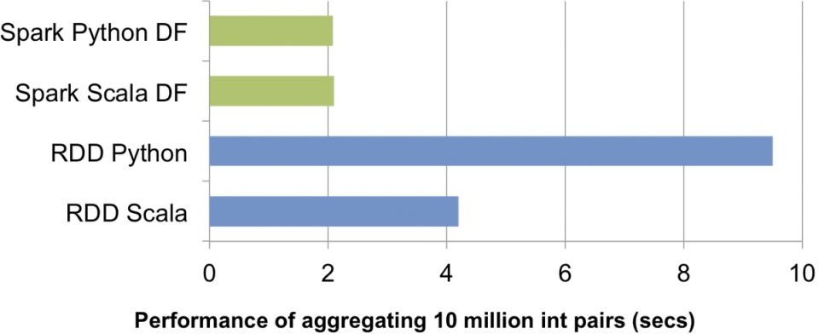
Spark DataFrames
Dataset organized into named columns
Similar to structure as Dataframes in Python (i.e. Pandas) or R
Lazily evaluated like normal RDDs
Tends to be more performant than raw RDD operations
https://databricks.com/blog/2015/02/17/introducing-dataframes-in-spark-for-large-scale-data-science.html

Slide 27
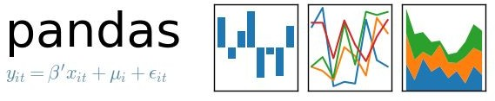
Pandas DataFrame
Does in-memory computing, but:
Not scalable by itself.
Not fault tolerant.
import pandas as pd
df = pd.read_csv("/path/to/data.json") df
first_name last_name
age preTestScore 4 25,000
24 94,000
57
postTestScore
0
1
2
Jason Miller Molly Jacobson
42
52
31
Tina . 36
3 | Jake | Milner | 24 | . | 62
4 | Amy | Cooze 73 | . | 70

Slide 28
Spark DataFrames
When to prefer RDDs over DataFrames:
  Need low-level access to data
  Data is mostly unstructured or schemaless
When to prefer DataFrames over RDDs:
  Operations on structured data
  If higher-level abstractions are useful (i.e. joins, aggregation, etc.)
  High-performance is desired, and workload fits within DataFrame APIs
    Catalyst optimization makes DataFrames more performant on average

Slide 29
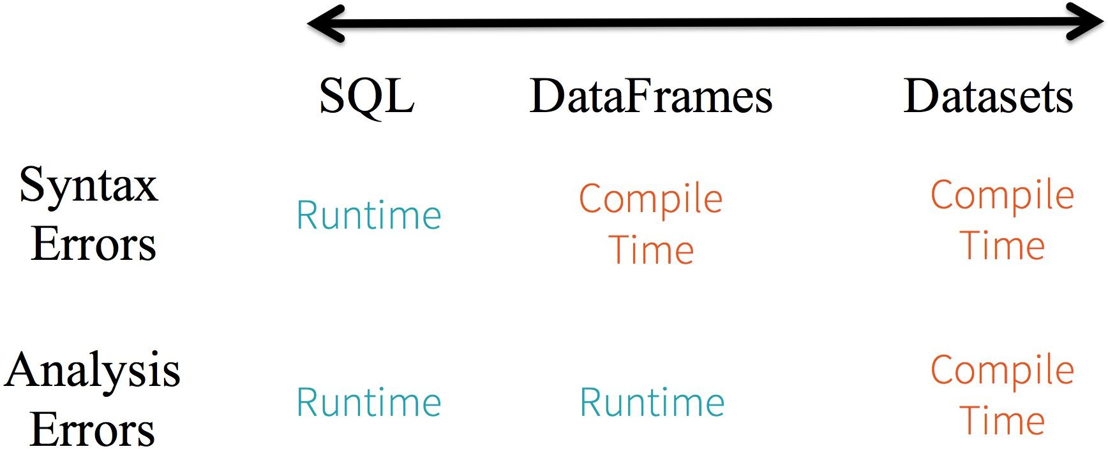
Spark DataSets
Strongly-typed DataFrames
Only accessible in Spark2+ using Scala
Operations on DataFrames are all statically typed, so you catch type errors at compile-time
https://databricks.com/blog/2016/07/14/a-tale-of-three-apache-spark-apis-rdds-dataframes-and-datasets.html

Slide 30
Data Ingest (RDD)
from pyspark.sql import SQLContext sqlContext = SQLContext(sc)
users_rdd = sc.parallelize([[1, 'Alice', 10], [2, 'Bob', 8]]) users = sqlContext.createDataFrame(
users_rdd,
['id', 'name', 'num_posts']) users.printSchema()
#root
# |-- id: long (nullable = true)
# |-- name: string (nullable = true)
# |-- num_posts: long (nullable = true)

Slide 31
Data Ingest (JSON)
from pyspark.sql import SQLContext sqlContext = SQLContext(sc)
users = sqlContext.read.json("/path/to/users.json") users.printSchema()
# | root
# | |-- | id: long (nullable = true)
# | |-- | name: string (nullable = true)
# | |-- | num_posts: long (nullable = true)

Slide 32
SQL API
# Register users DataFrame as a table called "users" users.createOrReplaceTempView( 'users')
# Query the table sqlContext.sql(
'SELECT * FROM users WHERE name="Bob"'
).collect()
# [Row(id=2, name='Bob', num_posts=8)]

Slide 33
DataFrame API
# Same query can be done with DataFrame API
users.filter(users.name=='Bob').collect() # [Row(id=2, name='Bob', num_posts=8)]
users.filter(users.name=='Eve').select('num_posts').collect() # [Row(num_posts=10)]

