Slide 1
Spark MLlib

Slide 2
Machine Learning Basics
What comes first?

Slide 3
Machine Learning Basics
What comes first?
Data, sparse and labeled

Slide 4
Machine Learning Basics
What comes first?
Data, sparse and labeled
How is the data represented?

Slide 5
Machine Learning Basics
What comes first?
Data, sparse and labeled
How is the data represented?
Continuous or Discrete? Supervised or Unsupervised?

Slide 6
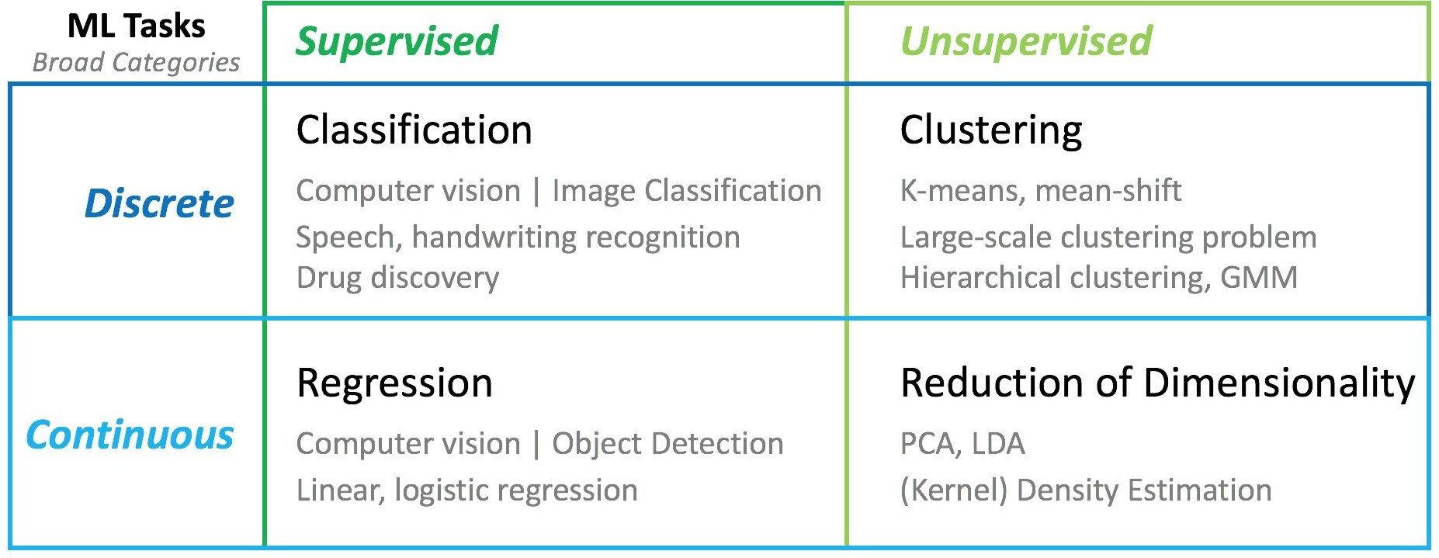
Machine Learning Techniques
We will be covering three broad types of techniques:
Regression
  Tries to predict an output given data (continuous)
Classifiers
  Takes data and try to assign it a label (discrete)
Clustering
  Don’t know labels or numbers.
  Groups similar data points into a group (or ‘cluster’).

Slide 7
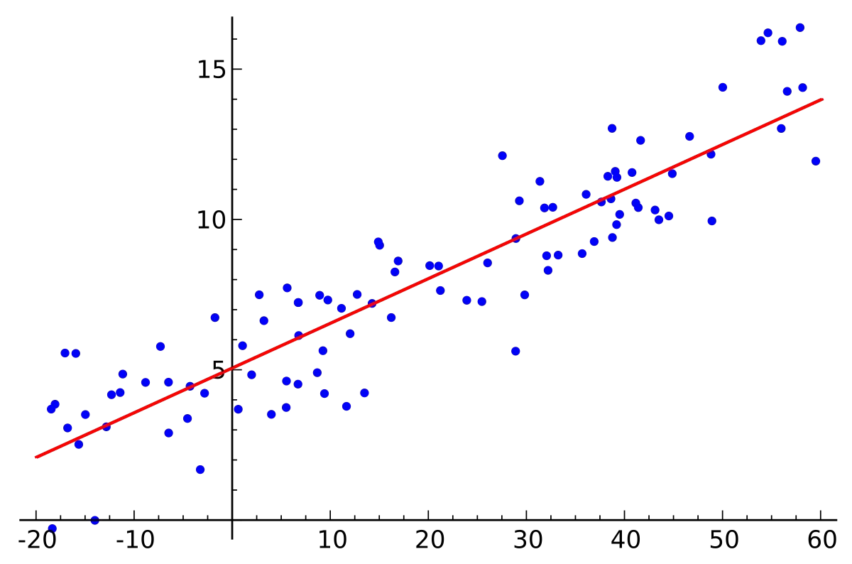
Regression
Fits a function to your data.
  For example, linear regression finds a line of best fit

Slide 8
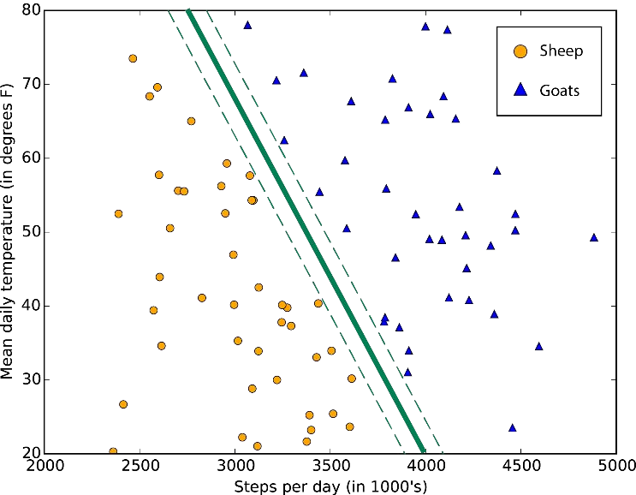
Classifiers
Takes data and assigns them a label based on what it is ‘closest’ to.
Supervised

Slide 9
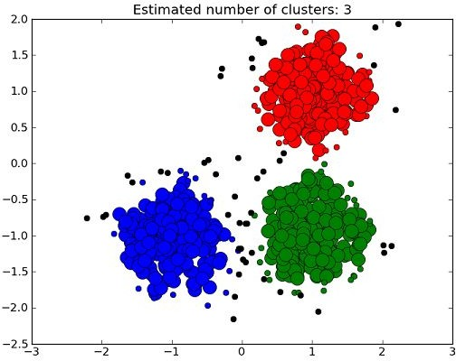
Clustering
Unsupervised; used when there are no labels
The algorithm determines the clusters

Slide 10
How Do I Know If My Model Is Any Good?
Check your data and clean it up!
  Good models only come from good data
  Don’t Overfit!!
Metrics
  Precision, accuracy, area under ROC, true positive rate, root mean squared error, etc…

Slide 11
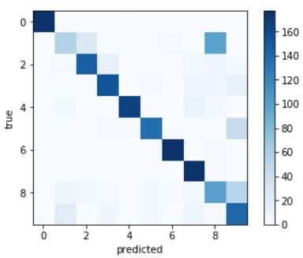
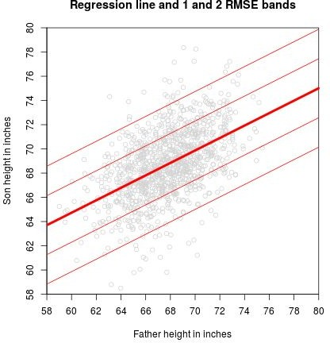
Performance Metrics
Confusion Matrix
  Useful for Classification
RMSE - Root Mean Square Error
  Useful for Regression

Slide 12
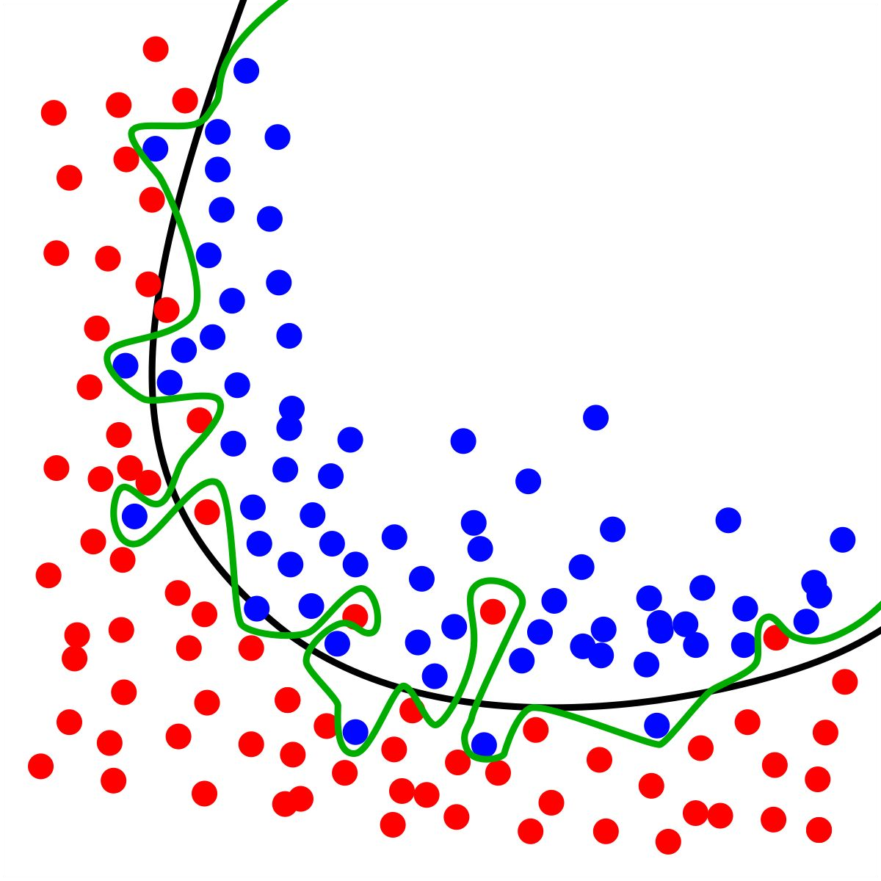
Overfitting
When your model is too good
Happens when your model ‘learns’ random noise in your training data.

Slide 13
Improve Models with Data
Get More Data
  Invent, Simulate, Resample…
Transform Data
  Reshape the distribution, Rescale the data...
Feature Engineering
  Create and add new features
Clean Data
  Missing data handling, Reduce Noise…

Slide 14
Improving Models
Feature Selection
Selecting features to improve the prediction model
  Use when there are a lot of features (noise) and not enough data points
  Sometimes adding more feature can also improve the model as it decrease bias.
To
Reduce Overfitting
Improve Accuracy
Reduce overall Training

Slide 15
Distributed Machine Learning

Slide 16



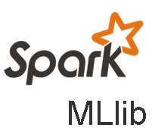
The Options
Apache Singa

Slide 17
Machine Learning on Spark (MLlib)
MLlib allows for distributed machine learning on very large datasets.
Built on top of Spark so you can use it easily within Spark
Designed to be similar in use to NumPy
Can interoperate with NumPy and SciPy

Slide 18
Machine Learning on Spark (MLlib)
Can use RDDs or DataFrames
  Unfortunately, they have slightly different feature sets…
RDD API:
  pyspark.mllib.*
  Original API, now in “Maintenance Mode”
DataFrame API:
  pyspark.ml.*
  Primary API for MLlib for Spark 2.0+
  Support for ML “pipelines”
    Less “glue” code necessary

Slide 19
When to use MLlib?
When your data is LARGE
To work with the Spark Ecosystem
Real-Time Machine Learning (with Spark Streaming)

