Slide 1
NoSQL and Key/Value Stores

Slide 2
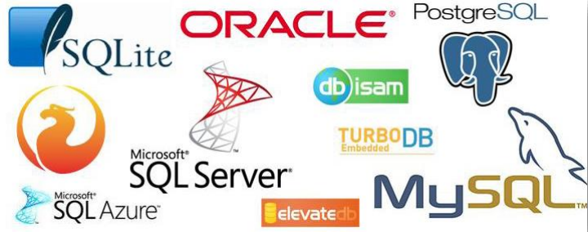
SQL databases

Slide 3
A little bit of history
Most databases became SQL-like in the 1980s
Term first used in 1998 - NoSQL stands for “Not Only SQL”
In 2006 Google published their BigTable paper
  It was not SQL
  It was designed to scale to petabytes of data (1000s of gigabytes) on thousands of nodes
  Solved scaling by relaxing availability
In 2007 Amazon published their Dynamo paper
  Again not SQL; Similarly solves the problem of scaling
  Solved scaling through relaxing consistency
By 2009 there were tons of systems like these
Now when you have hundreds of nodes, NoSQL is the normal solution

Slide 4
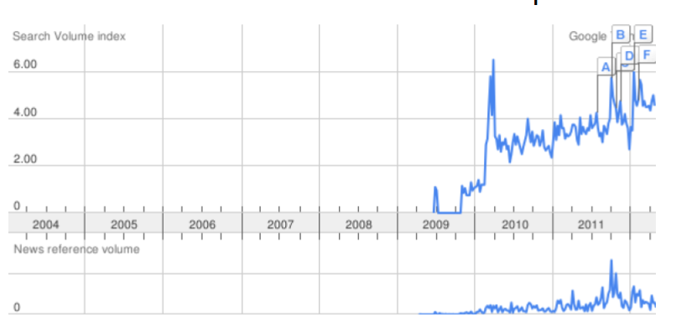
Reached a noticeable awareness in April 2009

Slide 5
Why NoSQL ?
Databases which may not be relational and can scale to tons and tons of servers
Building distributed RDBMSs is a very complex (expensive) task
Sacrifice SQL compatibility to get higher read/write/storage rates
Schema free - Handling Unstructured Data

Slide 6
SQL vs NoSQL
SQL systems are typically good at consistency
  If data is written to a row, all reads will get that write
  This can slow down transactions
The vast majority of databases (not only SQL) are ACID:
  Atomic
  Consistent
  Isolated
  Durable
ACID is analogous to the properties of a global variable in a single threaded program

Slide 7
NoSQL Database Types
Key Value Store (Redis, Riak, LocalStorage, Amazon DynamoDB, Datastore on GAE)
Document Oriented (MongoDB, CourchDB, RethinkDB)
Columnar Storage (HBase, Apache Cassandra, ClickHouse, Pinot, and Druid)
Multivalue databases (InfinityDB)
Graph (AllegroGraph, Neo4J)

Slide 8
Key Value Store
These store key value pairs really really well
Can be used as a distributed cache
Key-value databases are generally useful for storing session information, user profiles, preferences, shopping cart data
Some document stores are key value stores under the hood
{
Key1: val1, Key2: val2
}

Slide 9
Document Oriented Databases
They store complex structures like:
  JSON
  XML
  YAML
These work really well when most queries are for one item instead of aggregations
Typically provide their own unique query languages
These extend the idea of key value stores to more complex types

Slide 10
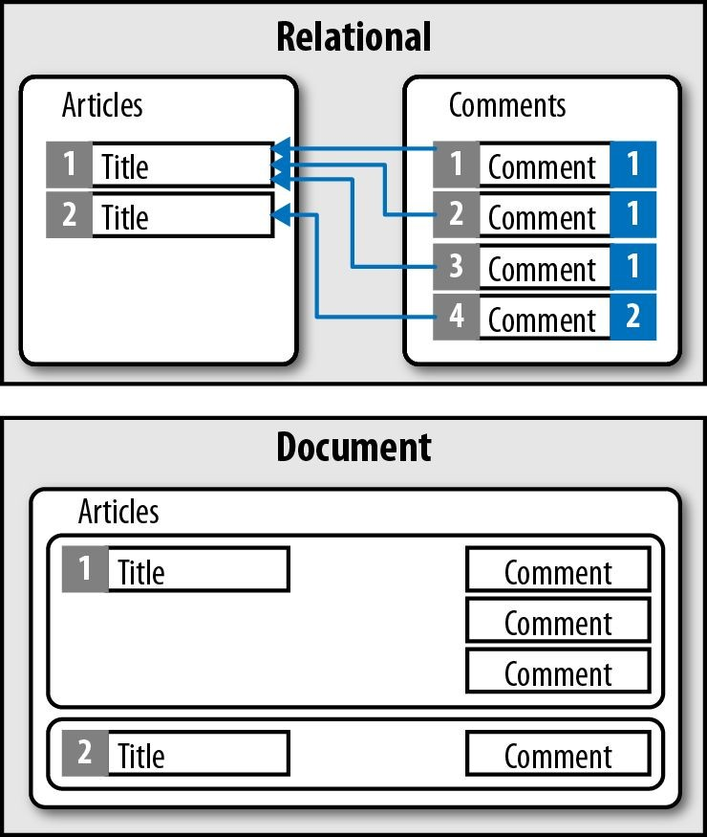

Slide 11
Document Vs Key Value Databases
Both address objects with a key:
Document DBs cluster documents within collections
Key value stores mainly have only one collection
Key value stores are faster (Smaller values and less structure)
Document DBs support more extensive query languages in general
If you do not need complex objects, use a key value store

Slide 12
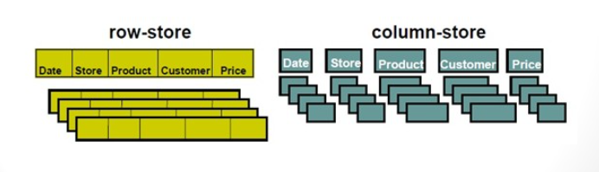
Columnar/Column based Databases
Columns are stored together instead of rows
A row is can be split amongst many machines
Makes aggregations really fast since a single column normally resides on one machine => This makes a big difference for analytical data processing
Usually does not support joins (or joins are very slow)

Slide 13
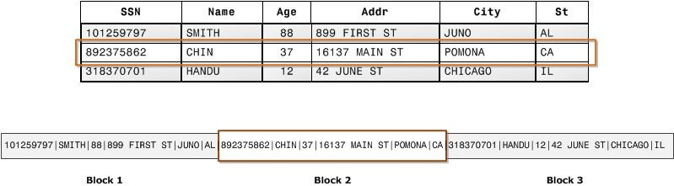
Row based databases
Columnar based databases

Slide 14
Relaxing Constraints
All of the above types can be implemented using a normal SQL database a backend
They can also be implemented as ACID (Atomicity, Consistency, Isolation, and Durability) databases
What if we specified you did not need strong consistency?

Slide 15

Eventual Consistency
Making everything consistent immediately means clients need to queue
Say you have 3 clients, one writing and the other two reading
Write X
Read X
Read X

Slide 16
Eventual Consistency
Making everything consistent immediately means clients need to queue
Say you have 3 clients, one writing and the other two reading
The true ordering is
T=0 | T=1 | T=2
Read X | Write X | Read X

Slide 17
Eventual Consistency
But you could receive this order because of network delays
T=0 | T=1 | T=2
Read X | Read X | Write X

Slide 18
Eventual Consistency
Or if you have two servers, one could receive the true ordering and one the out of order ordering
Server 1 sees
T=0 | T=1 | T=2
Read X | Write X | Read X
Server 2 Sees
T=0 | T=1 | T=2
Read X | Read X | Write X

Slide 19
Eventual Consistency
But sometimes we can afford old values being read for a little while. This means we can read and write at the same time.
Server 1 sees
T=0 | T=1 | T=2
Read X | Write X | Read X
Server 2 Sees
T=0 | T=1 | T=2
Read X | Read X | Write X

Slide 20
CAP Theorem
Consistency
  All reads receive the most recent write or error
Availability
  Every read/write receives a non error
Partition Tolerance
  Everything keeps working if the network starts dropping messages
Pick 2

Slide 21
CAP Theorem
Consistency
  All reads receive the most recent write or error
Availability
  Every read/write recieves a non error
Partition Tolerance
  Everything keeps working if the network starts dropping messages
Pick 2
Each of these have a non strict version
But you cannot guarantee all 3 in all scenarios

Slide 22
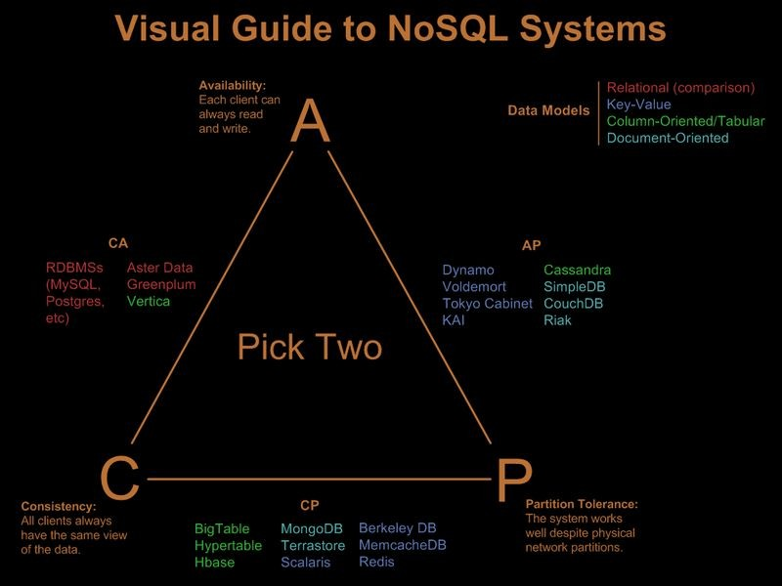
From Ofirm

Slide 23
CA Systems
Consistency and availability
  They will always respond with the latest write
Most SQL databases are CA systems.
SQL Systems
  MySQL
  MSSQL
  SQLite
  PostgreSQL

Slide 24
CP Systems
Consistency and Partition Tolerance
Will give you the latest write or give you an error if not possible
Can survive half the network going down
HBase, BigTable, MongoDB

Slide 25

Is a CP system
Used in HDFS
Linear and modular scalability.
Strictly consistent reads and writes.
Automatic and configurable sharding of table
Everything is still a table
Can return an error since it is CP

Slide 26

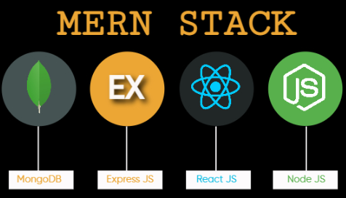
Is a CP system
Extremely easy to set up
  The defaults are insecure
Document Oriented DB
  Only stores JSON objects
  No longer a simple table
Is a key value store

Slide 27
Is Retains some friendly properties of SQL. (query, index)
Queries are javascript expressions
Run arbitrary javascript functions server-side
Master-slave replication
Sharding built-in
Concurrency: Update in Place
Has geospatial indexing
Stores documents as BSON (Binary JSON)
Provides CP (remember CAP theorem)
Enterprise class support

Slide 28
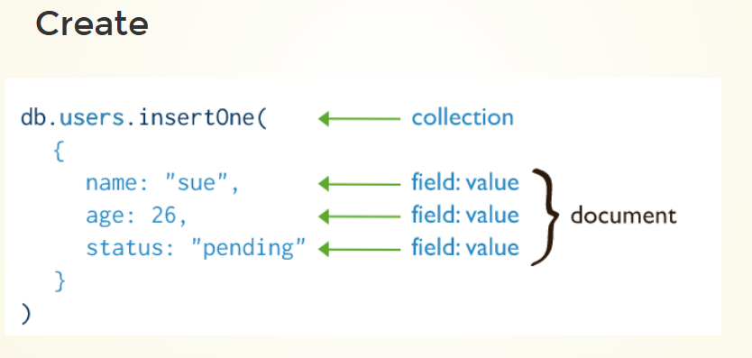

Slide 29
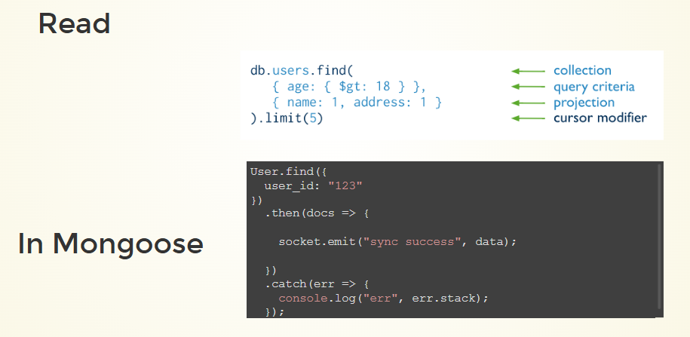

Slide 30
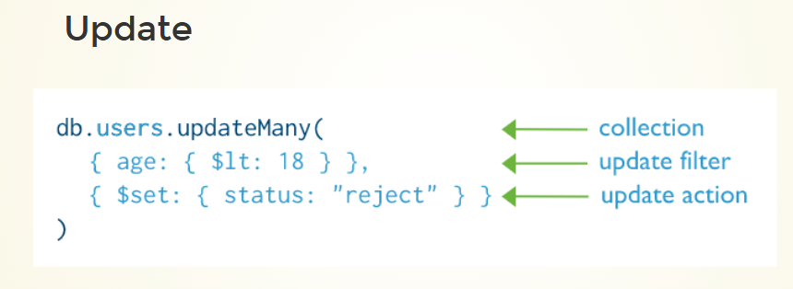

Slide 31

CP System
Is a key value store
Lets you write data structures into memory and share them
Very fast: Often used as a caching layer

Slide 32
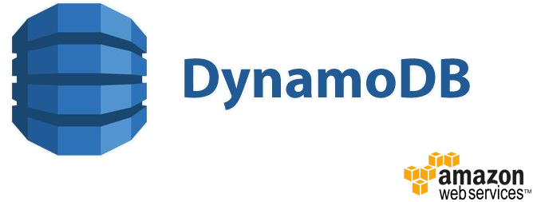
CP System
Resembles a key-value store
  Allows indexing, but this involves data-replication
Very fast reads
Scales well

Slide 33

Google Spanner
CP System
Global SQL Database

Slide 34
AP Systems
Available and partition tolerant
Never returns an error even when half the network is dead

Slide 35
From Ofirm

Slide 36

AP system
Column-Oriented
Super high availability and super high throughput
  Used by Reddit, Facebook and others

Slide 37

AP system
Key value store
Can be faster than MongoDB but sacrifices consistency

Slide 38
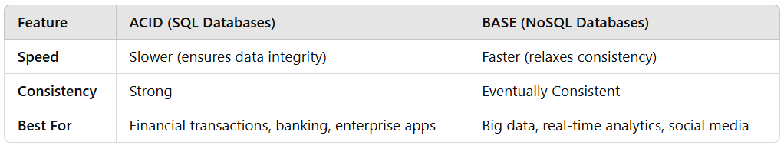
When to use SQL vs NoSQL
By default use an SQL database
Use NoSQL when you need more than one server AND you have a super high write rate
  NoSQL happens when you can sacrifice CA and need some other pair from CAP

Slide 39
Usage of NoSQL DBs at scale
Facebook
        RocksDB - Embeddable persistent key-value store.
Cassandra - Column-based database
Memcached - An in-memory key-value store
Pokemon GO
Google Cloud Datastore’s NoSQL database.
Clash of Clans
DynomoDB Amazon Web Services(AWS)

