Slide 1
Distributed Databases

Slide 2
Learning objectives
Understand differences between centralized and distributed databases
Understand different architectures, distribution strategies
Understand concurrency control & transactions
Notes:
https://www.youtube.com/watch?v=aReuLtY0YMI
https://www.youtube.com/watch?v=JWX5Inb--ig

Slide 3

Distributed Database (DDB)
A collection of multiple, logically interconnected databases that are physically distributed over a computer network on different sites
Data are physically stored across multiple sites, managed by a DBMS that is independent of the other site
Data at any site available to users at other sites
        Sites may be far apart, linked by some forms of telecommunication lines (secure lines or Internet)
Sites that are close together may be linked by a local area network (LAN)
Distributed databases – focus on database storage and location transparency

Slide 4
Why do we need Distributed Databases?
Example: IBM has offices in London, New York, and Hong Kong.
Employee data:
  EMP(ENO, NAME, TITLE, SALARY, …)
Where should the employee data table reside?

Slide 5
Data Access Pattern
Mostly, employee data is managed at the office where the employee works
  E.g., payroll, benefits, hire and fire
Periodically, we needs consolidated access to employee data
  E.g., changes benefit plans and that affects all employees.
  E.g., Annual bonus depends on global net profit.

Slide 6
London
Payroll app
New York
Payroll app
EMP
London
New York
Internet
Hong Kong
Payroll app
Problem:
NY and HK payroll
apps run very slowly!
Hong Kong

Slide 7
London
Payroll app
New York
Payroll app
London
Emp
NY
Emp
London
New York
Internet
Hong Kong
Payroll app
Much better!!
Hong Kong
HK
Emp

Slide 8
London
Payroll app
New York
Payroll app
Annual
Bonus app
London
Emp
NY
Emp
London
New York
Internet
Hong Kong
Payroll app
Distribution provides
opportunities for
parallel execution
Hong Kong
HK
Emp

Slide 9
London
Payroll app
New York
Payroll app
Annual
Bonus app
London
Emp
NY
Emp
London
New York
Internet
Hong Kong
Payroll app
Hong Kong
HK
Emp

Slide 10
London
Payroll app
New York
Payroll app
Annual
Bonus app
Lon, NY
Emp
NY, HK
Emp
London
New York
Internet
Hong Kong
Payroll app
Replication improves
availability
Hong Kong
HK, Lon
Emp

Slide 11
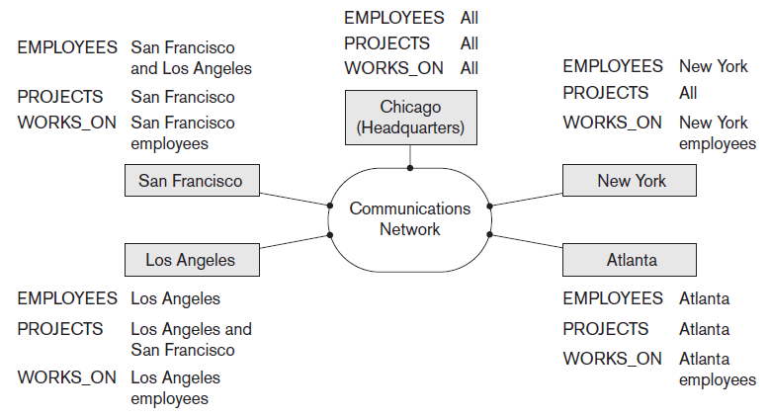
Distributed Databases
Figure: Data distribution and replication among distributed databases

Slide 12
Distributed Database Management
System (DDBMS)
A centralized software system that manages the DDB
Synchronizes the databases periodically
Provides an access mechanism that makes the distribution transparent to the users (as if it were all stored in a single location)
Ensures that the data modified at any remote site is universally updated
Supports a huge number of users simultaneously
Maintains data integrity of the databases

Slide 13
Challenges
Security: due to the Internet usage
Consistency issues: databases must be synchronized periodically to ensure data integrity
Increased storage requirements: due to replication of databases
Multiple location access: transactions may access data at one or more sites
How does the application find data?
Where does the application send queries?
How to execute queries on distributed data?
→ Push query to data.
→ Pull data to query.

Slide 14
Distributed Strategies
Based on the organizational needs and information split and exchange requirements, the distributed database environment can be designed in two ways:
Homogeneous
  Use the same DBMS for all database nodes that take part in the distribution
Heterogeneous
  May use a diverse DBMS for some of the nodes that take part in the distribution

Slide 15
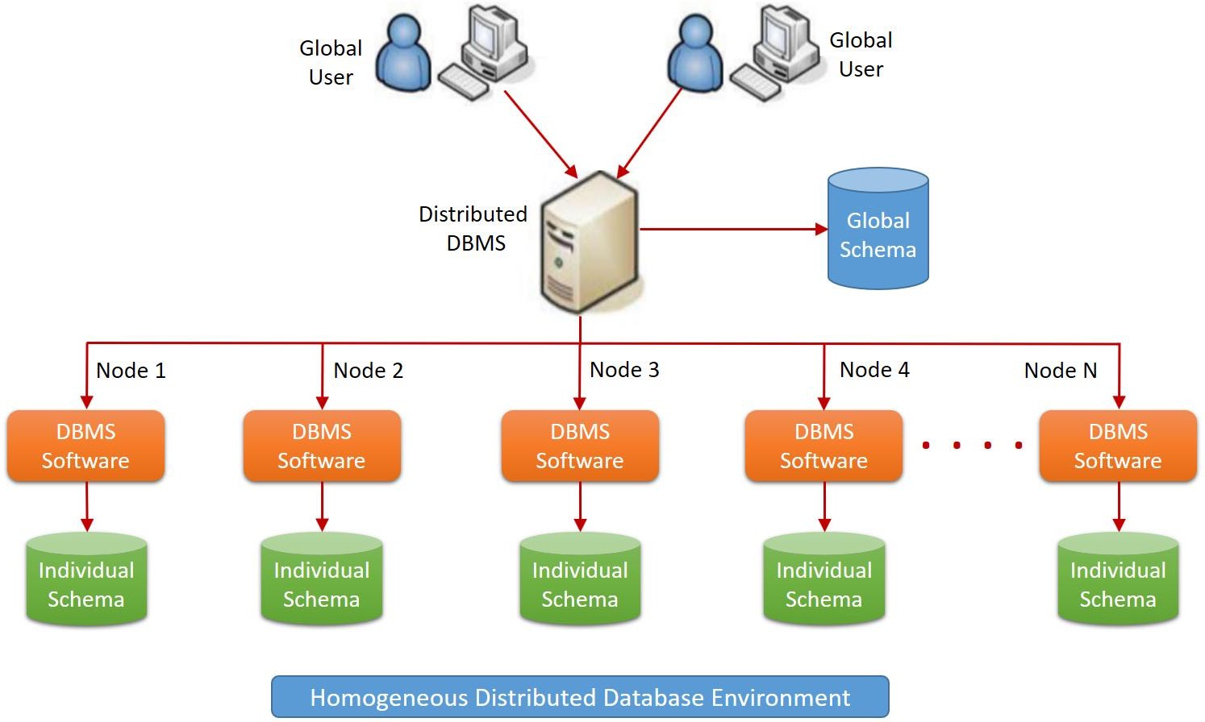
Homogeneous Distributed DB
Information is distributed between all the nodes
The same DBMS and schema are used across all the databases
The distributed DBMS controls all information
Every global user must access the information from the same global schema controlled by the distributed DBMS
A combination of all the individual DB schemas makes the global schema

Slide 16
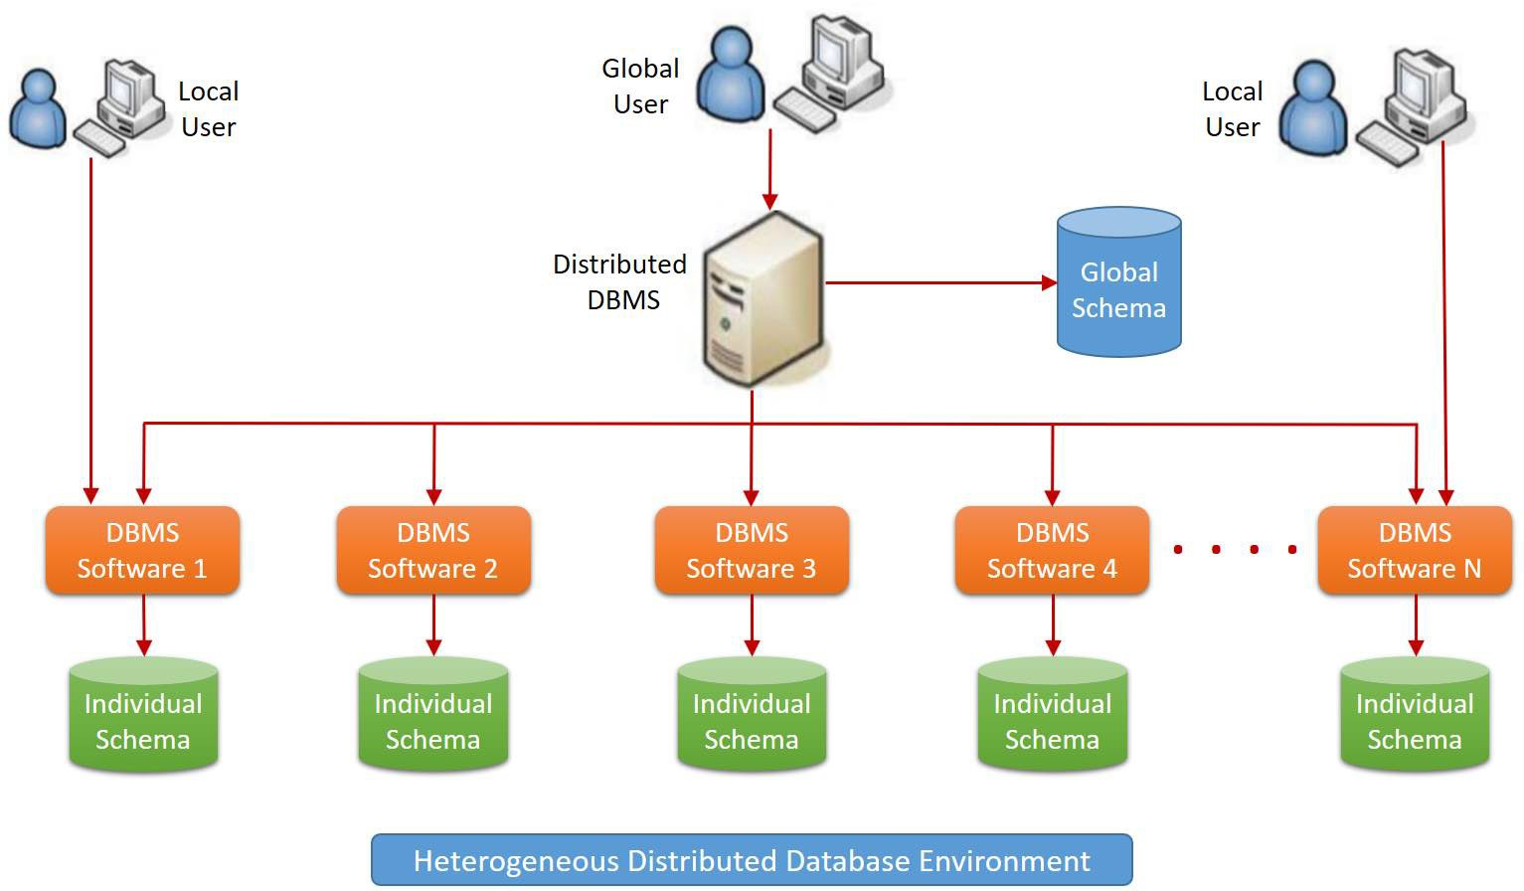
Heterogeneous Distributed DB
Information is distributed between all the nodes
Different DBMS and schemas may be used across the databases
Local users (interacting with one of the individual database) can access the corresponding DBMS and schema
Users who want to access the global information can communicate with the distributed DBMS, which has a global schema (a combination of all the individual DB schemas)

Slide 17






Heterogeneous DATABASE EXAMPLE
Middleware
Back-end DBMSs
Query Requests
Connectors
Application Server

Slide 18
Distributed DB Setup Method
Ongoing and future information maintenance must be determined
  Synchronous: information across all nodes should be kept in sync all the time
  Asynchronous: information is replicated at multiple nodes to make it available for other nodes
The setup can be performed in one of the following ways:
  Replication
  Fragmentation/partitioning (horizontal or vertical)
  Hybrid setup

Slide 19
Replication
Maintain multiple copies of the database instances, stored in different sites
Easy and minimum risk process as the information is copied from one instance to another without a logical separation
Each individual node has the complete information
Efficient in accessing the information without having network traversals and reduces the risk of network security
Fast retrieval
Increase fault tolerance
Require more storage space
Take longer to synchronize all the nodes when the information across all the nodes needs to be updated

Slide 20
Fragmentation (or Partition)
One copy of each data item, distributed across nodes
Split a database into disjoint fragments (or parts)
Fragments can be
  Vertical table subsets (formed by RA projection)
  Horizontal subsets (formed by RA selection)

Slide 21
Horizontal Fragmentation
Splitting the rows of a table (or a relation between two or more nodes, containing databases) to form a distributed database – “split by region”
Each individual database has a set of rows that belong to the table or relation that belongs to the specific database
N nodes
R₁, -inf < PK <= v₁
R₂, v₁ < PK <= v₂
…
R_{N}, v_{N} < PK < inf
PK | A | B
… | … | …
PK | A | B
PK | A | B
PK | A | B

Slide 22
Example: Horizontal Fragmentation
^{σ}major=“Math” ^{(students)}
stuId | lastName | firstName | major | credits
S1002 | Chin | Ann | Math | 36
S1013 | McCarthy | Owen | Math | 0
S1015 | Jones | Mary | Math | 42
… | … | … | … | …
stuId | lastName | firstName | major | credits
S1001 | Smith | Tom | History | 90
S1002 | Chin | Ann | Math | 36
S1005 | Lee | Perry | History | 3
S1010 | Burns | Edward | Art | 63
S1013 | McCarthy | Owen | Math | 0
S1015 | Jones | Mary | Math | 42
S1020 | Rivera | Jane | CSC | 15
… | … | … | … | …
^{σ}major=“History” ^{(students)}
stuId | lastName | firstName | major | credits
S1001 | Smith | Tom | History | 90
S1005 | Lee | Perry | History | 3
… | … | … | … | …
σ_{major=“Art”} (students)
stuId | lastName | firstName | major | credits
S1010 | Burns | Edward | Art | 63
… | … | … | … | …
σ_{major=“CSC”} (students)
stuId | lastName | firstName | major | credits
S1020 | Rivera | Jane | CSC | 15
… | … | … | … | …

Slide 23
Horizontal Fragmentation
The information access is efficient
Best if partitions are uniform
Optimal performance as the local data are only stored in a specific database
Allow parallel processing on fragments
More secure as the information belonging to the other location is not stored in the database
If a user wants to access some of the other nodes or a combination of node information, the access latency varies.
If there is a problem with a node or a network, the information related to that node becomes inaccessible to the users

Slide 24
Vertical Fragmentation
(aka normalization process in distributed database setup)
Splitting the columns of a table (or a relation between two or more nodes, containing databases) to form a distributed database while keeping a copy of the base column (primary key) to uniquely identifying each record – “split by purpose”
N nodes
Each node contains all rows of a table
PK | A | B
… | … | …
PK | A | B | C | D | E | F | G | … | X
… | … | … | … | … | … | … | … | … | …
PK | C | D | E | F | G
… | … | … | … | … | …
…
~Normalization for distributed databases
PK | X
… | …
Projection must be lossless

Slide 25
Example: Vertical Fragmentation
stuId | lastName | firstName | major | credits | …
S1001 | Smith | Tom | History | 90 | …
S1002 | Chin | Ann | Math | 36 | …
S1005 | Lee | Perry | History | 3 | …
S1010 | Burns | Edward | Art | 63 | …
S1013 | McCarthy | Owen | Math | 0 | …
S1015 | Jones | Mary | Math | 42 | …
S1020 | Rivera | Jane | CSC | 15 | …
… | … | … | … | … | …
Notice stuId in all fragments
πstuId, lastName, firstName^{(students)}
π_{stuId, major}(students)
πstuId, credits ^{(students)}
stuId | lastName | firstName
S1001 | Smith | Tom
S1002 | Chin | Ann
S1005 | Lee | Perry
S1010 | Burns | Edward
S1013 | McCarthy | Owen
S1015 | Jones | Mary
S1020 | Rivera | Jane
… | … | …
stuId | major
S1001 | History
S1002 | Math
S1005 | History
S1010 | Art
S1013 | Math
S1015 | Math
S1020 | CSC
… | …
stuId | credits
S1001 | 90
S1002 | 36
S1005 | 3
S1010 | 63
S1013 | 0
S1015 | 42
S1020 | 15
… | …
…

Slide 26
Vertical Fragmentation
Appropriate if each of the organizational units located in different geographies have separate operations
Partition based on behavior and function that each node performs
Best if partitions are uniform
Part of the tuple is stored where it is most frequently accessed
Allow parallel processing on fragments
Poorly chosen columns to split can lead to node bottleneck
The aggregation of the data involves complex queries with joins across the location database, as no replication is made for non- primary keys

Slide 27
Hybrid Setup
Involve a combination of replication and fragmentation
Relation is partitioned into several fragments
Some information is replicated across the database nodes
Data administrators play a crucial role to choose the right combination to ensure data integrity and security

Slide 28
BASE Consistency Model
With the enormous growth in data, achieving ACID or CAP becomes very difficult.
A more relaxed set of properties is BASE
Basically Available, Soft state, Eventually consistent
Most failures do not cause a complete system outage
System is not always write-consistent
Data will eventually converge to agreed values
Key idea:
  Databases may not all be in the same state at the same time (“soft state”)
  After synchronization is complete, the state will be consistent

Slide 29
Wrap-Up
Distributed Database Systems ➔ database scaling
Replication
Multiple copies of each database partition
Improves fault tolerance
Read performance ok
Write performance suffers
Fragmentation
Multiple machines to distribute data
Write performance ok
Read performance suffers

Slide 30
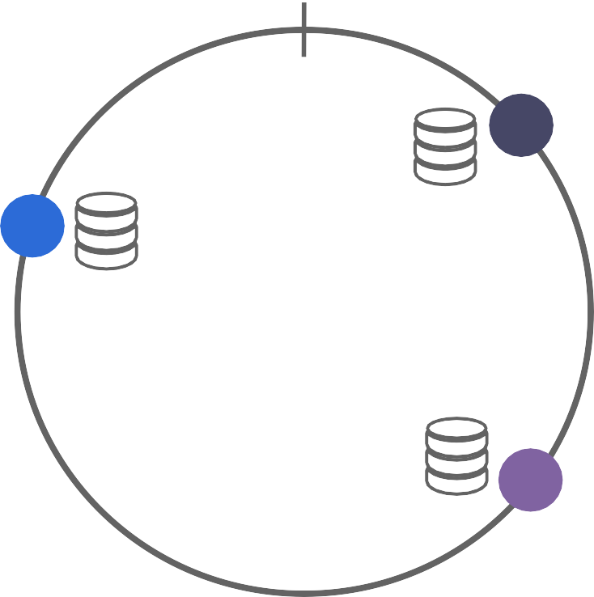
CONSISTENT HASHING
45
1 0
P1
P3
Consistent Hashing is a technique used in distributed systems to distribute data efficiently across multiple servers while minimizing disruption when servers are added or removed.
It is widely used in caching (Memcached, Redis Cluster), distributed databases (DynamoDB, Cassandra), and load balancing.
P2
0.5

Slide 31
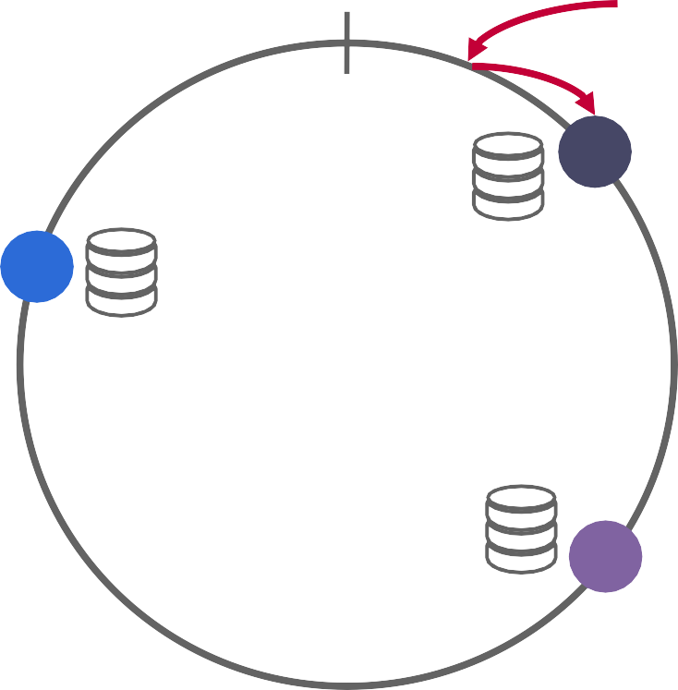
CONSISTENT HASHING
46
1 0
hash(key1)
P1
P3
P2
0.5

Slide 32
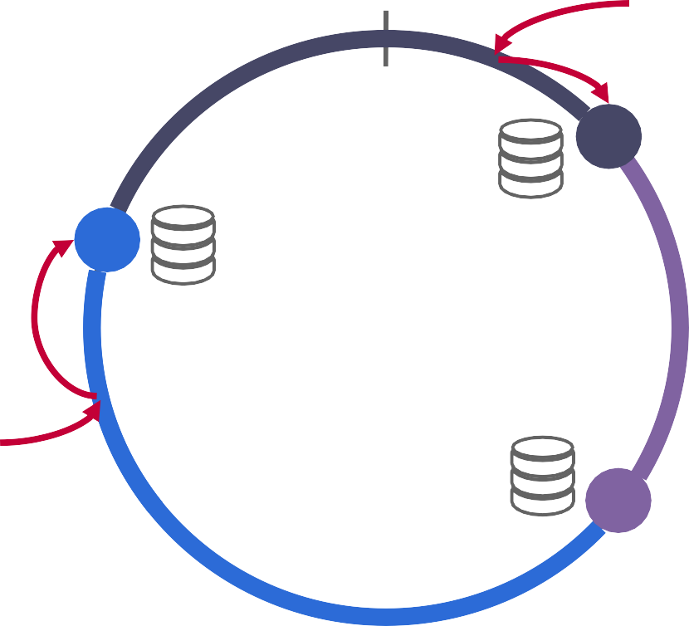
CONSISTENT HASHING
47
1 0
hash(key1)
P1
P3
hash(key2)
P2
0.5

Slide 33
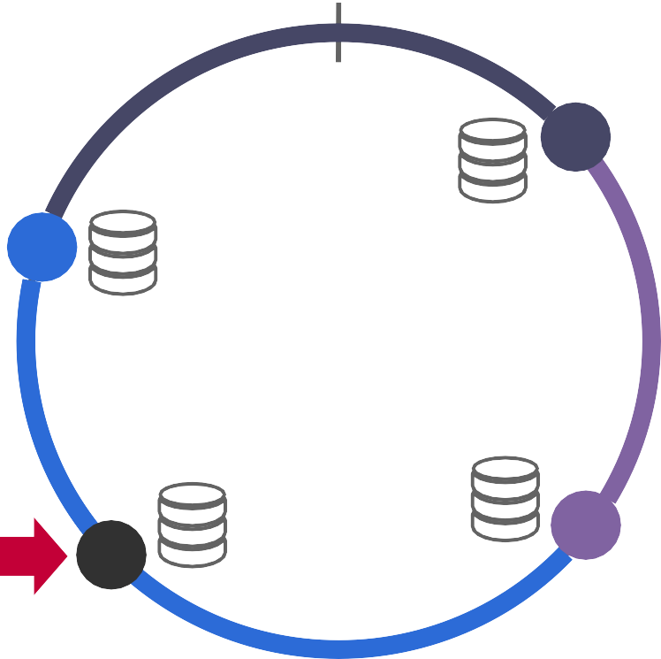
CONSISTENT HASHING
48
1 0
P1
P3
P2
New Partition
P4
0.5

Slide 34
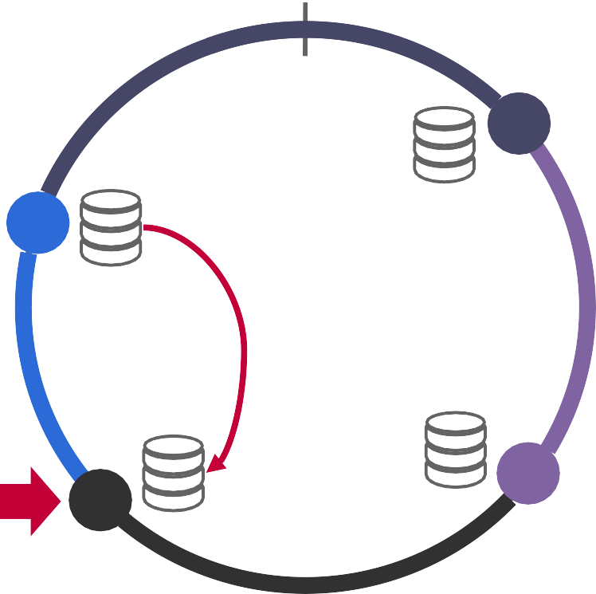
CONSISTENT HASHING
49
1 0
P1
P3
If hash(key)=P4
P2
New Partition
P4
0.5

Slide 35
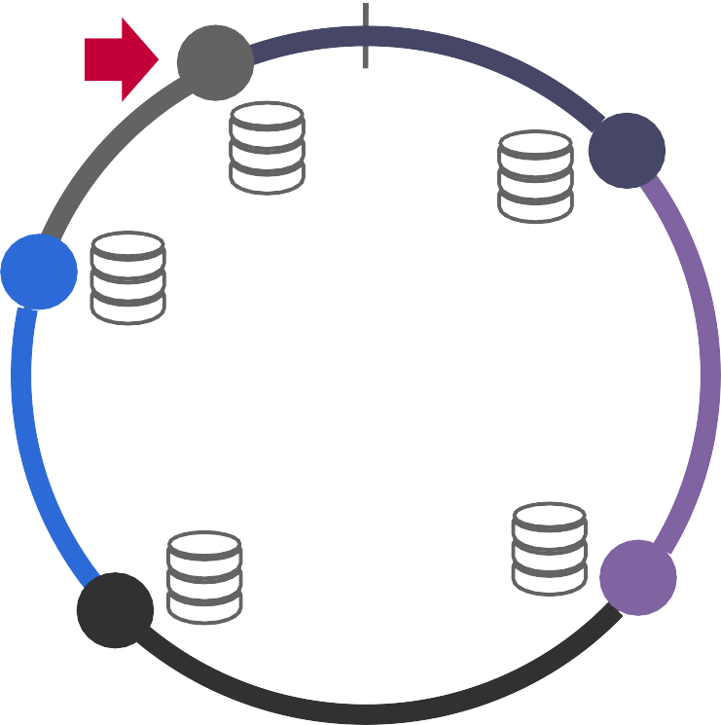
CONSISTENT HASHING
50
1 0
New Partition
P5
P1
P3
P2
P4
0.5

Slide 36
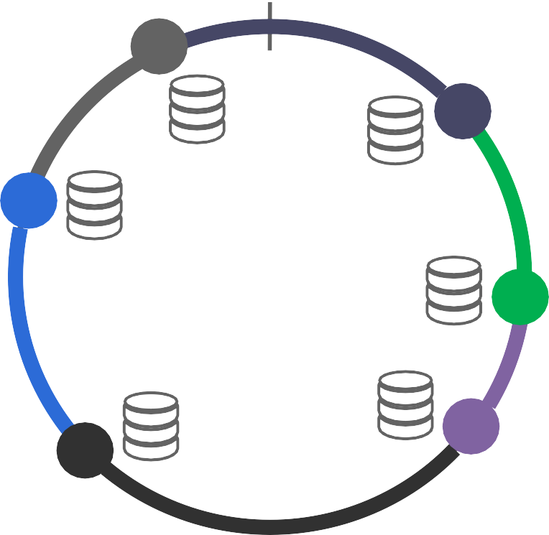
CONSISTENT HASHING
51
1 0
P5
P1
P3
P6
New Partition
P2
P4
0.5

Slide 37
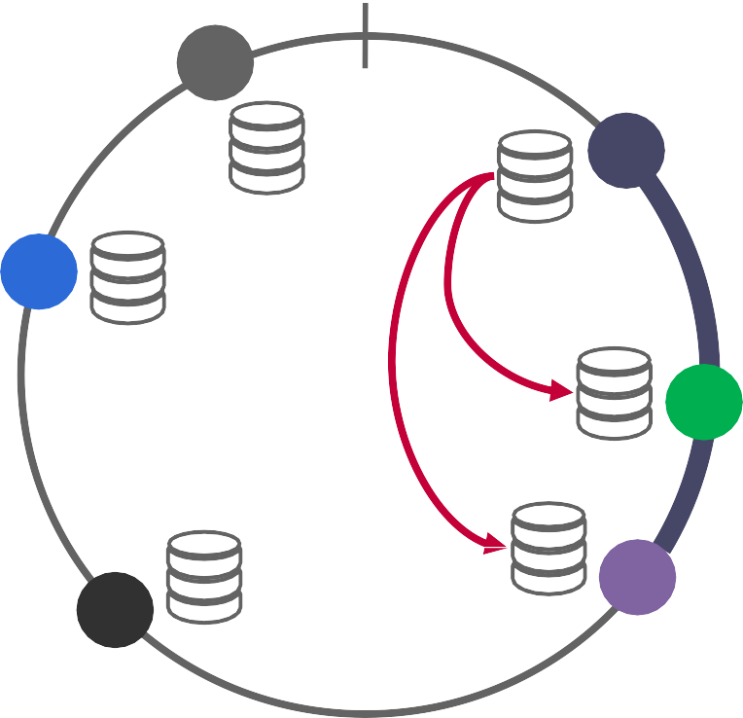
CONSISTENT HASHING
52
1 0
P5
Replication Factor = 3
P1
P3
P6
P2
P4
0.5
15-445/645 (Fall 2023)

Slide 38
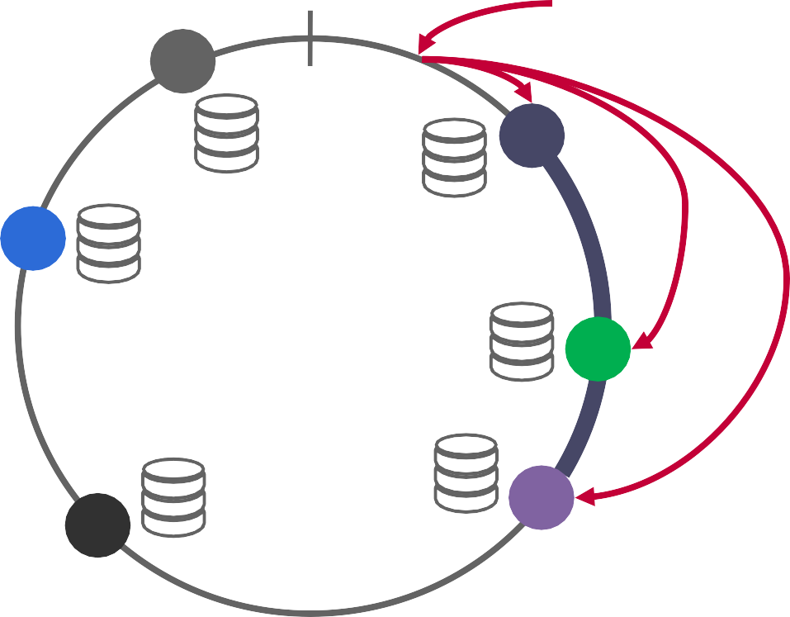
CONSISTENT HASHING
53
1 0
hash(key1)
Replication Factor = 3
P5
P1
P3
P6
P2
P4
0.5
15-445/645 (Fall 2023)

Slide 39







CONSISTENT HASHING
54
1 0
hash(key1)
Replication Factor = 3
P5
P1
P3
P6
P2
P4
0.5

Slide 40
Distributed ID generator
Functional Requirements
Each ID generated by the system must be unique across the entire distributed environment.
IDs should consist solely of numerical values
Each ID should fit into a 64-bit integer, which can store values up to approximately 9.22 × 10^18.
IDs should reflect the order of creation based on time, meaning newer IDs are larger than older ones.
The system must generate a large number of unique IDs efficiently, specifically at least 10,000 IDs per second.
Notes:
https://www.youtube.com/watch?v=N7BV_rRse30

Slide 41
Distributed ID generator
Nonfunctional Requirements
The ID generation system should scale effectively as the number of servers or data centers increases.
ID generation should be fast, with minimal delay to avoid becoming a bottleneck in the system.
The system should be reliable, with minimal risk of failure, even in the case of hardware or network issues.
The system should not rely on a central authority or server to generate IDs, reducing the risk of a single point of failure.
The design should be straightforward to implement and maintain, with clear procedures for handling system upgrades or scaling.
Notes:
https://www.youtube.com/watch?v=N7BV_rRse30

Slide 42
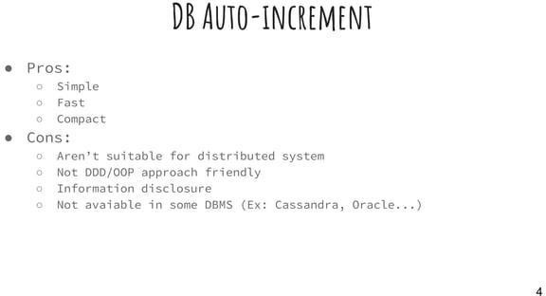

Slide 43
Distributed ID generator
Solution:
Ticket Server
Multi-master
UUID
ULID
Twitter snowflake
Notes:
https://www.youtube.com/watch?v=N7BV_rRse30

Slide 44
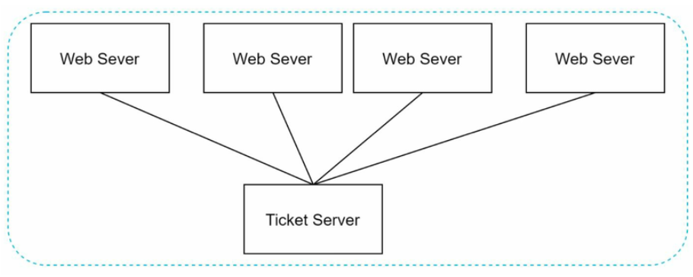
Distributed ID generator

Slide 45
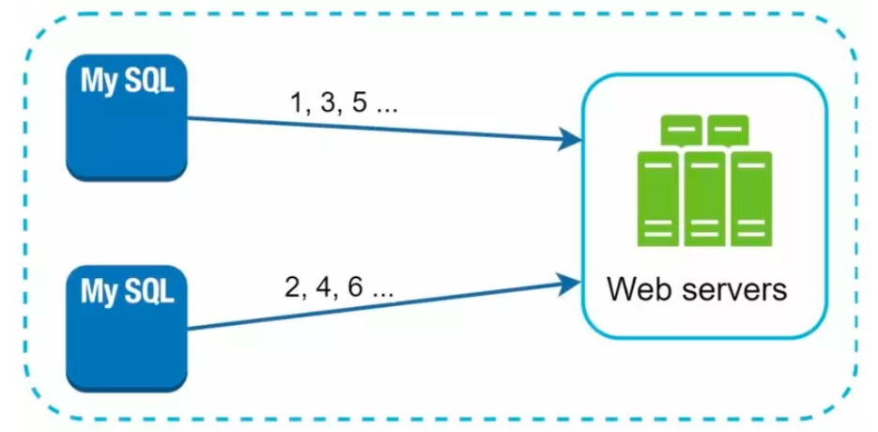
Distributed ID generator

Slide 46
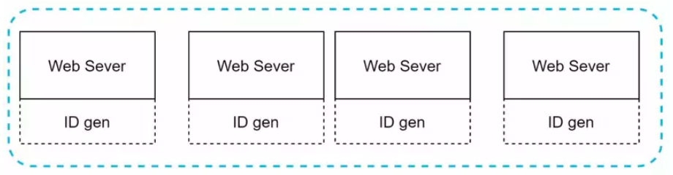
Distributed ID generator

Slide 47
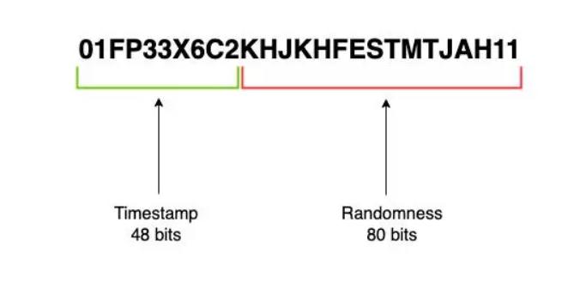
Distributed ID generator

Slide 48
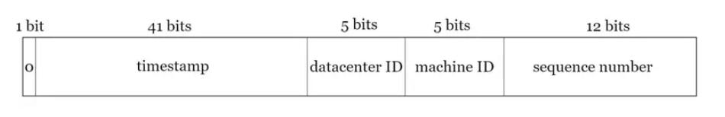
Snowflake ID
Sign Bit (1 bit): luôn là 0
Timestamp (41 bits): số milisecond kể từ Twitter epoch (mốc 2010-11-04).
Datacenter ID (5 bits): mã định danh cho datacenter. Giá trị được khởi tạo khi bắt đầu chạy trình Snowflake generator.
Machine ID (5 bits): mã định danh cho máy trong datacenter. Giá trị được khởi tạo khi bắt đầu chạy trình Snowflake generator.
Sequence Number (12 bits): Số đếm tăng dần cho các ID được sinh trong một mili giây. Số đếm này sẽ reset về 0 khi sang milisecond khác. Dùng để đảm bảo tính duy nhất trong một mili giây. Như vậy, 1 máy có sinh 2 ^ 12 (=4096) IDs trong vòng 1 mili giây.
Notes:
https://www.youtube.com/watch?v=N7BV_rRse30

Slide 49
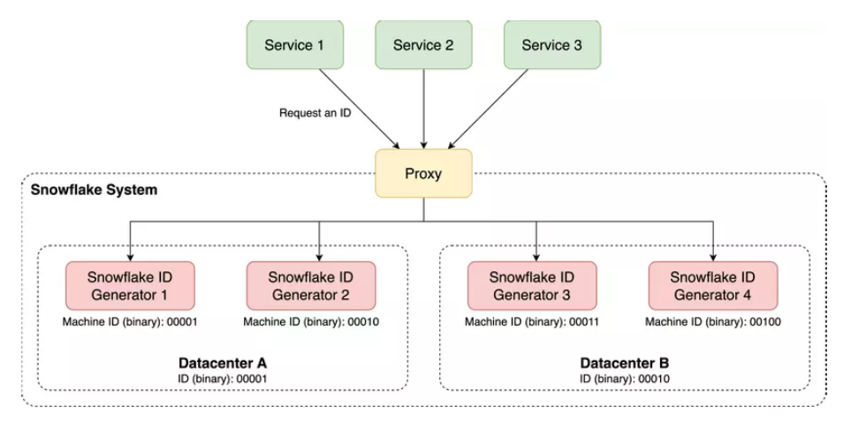
Distributed ID generator

