Slide 1
Cloud Providers

Slide 2
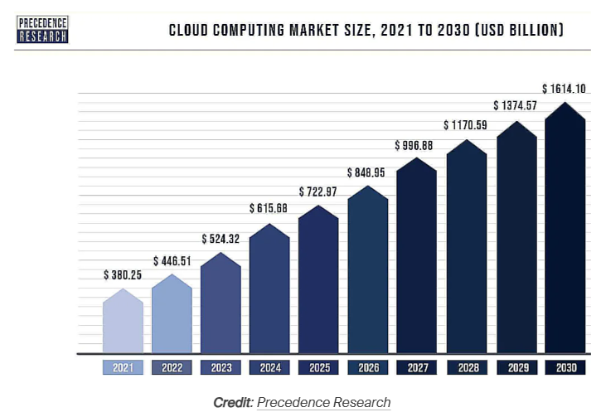

Slide 3
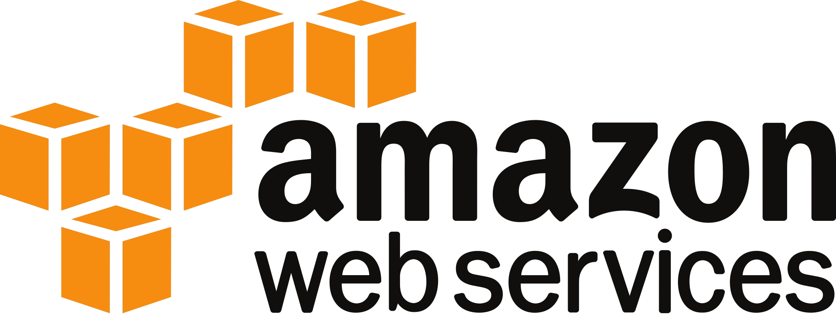
Amazon Web Services (AWS)
The largest by far of the public clouds
  You use it every day and don’t even know it
  Netflix, Reddit, Spotify, and millions others
When it goes down, the half of the internet goes down
  Example: The infamous S3 outage in February 2017

Slide 4
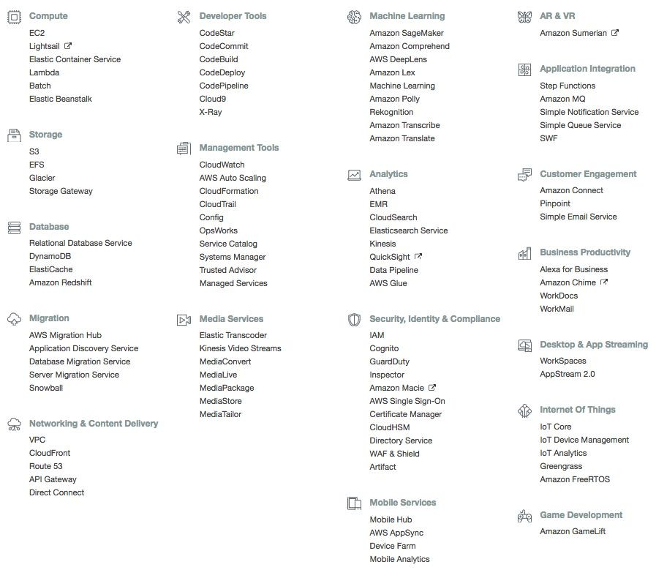
AWS Offerings

Slide 5
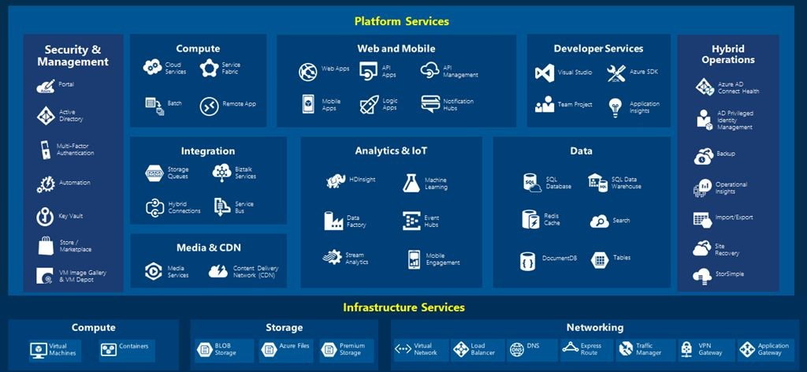
Azure Services

Slide 6
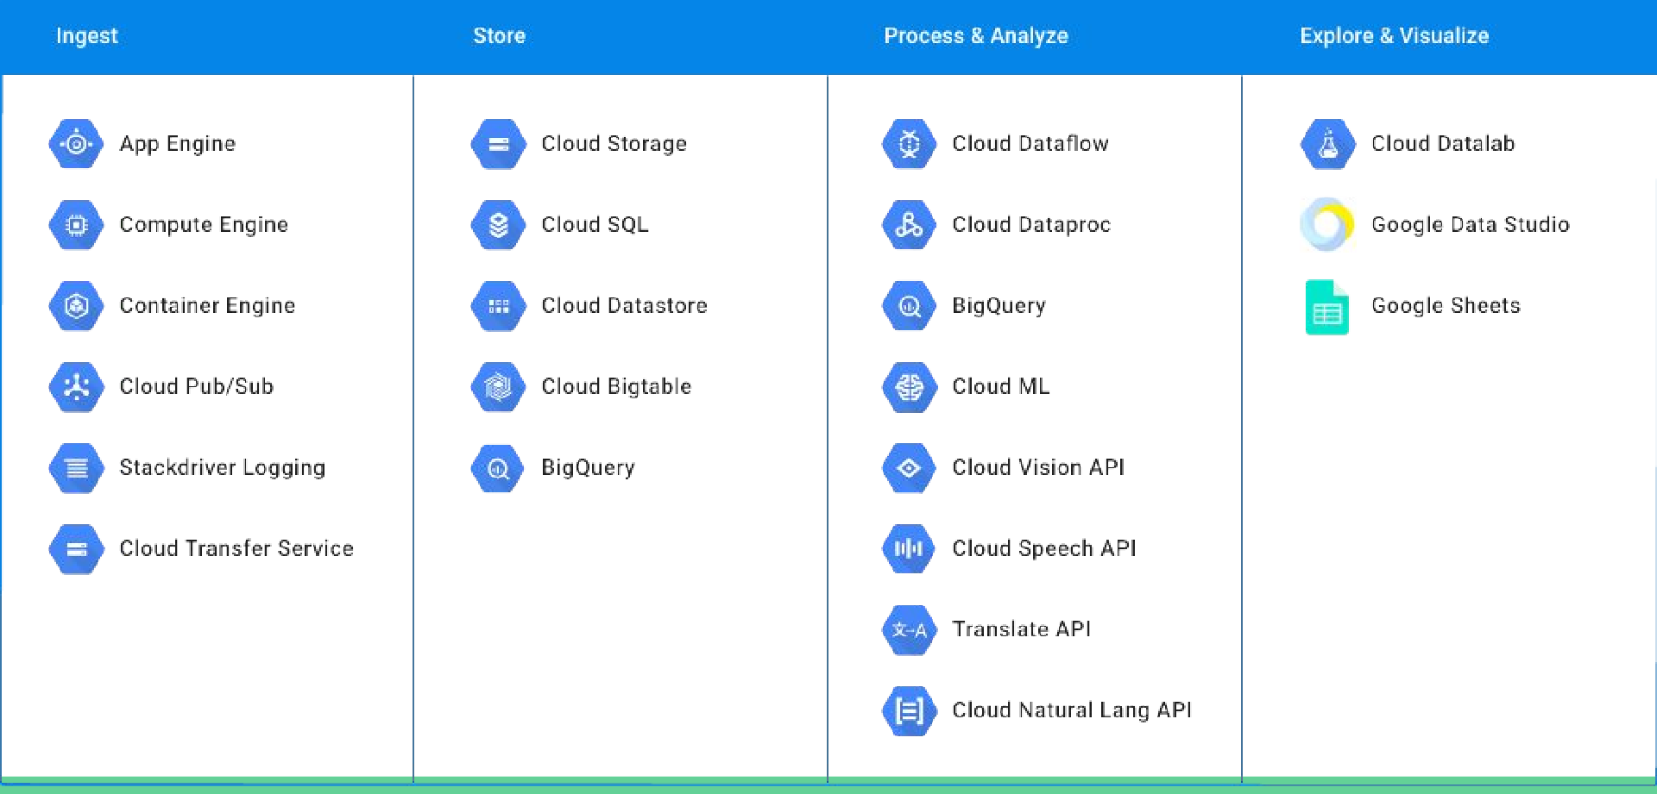
Google Cloud Platform

Slide 7
Feature Parity
All clouds try to compete on features so they all end up having extremely similar feature sets

Slide 8
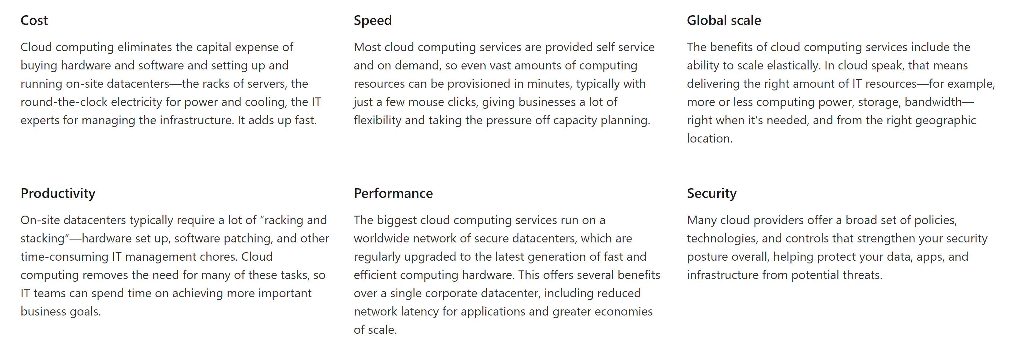
Top Benefits of Cloud Computing

Slide 9
Top Benefits of Cloud Computing
Public Cloud
Private Cloud
Hybrid Cloud
Owned and operated by third-party cloud service providers
Deliver computing resources like servers and storage over the internet
Owned exclusively by a single business or organization
Can be physically located on the company's on-site datacenter
Could also be hosted by a third-party service provider, but maintained by the organization on a private network
Somewhere in the middle of public and private
Bound by technologies that allows data and applications to be shared between them
Most flexible option as it allows for a broad range of deployment options
Most control over security and compliance

Slide 10
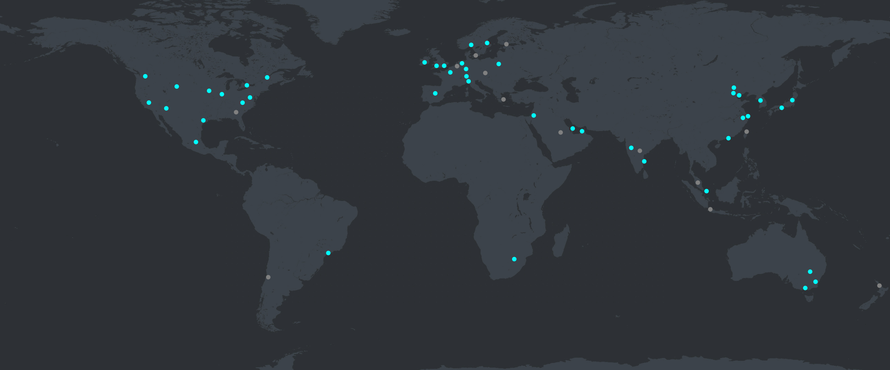
Azure Regions
60+ Azure Regions
https://datacenters.microsoft.com/globe/explore/

Slide 11
Reasons to Select a Region
Speed
  Pick a region that is the closest to you will help increase the speed of moving data in and out from your resources.
Cost
  You will face egress fees if you move data from one region to another. So, it's cheaper for you to have everything nearby.
  Some services are cheaper in certain regions over others. Using the Azure calculator can help you estimate the cost differences.
Available Resources
  Certain services are only available in certain regions. It might not be possible to have everything in the same place. (See Products by Region.)
Security and Compliance
  Depending on the scenario, a particular data center might need to be selected for security and compliance reasons. (Such as government or China)

Slide 12
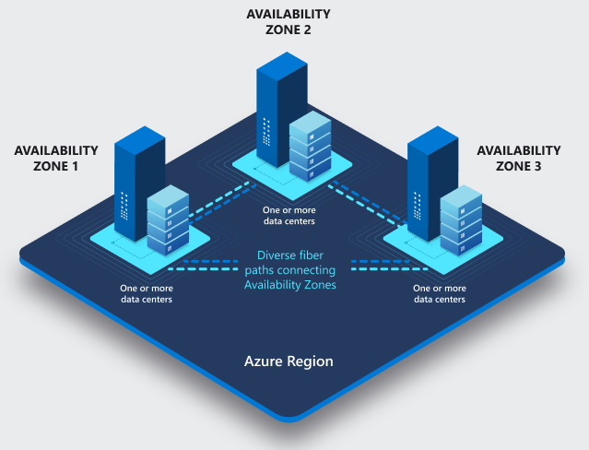
Availability Zones
Availability Zones
Physically separate locations within each Azure region that are tolerant to local failures (earthquakes, floods, fires, etc.)
Tolerance to failures is achieved because of redundancy and logical isolation of Azure services.
Azure availability zones are connected by a high-performance network with a round-trip latency of less than 2ms.

Slide 13
Available Service Categories
Available Service Categories
AI + Machine Learning
Analytics
Compute
Containers
Databases
Developer Tools
DevOps
Identity
Integration
Internet of Things
Management and Governance
Media
Migration
Mobile
Networking
Security
Storage
Web
https://azure.microsoft.com/en-us/services/

Slide 14
Virtual Machines

Slide 15
AWS Elastic Compute Cloud (EC2)
The basic one which all of these clouds provide are Virtual Machines
AWS has everything from the tiny to gigantic
  T2.Nano: 1 VCPU 512 MB Ram
  X1.32xlarge: 128 VCPU 2000 GB Ram
They have GPUS!
  Useful for deep learning
Priced per-second; Options for On-Demand and “Spot Instances”
  Spot instance: Auction for unused EC2 capacity; generally much cheaper than On-Demand
    Caveat: Your VM may be given a notice to shut down at any point

Slide 16
Azure Virtual Machines
Similar to AWS
GPUs
Not as many CPUs (Max is 32 currently)
Not as much ram (Max 800 GB currently)
But you probably will not hit these limits

Slide 17
Google Compute Engine
Provides VMs
Largest server is 96 VCPU, 624 GB Ram
Provides custom sized machines
Cost is per second

Slide 18
Storage

Slide 19
Storage
AWS Simple Storage Service (AWS S3)
  Massive storage, a ton of the internet stores all their content here.
    For example: Imgur
Google Cloud Storage
Azure Storage

Slide 20
Hosted Data Processing
Hosted Hadoop, Spark, HBase, Presto, Hive clusters
Performs all necessary cluster scaling / provisioning automatically
Amazon Elastic Map Reduce
Microsoft HDinsight
Google Dataproc

Slide 21
Databases
Let the clouds manage your database hosting
  Does create tables and stuff for you, just the stuff below it
AWS
  DyanamoDB
  Relational Database Server (RDS)
GCP
  BigTable
  BigQuery
  CloudSQL
  Spanner
Azure
  MSSQL
  DocumentDB

Slide 22
Unique Features
GCP
  CloudSpanner
    A planet distributed database
    CP System
  Tensor Processing Unit
    Do deep learning in hardware
AWS
  Absurdly large feature set
  FPGAs
Azure

Slide 23
Cloud Security

Slide 24
Cloud Security
Data Storage
  Regulatory Standards for confidential data.
  Compliance
Data Migration
  How to move sensitive data across data centers?
Cloud Permissions
  Easier permission setup within organizations
    Students don’t get sudo access!
DDoS Mitigation
  Fleet of cluster, network security, etc.
High Scalability
  Scale with security setting

Slide 25
