Slide 1
Infrastructure as Code

Slide 2
Problem Statement
Distributed applications…
  Are sensitive to how they are configured
    i.e. Needs of a database server will be different than an web server
  Are updated continuously
    New code and patches are deployed daily, if not hourly
  Will be operated by teams of humans
    i.e. Possibility of “operator error”
  Run on tens/hundreds/thousands of nodes

Slide 3
How do we deploy our Cloud infrastructure?
Approaches:
Setup everything manually!
  Does this scale? Clearly no.

Slide 4
How do we deploy our Cloud infrastructure?
Approaches:
Setup everything manually!
  Does this scale? Clearly no.
Custom scripts
  Use your cloud provider’s API to create machines
  Programmatically SSH into the machine to do tasks
  Does this scale? Maybe... but why reinvent the wheel?

Slide 5
How do we deploy our Cloud infrastructure?
Approaches:
Setup everything manually!
  Does this scale? Clearly no.
Custom scripts
  Use your cloud provider’s API to create machines
  Programmatically SSH into the machine to do tasks
  Does this scale? Maybe... but why reinvent the wheel?
Infrastructure as Code
  Declare your infrastructure setup in a specific format
  Your IaC framework deploys/updates your cloud infrastructure!
  Does this scale? Yes!

Slide 6
Infrastructure as Code Ideas
Approaches to “writing down” cloud configuration:
  Declarative: Define the target state of your cloud. What should the eventual cloud deployment look like?
  Imperative: Define how the configuration system should setup the cloud. How should the system deploy your application?
  Intelligent: Define relationships and constraints between services, and the system will figure out how and what to update.

Slide 7
Infrastructure as Code Ideas
Approaches to updating cloud configuration:
  Push: A central server tells child servers their configuration
  Pull: Child servers request configuration from a central server

Slide 8



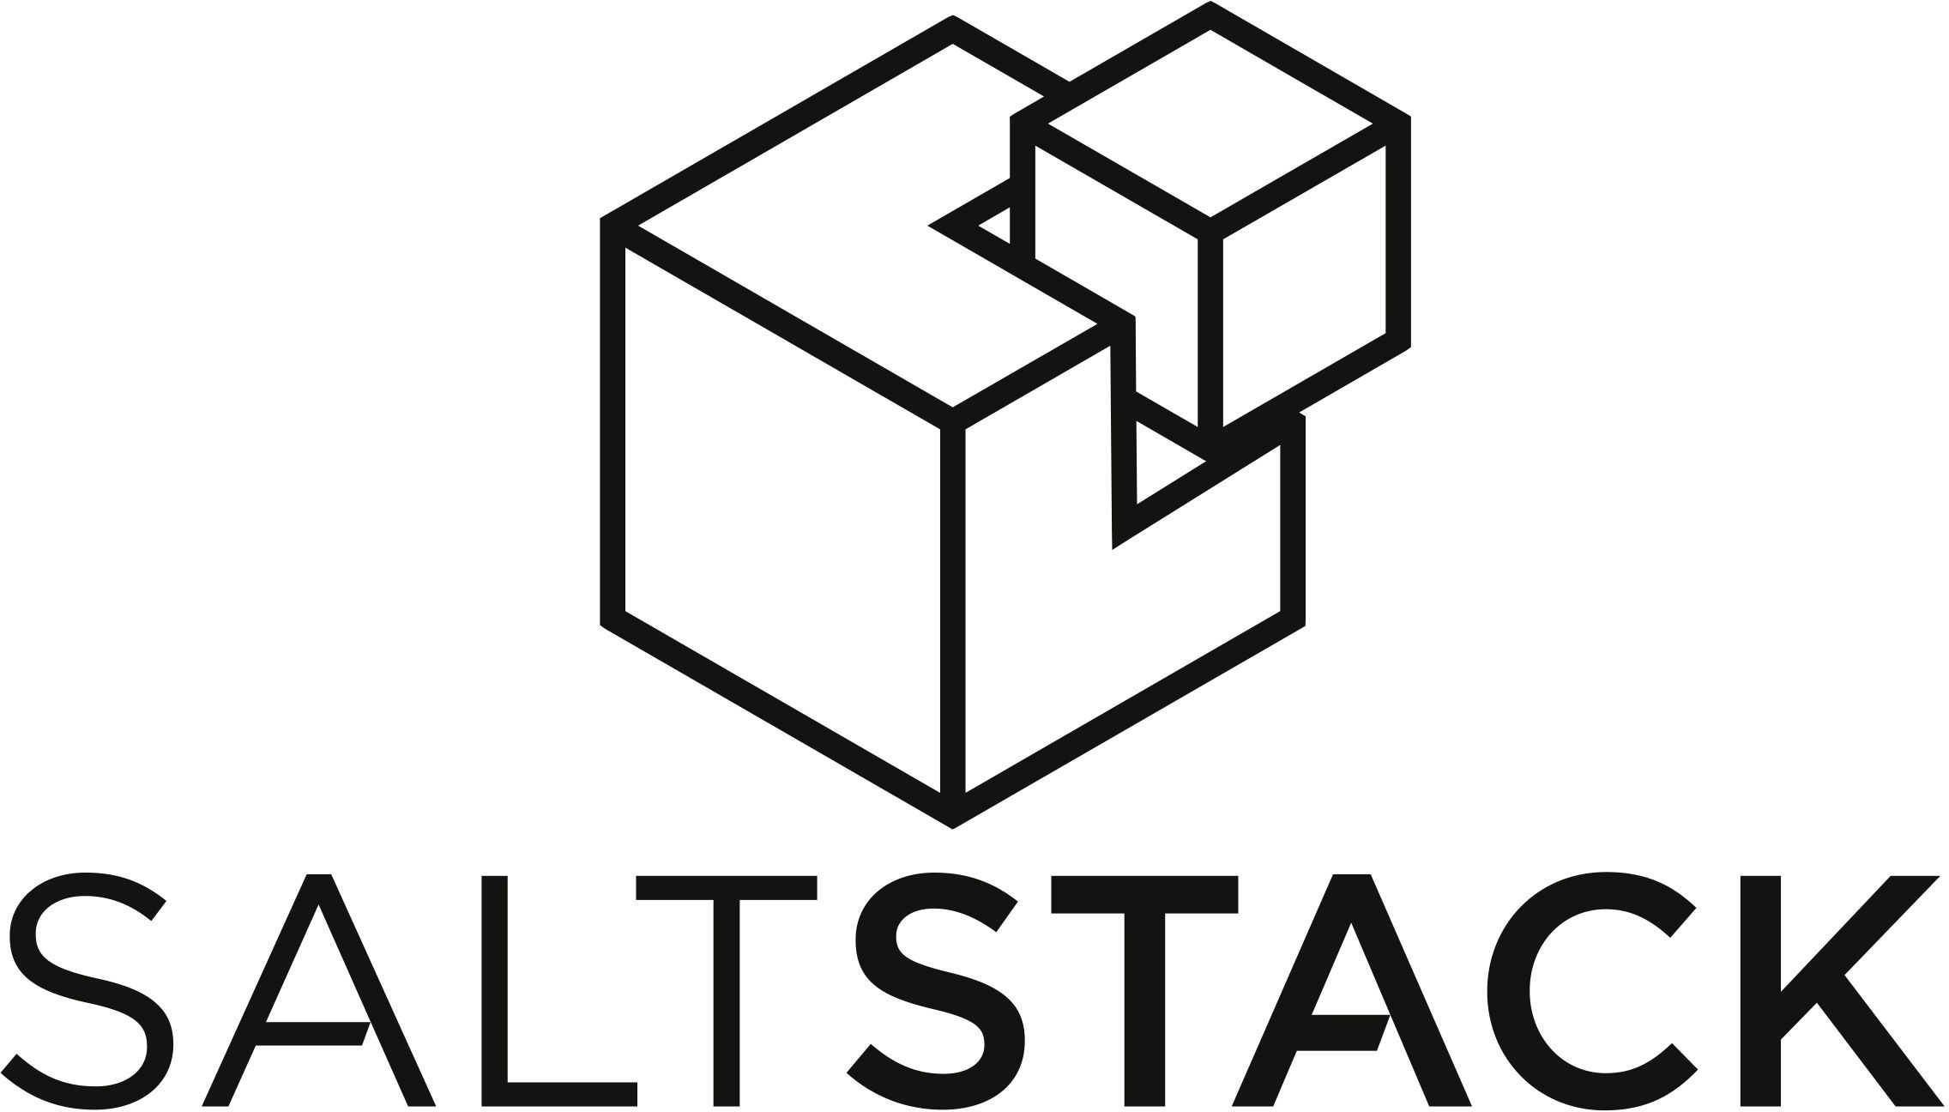

Infrastructure as Code Solutions
Ansible: Declarative/Imperative; Push
Puppet: Declarative; Pull
Chef: Imperative; Pull
Salt: Declarative
Terraform: Declarative/Intelligent; Push

Slide 9
Terraform
Created by HashiCorp; Open source
Cloud Platform Agnostic
  Support for AWS, GCP, Azure, Kubernetes, Heroku, and a bunch more
Stateful and environment aware
  Internal resource graph used to create cloud resources in the correct order
  Internal state and configuration can be easily version-controlled

Slide 10
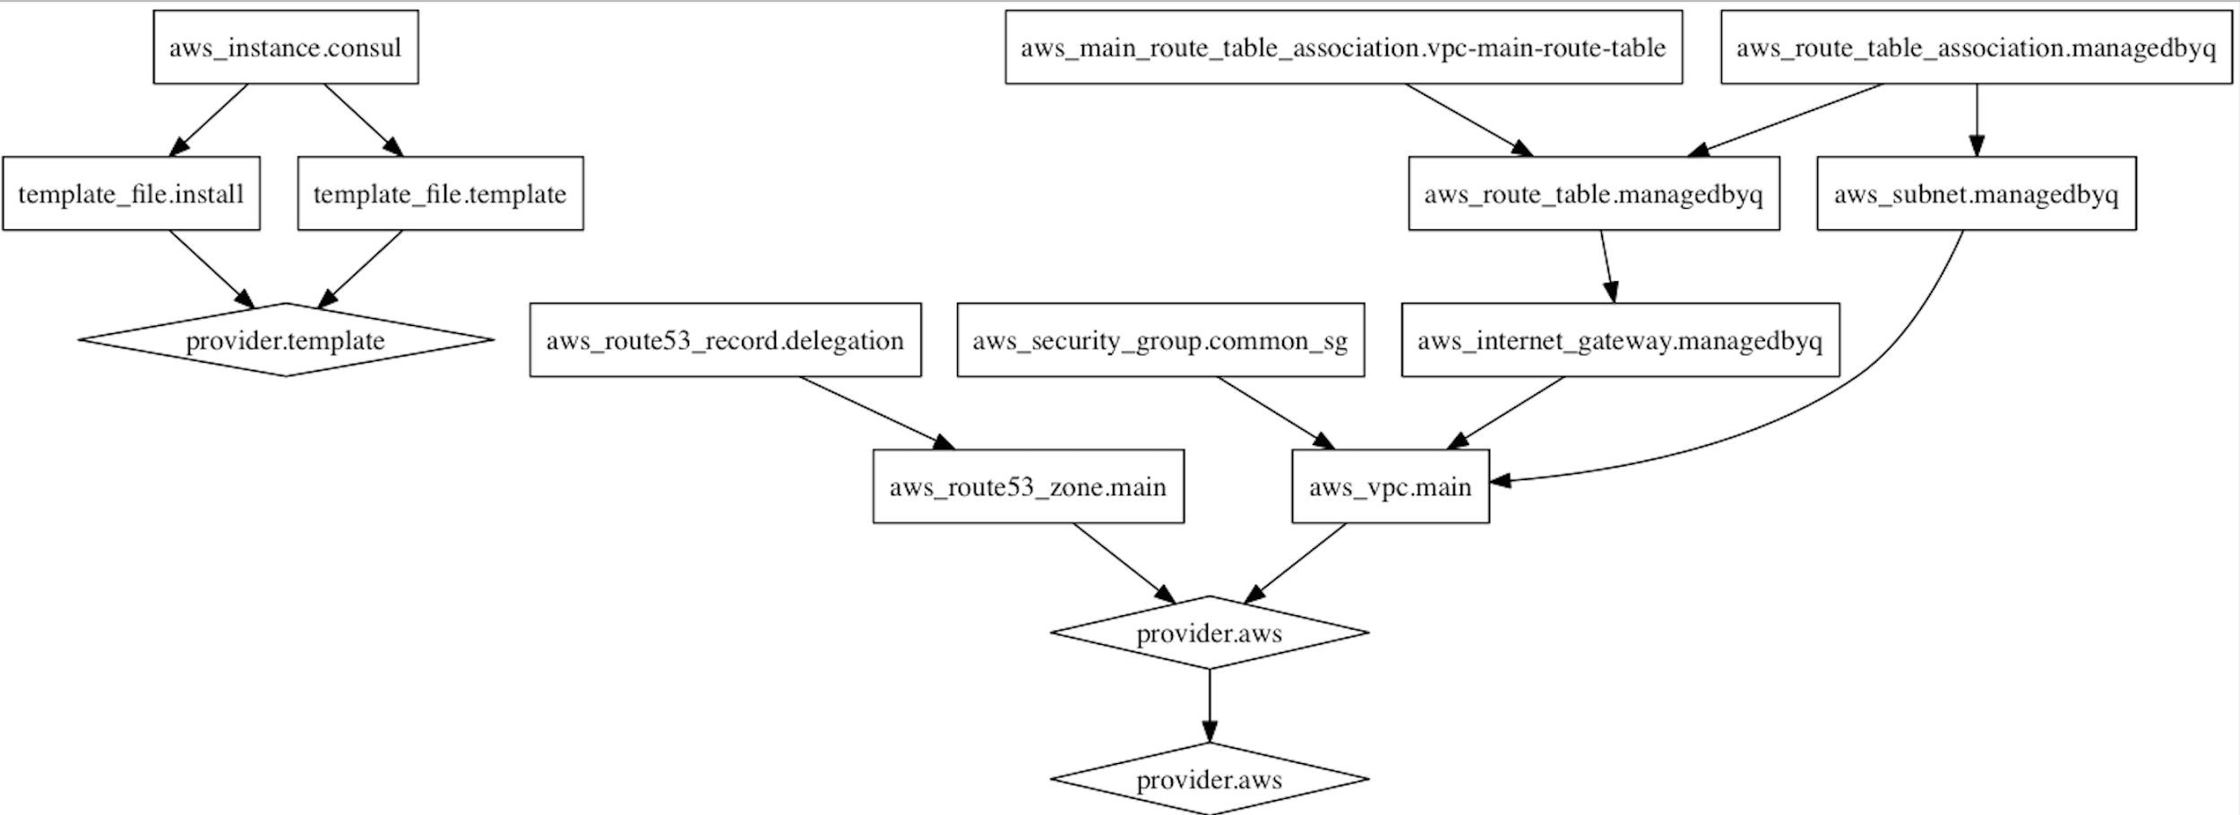
Terraform Resource Graph
https://github.com/hashicorp/terraform/issues/1997

Slide 11
Terraform Definitions
Provider:
  Interacts with a cloud service (i.e. GCP, AWS, Azure)
  Affects change in a cloud service (i.e. creating/destroying resources) using the service’s API
Resource:
  An infrastructure component
  i.e. VMs, Networks, Containers, Hard Drives, Storage Buckets

Slide 12
Terraform Modules
Terraform uses *.tf files for configuration
Common semantics:
  variables.tf
    Hold variables that may change over the lifetime of the configuration
    i.e. Instance sizing, database table names, etc.
  main.tf
    Import variables and any necessary modules.
  Others (i.e. ec2.tf)
    Service-specific configuration
    Usually 1-file-per-service (i.e. one for EC2, and another for DynamoDB)

Slide 13
Terraform Syntax
Basic configuration language that supports some interpolation, but is generally declarative
Useful to lookup and use examples
  Many open-source Terraform templates are available

Slide 14
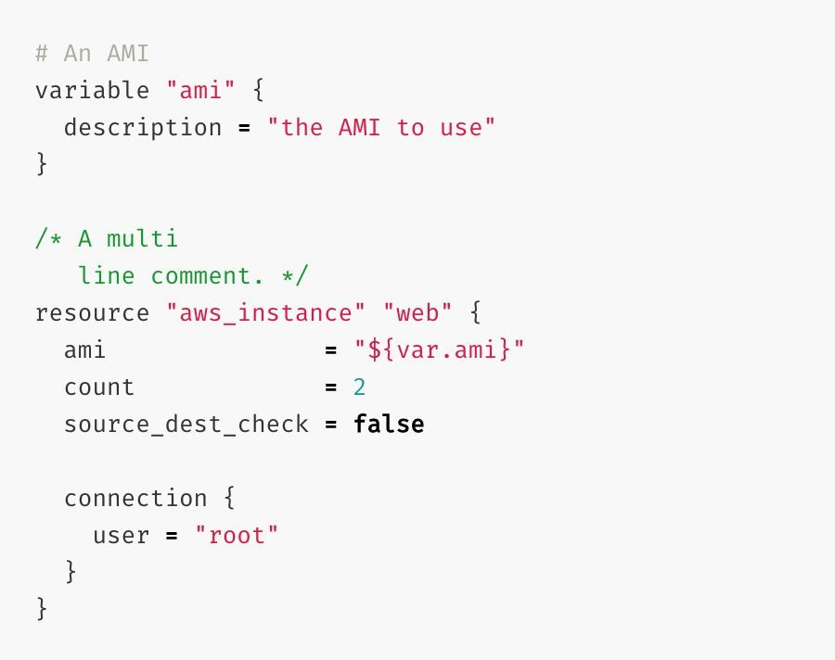
Terraform Syntax

Slide 15



Terraform Syntax
Variable
Resource
Variable Interpolation

Slide 16


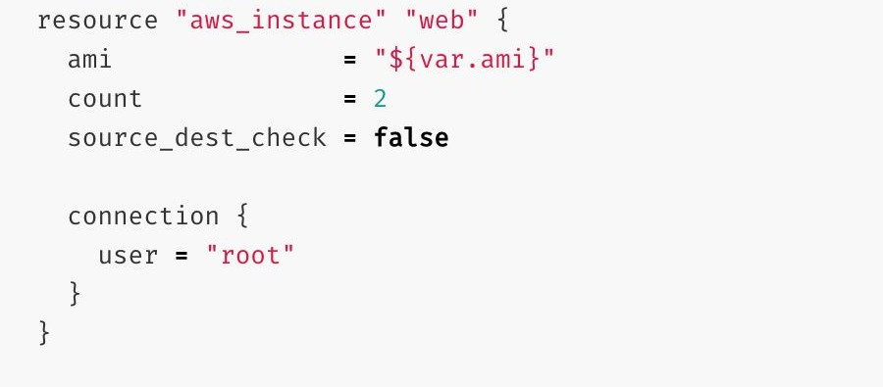
Terraform Syntax
Resource Type
(Defined by Provider)
Resource Name
(Defined by You)

Slide 17
Terraform Commands
terraform get
  Downloads and updates local terraform modules
terraform plan
  Creates an execution plan to transform the state in your cloud to the state of your current local configuration
terraform apply
  Runs the execution plan, and creates/updates/deletes resources in your cloud as necessary
  Can be a destructive action if you’re not careful!

Slide 18
Terraform Use Cases
Complex, Multi-Tiered Applications
  Terraform modules are easily composable into complex architectures
Temporary Environments
  Useful for creating staging/testing environments
  Can create identical infrastructure setup to production environment
Deploying Across Multiple Cloud Providers
  Terraform is platform agnostic
  Similar configurations can be automatically replicated across clouds

