Slide 1
Object-Oriented Programming CSE-703029
Faculty of Computer Science
Phenikaa University
Lecture 6: Interfaces and Inner Classes

Slide 2
Today’s Topics
Interfaces: the ultimate in [completely] abstract classes
Simulating multiple inheritance
“Stupid interface tricks”
Inner classes: named, anonymous, and static
The “callback” idea
Control frameworks

Slide 3
Interfaces
An interface is a “pure” abstract class.
The intent of an interface is to specify a set of methods that a concrete class will honor.
Class inherits interface is to implement interface.
New class can implement several interfaces.
Interfaces have no data members (except static final) or no method bodies.

Slide 4
Some Java Interfaces
EventListener
Methods: none
ActionListener extends EventListener
Methods: ActionPerformed()
Adjustable (java.awt.Adjustable)
Methods: get/setMaximum/Minimum(), getValue(), etc.
CharacterIterator
Methods: first(), last(), next()

Slide 5
Technical details
interface Animal{
public void animalSound();
}
class Dog implements Animal {
public void animalSound(){
System.out.println(“Dog is barking”);}
}
Use the interface keyword.
An interface usually sits in its own .java file.
Use public or nothing (making it friendly).
private and protected aren’t allowed. (no inheritance)
To implement, use a class with a keyword of implements
Interface methods are always public.

Slide 6
Node as an Interface
public interface Node {
void setChild(int position, Node n);
double eval();
String toString();
}
Note there is no constructor given.
The abstract keyword isn’t used for the methods.
The methods are automatically public.

Slide 7
Abstract class
Special type of Class, can not instantiate
Animal obj X new Animal();
Animal is abstract class
Type of Objects
At least One pure virtual function (function without implementation)
public void animalSound();

Slide 8
Binop Can Still be Abstract
public abstract class Binop implements Node {
protected Node lChild, rChild;
public Binop() {}
public Binop(Node l, Node r) {
lChild = l; rChild = r;
}
//Abstract class can have abstract and concrete methods
//concrete method
public void setChild(int position, Node n) {
if (position == 1)
lChild = n;
else
rChild = n;
}
}

Slide 9
 | Abstract Class | Interface
1 | Type of Objects | Set of behaviours
2 | Access modifiers: Public, Protected, and Private | Public
3 | A Class can inherit from One Abstract Class | A Class can implement multiple interfaces
4 | Have Abstract and Concrete Methods | Only Abstract Methods
5 | Can implement Interface | Can NOT implement Abstract Class
6 | Keywords: Extends | Keywords: implements
7 | Extend only One abstract class and implement multiple interfaces | Can implement multiple interfaces

Slide 10
Make Binop an Interface?
Binop currently has the implementation of setChild().
We would have to place copies of this code in all the classes that implemented Binop.
This is probably unwise (“inelegant and error-prone”).
Note that Node is still a type, so we use it just as before.

Slide 11
Java’s Comparable Interface
public class Student implements Comparable {
public Student(String name, float gpa) {
this.name = name;
this.gpa = gpa;
}
public Student() {}
//Object is the ancestor of every class
public int compareTo(Object o) {
//cast the correct type (Student)o
if ( ((Student)o).gpa < gpa ) return 1;
else if ( ((Student)o).gpa > gpa ) return -1;
else return 0;
}

Slide 12
Class Student (cont.)
// Can this equals() be improved and be consistent??
public boolean equals(Object o) {
//cast the correct type (Student)o
if (gpa == ((Student) o).gpa) return true;
else return false;
}
public String getName() { return name;}
public float getGpa() { return gpa;}
private String name;
private float gpa;
}

Slide 13
Using Class Student
public class TestStudent {
public static void main(String[] args) {
Student s1 = new Student("Fred", 3.0F);
Student s2 = new Student("Sam", 3.5F);
Student s3 = new Student("Steve", 2.1F);
if (s3.compareTo((Object)s2) < 0)
System.out.println(s3.getName() + " has a lower gpa than " + s2.getName());
//Set is an interface in Java ; TreeSet is its implementation
Set studentSet = new TreeSet();
//Method of set add(element)
studentSet.add(s1); studentSet.add(s2); studentSet.add(s3);
//Iterator interface access elements of Map, List, Set
Iterator i = studentSet.iterator();
//method of Iterator hasNext()
while(i.hasNext())
System.out.println( ((Student)i.next()).getName());
}
}

Slide 14
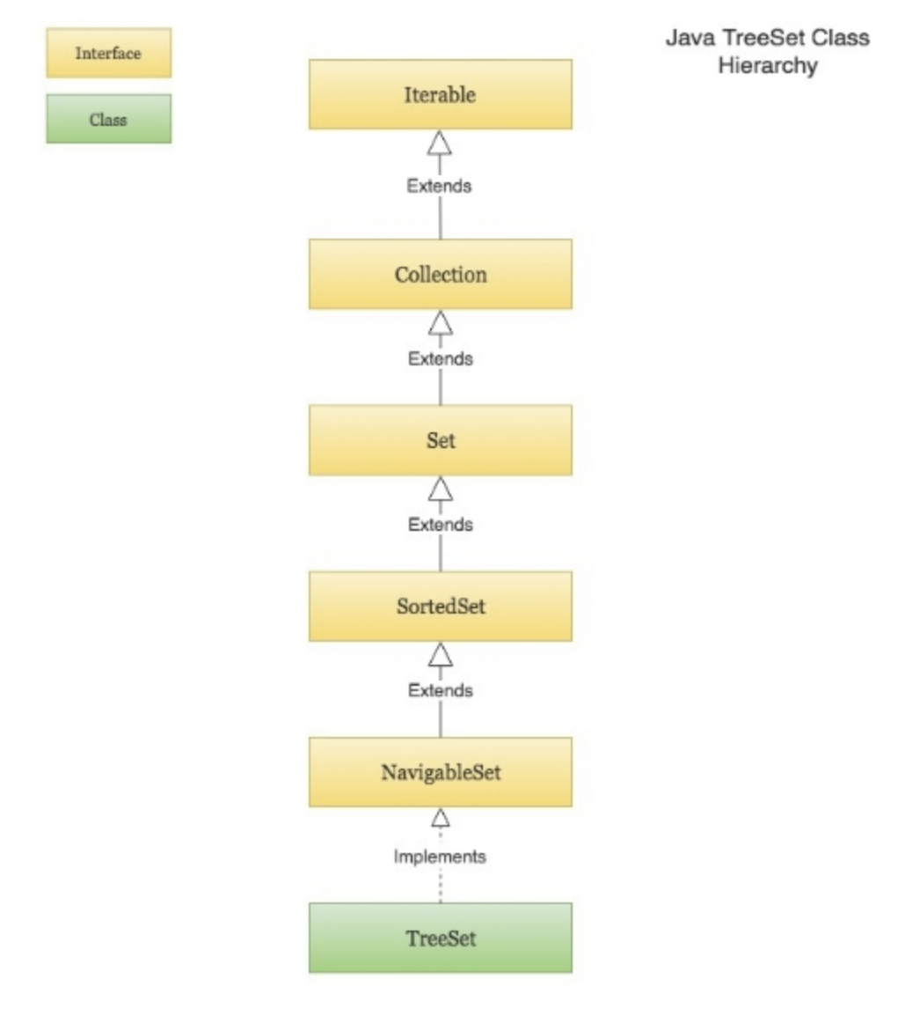

Slide 15
Interface and its implementation: Style of writing code in Java
Left: Declaring a variable the generic set interface
Right: Specific implementation
Set studentSet = new TreeSet();

Slide 16
Comparable and TreeSet
The Comparable interface specifies a single method, compareTo(Object).
It should be “consistent with equals()”, so I defined equals() accordingly. But was my equals() enough? No, see the notes for the last lecture!
Since Student implements Comparable, a “container class” like TreeSet knows how to use them (it stores them in order).

Slide 17
Other Interface Issues
You can inherit from an interface to create a new interface.
A single class can implement several interfaces simultaneously (Java’s version of multiple inheritance).
This is OK, since interfaces have no data or method code that could conflict.
You must watch out for method name clashes, though.

Slide 18
Example of a Name Collision
interface I1 { void f(); }
interface I2 { int f(int i); }
interface I3 { int f(); }
class C { public int f() { return 1; } }
class C2 implements I1, I2 {
public void f() {}
public int f(int i) { return 1; } //overloaded
}
class C3 extends C implements I2 {
public int f(int i) { return 1; } //overloaded
}
class C4 extends C implements I3 {
// identical, no problem
public int f() { return 1; }
}
public class Collision extends C implements I1 { }
f() in C cannot implement
f() in I1; attempting to use
incompatible return type

Slide 19
Inner Classes
It’s possible (and sometimes encouraged!) to define one class within another.
This provides another way to group classes that work closely together.
Inner classes can be “shielded” so that they are unknown to the outside world.
Often inner classes are used to hide a class-specific implementation of an external interface.

Slide 20
A Primitive Iterator
This provides a way to access elements in “container classes.”
If everyone uses the same interface, new container class types are interchangeable.
public interface Selector {
boolean end();
Object current();
void next();
}

Slide 21
A Primitive Container Class
public class Sequence {
private Object[] objects; //array of Object
private int next = 0;
public Sequence(int size) { objects = new Object[size]; }
public void add(Object x) { //x dont have length
if (next < objects.length) { objects[next] = x; next++} }
//inner class SSelector of Sequence
private class SSelector implements Selector {
//Selector is an interface
int i = 0;
public boolean end() { return i == objects.length }
public Object current() { return objects[i]; }
public void next() {if (i < objects.length) i++; }}
public Selector getSelector() { return new SSelector();}
}
}

Slide 22
Testing the Sequence Class
public class TestSequence {
public static void main(String[] args) {
Sequence s = new Sequence(10);
for (int i = 0; i < 10; i++)
s.add(Integer.toString(i));
//selector is interface
Selector sl = s.getSelector();
while(!sl.end()) {
System.out.println(sl.current());
sl.next();
}
}
}

Slide 23
Inner Class
//Outerclass
public class OuterClassTest {
int var1 ;
public class InnerClassTest {
public void InnerClassTest(){System.out.println(“var1”+this.var1)}
}
}
//Main
public static void main(String[] args) {
OuterClassTest oct= new OuterClassTest();
OuterClassTest.InnerClassTest ict = oct.new InnerClassTest();
System.out.println(ict);
}
}

Slide 24
Sequence and Selector
This is quite similar to Java’s use of Iterator
The inner class can
access the outer class (e.g., get at the array),
implement a public interface, and
remain private, and specialized.
We might write a tree-based container, using the same Selector interface.
It would be easy for clients to switch between the two, if necessary for performance reasons.

Slide 25
Sequence and Selector (cont.)
Sequence is pretty primitive, eh?
How would you improve it to
be more type-specific?
handle overflow more gracefully?
access specific elements directly?

Slide 26
More on Inner Classes
Look again at SSelector, for example the line return objects[i]; in the method current().
How does the SSelector object know which Sequence object it “belongs to”?
It holds a reference to the object that created it. The compiler takes care of these details.
You can get this reference by saying outerClass.this
You can’t create an inner class object unless you have an outer class object to start with, unless…

Slide 27
Static Inner Classes
You don’t need an object of the outer class type to create an object of a static inner class type.
You can’t access an outer class object with a static inner class type (there is no this).
A bottle of Rolling Rock to the first person providing a convincing example of where you’d want to do this!

Slide 28
Anonymous Inner Classes
If we never need to invoke the name of an inner class type, we can make the inner class anonymous.
This is a common idiom in Java, but somewhat confusing.
It is much used, for example, in GUI programming with Swing listener classes.

Slide 29
Anonymous Selector Subclass
public class Sequence {
:
public Selector getSelector() {
return new Selector() {
int i = 0;
public boolean end() {
return i == objects.length;
}
public Object current() {
return objects[i];
}
public void next() {
if (i < objects.length) i++;
}
};
}
}
This replaces the explicit
definition of SSelector,
whose name we never used.
Selector is an interface, but
this idea works with concrete
classes too.
SSelector is innerClass
Skip the name to Anonymous innerClass

Slide 30
Random Facts on Inner Classes
.class files are created, using the convention OuterClassName$InnerClassName.class
Anonymous inner classes are in files like OuterClassName$1
You can nest inner classes indefinitely, but things quickly become confusing.
You can have multiple inner classes implementing different interfaces.

Slide 31
Simple Callback Mechanism
interface Incrementable {
void increment();
}
public class Callee implements Incrementable {
private int i = 0;
public void increment() {
i++;
System.out.println("Callee increments i to " + i);
}
}

Slide 32
Simple Callback (cont.)
public class Caller {
private Incrementable callbackReference;
Caller(Incrementable cbr) {
callbackReference = cbr;
}
void go() {
callbackReference.increment();
}
}
public class TestCallback {
public static void main(String[] args) {
Callee callee = new Callee();
Caller caller = new Caller(callee);
caller.go();
}
}
Callback :
Incrementatble is implemented in Callee.
Caller call “Incrementable” back
Caller call Callee

Slide 33
Event-Driven Systems
Normally we write code with a specific sequence of message passing in mind.
Sometimes, though, the “outside world” has to determine the sequence of events:
responding to server hits
responding to external sensors
responding to UI activities

Slide 34
Event-Driven Systems (cont.)
Eckel’s simulation of an event-driven system illustrates this.
There is an Event interface with //Eckel’s built
a time to “fire”
a constructor
a ready() method to see if the Event should “fire”
an action() method performing the event’s responsibility
a description() method

Slide 35
The Event Class
public abstract class Event {
private long eventTime; // the time for this event to “fire”
public Event(long evtTime) {
eventTime = evtTime;
}
public boolean ready() { // is it time to “fire” yet?
return System.currentTimeMillis() >= eventTime;
}
abstract public void action(); // what to do when I “fire”
abstract public String description();
}

Slide 36
The EventSet Class
This holds an array of objects (pending Events), named events[].
Event events[] = new Event[100]
events[] elements refer to either an actual pending Event, or to null.
The getNext() method looks for a non-null Event in events[], and returns it if there is one. It returns null if there are no more events to process.
This is quite realistic in a GUI-based program.

Slide 37
The Class EventSet
public class EventSet {
private Event[] events = new Event[100];
private int index = 0; // index for inserting
private int next = 0; // next place to look
public void add(Event e) {
if (index >= events.length)
return; // Event e isn’t added! Bad!
events[index++] = e;
}
public void removeCurrent() {
events[next] = null; // mark for garbage collection
}

Slide 38
EventSet Structure
event[0]
index
event[99]
…
EventTime =
47470
null
EventTime =
28800
null

Slide 39
EventSet’s getNext() Method
// return the next pending Event, or null if no more Events
public Event getNext() {
boolean looped = false;
int start = next;
do { // look for a non-null
next = (next + 1) % events.length;
if (start == next)
looped = true;
if ((next == (start + 1) % events.length) && looped)
return null;
} while(events[next] == null);
return events[next];
}

Slide 40
Now The Controller Class
public class Controller {
private EventSet es = new EventSet();
public void addEvent(Event c) { es.add(c); }
public void run() {
Event e;
while ((e = es.getNext()) != null) {
if (e.ready()) {
e.action();
System.out.println(e.description());
es.removeCurrent();
}
}
}
}

Slide 41
Some Event Subclasses
private class StartStudying extends Event {
public StartStudying(long eventTime) {
super(eventTime);
}
public void action() {
studying = true;
}
public String description() {
return "Can't you see I'm studying Java?";
}
}

Slide 42
Some Event Subclasses
private class StopStudying extends Event {
public StopStudying(long eventTime) {
super(eventTime);
}
public void action() {
studying = false;
}
public String description() {
return "I'm sick of studying Java!";
}
}

Slide 43
Some Event Subclasses
private class StartSleeping extends Event {
public StartSleeping(long eventTime) {
super(eventTime);
}
public void action() {
sleeping = true;
}
public String description() {
return "Buzz off, I'm sleeping!";
}
}

Slide 44
Some Event Subclasses
private class StopSleeping extends Event {
public StopSleeping(long eventTime) {
super(eventTime);
}
public void action() {
sleeping = false;
}
public String description() {
return "I'm awake now, think I'll study Java.";
}
}

Slide 45
“Bootstrap” Some Events
private class AnotherWeekAtCMU extends Event {
public AnotherWeekAtCMU(long eventTime) {
super(eventTime);
}
public void action() {
//add event in Controller
long tm = System.currentTimeMillis();
addEvent(new StartSleeping(tm)); // Sunday at midnight
addEvent(new StopSleeping(tm + 28800)); // Monday at 8 am
addEvent(new StartStudying(tm + 28801));
addEvent(new StartEating(tm + 28860));
}
public String description() {
return "Starting another week at CMU";
}
}

Slide 46
Pull It All Together
public class LifeAtCMUControls extends Controller {
private boolean studying = false;
private boolean sleeping = false;
private boolean eating = false;
private boolean playing = false; // Jeez, what a life!
// All the previous classes go in here
public static void main(String[] args) {
LifeAtCMUControls life = new LifeAtCMUControls();
long tm = System.currentTimeMillis();
life.addEvent(life.new AnotherWeekAtCMU(tm));
life.run();
}
}

Slide 47
Callbacks
Suppose we want to implement Incrementable, yet derive from MyIncrement:
interface Incrementable {
void increment();
}
public class MyIncrement {
public void increment() {
System.out.println("MyIncrement increment operation");
}
}

Slide 48
A Callee Can “Leave a Message”
public class Callee extends MyIncrement {
private int i = 0;
private void incr() {
i++;
System.out.println("Callee i incremented to " + i);
}
private class Closure implements Incrementable {
public void increment() { incr(); }
}
Incrementable getCallbackReference() {
return new Closure();
}
}

Slide 49
A Caller Can “Call Back”
public class Caller {
private Incrementable callbackReference;
Caller(Incrementable cbr) {
callbackReference = cbr;
}
void go() {
callbackReference.increment();
}
}

Slide 50
It Works Like This
public class TestCallbacks {
public static void main(String[] args) {
Callee c = new Callee();
c.increment();
Caller caller = new Caller(c.getCallbackReference());
caller.go();
caller.go();
}
}

