Slide 1
Used Cars Price Prediction
Capstone Project by Noel Mathew

Slide 2
Project Overview
- Objective: Predict used car prices using machine learning to help Cars 4U a major player in the used car market in India
- Target Variable: Price
To come up with a pricing model for the used cars
- Methods: Data preprocessing, feature engineering, regression models

Slide 3
Dataset Snapshot
- Total rows: 7253
- Key features: Year, Kilometers_Driven, Fuel_Type, Transmission, Owner_Type, Mileage, Engine, Power, Seats, New_price
- Missing values:
- New Price: ~86% missing
- Price: ~17% missing
- Power, Engine, Seats also contain nulls

Slide 4
Univariate Analysis
- Skewed distributions observed in:
- Kilometers Driven – highly right
- Engine - right
- Power - right
- Price – highly right
- New Price – highly right
- Log transformation applied for normalization
Used it for KM and Price to make it normally distributed

Slide 5
skewness
Year : -0.8397050406997638
Kilometers_Driven : 3.832545848818344
Mileage : -0.43849302953596925
Engine : 1.413133430829896
Power : 1.9624262822569614
Seats : 1.9548877812669965
New_price : 4.128299677490268
Price is : 3.337576076530038

Slide 6
Categorical Insights
- Top cities: Mumbai (13.1%)
- Top fuel types: Diesel, Petrol
- Transmission: Manual (72%)
- Owner Type: First Owner (82%)

Slide 7
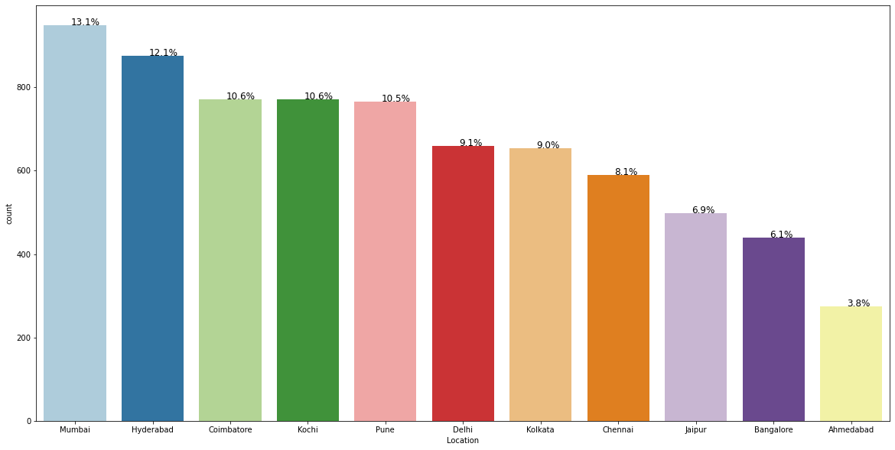
Graphs

Slide 8
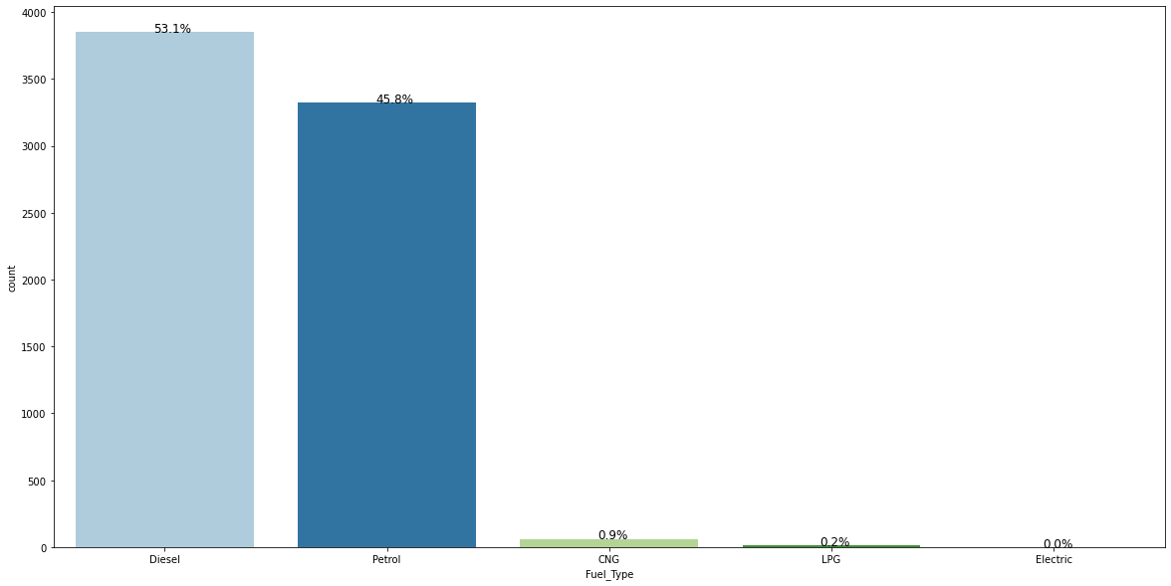

Slide 9
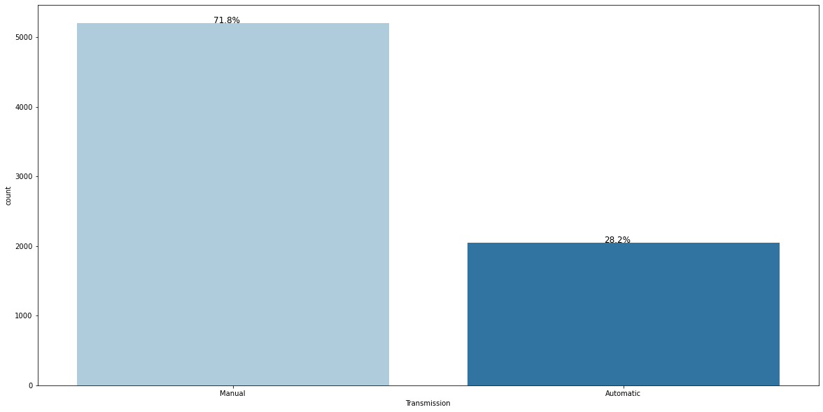

Slide 10
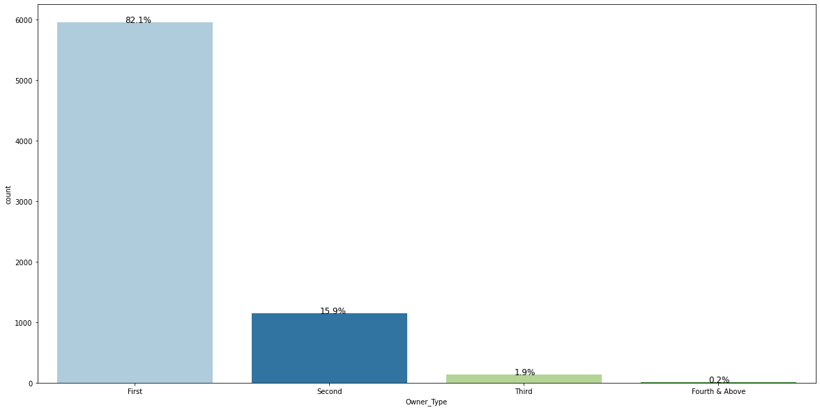

Slide 11
Bivariate Analysis
- Positive correlations between:
- Engine, Power, and Price
- Year and Price
Negative correlations
KM Driven, Mileage, and Price
- Boxplots reveal high-price clusters in Bangalore and Coimbatore

Slide 12
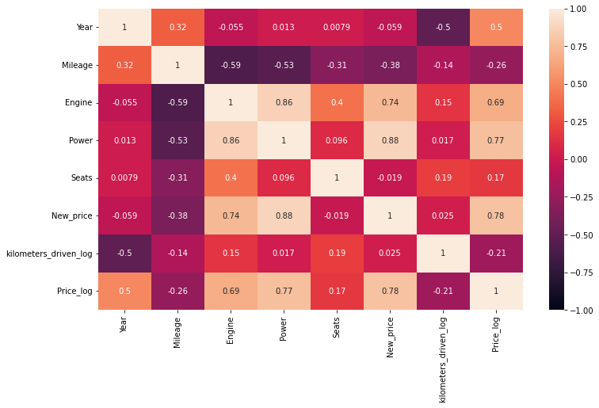
Graphs

Slide 13
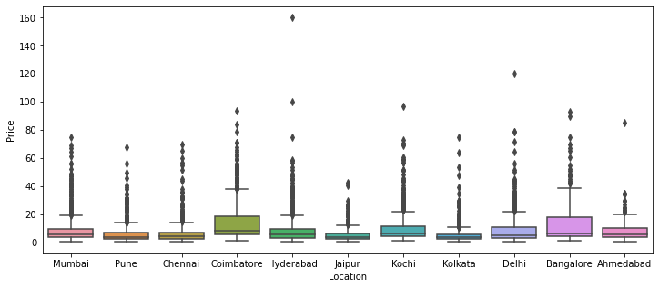

Slide 14
Feature Engineering
- Extracted brand from `Name` column
- Transformed skewed numeric features:
Price, km_driven
Filled in missing values with median values
Seats, engine, mileage, power, new_price
Dropped highly missing or unhelpful feature
i.e. new_price which was missing 6/7 values

Slide 15
Model Building
- Data split: Train/Test
- Encoded categorical variables
- Regression models used:
- Linear, Ridge, Lasso
- Decision Tree
- Random Forest (tuned)

Slide 16
Model Performance
- Evaluation metrics:
- RMSE and R² on train/test sets
- Top performing model: Random Forest
Similar values on RSME and R2 for both train and test

Slide 17
Model | Train_r2 | Test_r2 | Train_RMSE | Test_RMSE
0 | Linear Regression | 0.900448 | 0.783791 | 4.894581e+00 | 5.115314
1 | OLS model | 0.851201 | 0.684998 | 5.983998e+00 | 6.174364
2 | Ridge | 0.901957 | 0.829453 | 4.857342e+00 | 4.543158
3 | Lasso | 0.177724 | -0.113800 | 1.406695e+01 | 11.610183
4 | Decision Tree | 1.000000 | 0.895822 | 4.045390e-15 | 3.550778
5 | Random forest | 0.980143 | 0.959706 | 2.185988e+00 | 2.208283
6 | Tuned Decision Tree | 0.857945 | 0.880357 | 5.846828e+00 | 3.805213
7 | Tuned Random forest | 0.894260 | 0.936838 | 5.044417e+00 | 2.764804

Slide 18
Key Takeaways
- Data normalization critical due to skewed features
- Feature engineering boosted model accuracy
- Top price influencers:
New_Price 80% of influence
Log of Km driven and Year had some influence
Brand is Porsche had influence
- Future Work: Handle missing values better, explore deep learning models

