Slide 1
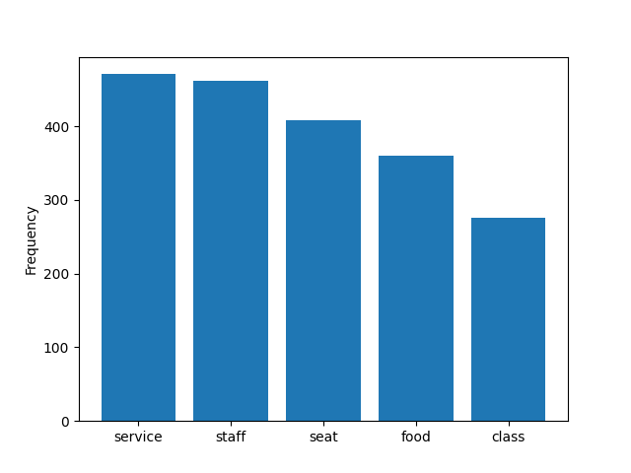
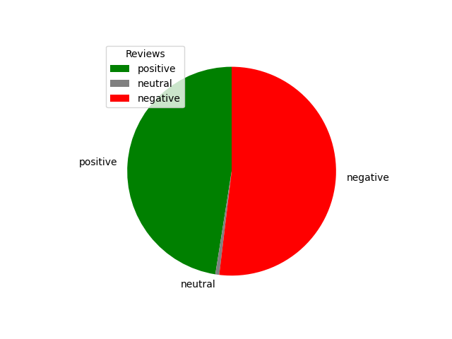
REVIEW ANALYSIS
Key topics
The frequency chart below illustrates that the key topics with the reviews include “service”, “staff”, “seat”, “food” and “class”, showing that people are actively arguing about their flight experience.
Sentiment
Out of 1000 reviews, 475 were positive, 6 were neutral and 519 were negative. This means the majority of reviews were polarise as either positive or negative.

Slide 2
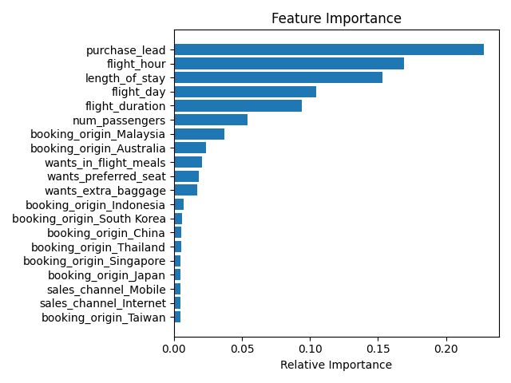
CUSTOMER PREDICTION
Evaluation
The most important variable in the model was purchase_lead, that is the time between purchase and departure.
Information about the flight, e.g. flight time and duration was also significant, however booking origin of the customer was not important.
Accuracy: 0.85, Precision: 0.51, Recall: 0.11 and F1_score: 0.18, showing that this model requires more improvement. I suggest adding more customer-centric features into the model.

