Slide 1
Keras

Slide 2
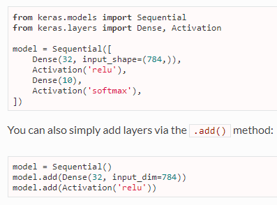
Sequential Model
Batch size
Input Dimension

Slide 3
