Slide 1

Network Analytics : Intrusion Detection using Machine Learning

Slide 2
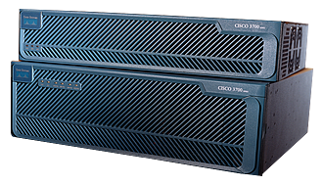

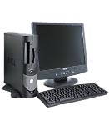


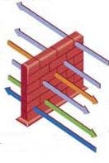



Intrusion Detection System(IDS)
Combination of software and hardware that attempts to perform intrusion detection
Raise the alarm when possible intrusion or suspicious patterns are observed
IDS
The Internet
Intrusion
Intrusion
Attacker
Firewall
IDS
Internal Network

Slide 3
Why we need IDS?
Unknown weakness or bugs
Complex, unforeseen attacks
Firewalls, security policies
Using information detected
Recover compromised system
Understand the attack mechanism
Detect novel attacks
Defend our systems

Slide 4
Types of IDS
These are the main types of Intrusion Detection Systems:
• Host Based • Network Based • Stack Based • Signature Based • Anomaly Based

Slide 5
KDD Cup 99 Data Set
Modification of DARPA 1998 data set
DARPA 1998 data set
Managed by Lincoln Lab.(under DARPA sponsorship)
Simulated nine weeks of raw TCP dump data
Attacks
38 different attacks against Unix/Linux machines
DoS, Scan, Buffer overflow and so on.
Normal traffic
1000’s of virtual hosts and 100’s of user automata

Slide 6
KDD Cup 99 Data Set
Each connection ⇒ 41-dimensions vector
Samples
5,tcp,smtp,SF,959,337,0,0,0,0,0,1,0,0,0,0,0,0,0,0,0,0,1,1,0.00,0.00,0.00,0.00,1.00,
0.00,0.00,144,192,0.70,0.02,0.01,0.01,0.00,0.00,0.00,0.00,normal
0,tcp,http,SF,54540,8314,0,0,0,2,0,1,1,0,0,0,0,0,0,0,0,0,2,2,0.00,0.00,0.00,0.00,1.0
0,0.00,0.00,118,118,1.00,0.00,0.01,0.00,0.00,0.00,0.02,0.02,back.
Numerical: 34, Categorical: 7
Basic feature： “duration”, “protocol”…
Statistical feature： “number of connections to the same host as the current connection in the past two seconds”…
Label ⇒ “normal” or “name of attacks”

Slide 7
FLOW:
Pre-processing of data in R
Pre-processing of data in Azure ML
Filter-based Feature Selection
Model Selection
Build website for ML as a Service
Deploy the selected model
Build system for selected model
Tune Model Parameters

Slide 8
Data pre-processing in R
Assign column values to the dataset
Transformation of labels into binomial classes

Slide 9
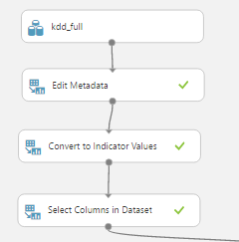
Data pre-processing in Azure ML
Store the Training and testing data in the Azure cloud storage
Specify the categorical variables by editing the metadata
Convert the categorical variables into dummy numerical variables

Slide 10
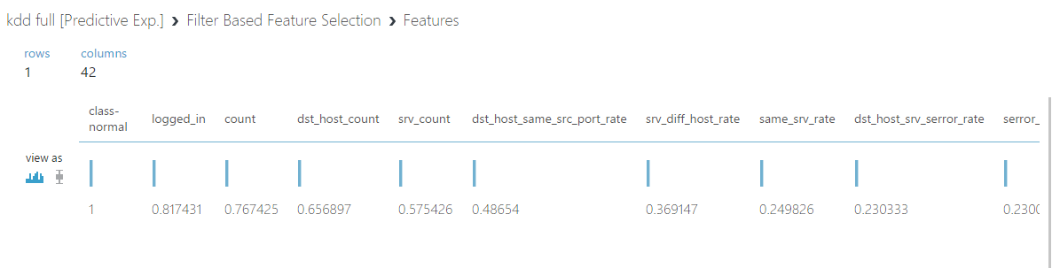
Filter-based feature selection
Total number of features = 41
Selected number of features = 15
Method used = Pearson Correlation

Slide 11
Model Selection
We need both accuracy and good response time!
Evaluated different models on 10% data and then evaluated each of them.
Model | Accuracy (AUC)
Logistic Regression | 0.995634
Boosted Decision Tree | 0.999093
Neural Network | 0.996295
Support Vector Machines | 0.994526

Slide 12
Tune Model hyper parameters
The model's hyper parameters are the settings and values you use when configuring and testing the model, with the aim of finding the best combination.
You get an accuracy report describing the different models that were created and their parameters, plus a trained model that you can save for re-use.

Slide 13
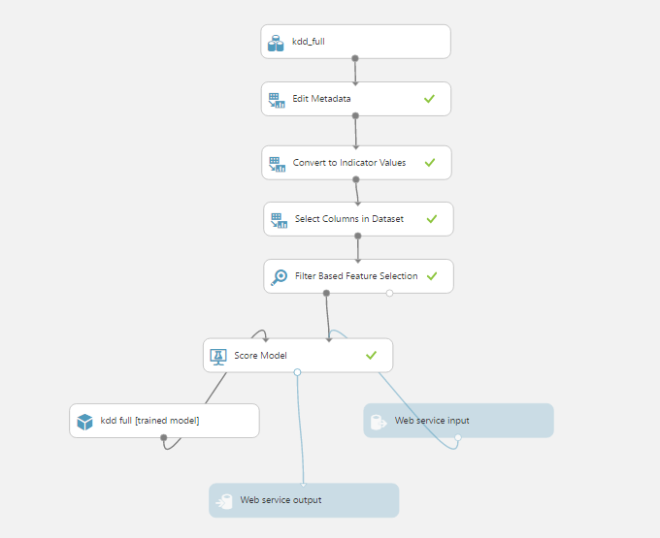
Build System for selected model
Boosted Decision Tree – For its high accuracy and good response time
Train the data 100% of the training data
Build and Deploy the model as a web service

Slide 14
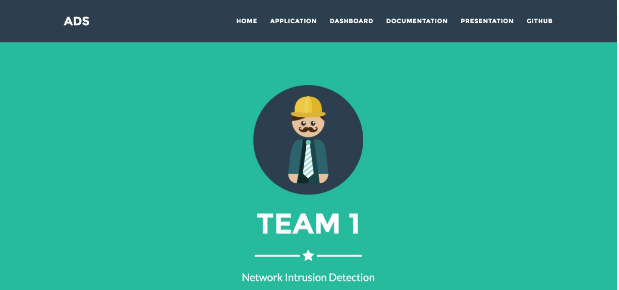
Place your screenshot here
Machine Learning as a Service
Frontend : HTML5, CSS3, Bootstrap, jQuery
Backend : Python Flask
DEMO!

Slide 15
Thank you!!

