Slide 1
HELLO EVERYBODY

Slide 2
[DOTNETVN]
BUILD A SIMPLE WEB API USES ASPNET CORE 2.0
ASPNET CORE 2.0
MSSQL Server
Entity Framework

Slide 3
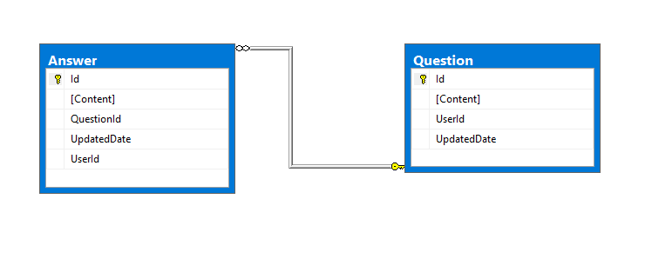
Database

Slide 4
Methods need to build in this demo (CRUD)
No | Route | Request Body | Method
1 | /api/question | N/A | GET
2 | /api/question/{id} | N/A | GET
3 | /api/question | A new question item | POST
4 | /api/question/{id} | An existed question item | PUT
5 | /api/question/{id} | N/A | DELETE

Slide 5
CREATE DATABASE
1. In this demo we use Microsoft SQL Server
2. Create 2 tables follow to data structure in slide 2
3. Open project which attached then run the dbscript.sql file

Slide 6
Create New Project
1. Install Visual Studio 2017
2. Install .Net core: https://www.microsoft.com/net/download/windows
3. Open Visual Studio 2017 => File => new project => ASP.NET Core Web Application => Web API

Slide 7
Work With Entity Framework CORE
1. Setup database Connect String: => open project => find to appsettings.json file
2. Create Model Classes
- Class Question which will be mapped to Question table
- Class Answer which will be mapped to Answer table
=> Put all of them in “Models” folder
3. Create DbContext Class with name QuestionDbContext
Try to make familiar with basic structure of DbContext Class
Ref Link for you: http://www.entityframeworktutorial.net/efcore/entity-framework-core.aspx

Slide 8
public class QuestionDbContext : DbContext
{
public QuestionDbContext(DbContextOptions<QuestionDbContext> options)
: base(options)
{
}
public DbSet<Question> Questions { get; set; }
public DbSet<Answer> Answers { get; set; }
protected override void OnModelCreating(ModelBuilder modelBuilder)
{
modelBuilder.Entity<Question>().ToTable("Question");
modelBuilder.Entity<Answer>().ToTable("Answer");
}
}

Slide 9
Register QuestionDbContext to ServiceCollection
1. Open Startup.cs file
Inside ConfigureServices function add line as below:
services.AddDbContext<QuestionDbContext> ( options =>options.
UseSqlServer(Configuration.GetConnectionString("question")), ServiceLifetime.Scoped);

Slide 10

Create QuestionController
1. Create a controller and set name to QuestionController
2. Define route attribute for QuestionController
Use attribute “Route”: [Route(template)]

Slide 11
Build CRUD Methods
Open source code for more details
1. Get all method
/// <summary>
/// Get all questions
/// </summary>
/// <returns></returns>
[HttpGet]
public async Task<IEnumerable<Question>> Get()
{
//TODO
}

Slide 12
2. Get detail
/// <summary>
/// Get a question by id
/// </summary>
/// <param name="id"></param>
/// <returns></returns>
[HttpGet("{id}")]
public async Task<IActionResult> Get(int id)
{
//TODO
}

Slide 13
3. Create new question
/// <summary>
/// POST api/question
/// </summary>
/// <param name="value"></param>
[HttpPost]
public async Task<IActionResult> Post([FromBody] Question item)
{
//TODO
}

Slide 14
4. Update an existed question
/// <summary>
/// PUT api/question/id
/// </summary>
/// <param name="id"></param>
/// <param name="value"></param>
[HttpPut("{id}")]
public async Task<IActionResult> Put(int id, [FromBody] Question item)
{
//TODO
}

Slide 15
5. Delete a question
/// <summary>
/// DELETE api/question/id
/// </summary>
/// <param name="id"></param>
[HttpDelete("{id}")]
public async Task<IActionResult> Delete(int id)
{
//TODO
}

Slide 16
THANKS
AND
HAPPY CODING ☺

