Slide 1
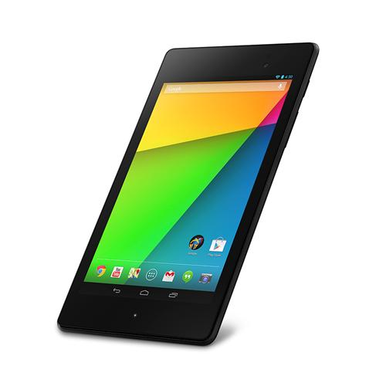
Android Project
Final presentation
Image application

Slide 2
INTRODUCTION
ARCHITECTURE
ACTIVITY
NETWORKING
DEMO
CONCLUSION

Slide 3
Members
Ta Quang Huy
Ngoc An
Le Sinh Quy
Bui Quang Tan

Slide 4
Introduction
This app purpose is to browse the most recent image from Flickr, search for a image desired and look up the image from Flickr site

Slide 5
Architecture
The main page will be the gallery from Flickr recent photos. Then you can search for the image you want and view it in detail

Slide 6
Architecture
Flickr
Fetchr
GalleryItem
Using recycleView to show the image, accessed by PhotoGalleryFragment (PGF)
PGF also rely on FlickrFetch to fetch the data from Flickrstore in the List which parameter is take by GalleryItem
PhotoGallery
Fragment
List
RecyclerView

Slide 7
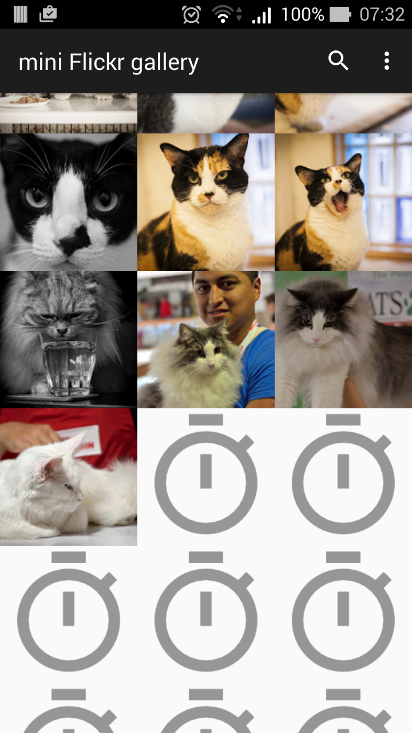
Activity
Main page- gallery
This is the page while loading the images

Slide 8
Activity
Starting by creating blank images
Then Fetch the images and replace it
Finally download the thumbnail for each image The fetching progress is done through AsyncTask

Slide 9
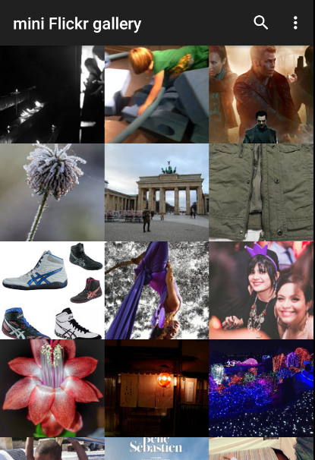
Activity
Main page- gallery
This is where the image from flick are shown

Slide 10
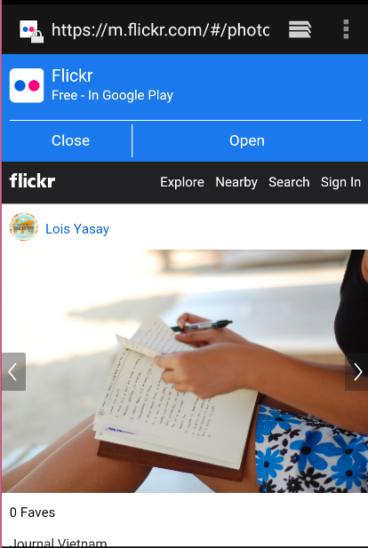
Activity
Detail
When we click on the image, it will lead us to the flickr page of that image

Slide 11
Activity
By fetching the image data from Flickr
We also gain the url to trace back to the web page contain the image

Slide 12
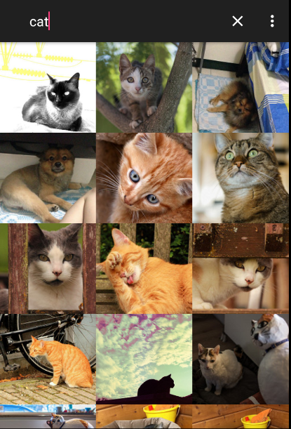
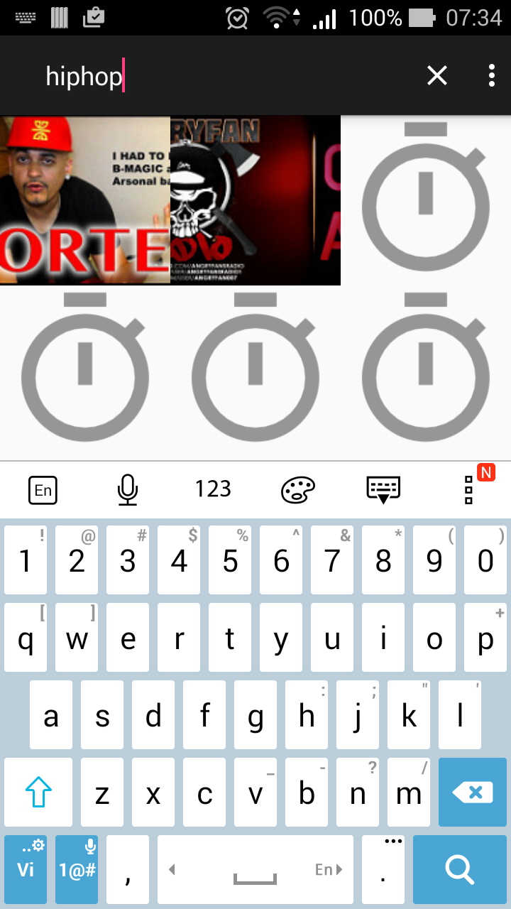
Activity
Search
This is where we can find the desired image

Slide 13
Activity
Submit a url to request the Flickr to send photo.
url built based on method+api key+search text
Search text then saved in memory to reuse

Slide 14
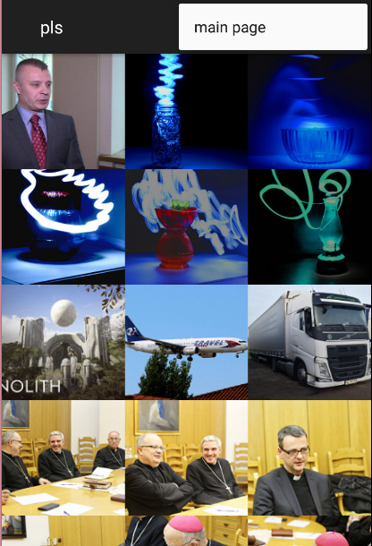
Activity
Return to main menu- gallery

Slide 15
Activity
Planned but failed to develop:
1. Camera access 2. Web view image detail

Slide 16
Networking
Using JSON through API to gain access to Flickr
After that using method get.Recent to gain Flickr recent photo and use photo.search to get the desired photo

Slide 17
Demo

Slide 18
Conclusion
We have a rough start but finally manage to finish the project.
All the basic function are finished
Team work is getting improved through time

Slide 19
Conclusion
The app was small in scale
The web can’t return back to main page
Some early planned function failed

