Slide 1
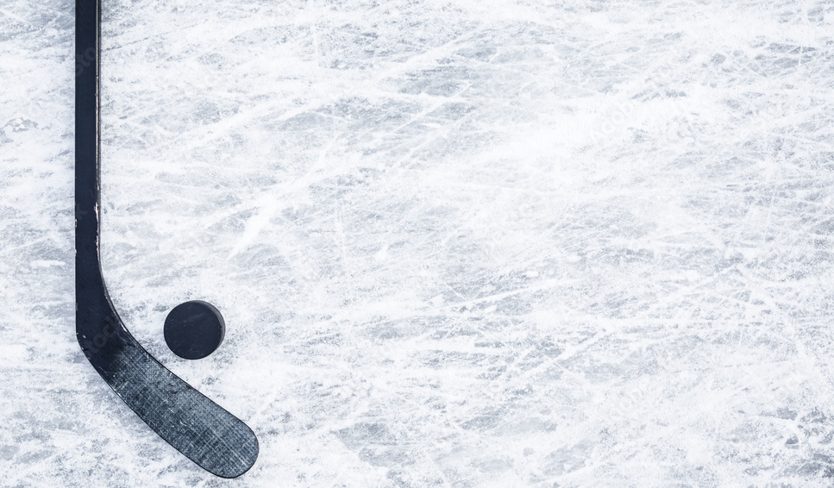
Scoring in the NHL
By Fritz Sanger, Christina Vu, Chisunta Chikwamu

Slide 2
Overview of our dataset
2023 NHL Playoff shots database
Each entry is a shot attempt (over 122,000 entries)
Dataset contains 124 variables giving information about:
Result of shot
How long/many players were on the ice at time of shot
Shot characteristics (location, distance, angle, type)
The event previous to the shot
etc.
Notes:
We used an NHL shots database for our project. The data contains information on NHL shot attempts, with the dataset containing 124 variables. Additionally, this database has over 122,000 data entries. The dataset contains information about the result of the shot, how long and how many players were on the ice at the time of the shot, the location, distance, angle and type of the shot, and information about the event previous to the shot.

Slide 3
Relationship between Player Fatigue and Shot effectiveness
Question: Is there a relationship between player fatigue and shot effectiveness?
Hypothesis
The longer time the player spends on ice the less likely they are to score.
Metrics:
Shot effectiveness defined as the total number of goals made out of the total shots made in a specified time interval.
Player fatigue is defined as the times a player spends on Ice segmented into intervals of 60 seconds each

Slide 4
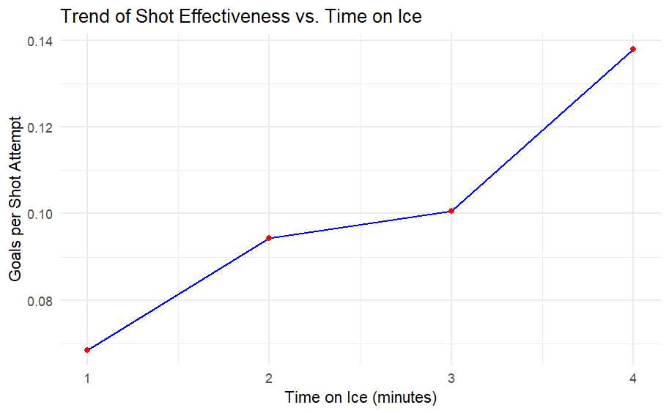
Shot effectiveness increases with increase in shooter time on Ice

Slide 5
How Does Shooting Effectiveness Change as the Number of Defenders Decreases
Hypothesis: Player shooting efficiency will improve across all categories as the number of opposing players on the ice decreases
Notes:
In the NHL when a player commits a penalty they taken off the ice for two minutes and their team has to play with less men on the ice. From our background knowledge of hockey we knew that it is easier to score goals on a powerplay. However, we wondered why this is the case. Is this because offensive shooting efficiency increases during these periods as players are possibly able to more open looks, or is it because with less defenders it is easier for the offense to retain possession, so they are able to get more shots off…
Our hypothesis was that overall shooting efficiency would increase in all aspects as the number of opposing players decreases.

Slide 6
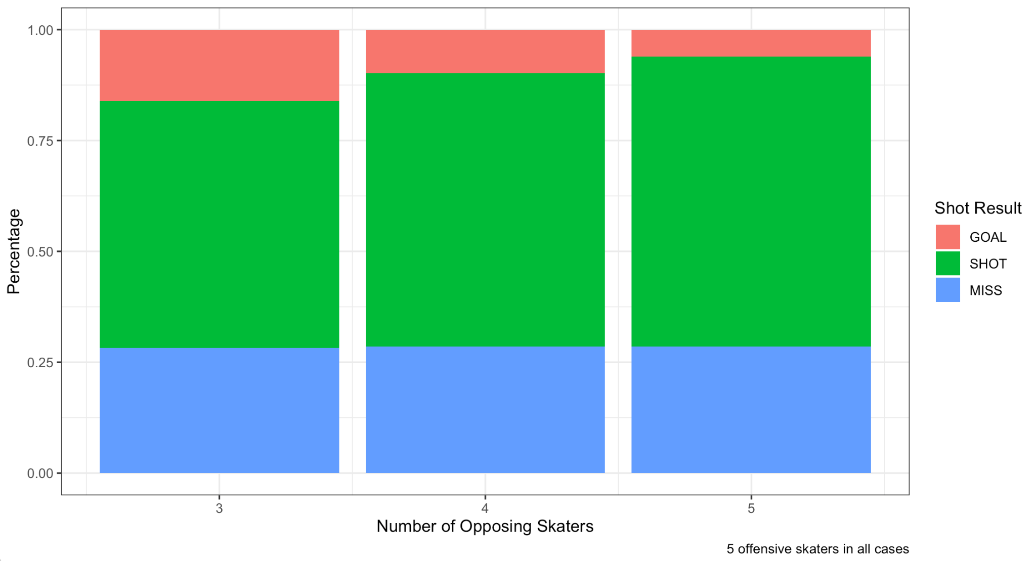
Shooting Performance by Number of Opposing Skaters
Notes:
The event variable measures the result of the shot. MISS = shot off target. SHOT = shot on goal that is saved. GOAL = a goal. The y axis for this plot is on a percent scale. As we can see, there percentage of missed shots stays constant across the number of opposing players on the ice. This is a little surprising as we would’ve thought misses would decrease since you should have less rushed shots when there are less defenders. We also notice that as the number of opposing skaters decreases, the percentage of shots on goal that result in goals increases. This fits with our expectation, since it is easier for the shooting team to get high quality looks with less defenders on the ice.

Slide 7
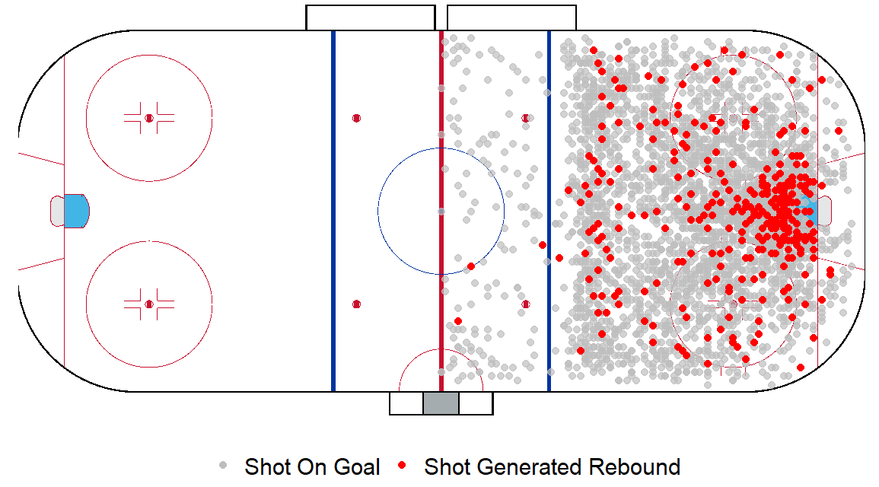
Are shots taken closer to the net more likely to generate rebounds?
The Penguins Missed Shot and Rebound Locations
What’s wrong?
Higher shot density near the net
Not account for shot techniques

Slide 8
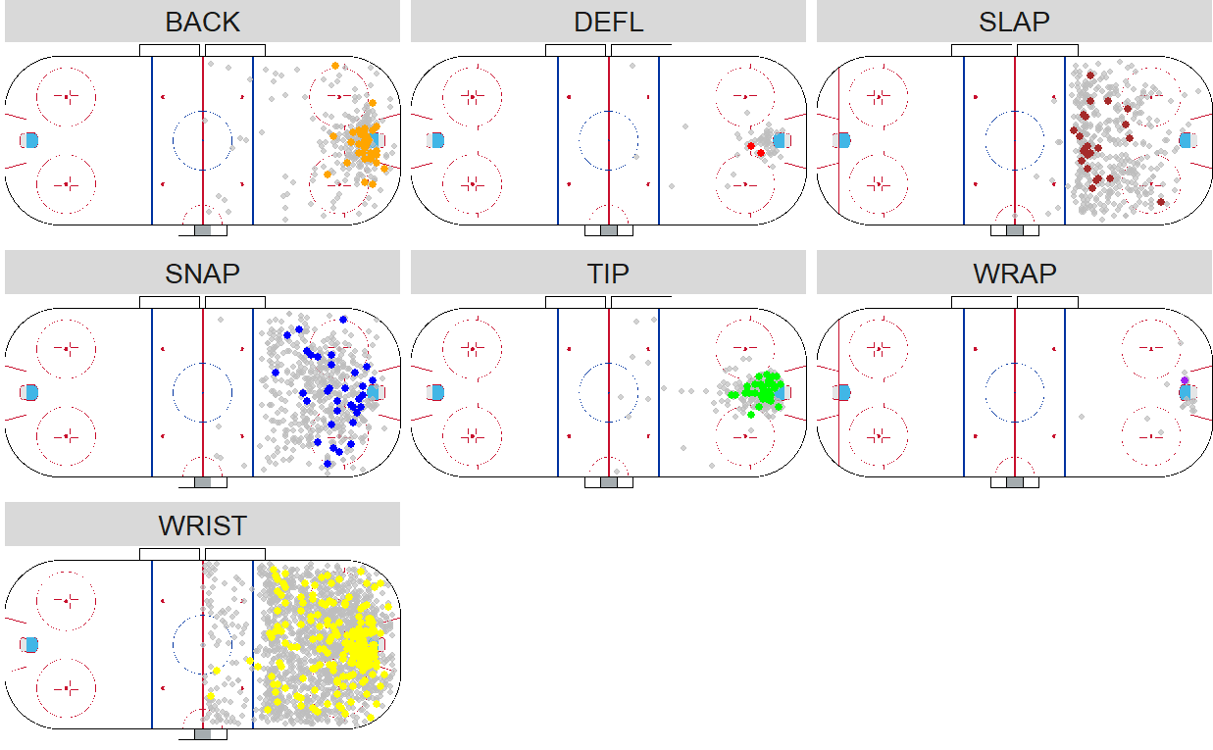
The Penguins Missed Shot and Rebound Locations by Shot Types
Not effective near the net
Only from the side of the net
Conclusion
Most rebounds were generated near the net, but varied by short types

Slide 9
Cluster Analysis of NHL Team Shot Patterns
Choosing Key Variables: Principal Component Analysis (PCA)
Reduce dimension while keeping key information.
Identify variables that best differentiate teams' shot patterns.
Variables | PC1 Loadings
Average Expected Goals | 0.5723
Average Expected Rebounds | 0.6011
Average Shot Distance | -0.0070
Average Number of Away Players on Ice | -0.3834
Average Time Players on Ice | 0.4051

Slide 10
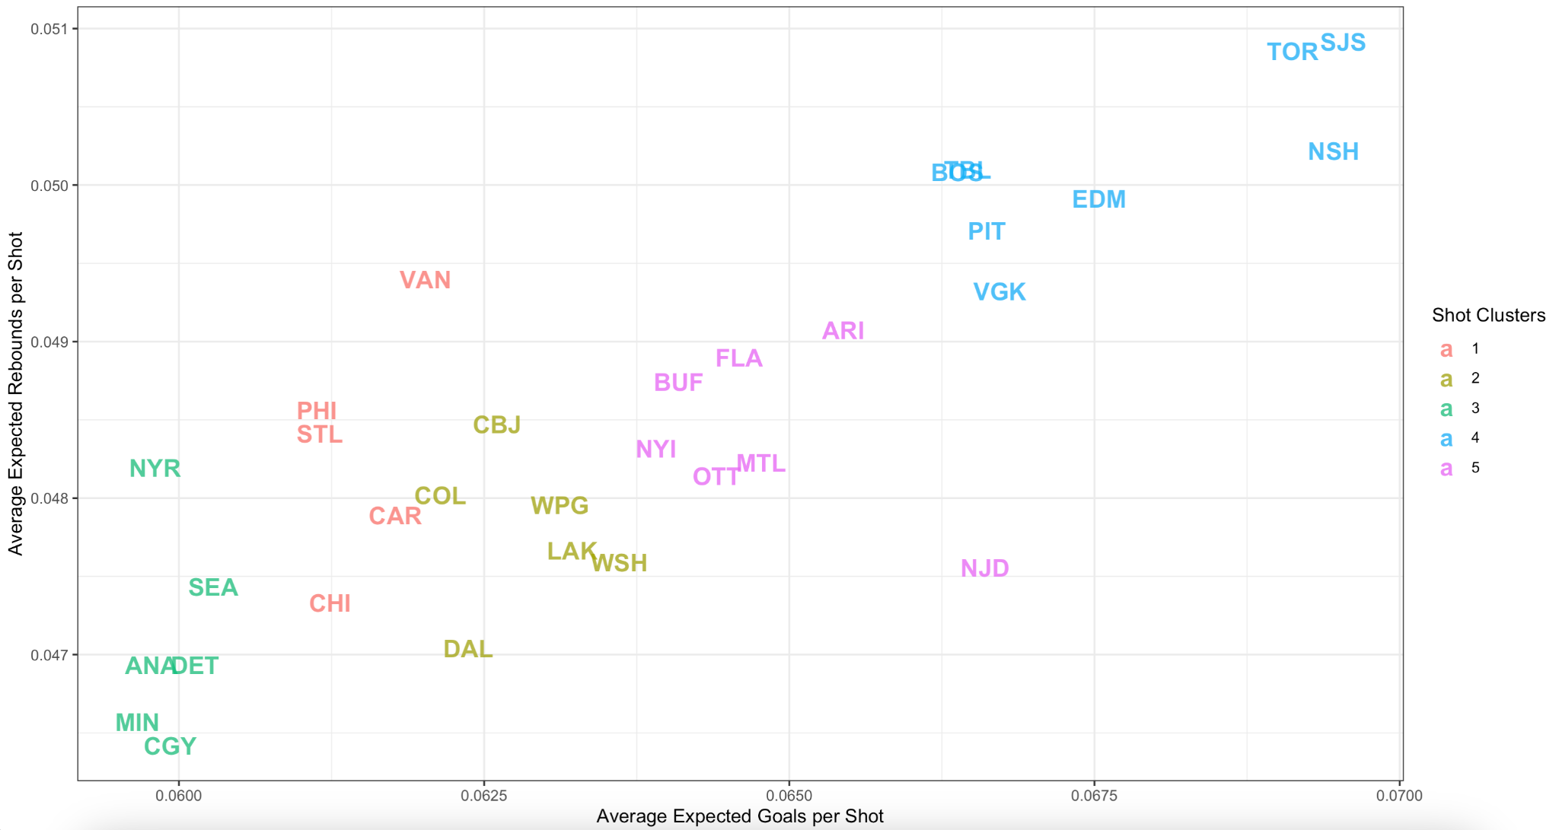
Clustering of NHL teams by Average Expected Goals and Average Rebounds per Shot Attempt
Notes:
Strong positive trend…

Slide 11
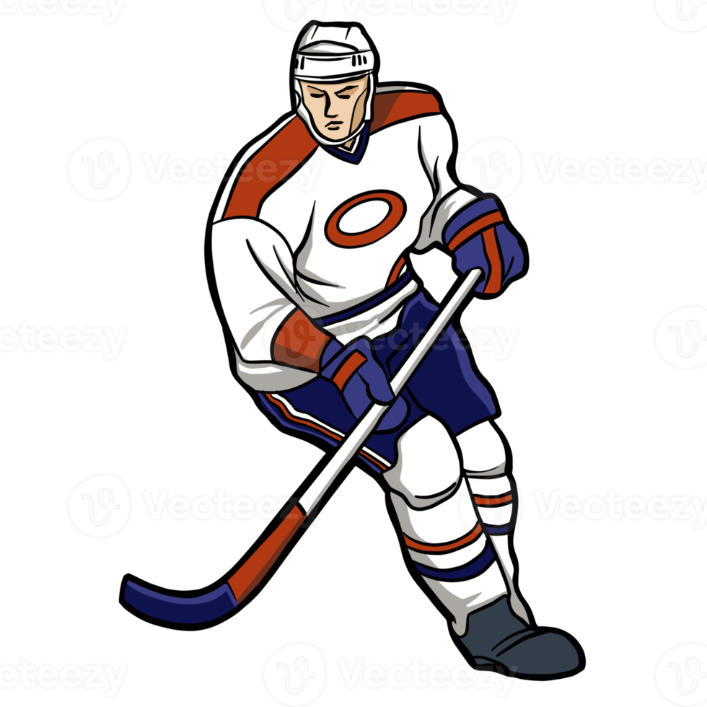
Summary
As the number of opposing players on the ice decreases, a greater percentage of shots on goal score.
Most rebounds were generated near the net, but varied by shot types.
Shot effectiveness increases with increase in shooter time on ice.

