Slide 1
Comparing Human and AI Scoring in Oral Reading Accuracy
Christina Vu, advised by Dr. Nelis Potgieter

Slide 2

What is Oral Reading Accuracy?
Oral Reading Accuracy (ORA) is a measure to assess the ability to pronounce words correctly when reading aloud.
Accurate ORA assessments allow educators to evaluate a student’s ability to comprehend texts — an important skill in language education.
Our research studies the potential of integrating an AI voice recognition system to improve the evaluation process.

Slide 3
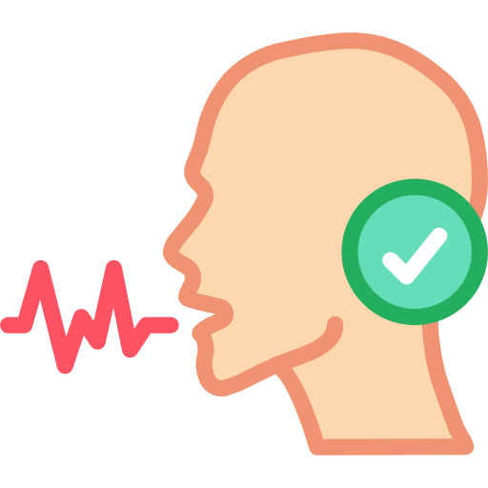
How ORA is measured?
Words Read Correctly (WRC) measures the number of words a student correctly pronounces while reading a passage.
X: true WRC scores by multiple human evaluators.
Y1: WRC scores by a human evaluator.
Y2: WRC scores by the AI system.
Achieving an accurate true score can be challenging, which highlights the need for an automated system that can assist educators.

Slide 4
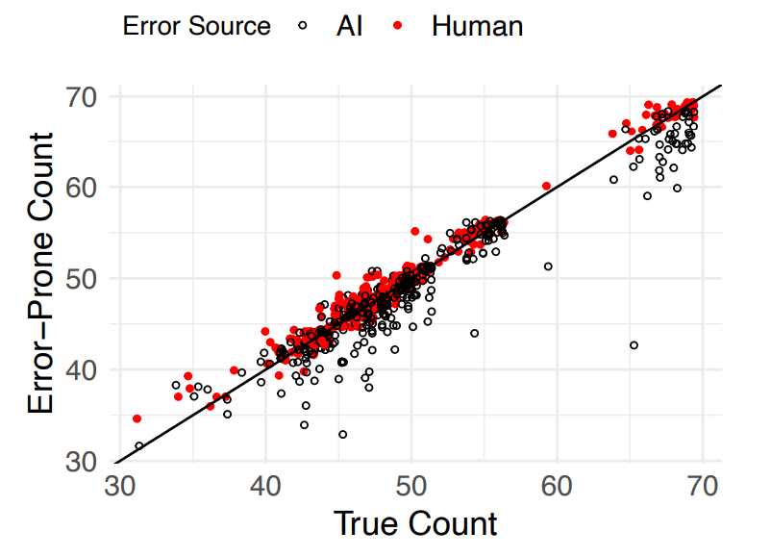
Data
507 students, each reading one of 10 passages.
Human scores show greater consistency with true scores.
AI scores show an underestimation bias.

Slide 5
Model Definition
For a passage consisting of N words:
X_{1𞺴}∼ Bin(X, π_{tp}): True Positive, the number of correct words recorded as correct.
X₂ ∼ Bin(N-X, π_{tn}): False Positive, the number of incorrect words recorded as correct.
Y = X₁ + X₂: the number of words recorded as correct.

Slide 6
Approach 1: Method of Moments (MOM)
Using the properties of the binomial distribution and moment relationships, we find
E[Y] = μ_{x} · π_{tp} + (N − μ_{x}) · (1 − π_{tn})
Cov[XY] = (σ_{x}² + μ_{x}²) · (π_{tp} − π_{tn} + 1) + (N · μ_{x}) · (1 − π_{tn}) − μ_{x} · μ_{y}
From the Method of Moments where ˆμ_{x} ¯x, ˆσ_{xy} = s_{xy}, we derive estimators
ˆπ_{tn} = 1 − ¯y N + ¯x N · s_{xy} s_{x}²
ˆπ_{tp} = s_{xy} s_{x}² + ¯y N − ¯x N · s_{xy} s_{x}²

Slide 7
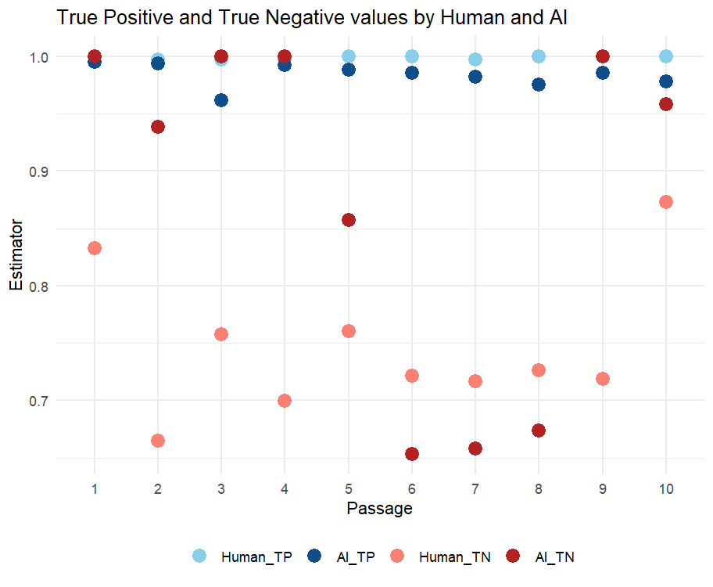
Estimating True Positive (TP) and True Negative (TN)
Both Human and AI show an overall strong performance.
However, low True Negative rates suggest concerns of recording incorrect words as being correct too often.

Slide 8
Simulation Study
Setup:
Generate data using beta-binomial distribution with parameters:
p: Probability of success (0.96, 0.98)
ρ: Overdispersion degree (0.01, 0.06)
N: Number of words (44, 69)
Simulate using combinations of (N,p,ρ).
Standard error (SE) estimations using Delta, ordinary Bootstrap, and m-out-of-n Bootstrap method.
Average Monte Carlo SE ratios:
The m-out-of-n Bootstrap is the most reliable method for unbiased estimations.
Delta |  | Ordinary Bootstrap |  | m-out-of-n Bootstrap
TP | TN | TP | TN | TP | TN
0.957 | 0.468 | 0.962 | 0.890 | 0.963 | 0.958

Slide 9
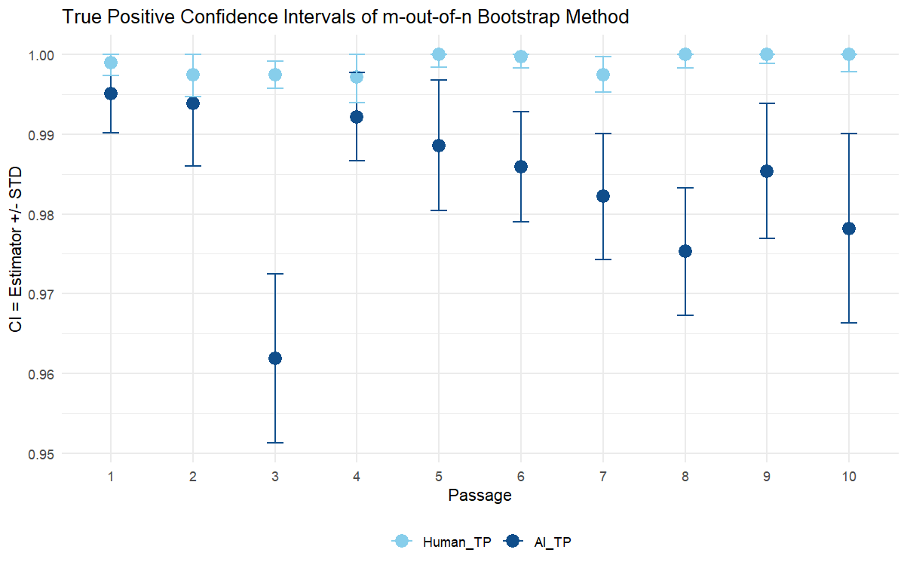
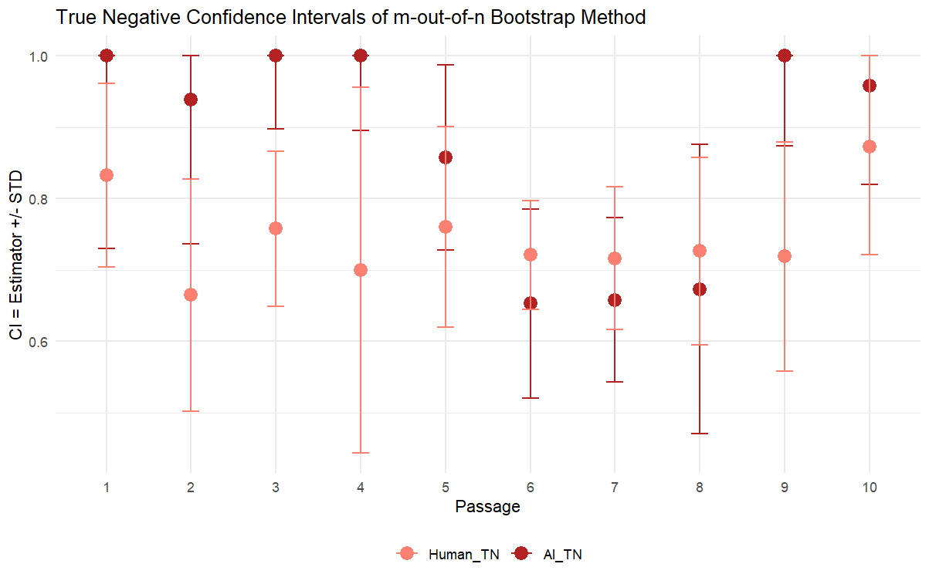
Estimating Standard Errors
using m-out-of-n Bootstrap method.
Low standard errors of True Positives show both Human and AI are consistent with correct words.
True Negatives of AI have the highest standard errors, suggest AI has issues identifying incorrect words.

Slide 10
Approach 2: Generalized Method of Moments (GMM)
In solution 1, we use sample statistics ¯X, ¯Y , s_{x}², s_{xy}. Solution 2 will incorporate s_{y}² .
Define parameter vector
θ = (μ_{x​},σ_{x}²​,π_{tp​},π_{tn​})⊤
sample moment vector
ˆm = ( ¯x, s_{x}², ¯y , s_{x}², s_{xy})
population moment vector
m(θ) = ​(μ_{x​}(θ), x^{2​}(θ), μ_{y​}(θ), σ_{x}²​(θ), σ_{xy​}(θ))^{T}
we minimize the distance:
D_{n​}(θ)=(m(θ)−m^)⊤ Σ_{n}⁻¹ ​(m(θ)−m^)

Slide 11
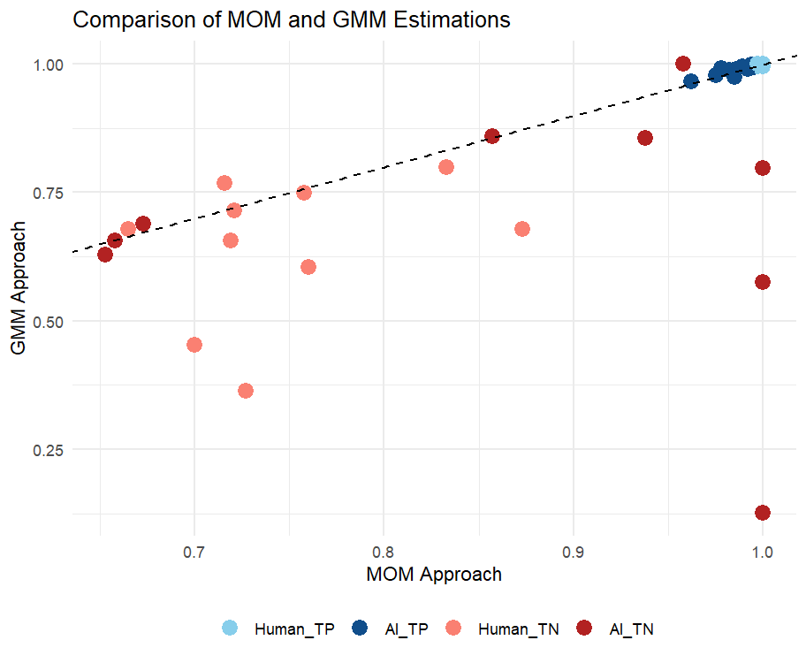
Comparing MOM and GMM Approach
MOM and GMM are consistent for True Positive values.
True Negative values show some variation, particularly for AI.
From the m-out-of-n Bootstrap method, we find that MOM has lower standard errors on average.

Slide 12
Contaminated Data Solution
In real-world scenarios where true counts X are unavailable, this solution estimate parameters from only contaminated data Y.
To account for the absence of true scores, we assume that X follows a Beta-Binomial distribution with parameters:
N: total count / passage length.
p: average success probability.
ρ: intra-class correlation controlling over-dispersion relative to the binomial.

Slide 13
GMM for Contaminated Data Solution
We apply GMM with parameter vector
θ = (πtp, πtn, px, ρ)
the mean
μy = μx · πtp + (Nj − μx) · (1 − πtn)
the variance
σ2y = μx · (πtp + πtn − 1) · (πtn − πtp) + σ2x · (πtp + πtn − 1)2 + Nj · (1 − πtn) · πtn
the covariance

Slide 14
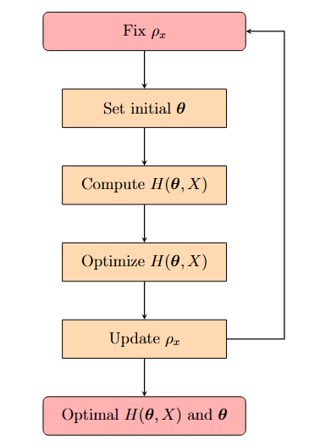
Optimization Process
We introduce the penalty function to constrain θ:
H(θ, X) = D(θ, X) + λ · Pen(θ)
where
D(θ, X) is the GMM distance function
Pen(θ)= −x∈θ∑​log(x(1−x))
To choose the penalty parameter, we apply 5-fold cross-validation by optimizing each fold while using the remaining folds for validation.

Slide 15
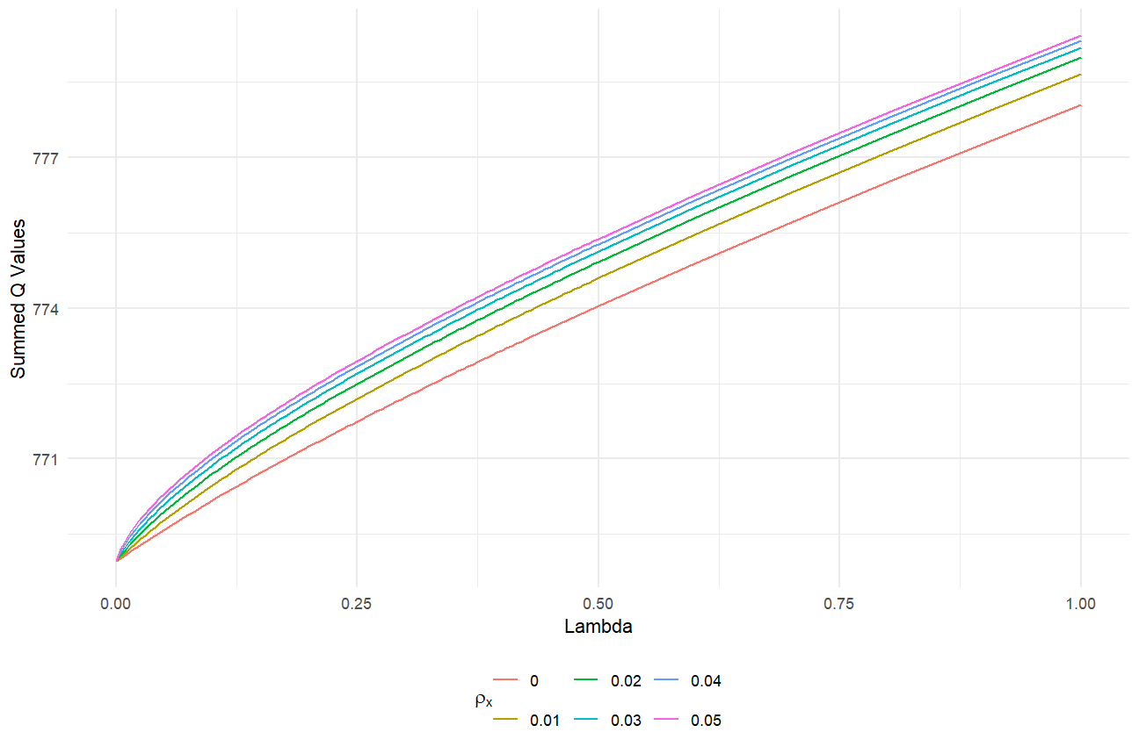
Optimization Result
Optimal function by ρ for Human and AI
ρ=0 minimizes the objective function.
Human performs better than AI.
Both Human and AI perform well at identifying correctly read words but struggle more with incorrectly words.
(ˆπtp1, ˆπtn1, ˆπtp2, ˆπtn2) = (0.9833, 0.8725, 0.9673, 0.7565)

Slide 16
Conclusion
Reference
DiSalle, K. and Rasinski, T. (2017). Impact of short-term intense fluency instruction on students’ reading achievement: A classroom-based, teacher-initiated research study. Journal of Teacher Action Research, 3(2):1–13.
Rosner, B. (2014). Beta-Binomial Distribution. John Wiley Sons, Ltd.
Ross, S. M. (2022). Simulation. academic press.
Tibshirani, R. J. and Efron, B. (1993). An introduction to the bootstrap. Monographs on statistics and applied probability, 57(1):1–436.
We explored different methods to estimate accuracy.
Results consistently show that Human outperforms AI.
Both Human and AI slightly struggle with misclassifications

