Slide 1


How to START using
Ngoc Dao

Slide 2
This talk is not about Scala syntax
(You can learn 80% of it in 2 days, Sat & Sun)

Slide 3
Source code:
https://github.com/ngocdaothanh/sclart

Slide 4
Why I use Scala
Syntax is similar to Ruby (human oriented)
Faster than Ruby (= Java, ~C)
Can reuse all Java libs (Java has lots of libs!)
Easy to program for multicores (like Erlang)

Slide 5
Agenda
“scala” and “scalac” commands
SBT (Scala Build Tool)
Some useful frameworks

Slide 6
Part 1: scala & scalac

Slide 7
Install Scala
Download from scala-lang.org
Config PATH
.bash_profile:
PATH=~/opt/scala-2.9.2/bin:$PATH

Slide 8
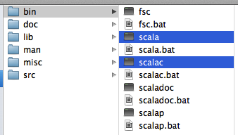
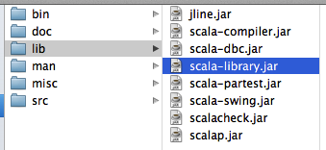
~/opt/scala-2.9.2:

Slide 9
Interactive console
For trying out code snippets
Like “irb” of Ruby

Slide 10
$ scala
Welcome to Scala version 2.9.2
Type :help for more information.
scala> 1 + 2
res0: Int = 3
scala> "hello".length
res1: Int = 5
scala> :q
$

Slide 11
Scripting Scala
Can run a script right away, no compile step is needed
To run, “scala” command is needed; it will compile on the fly then run
For simple one-file programs

Slide 12
$ cat Hello1.scala
println(1 + 2)
println("hello".length)
$ scala Hello.scala
3
5

Slide 13
Compile Scala
Compile .scala file to .class file
Can use “scala” or normal “java” command to run .class file
Simple programs: scalac (like javac)
Bigger programs: SBT (see next slides)

Slide 14
Compile Scala
Compile .scala file to .class file
Can use “scala” or normal “java” command to run .class file
Simple programs: scalac (like javac)
Bigger programs: SBT (see next slides)

Slide 15
$ scalac Hello1.scala
Hello1.scala:1: error: expected class or object definition
println(1 + 2)
^
Hello1.scala:2: error: expected class or object definition
println("hello".length)
^
two errors found
Need to wrap the script with “main”

Slide 16
$ cat Hello2.scala
object Hello2 {
// Similar to normal Java/C programs
def main(args: Array[String]) {
println(1 + 2)
println("hello".length)
}
}

Slide 17
Run with “scala” command
$ scalac Hello2.scala
$ ls
Hello2$.class Hello2.class Hello2.scala
$ scala Hello2
3
5

Slide 18
Run with “java” command
$ java Hello2
Exception in thread "main" java.lang.NoClassDefFoundError: scala/ScalaObject
$ java -cp
~/opt/scala-2.9.2/lib/scala-library.jar:. Hello2

Slide 19
Part 2: SBT

Slide 20
SBT (Scala Build Tool)
Dependency library manager
Build tool
Like “gem” + “rake” of Ruby
Like Maven of Java

Slide 21
Install SBT
There are several ways to install:
https://github.com/harrah/xsbt/wiki/Getting-Started-Setup
I prefer installing SBT manually

Slide 22

Install SBT manually
~/opt/sbt:
sbt:
java -Xmx512M -XX:MaxPermSize=128M \
-jar `dirname $0`/sbt-launch-0.12.0.jar "$@"
.bash_profile:
PATH=~/opt/sbt:$PATH

Slide 23
Project structure
hello
build.sbt
src
main
scala
should_be_under_a_package
Hello2.scala
java
(Java source files, if any)
test
(Scala/Java test source files, if any)
scala
java
target
scala-2.9.2
classes
(Compiled .class files)

Slide 24
build.sbt
organization := "com.kayac"
name := "hello"
version := "1.0-SNAPSHOT"
scalaVersion := "2.9.2"
scalacOptions ++= Seq(
"-deprecation",
"-unchecked"
)
Like Gemfile of Ruby
Packaged .jar file:
hello_2.9.2-1.0-SNAPSHOT.jar
(Management of dependency libraries will be talked at part 3)

Slide 25
SBT tasks
$ sbt tasks
console Starts the Scala interpreter
compile Compiles sources
clean Deletes files produced by the build
run Runs a main class
package Produces project jar file
publish Publishes project jar file to a repository
publish-local Copies project jar file to ~/.ivy2
test Executes all tests
test-only Executes the tests provided as arguments
test-quick Executes the tests that either failed before

Slide 26
Demo
https://github.com/ngocdaothanh/sclart/tree/master/sbt/hello
sbt console, run, package etc.

Slide 27
SBT plugins
https://github.com/harrah/xsbt/wiki/sbt-0.10-plugins-list
Some useful plugins:
* Create Eclipse project file (with library paths):
https://github.com/typesafehub/sbteclipse
* One jar plugins

Slide 28
Install SBT plugins
1. Install plugins at global level
~/.sbt/plugins/build.sbt
Ex:
addSbtPlugin("com.typesafe.sbteclipse" % "sbteclipse-plugin" % "2.1.0")
2. Install plugins at project level
project/plugins.sbt
Ex:
https://github.com/ngocdaothanh/xitrum-demos/blob/master/project/plugins.sbt

Slide 29
Demo
Use sbt eclipse to create Eclipse project and see lib paths

Slide 30
Part3: Some useful frameworks
https://wiki.scala-lang.org/display/SW/Tools+and+Libraries

Slide 31
Xitrum
Combine web server + web framework
https://github.com/ngocdaothanh/xitrum
Scalable: session, realtime data etc.
+------------------+
| Your app |
+------------------+
| Xitrum |
|+----------------+|
|| Web framework || <-- Hazelcast --> Other instances
||----------------||
|| HTTP(S) Server ||
|+----------------+|
+------------------+
Fast static file serving: https://gist.github.com/3293596
WebSocket

Slide 32
Demo
https://github.com/ngocdaothanh/xitrum-demos
Routes
WebSocket
xitrum-package

Slide 33
Akka
http://akka.io/
Better than Scala's default actor library
Has power of Erlang:
concurrency
distribution
failure supervisor
FSM (Finite State Machine, very good for realtime multiplayer games, to manage states of game sessions and inter-player interactions)

Slide 34
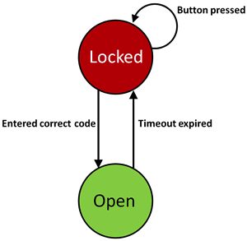
FSM Demo
https://github.com/ngocdaothanh/code-lock-fsm-akka

