Slide 1
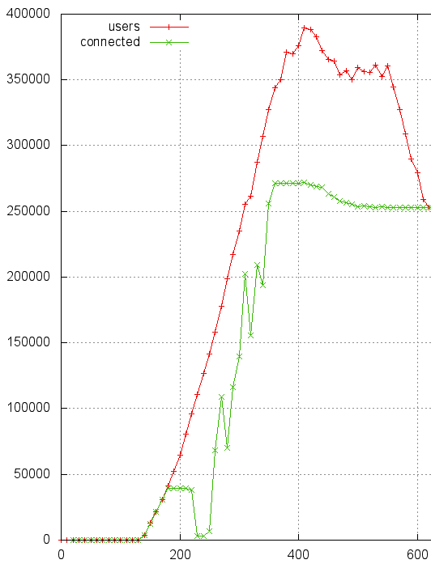
Easy distributed load test with Tsung
Ngoc Dao

Slide 2
Source code:
https://github.com/ngocdaothanh/tsart
Full doc:
http://tsung.erlang-projects.org/user_manual.html

Slide 3
Agenda
Install Tsung
Load test from one machine
Distributed load test
Test WebSocket

Slide 4
Install Tsung

Slide 5
How to install Tsung
Install Erlang
Install Tsung
Tsung is a program
written in Erlang language
(Erlang presentation next time)

Slide 6
Install Erlang
sudo yum install yum install gcc
sudo yum install openssl-devel
sudo yum install ncurses-devel
wget http://www.erlang.org/download/otp_src_R15B01.tar.gz
tar xzf otp_src_R15B01.tar.gz
cd otp_src_R15B01
./configure –prefix=$HOME/opt/erlang-R15B01
make install
For connecting to
other machines
to do distributed
load test (later slides)
For Erlang
command line
http://www.erlang.org/download.html

Slide 7
Install Tsung
export PATH=$PATH:$HOME/opt/erlang-R15B01/bin
wget http://tsung.erlang-projects.org/dist/tsung-1.4.2.tar.gz
tar xzf tsung-1.4.2.tar.gz
cd tsung-1.4.2
./configure –prefix=$HOME/opt/tsung-1.4.2
make install
export PATH=$PATH:$HOME/opt/tsung-1.4.2/bin
Need “erlc” command
to compile Tsung
http://tsung.erlang-projects.org/dist/

Slide 8
Load test from one machine

Slide 9
share/doc/tsung/examples
Load test
target
test.xml
Tsung
lib/tsung/bin/tsung_stats.pl
sudo yum install gnuplot
sudo cpan Template
Reports

Slide 10
To be able to create many connections
Each connection is seen as an open file; default limit:
Linux: limit -n => 1024
Mac: launchctl limit => 256
Linux:
Edit /etc/security/limits.conf:
* soft nofile 1000000
* hard nofile 1000000
Mac:
sudo launchctl limit maxfiles 1000000 1000000
Or create /etc/launchd.conf:
limit maxfiles 1000000 1000000

Slide 11
More info on tuning:
http://ngocdaothanh.github.com/xitrum/guide/deploy.html#tune-linux-for-many-connections

Slide 12
test.xml
https://github.com/ngocdaothanh/tsart/blob/master/single.xml
Pitfall:
<!DOCTYPE tsung SYSTEM "path/to/tsung-1.0.dtd">
The path must be correct.
Be careful if you copy the XML file from other machines.

Slide 13
Bypassing 30k limit
Each IP can only create about 25 thousands connections. To bypass this problem:
1. Create multiple IPs for one network interface
2. Set "ports_range" option
http://tsung.erlang-projects.org/user_manual.html
http://lists.process-one.net/pipermail/tsung-users/2010-October/001554.html

Slide 14
<load>...</load>
<options>
<option name="ports_range" min="1025" max="65535"/>
</options>
<sessions>...</sessions>

Slide 15
Demo
Run test:
tsung-1.4.2/bin/tsung -f test.xml -l . start
See status during test:
tail -f tsung_controller.log
tsung-1.4.2/bin/tsung status
Create reports:
perl tsung-1.4.2/lib/tsung/bin/tsung_stats.pl

Slide 16
Distributed load test

Slide 17
Tsung
worker
test.xml
Tsung
worker
Target
Tsung
controller
Tsung
worker
Reports
EC2 is very convenient!

Slide 18
test.xml
https://github.com/ngocdaothanh/tsart/blob/master/distributed.xml
<clients>
<!-- Must be hostname, can't be IP -->
<client host="t1" cpu="8" maxusers="200000"/>
<client host="t2" cpu="8" maxusers="200000"/>
<client host="t3" cpu="8" maxusers="200000"/>
</clients>
Distributed test is easy:
Just add more clients

Slide 19
machine1
machine2
Tsung
controller
(Erlang node)
Tsung
worker
(Erlang node)
http://linux.die.net/man/1/epmd
http://www.erlang.org/doc/apps/erts/erl_dist_protocol.html

Slide 20
Can’t start distributed clients: timeout error
bash: erl: command not found
=>
Install same version of Erlang and Tsung on all machines, at same paths
Config SSH login without password
Config /etc/hosts
If we have t1 (controller), t2, t3 as test clients:

Slide 21
Should not be 127.0.0.1
=>
/etc/hosts on t1:
<ip1> t1
<ip2> t2
<ip3> t3
/etc/hosts on t2, t3:
<ip1> t1

Slide 22
EC2 has “Security Group” feature,
stopping firewall is not a big problem
=>
Stop firewall:
sudo /etc/init.d/iptables stop
Disable SELinux:
sudo setenforce 0
Or edit /etc/sysconfig/selinux

Slide 23
=>
Add erl to PATH:
sudo echo 'pathmunge /home/ngoc/opt/erlang-R15B01/bin' > /etc/profile.d/erlang.sh
sudo chmod +x /etc/profile.d/erlang.sh
Or edit /etc/environment:
PATH=”/home/ngoc/opt/erlang-R15B01/bin...”

Slide 24
Install once, copy everywhere
Basically, you only have to install on one machine, then copy to others:
/etc/hosts
/etc/environment
/etc/sysctl.conf
/etc/security/limits.conf
Erlang
Tsung

Slide 25
Confirm
From the controller machine (t1):
ssh t1 erl
ssh t2 erl
ssh t3 erl
ssh localhost erl
Trouble shooting:
http://tsung.erlang-projects.org/user_manual.html
> Frequently Asked Questions
Pitfall:
Remember to run
this command to confirm,
if you use
<client host="localhost"/>

Slide 26
Demo

Slide 27
Test WebSocket
This one is good:
https://github.com/onlychoice/tsung/tree/websocket
This one may be better:
https://github.com/wulczer/tsung_ws

Slide 28
Example
https://github.com/wulczer/tsung_ws/blob/master/websocket.xml

Slide 29
Pitfall
I installed tsung-1.4.2 on t1, t2, t3. Then installed tsung-1.4.2-with-websocket-plugin on t1, but forgot to install it on t2 and t3.
=>
Install same version of Erlang and Tsung on all machines, at same paths
Tsung by default only creates 800 connections on each Erlang VM. It will spawn more Erlang nodes to create more connections. But Tsung will stop working when there are too many nodes (~100)
=>
Set maxusers to a large number (~200K/client).

Slide 30
<clients>
<client host="t1" cpu="8" maxusers="200000">
<ip scan="true" value="eth0"/>
</client>
</clients>

Slide 31
Amazon EC2
Good: There is no Data Transfer charge between Amazon EC2 and other Amazon Web Services within the same region
http://aws.amazon.com/ec2/pricing/
=> Use private DNS address or IP instead of public ones
m1.xlarge can create about 200 new connections/s
Use Amazon VPC (Virtual Private Cloud) feature to create multiple virtual IPs for one network interface
Pitfall: IP addresses of machines change after each restart => Need to update /etc/hosts of the controller machine

Slide 32
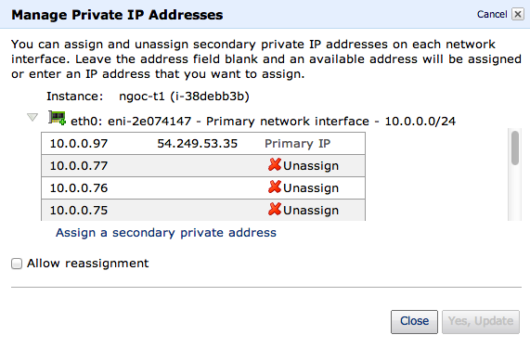

Slide 34
Bypassing 30k limit on EC2
1. Create VPC
2. Use admin page to add instance to the VPC
3. Use admin page to add virtual IPs
4. Assign virtual IPs to network inteface eth0
5. Confirm

Slide 35
MAC_ADDR=$(ifconfig eth0 | sed -n 's/.*HWaddr \([a-f0-9:]*\).*/\1/p')
IP=($(curl http://169.254.169.254/latest/meta-data/network/interfaces/macs/$MAC_ADDR/local-ipv4s))
for ip in ${IP[@]:1}; do
echo "Adding IP: $ip"
sudo ip addr add dev eth0 $ip/24
done
ip addr show
http://about.silkapp.com/page/Multiple%20IP%20addresses%20on%20Amazon%20EC2

Slide 36
More topics
tsung-recorder:
Use normal browsers to create test.xml
tsplot:
Merge various tsung_stats.pl graphs into one
Monitoring:
Erlang, SNMP, Munin
Loops, variables etc.
http://tsung.erlang-projects.org/user_manual.html

