Slide 1
Finding the most efficient marketing channel
Ngoc Hoang

Slide 2
Objective
To predict the number of clicks that each marketing channel get for the following month based on past performance
To identify opportunities to invest on the most efficient channel

Slide 3
Hypothesis
Most clicks come from Search

Slide 4
Data Origin
Data from 2013
Data collected by applications in which we use to run marketing ad campaigns (which we refer to as the UIs)
3 different channels: search (Google and Bing), video (Youtube) and display (GDN)
Data was transformed for the purpose of presentation

Slide 5
What are the variables?
Dependent Variable: Clicks
Independent Variables: Month, Year, Device, Channel (Vendor), Campaign Type, Media Type, Region, Targeting, Cost
Cost is the only continuous variable

Slide 6
Creating the Predictive models
Linear Regression
Low accuracy
Decision Tree
Random Forest
Overfitting

Slide 7
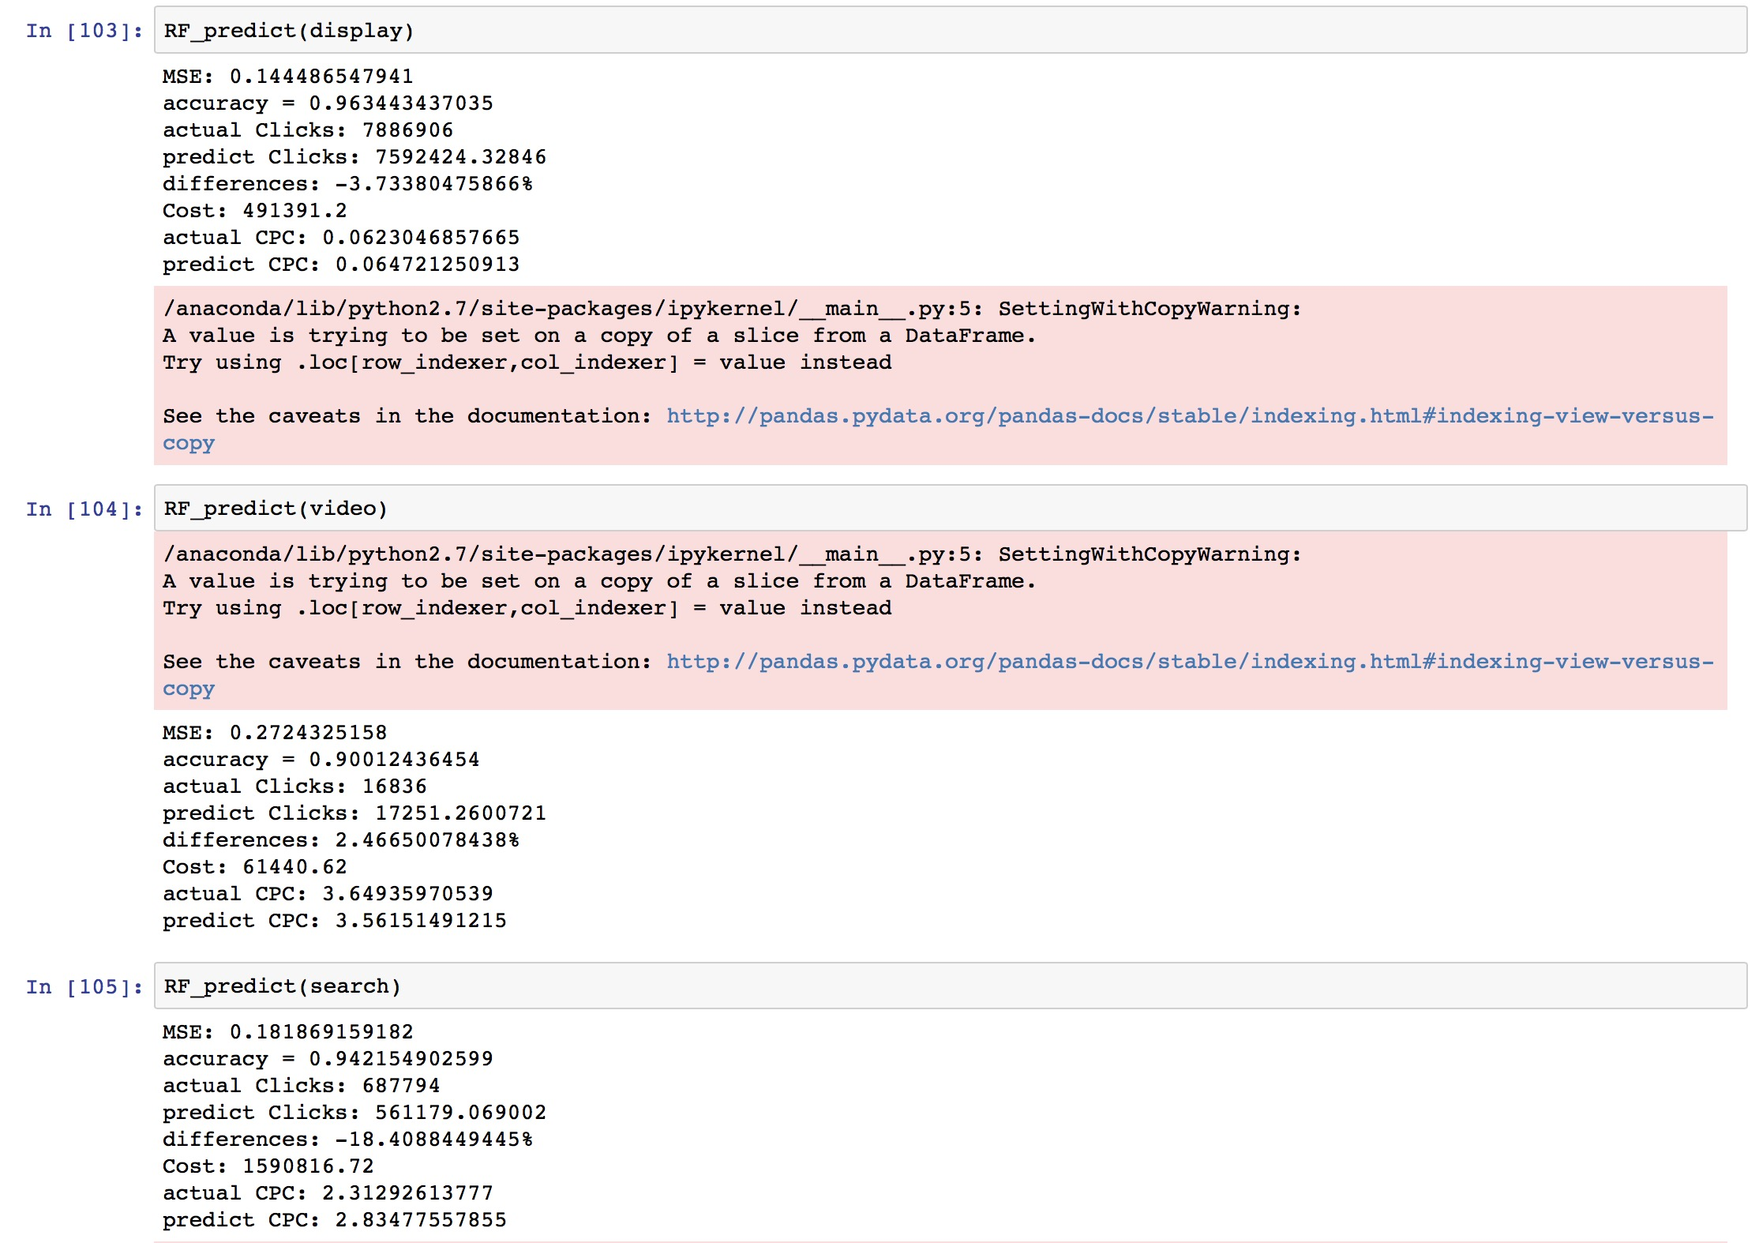
Finding
Number of clicks for Search will not be as good as last December
Search will be expensive to invest on. Should look at the other 2 channels instead

Slide 8
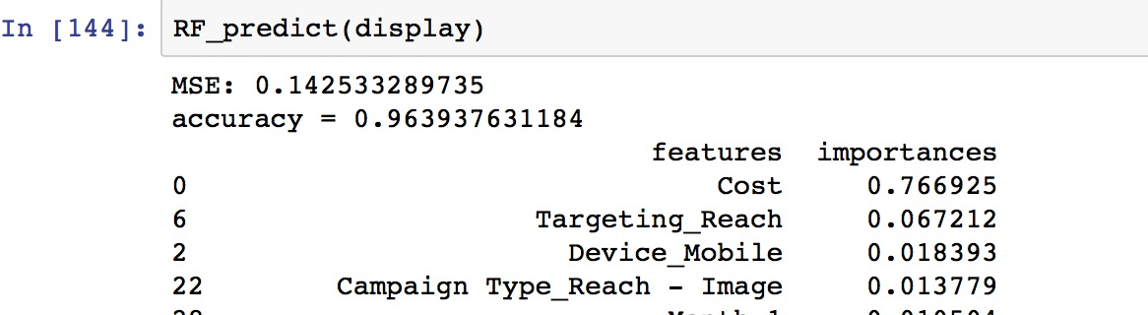
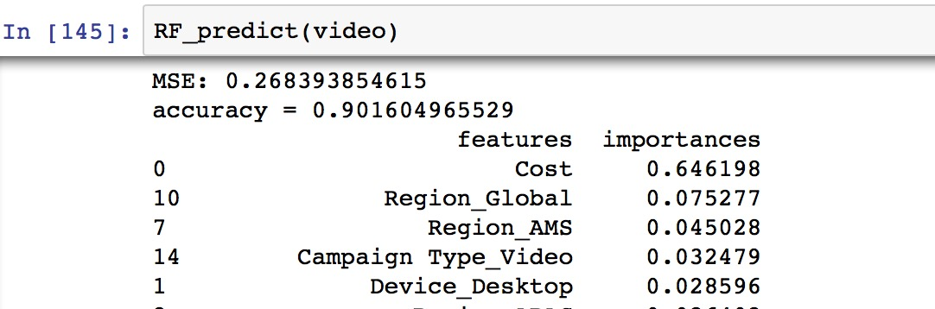
Finding

Slide 9
Things I learned
Creating functions to reuse repeat code
Creating predictive models
Use train_test_split to avoid overfitting
Log transform the dependent variable

Slide 10
Room for improvements
Model tuning (parameter tuning…)
Normalize data
Eliminate not-important-variables
Apply different predictive models

