Slide 1
CREDIT CARD FRAUD DETECTION

Slide 2
GROUP 02
1753075 – Huynh Doan Minh Ngoc
1753074 – Nguyen Kim Ngan
1753086 – Tong Le Thien Phuc

Slide 3
CONTENTS
Dataset
Choosing model and data
Demo and Result

Slide 4
1.
DATASET
We use Kaggle dataset in this project

Slide 5

284,807
31
100%
KAGGLE
DATASET
Instances
Attributes
Non-null data of each attribute

Slide 6
KAGGLE DATASET
31 columns
Time: number of seconds elapsed
Amount: transaction amount
Class:
1 : fraudulent transactions
0 otherwise
V1 – V28: Result of a PCA Dimensionality reduction
Notes:
Transaction amount: so tien giao dich

Slide 7
Maps
survey locations
European

Slide 8
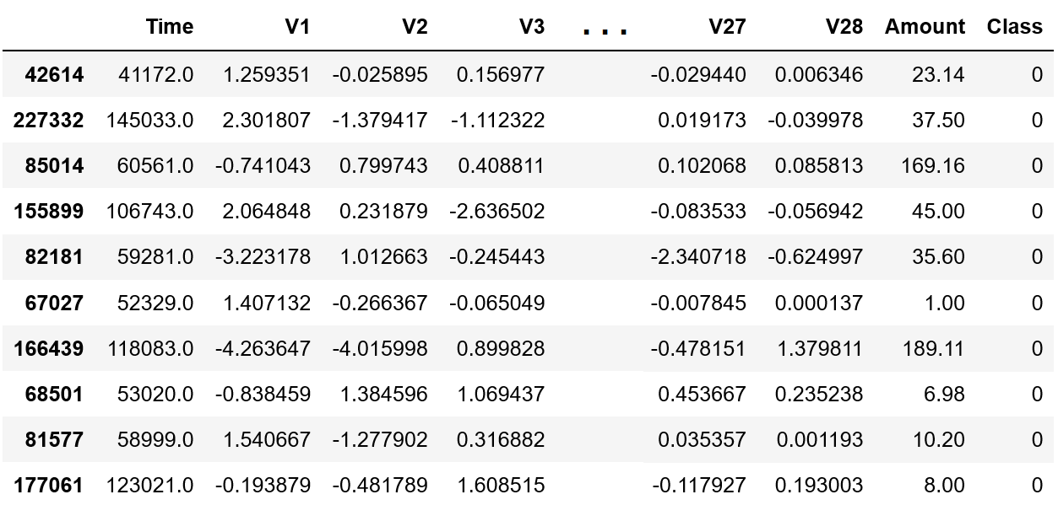
Random 10 samples from the dataset

Slide 9
Exploratory Data Analysis
Few initial comparisons between three attributes: Time, Amount, Class

Slide 10
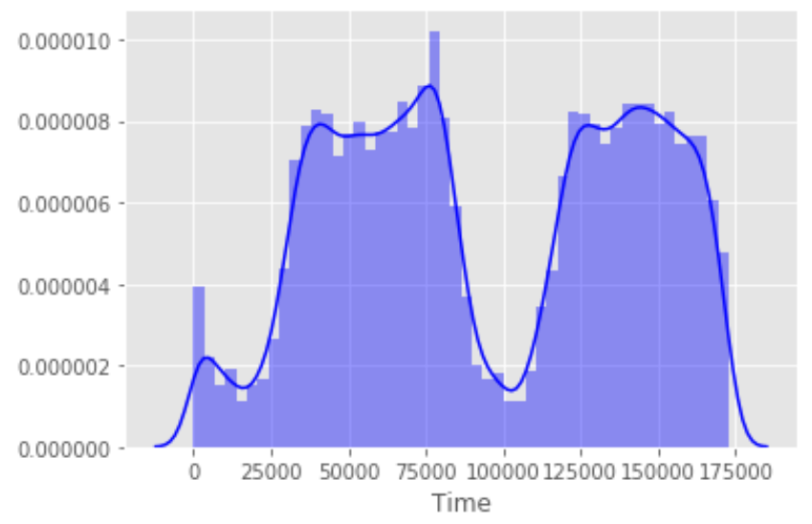
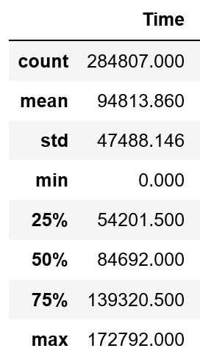
Time Distribution of Credit Card Data

Slide 11
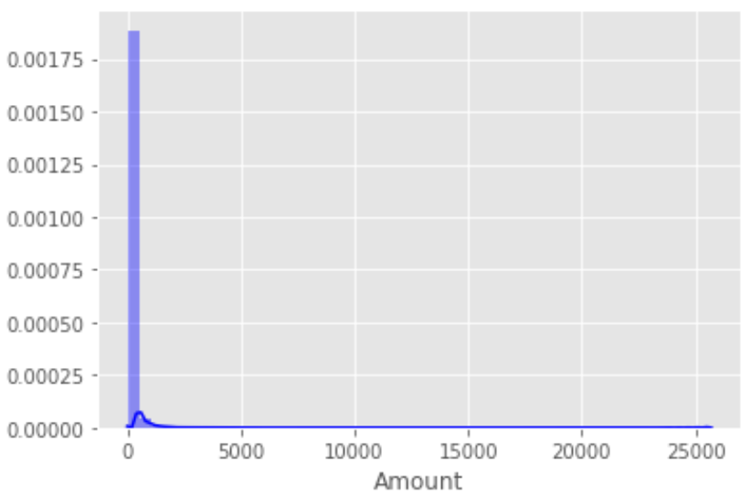
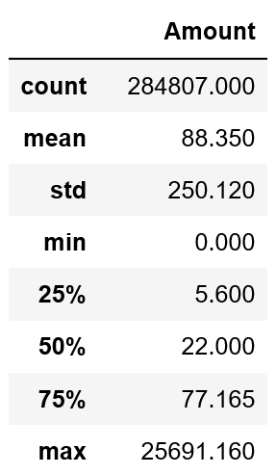
Amount Distribution of Credit Card Data

Slide 12
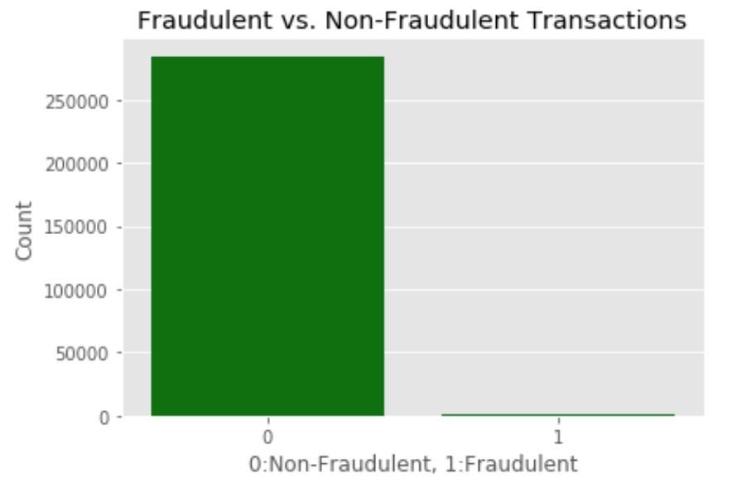
Class Attribute
Ratio: 0.173% | Number of transactions
Fraudulent | 492
Non-fraudulent | 284,315

Slide 13
$60,127.97
Only 2 days
Total amount of fraud transactions
(Nearly 0.24%)

Slide 14
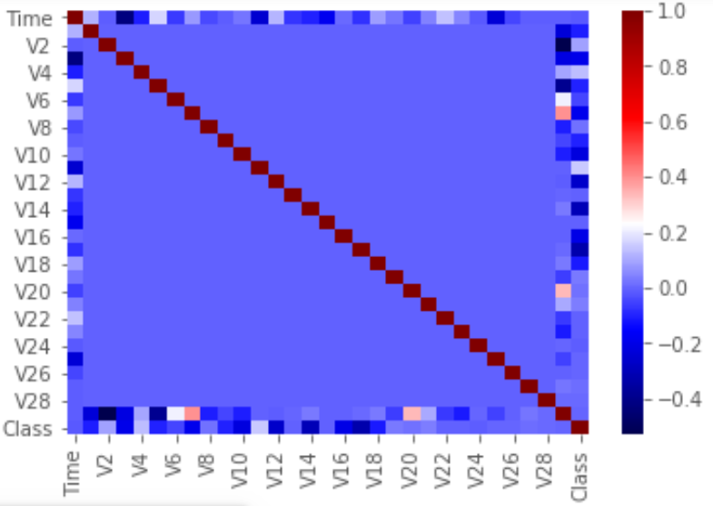
Find Highest Correlations
Time & V3 (-0.42)
Amount & V2 (-0.53)
Amount & V4 (0.4)

Slide 15
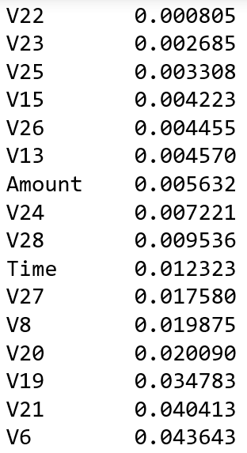
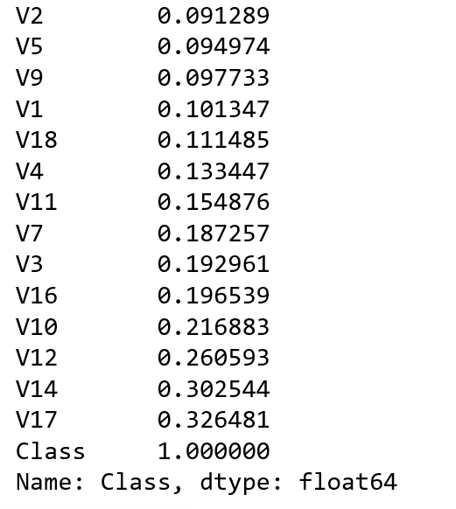
Find Highest Correlations Of Class Attribute

Slide 16
2.
CHOSING MODEL AND DATA

Slide 17
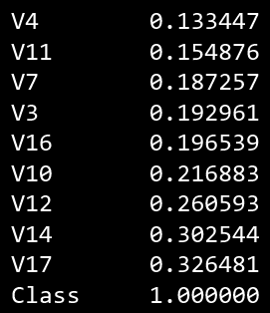
Choose Attributes for Training
10 columns ⬄ 10 attributes
Based on correlation values
Avoiding overfiting
10 chosen columns are: Class, V17, V14, V12, V10, V16, V3, V7, V11, V4.

Slide 18
Before Training
Splitting dataset to 2 paths: training, validation and testing
Test_size = 0.2
Train_size = 0.75 (of 0.8 dataset)
Val_size = 0.25 (of 0.8 dataset)
Using z-score to normalize

Slide 19
Models for Training
Logistic Regression
Naïve Bayes Model
Training with 20 epochs to find best threshold (using validation dataset)

Slide 20
Accuracy Of 2 Models (validation set)

Slide 21
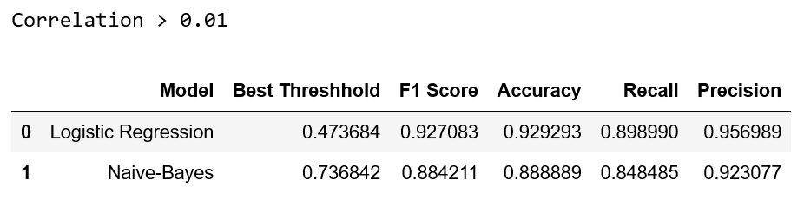
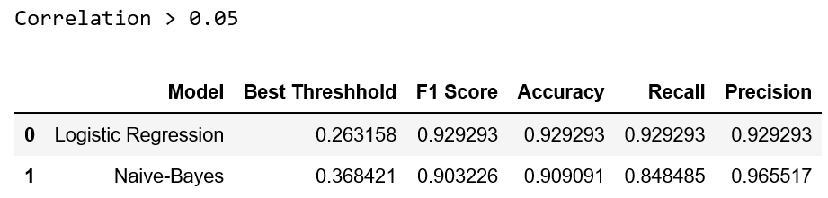
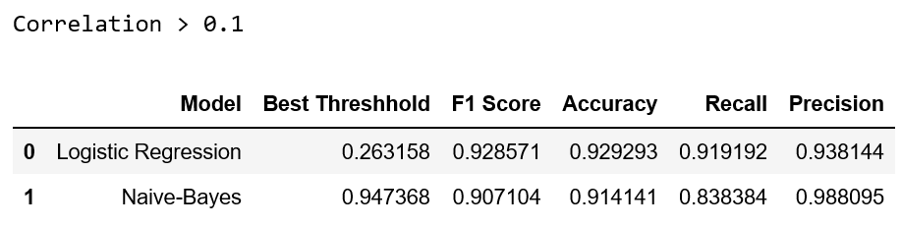
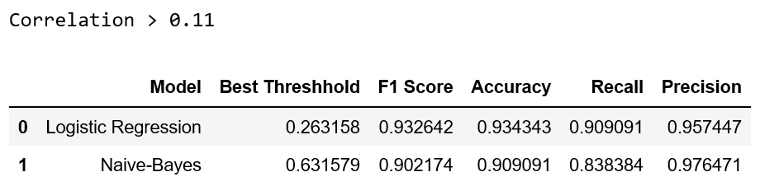

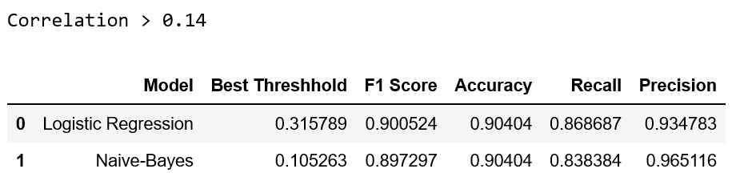
Compare results of Different Chosen Dataset

Slide 22
3.
DEMO AND RESULT

Slide 23
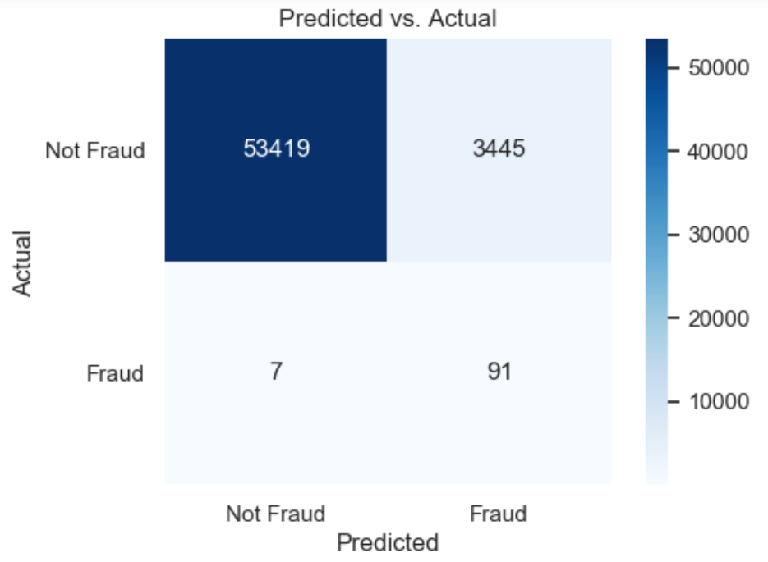
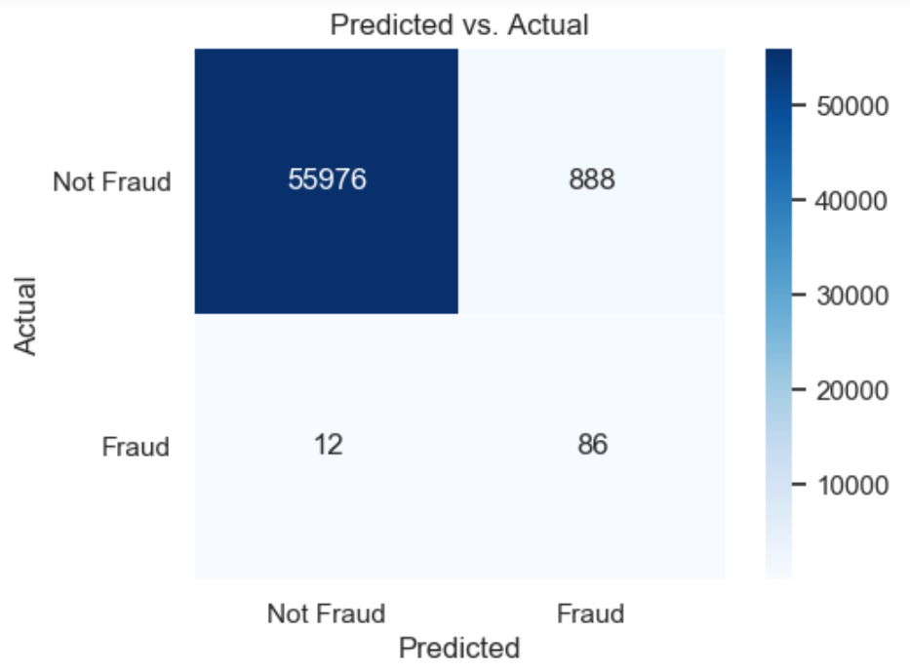
Compare Accuracy of Two Models (test set)
Accuracy of logistic regression model: 0.94
Accuracy of Naïve Bayes model: 0.98
Logistic Regresison
Naïve Bayes

Slide 24
Thanks For Listening!
Any questions?
Group 02

