Slide 1
UNITTEST WITH G-TEST GUIDELINE
Nguyen Ngoc Hung

Slide 2
Content
Introduce G-test
G-test Idea
Structure of Mock files.
Test Case and some tip

Slide 3
Introduce G-test
Introduce G-test:
This is test Framework, built and developed by Google.
It is a library for writing c++ test.
It is based on xUnit architecture which is a set of “Frameworks” for programming and automated execution of test cases.
Why Google-test?
Googletest helps us to write better C++ tests.
Independent and Repeatable: Googletest isolates the tests by running each of them on a different object.
Portable and Reusable: Googletest works on different Oses (Linux, Windows, or a Mac), with different compilers.
When tests fail, it should provide as much information about the problem as possible.
Reference: https://www.geeksforgeeks.org/gtest-framework/

Slide 4
G-test Idea
G-test Idea:
The main target of test is show that the tested function is doing it’s job correctly.
In this example, expectations are divided to case:
b.g() return true, and function f return immediately.
b.g() return false, the function will do something after.
So the problem is how to know, and control the result of B::g().
Class under test
class A{
public:
void f(int a) {
B b;
if(b.g())
return;
else
{ do something….}
}
};
To resolve this problem, G-test made another function, with named: Mock_function to control the result of B::g(), and the files collect all the function of class B, called: Mock_file class B. It has structure as below:
=> So when calling b.g() in function f, G-test will try to call function was defined in Mock_class, and the object of MockB will toward to call MOCK_METHOD. Then you can use some functions of G-test to control and know b.g() was call or not, and return the value as you expect (let see at the next sections).
Mock class of classB
class MockB
{
MOCK_METHOD0(g,void());
}
MockB M_B;
Void B::g(){
M_B.g();
}

Slide 5
G-test Idea
G-test Idea:
To easy to control all Tested Functions and all test cases correspondingly. We will collect all in file, let name it: GMock_file_under_test.cpp.
So Until now we knew three files:
Under test files.
Mock files.
GMock files.
Under test files | Mock files | GMock files
Files need to check that it is following the expectations. It has all functions need to test. | The files has all mock files, which are defined and declared as g-test rule. | File will include both of under test file and mock files, and has some especial function to setup and tear down the objects. It also has all test cases to test the functions of under test file.

Slide 6
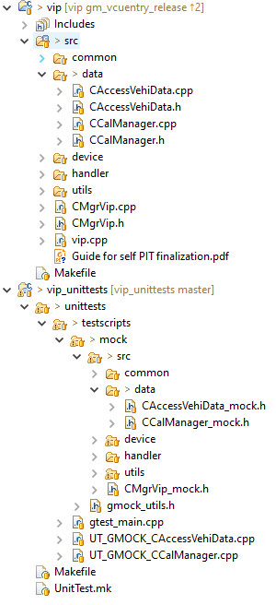
G-test Idea
Mock class of classA
class MockA
{
MOCK_METHOD1(f,void(int a));
}
MockA M_A;
Void A::f(int a){
M_A.f(a);
}
Mock class of classB
class MockB
{
MOCK_METHOD0(g,void());
}
MockB M_B;
Void B::g(){
M_B.g();
}
Folder structure (L3)
+use
Class under test
class A{
public:
void f(int a) {
B b;
b.g();
}
};
Class under test
Class B{
public:
void g();
};
+use
+use
TC for method f
TEST_F(ATest,A_f_TC001){
A testObj;
EXPECT_CALL(M_B,g());
testObj.f(1);
}
TC for method g
TEST_F(Btest,B_f_TC001){
//do something
}

Slide 7
Structure of Mock files
Let put name of class mock of class B: MockB (Mock +original class name).

Slide 8
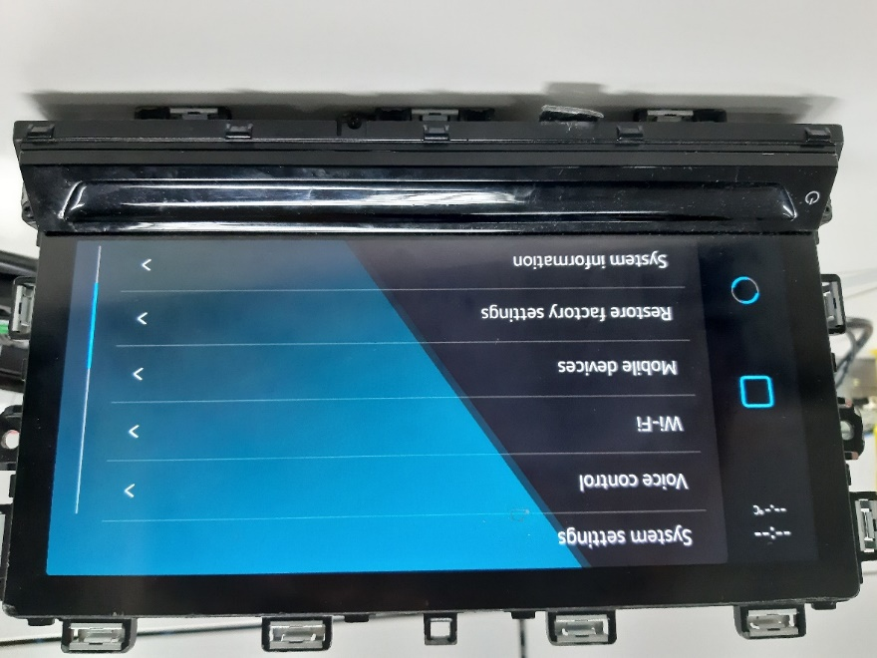
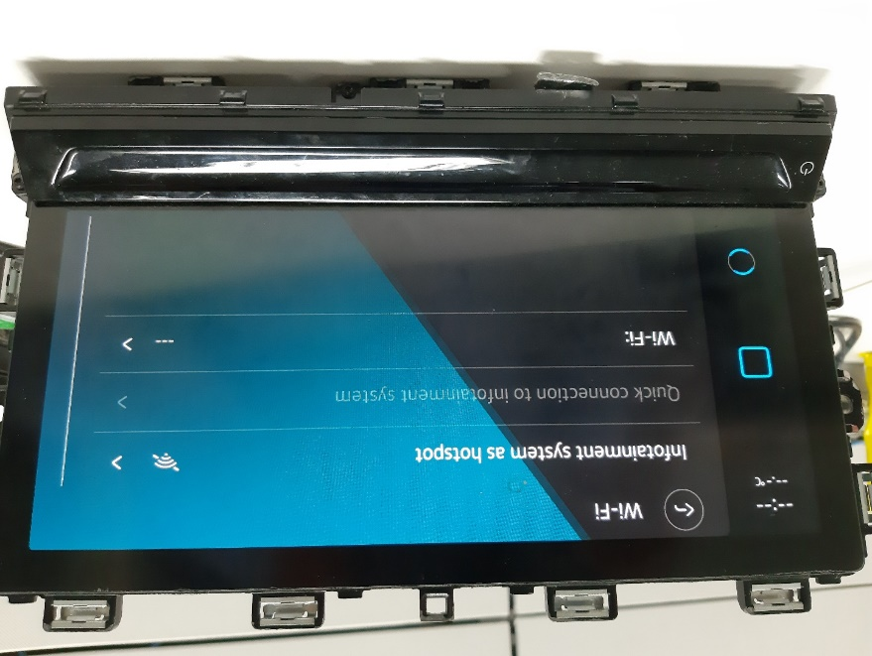
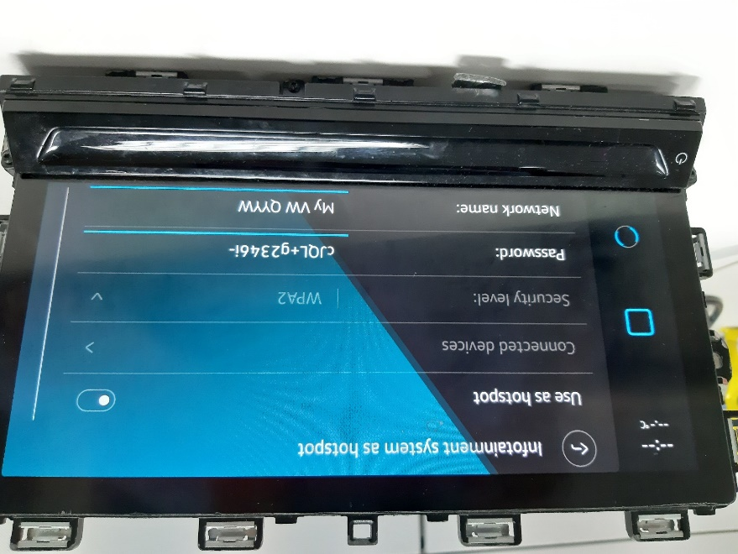
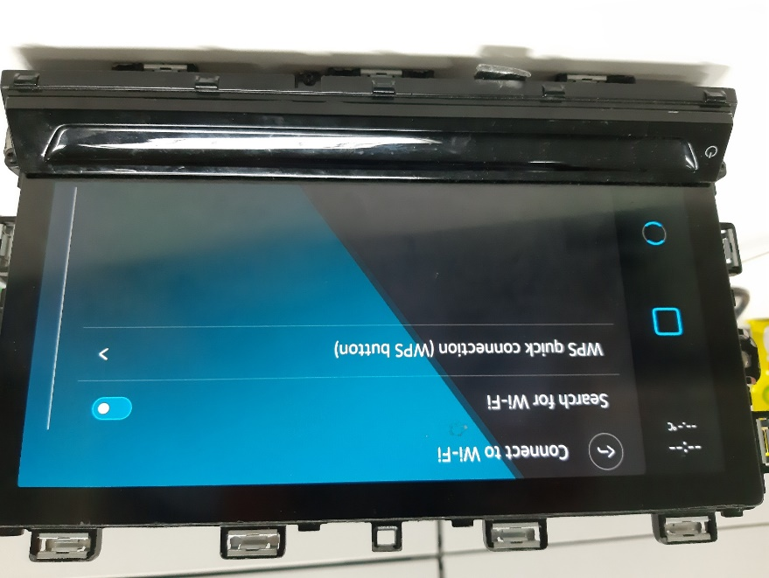
Icas-wlan structure
The actual image on HU
AP mode
STA mode

Slide 9
WLAN main function list
The main functions of AP and STA mode
AP | STA
Displaying current and configuration | Displaying current and configuration
Switching AP mode on/off through User | Switching STA mode on/off through User
Association/Disassociation to system’s AP through clients | Scanning for Wi-fi Network
Changing configuration of the system’s AP | Automatic/manual connection to a wifi-network
QR code handling | Postmortem handling of wificonnection (with old connection)
Connection of clients | Wps client mode
Inspection currently connected clients in AP mode | WPS PBC in STA mode
Managing currently connected clients in AP mode | WPS PIN in STA mode(display/keypad)
WPS PBC in AP mode
WPS PIN AP mode (display/keypad)
Error handling in AP mode

Slide 10
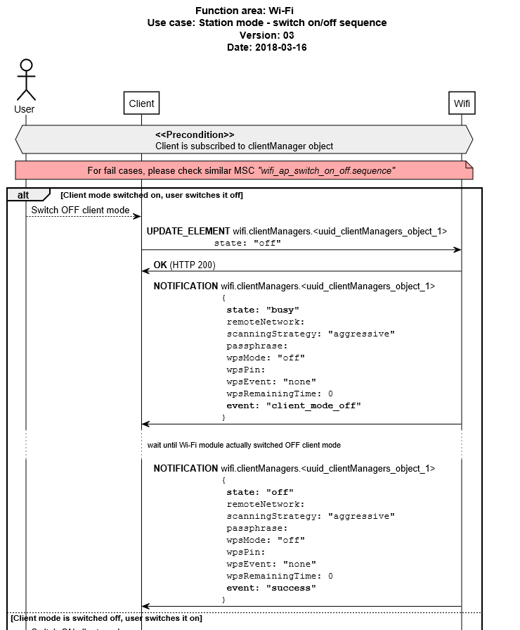
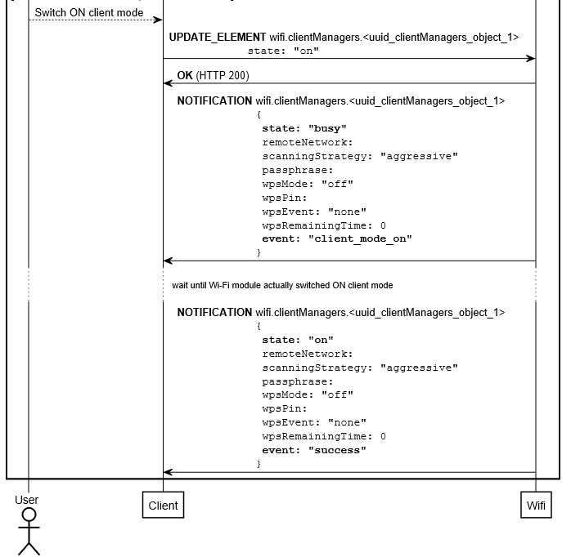
Some sequence examples
Switch on/of sequence chart

Slide 11
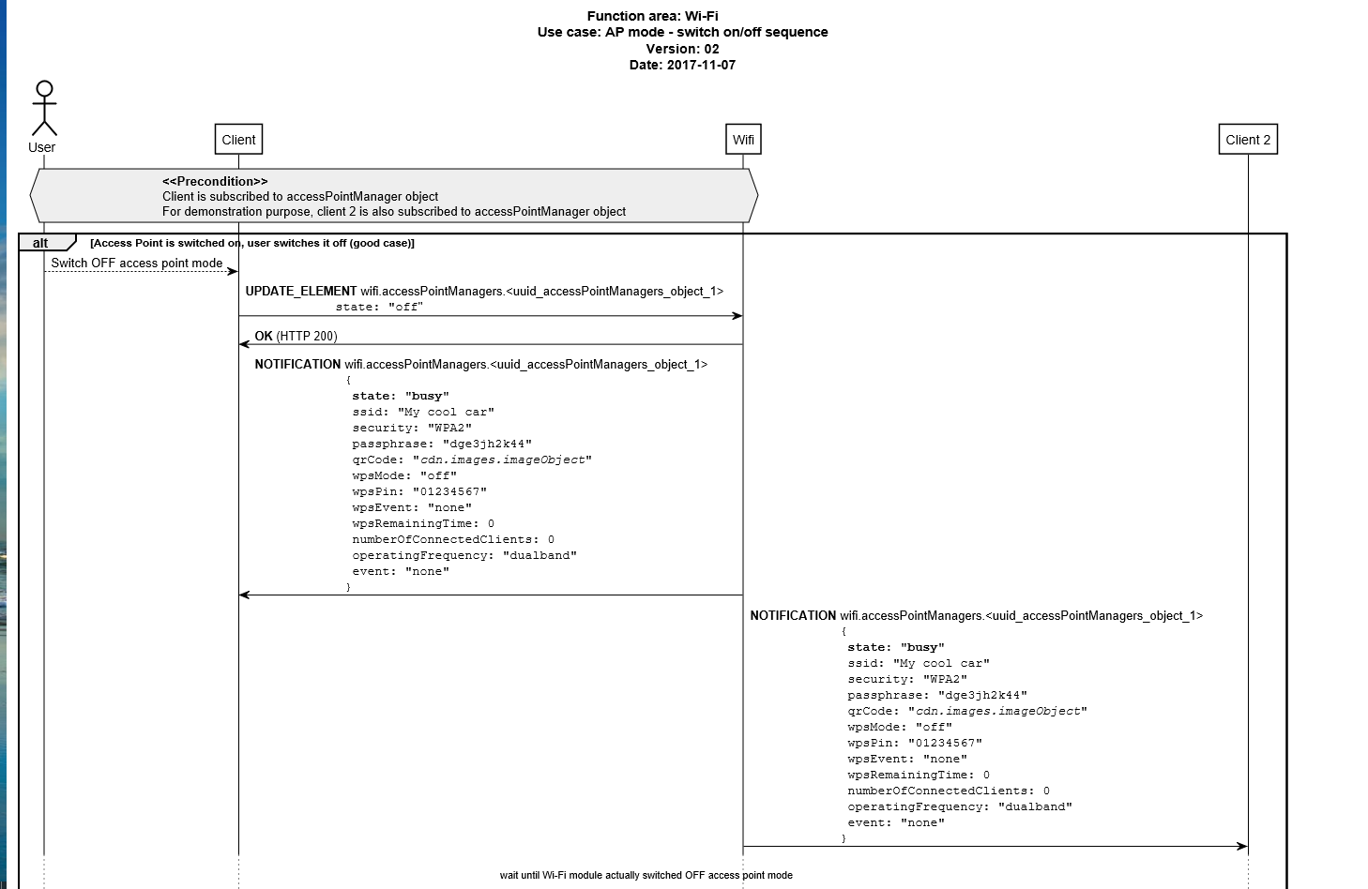
Some sequence examples
Switch on/of sequence chart

Slide 12
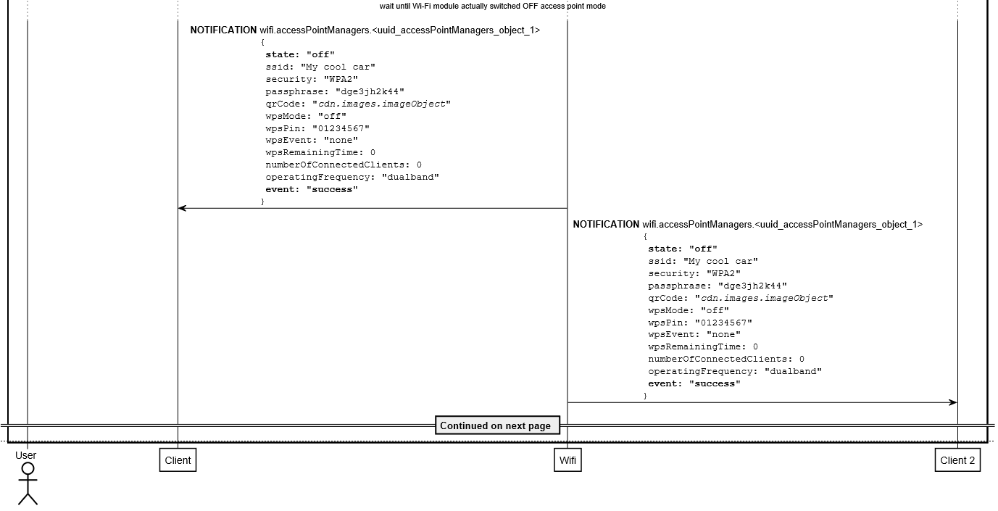
Some sequence examples
Switch on/of sequence chart

Slide 13
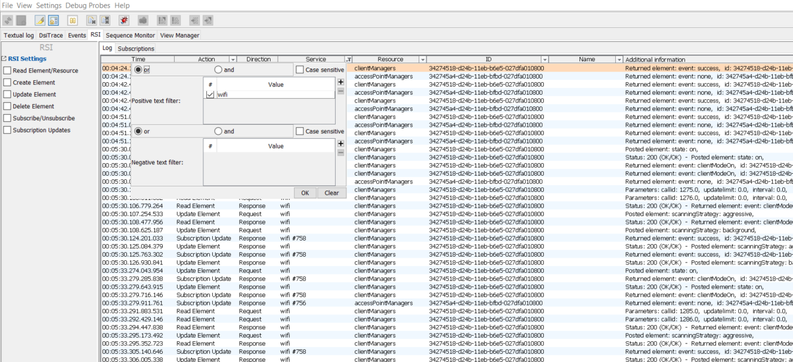
Some log display examples
HMI selection guideline
Selection RSI and then add search key “wifi” or another key to other field to get your expected results

Slide 14
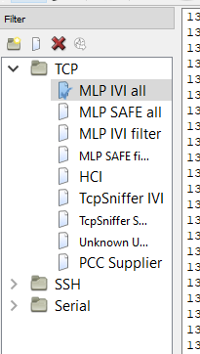
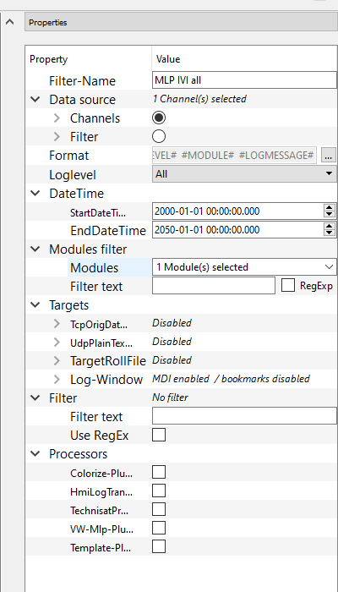
Some log display examples
Seriel2 log: selection guideline
Click here and select WLAN to see log of WLAN
Select “MLP IVI all” to see all log, or another action as you want
You also input text to filter anything as you want
Actually you can use combination of key (Ctrl+F) to search some key also.

Slide 15
Some log display examples
Switch on log example:
17:56:10.439 02:21:53.672- 2020-07-02: Info ApplicationProcessor.Application.Connectivity.General RsiHTTPRequestHandler.cpp handleRequest 79 [rsi][wlanmgr]request URL = /wifi/clientManagers/1a8b5174-a6b9-11d3-b15b-027dfa010801
17:56:10.439 02:21:53.672- 2020-07-02: Info ApplicationProcessor.Application.Connectivity.General RsiHTTPRequestHandler.cpp handleRequest 81 [rsi][wlanmgr]User-Agent = VW-HMI
17:56:10.439 02:21:53.672- 2020-07-02: Info ApplicationProcessor.Application.Connectivity.General RsiRequest.cpp RsiRequest 62 [rsi][wlanmgr]Receive POST /wifi/clientManagers/1a8b5174-a6b9-11d3-b15b-027dfa010801
17:56:10.439 02:21:53.672- 2020-07-02: Info ApplicationProcessor.Application.Connectivity.WLAN WifiClientManagerElement.cpp 376 WL#RSI:fromJSON:request update : KEY_STATE= on

Slide 16
Explanation of checking bug
Link ticket: http://vlm.lge.com/issue/browse/VWICASDQA4450?attachmentSortBy=dateTime&attachmentOrder=asc
Let read carefully all the precondition of test case.
Analyzing carefully the provided video and find the actions of user.
On log Seri2 let check: kls=1 and power mode =9, if two conditions is not fulfill you can deny this bug and request to get new log with two corrected conditions.
If Seri2 log is correct, let start from the action of HMI log first. Let check the action on Seri2 log also (example FromJson…)
Keep on doing with your analysis.
However these steps just is reference you can do as another was, if you can sure it true.

Slide 17
Contact points
VH FO WLAN: huynh.pham (Pham Van Huynh)
HQ FO WLAN: kim.sejin (Kim Sejin)
CHN FO WLAN: byoungwook.baek (Byong Wook Baek)
VH Old WLAN’s member: luan1.nguyen(Nguyen Van Luan)
HMI DRI:
Tester:

Slide 18

Thank you

