Slide 1

Web Scraping & Rendering Data

Slide 2
Content
Section 1: Brief introduction to web scraping
What is web scraping?
What is it used for?
How does it work?
Section 2: What I have done with web scraping to build a personal web application

Slide 3
What is Web Scraping?
Web scraping refers to the extraction of data from a website.

Slide 4
What is Web Scraping used for?
BI Analyst
Data to create dashboards and business
insights
Data Scientist
Data to train data science models
Job Seekers
Get contact info of recruiters and department heads/directors
Investors
Gather stock prices, financial info & market news

Slide 5
How does it work?
Let’s do a little experiment!

Slide 6
Side Project – Web Application
A simple website to keep up to date with what is going on in Melbourne for This Weekend
Which are the top events for this weekend?
What is on in Melbourne for this season?
How is the weather like?
# Covid cases today?

Slide 7
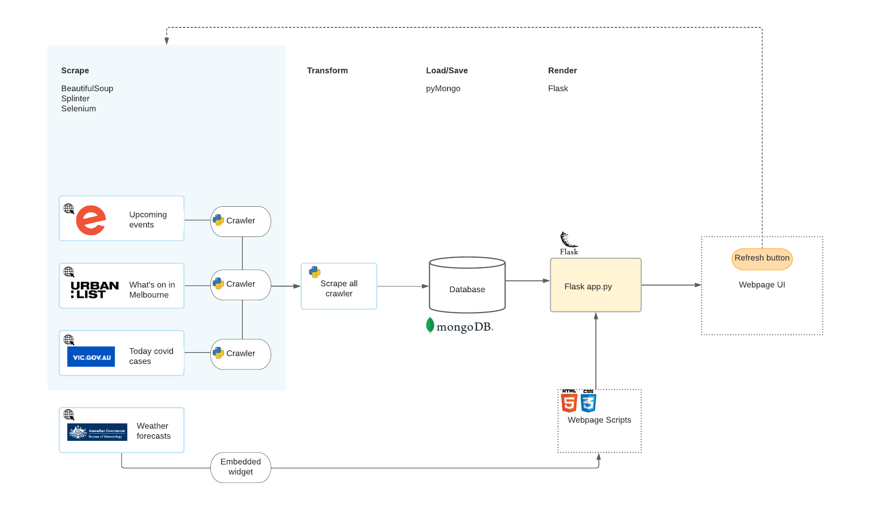
Data framework
Preferred for unstructured data (scrappy data)

