Slide 1
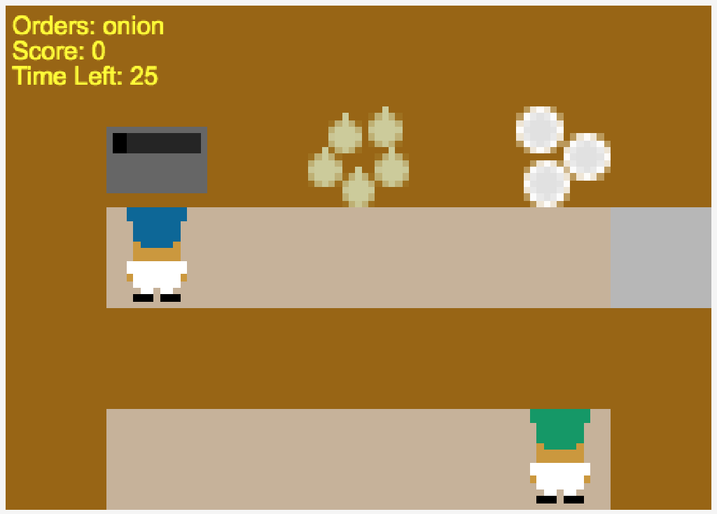
Soup orders,
Score,
And time left (sec)
Cook onions
in this pot
(3 needed)
Get onions here
Dishes for serving
Your Partner
Serving counter
This is you

Slide 2
Serving counter

Slide 3


Cooking
Soup
Cooked
Soup

Slide 4
