Slide 1
Review the last lesson
What did we learn from the last lesson?

Slide 2
CHAPTER 14 Beyond functionality

Slide 3
Objectives
Understand the role of quality requirements in software development.
1
Be able to define and specify nonfunctional requirements.
2
Understand the quality attributes on agile projects.
3

Slide 4
Contents
Nonfunctional requirements
Software quality attributes
Defining quality requirements
Exploring quality attributes
Constraints
Quality attribute trade-offs
Implementing quality attribute requirements
Specifying quality requirements with Planguage
Handling quality attributes on agile projects

Slide 5
1. Nonfunctional requirements
What happen if your application is:
Very difficult to use
Very slow running
Easy to lose data
Not able to extend to serve more users
…
Nonfunctional requirements contain of:
External interface requirements
Quality attributes
Constraints

Slide 6
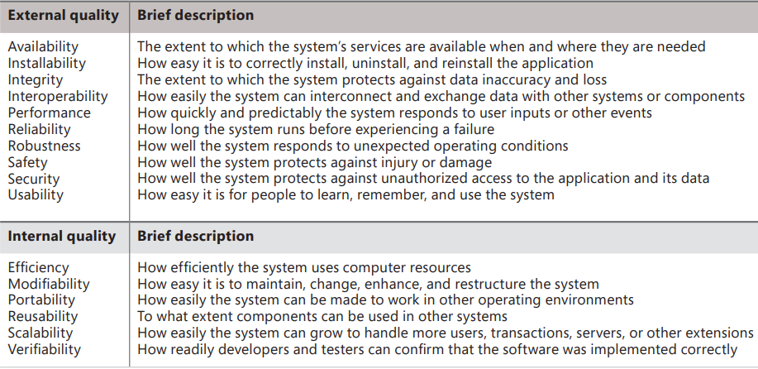
2. Software quality attributes
TABLE 14-1 Some software quality attributes
Notes:
External: can be recognized through execution, are primarily important to users
Internal: can not, are more significant to development and maintenance staffs

Slide 7
3. Defining quality requirements External quality attributes
External quality attributes describe characteristics that are observed when the software is executing.
They profoundly influence the user experience and the user’s perception of system quality.
The external quality attributes described in this chapter are availability, installability, integrity, interoperability, performance, reliability, robustness, safety, security, and usability.

Slide 8
External quality attributes Availability
A measure of the planned-up time during which the system’s services are available for use and fully operational.
Formally, availability equals the ratio of up time to the sum of up time and down time.
Samples:
AVL-1. The system shall be at least 95 percent available on weekdays between 6:00 A.M. and midnight Eastern Time, and at least 99 percent available on weekdays between 3:00 P.M. and 5:00 P.M. Eastern Time.
AVL-2. Down time that is excluded from the calculation of availability consists of maintenance scheduled during the hours from 6:00 P.M. Sunday Pacific Time, through 3:00 A.M. Monday Pacific Time.
When eliciting availability requirements, ask questions to explore the following issues:
■ What portions of the system are most critical for being available?
■ What are the business consequences of the system being unavailable to its users?
■ If scheduled maintenance must be performed periodically, when should it be scheduled? What is the impact on system availability? What are the minimum and maximum durations of the maintenance periods? How are user access attempts to be managed during the maintenance periods?
Notes:
The extent to which the system’s services are available when and where they are needed

Slide 9
External quality attributes Installability
A measure of a system’s installability is the mean time to install the system.
Samples:
INS-1. An untrained user shall be able to successfully perform an initial installation of the application in an average of 10 minutes.
INS-2. When installing an upgraded version of the application, all customizations in the user’s profile shall be retained and converted to the new version’s data format if needed.
INS-3. The installation program shall verify the correctness of the download before beginning the installation process.
INS-4. Installing this software on a server requires administrator privileges.
INS-5. Following successful installation, the installation program shall delete all temporary, backup, obsolete, and unneeded files associated with the application.
Installability addresses the following activities:
■ Initial installation
■ Recovery from an incomplete, incorrect, or user-aborted installation
■ Reinstallation of the same version
■ Installation of a new version
■ Reverting to a previous version
■ Installation of additional components or updates
■ Uninstallation
Following are examples of some questions to explore when eliciting installability requirements:
■ What installation operations must be performed without disturbing the user’s session?
■ What installation operations will require a restart of the application? Of the computer or device?
■ What should the application do upon successful, or unsuccessful, installation?
■ What operations should be performed to confirm the validity of an installation?
■ Does the user need the capability to install, uninstall, reinstall, or repair just selected portions of the application? If so, which portions?
Notes:
How easy it is to correctly install, uninstall, and reinstall the application

Slide 10
External quality attributes Integrity
Integrity deals with preventing information loss and preserving the correctness of data entered into the system.
Integrity requirements have no tolerance for error: the data is either in good shape and protected, or it is not. Samples:
INT-1. After performing a file backup, the system shall verify the backup copy against the original and report any discrepancies.
INT-2. The system shall protect against the unauthorized addition, deletion, or modification of data.
INT-3. The Chemical Tracking System shall confirm that an encoded chemical structure imported from third-party structure-drawing tools represents a valid chemical structure.
INT-4. The system shall confirm daily that the application executables have not been modified by the addition of unauthorized code.
Some factors to consider when discussing integrity requirements include the following:
■ Ensuring that changes in the data are made either entirely or not at all. This might mean backing out of a data change if a failure is encountered partway through the operation.
■ Ensuring the persistence of changes that are made in the data.
■ Coordinating changes made in multiple data stores, particularly when changes have to be made simultaneously (say, on multiple servers) and at a specific time (say, at 12:00 A.M. GMT on January 1 in several locations).
■ Ensuring the physical security of computers and external storage devices.
■ Performing data backups. (At what frequency? Automatically and/or on demand? Of what files or databases? To what media? With or without compression and verification?)
■ Restoring data from a backup.
■ Archiving of data: what data, when to archive, for how long, with what deletion requirements.
■ Protecting data stored or backed up in the cloud from people who aren’t supposed to access it.
Notes:
The extent to which the system protects against data inaccuracy and loss

Slide 11
External quality attributes Interoperability
Interoperability indicates how readily the system can exchange data and services with other software systems and how easily it can integrate with external hardware devices.
Samples:
IOP-1. The Chemical Tracking System shall be able to import any valid chemical structure from the ChemDraw (version 13.0 or earlier) and MarvinSketch (version 5.0 or earlier) tools.
IOP-2. The Chemical Tracking System shall be able to import any chemical structure encoded using the SMILES (simplified molecular-input line-entry system) notation.
Following are some questions you can use when exploring interoperability requirements:
■ To what other systems must this one interface? What services or data must they exchange?
■ What standard data formats are necessary for data that needs to be exchanged with other systems?
■ What specific hardware components must interconnect with the system?
■ What messages or codes must the system receive and process from other systems or devices?
■ What standard communication protocols are necessary to enable interoperability?
■ What externally mandated interoperability requirements must the system satisfy?
Notes:
How easily the system can interconnect and exchange data with other systems or components

Slide 12
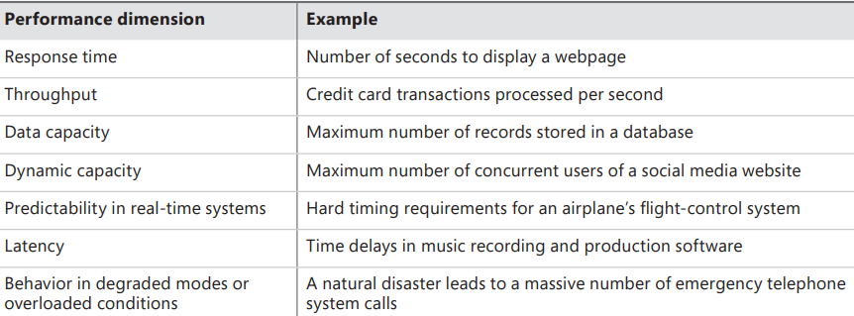
External quality attributes Performance
Performance represents the responsiveness of the system to various user inquiries and actions. Samples:
PER-1. Authorization of an ATM withdrawal request shall take no more than 2.0 seconds.
PER-2. The anti-lock braking system speed sensors shall report wheel speeds every 2 milliseconds with a variation not to exceed 0.1 millisecond.
PER-3. Webpages shall fully download in an average of 3 seconds or less over a 30 megabits/second Internet connection.
PER-4. At least 98 percent of the time, the trading system shall update the transaction status display within 1 second after the completion of each trade.
TABLE 14-2 Some aspects of performance
Notes:
How quickly and predictably the system responds to user inputs or other events

Slide 13
External quality attributes Reliability
Reliability: The probability of the software executing without failure for a specific period of time is known as reliability.
Samples:
REL-1. No more than 5 experimental runs out of 1,000 can be lost because of software failures.
REL-2. The mean time between failures of the card reader component shall be at least 90 days.
Following are some questions to ask user representatives when you’re eliciting reliability requirements:
■ How would you judge whether this system was reliable enough?
■ What would be the consequences of experiencing a failure when performing certain operations with the system?
■ What would you consider to be a critical failure, as opposed to a nuisance?
■ Under what conditions could a failure have severe repercussions on your business operations?
Notes:
How long the system runs before experiencing a failure

Slide 14
External quality attributes Robustness
Robustness is the degree to which a system continues to function properly when confronted with invalid inputs, defects in connected software or hardware components, external attack, or unexpected operating conditions.
Samples:
ROB-1. If the text editor fails before the user saves the file, it shall recover the contents of the file being edited as of, at most, one minute prior to the failure the next time the same user launches the application.
ROB-2. All plot description parameters shall have default values specified, which the Graphics Engine shall use if a parameter’s input data is missing or invalid.
Notes:
How well the system responds to unexpected operating conditions

Slide 15
External quality attributes Safety
Safety requirements deal with the need to prevent a system from doing any injury to people or damage to property.
Samples:
SAF-1. The user shall be able to see a list of all ingredients in any menu items, with ingredients highlighted that are known to cause allergic reactions in more than 0.5 percent of the North American population.
SAF-2. If the reactor vessel’s temperature is rising faster than 5°C per minute, the Chemical Reactor Control System shall turn off the heat source and signal a warning to the operator.
SAF-3. The therapeutic radiation machine shall allow irradiation only if the proper filter is in place.
SAF-4. The system shall terminate any operation within 1 second if the measured tank pressure exceeds 90 percent of the specified maximum pressure.
Notes:
How well the system protects against injury or damage
Allergic: dị ứng

Slide 16
External quality attributes Security
Security deals with blocking unauthorized access to system functions or data, ensuring that the software is protected from malware attacks, and so on.
Following are some considerations to examine when eliciting security requirements:
User authorization or privilege levels (ordinary user, guest user, administrator) and user access controls
User identification and authentication (password construction rules, password change frequency, security questions, forgotten logon name or password procedures, biometric identification, account locking after unsuccessful access attempts, unrecognized computer)
Data privacy (who can create, see, change, copy, print, and delete what information)
Deliberate data destruction, corruption, or theft
Protection against viruses, worms, Trojan horses, spyware, rootkits, and other malware
Firewall and other network security issues
Encryption of secure data
Building audit trails of operations performed and access attempts.
Notes:
How well the system protects against unauthorized access to the application and its data
Deliberate: Cố ý

Slide 17
Security (cont.)
Samples:
SEC-1. The system shall lock a user’s account after four consecutive unsuccessful logon attempts within a period of five minutes.
SEC-2. The system shall log all attempts to access secure data by users having insufficient privilege levels.
SEC-3. A user shall have to change the temporary password assigned by the security officer to a previously unused password immediately following the first successful logon with the temporary password.
SEC-4. A door unlock that results from a successful security badge read shall keep the door unlocked for 8.0 seconds, with a tolerance of 0.5 second.
SEC-5. The resident antimalware software shall quarantine any incoming Internet traffic that exhibits characteristics of known or suspected virus signatures.
SEC-6. The magnetometer shall detect at least 99.9 percent of prohibited objects, with a false positive rate not to exceed 1 percent.
SEC-7. Only users who have Auditor access privileges shall be able to view customer transaction histories.

Slide 18
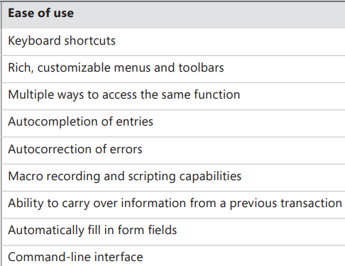
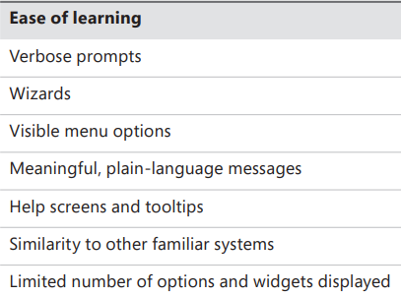
External quality attributes Usability
Usability addresses the myriad factors that constitute what people describe colloquially as user-friendliness, ease of use, and human engineering. Samples:
USE-1. A trained user shall be able to submit a request for a chemical from a vendor catalog in an average of three minutes, and in a maximum of five minutes, 95 percent of the time.
USE-2. All functions on the File menu shall have shortcut keys defined that use the Control key pressed simultaneously with one other key. Menu commands that also appear in Microsoft Word shall use the same default shortcut keys that Word uses.
USE-3. 95 percent of chemists who have never used the Chemical Tracking System before shall be able to place a request for a chemical correctly with no more than 15 minutes of orientation.
TABLE 14-3 Possible design approaches for ease of learning and ease of use
Notes:
How easy it is for people to learn, remember, and use the system
Verbose: Dài dòng

Slide 19
Internal quality attributes Efficiency
Efficiency is closely related to the external quality attribute of performance. Efficiency is a measure of how well the system utilizes processor capacity, disk space, memory, or communication bandwidth.
Samples:
EFF-1. At least 30 percent of the processor capacity and memory available to the application shall be unused at the planned peak load conditions.
EFF-2. The system shall provide the operator with a warning message when the usage load exceeds 80 percent of the maximum planned capacity.
Notes:
How efficiently the system uses computer resources

Slide 20
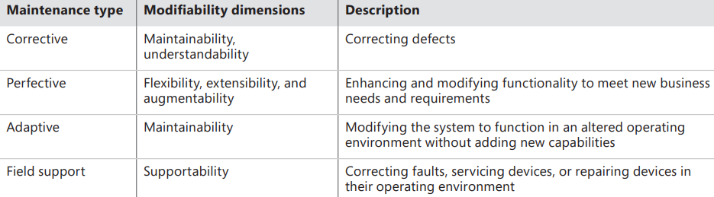
Internal quality attributes Modifiability
Modifiability addresses how easily the software designs and code can be understood, changed, and extended. Samples:
MOD-1. A maintenance programmer experienced with the system shall be able to modify existing reports to conform to revised chemical-reporting regulations from the federal government with 10 hours or less of development effort.
MOD-2. Function calls shall not be nested more than two levels deep
SUP-1. A certified repair technician shall be able to replace the scanner module in no more than 10 minutes.
SUP-2. The printer shall display an error message if replacement ink cartridges were not inserted in the proper slots.
TABLE 14-4 Some aspects of modifiability
Notes:
How easy it is to maintain, change, enhance, and restructure the system

Slide 21
Internal quality attributes Portability
Portability: The effort needed to migrate software from one operating environment to another is a measure of portability.
Samples:
POR-1. Modifying the iOS version of the application to run on Android devices shall require changing no more than 10 percent of the source code.
POR-2. The user shall be able to port browser bookmarks to and from Firefox, Internet Explorer, Opera, Chrome, and Safari.
POR-3. The platform migration tool shall transfer customized user profiles to the new installation with no user action needed.
When you are exploring portability, questions like the following might be helpful:
What different platforms will this software need to run on, both now and in the future?
What portions of the product need to be designed for greater portability than other portions?
What data files, program components, or other elements of the system need to be portable?
By making the software more portable, what other quality attributes might be compromised?
Notes:
How easily the system can be made to work in other operating environments

Slide 22
Internal quality attributes Reusability
Reusability indicates the relative effort required to convert a software component for use in other applications. Reusable software must be modular, well documented, independent of a specific application and operating environment, and somewhat generic in capability.
Samples:
REU-1. The chemical structure input functions shall be reusable at the object code level in other applications.
REU-2. At least 30 percent of the application architecture shall be reused from the approved reference architectures.
REU-3. The pricing algorithms shall be reusable by future store-management applications.
Consider discussing the following questions when you are trying to learn about reusability requirements for your project:
What existing requirements, models, design components, data, or tests could be reused in this application?
What functionality available in related applications might meet certain requirements for this application?
What portions of this application offer good potential for being reused elsewhere?
What special actions should be taken to facilitate making portions of this application reusable?
Notes:
To what extent components can be used in other systems

Slide 23
Internal quality attributes Scalability
Scalability requirements address the ability of the application to grow to accommodate more users, data, servers, geographic locations, transactions, network traffic, searches, and other services without compromising performance or correctness.
SCA-1. The capacity of the emergency telephone system must be able to be increased from 500 calls per day to 2,500 calls per day within 12 hours.
SCA-2. The website shall be able to handle a page-view growth rate of 30 percent per quarter for at least two years without user-perceptible performance degradation.
SCA-3. The distribution system shall be able to accommodate up to 20 new warehouse centers.
The following questions could be helpful during those discussions:
What are your estimates for the number of total and concurrent users the system must be able to handle over the next several months, quarters, or years?
Can you describe how and why data capacity demands of the system might grow in the future?
What are the minimum acceptable performance criteria that must be satisfied regardless of the number of users?
What growth plans are available regarding how many servers, data centers, or individual installations the system might be expected to run on?
Notes:
How easily the system can grow to handle more users, transactions, servers, or other extensions

Slide 24
Internal quality attributes Verifiability
Verifiability: More narrowly referred to as testability, verifiability refers to how well software components or the integrated product can be evaluated to demonstrate whether the system functions as expected.
VER-1. The development environment configuration shall be identical to the test configuration environment to avoid irreproducible testing failures.
VER-2. A tester shall be able to configure which execution results are logged during testing.
VER-3. The developer shall be able to set the computational module to show the interim results of any specified algorithm group for debugging purposes.
VER-4. The maximum cyclomatic complexity of a module shall not exceed 20.
Defining verifiability requirements can be difficult. Explore questions like the following:
How can we confirm that specific calculations are giving the expected results?
Are there any portions of the system that do not yield deterministic outputs, such that it could be difficult to determine if they were working correctly?
Is it possible to come up with test data sets that have a high probability of revealing any errors in the requirements or in their implementation?
What reference reports or other outputs can we use to verify that the system is producing its outputs correctly?
Notes:
How readily developers and testers can confirm that the software was implemented correctly

Slide 25
4. Exploring quality attributes
Step 1
Start with a broad taxonomy
Step 2
Reduce the list
Step 3
Prioritize the attributes
Step 4
Elicit specific expectations for each attribute
Step 5
Specify well-structured quality requirements

Slide 26
Step 1&2: Taxonomy and Reduce the List
Step 1: Start with a broad taxonomy
Begin with a rich set of quality attributes to consider, such as those listed in Table 14-1. This broad starting point reduces the likelihood of overlooking an important quality dimension.
Step 2: Reduce the list
Engage a cross-section of stakeholders to assess which of the attributes are likely to be important to the project.
An airport check-in kiosk needs to emphasize usability (because most users will encounter it infrequently) and security (because it has to handle payments).
Attributes that don’t apply to your project need not be considered further. Record the rationale for deciding that a particular quality attribute is either in or out of consideration.

Slide 27
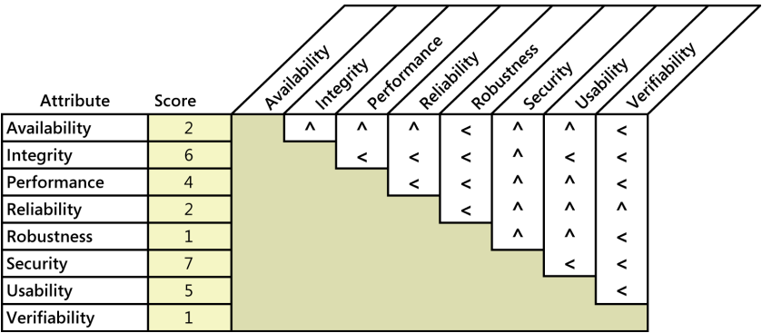
Step 3: Prioritize the attributes
Figure 14-1 illustrates how to to assess the quality attributes for an airport check-in kiosk. For each cell at the intersection of two attributes, ask yourself, “If I could have only one of these attributes, which would I take?” Entering a sign < in the cell indicates that the attribute in the row is more important; a caret symbol (^) points to the attribute at the top of the column as being more important.
FIGURE 14-1 Sample quality attribute prioritization for an airport check-in kiosk.

Slide 28
Step 4: Elicit specific expectations for each attribute
Following are a few questions a BA might ask to understand user expectations about the performance of a system that manages applications for patents that inventors have submitted:
1. What would be a reasonable or acceptable response time for retrieval of a typical patent application in response to a query?
2. What would users consider an unacceptable response time for a typical query?
3. How many simultaneous users do you expect on average?
4. What’s the maximum number of simultaneous users that you would anticipate?
5. What times of the day, week, month, or year have much heavier usage than usual?

Slide 29
Step 5: Specify well-structured quality requirements
When writing quality requirements, keep in mind the useful SMART mnemonic—make them Specific, Measurable, Attainable, Relevant, and Time-sensitive.

Slide 30
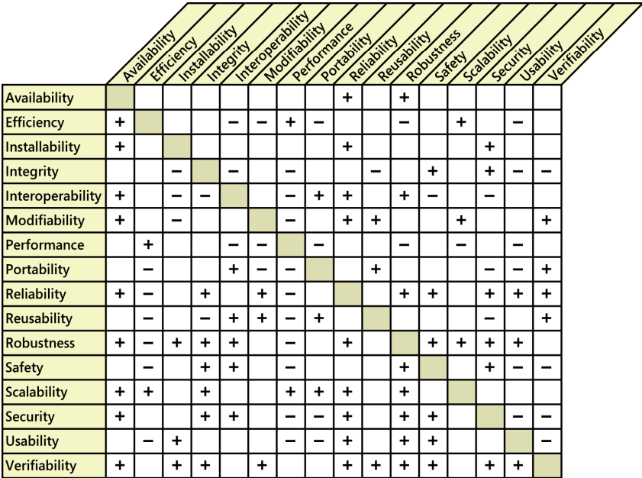
5. Quality attribute trade-offs
Certain attribute combinations have inescapable trade-offs. Users and developers must decide which attributes are more important than others, and they must respect those priorities when they make decisions.
The technique described earlier in “Step 3: Prioritize the attributes” can help with this analysis.
A plus sign in a cell indicates that increasing the attribute in the corresponding row usually has a positive effect on the attribute in the column.
A minus sign in a cell means that increasing the attribute in that row generally adversely affects the attribute in the column.
An empty cell indicates that the attribute in the row has little effect on the attribute in the column.
FIGURE 14-2 Positive and negative relationships among selected quality attributes.

Slide 31
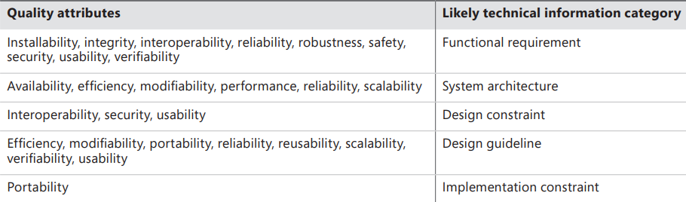
6. Implementing quality attribute requirements
Designers and programmers will have to determine the best way to satisfy each quality requirement.
Although these are nonfunctional requirements, they can lead to derived functional requirements, design guidelines, or other types of technical information that will produce the desired product characteristics.
Table 14-5 indicates the likely categories of technical information that different types of quality attributes will generate.
TABLE 14-5 Translating quality attributes into technical specifications

Slide 32
7. Constraints
Constraint places restrictions on the design or implementation choices available to development team.
CON-1. The user clicks at the top of the project list to change the sort sequence. [specific user interface control imposed as a design constraint on a functional requirement]
CON-2. Only open-source software available under the GNU General Public License may be used to implement the product. [implementation constraint]
CON-3. The application must use Microsoft .NET framework 4.5. [architecture constraint]
CON-4. ATMs contain only $20 bills. [physical constraint]
CON-5. Online payments may be made only through PayPal. [design constraint]
CON-6. All textual data used by the application shall be stored in the form of XML files. [data constraint]

Slide 33
8. Specifying quality requirements with Planguage
Planguage: a language with a rich set of keywords that permits precise statements of quality attributes and other project goals.
Purpose: address the problem of ambiguous and incomplete nonfunctional requirements.

Slide 34
Specifying quality requirements with Planguage
Example: At least 95 percent of the time, the system shall take no more than 8 seconds to display any of the predefined accounting reports.
TAG Performance.Report.ResponseTime
AMBITION Fast response time to generate accounting reports on the base user platform.
SCALE Seconds of elapsed time between pressing the Enter key or clicking OK to request a report and the beginning of the display of the report.
METER Stopwatch testing performed on 30 test reports that represent a defined usage operational profile for a field office accountant.
GOAL No more than 8 seconds for 95 percent of reports. -<-Field Office Manager
STRETCH No more than 2 seconds for predefined reports, 5 seconds for all reports.
WISH No more than 1.5 seconds for all reports.
Base user platform DEFINED Quad-core processor, 8GB RAM, Windows 8, QueryGen 3.3 running, single user, at least 50 percent of system RAM and 70 percent of system CPU capacity free, network connection speed of at least 30 Mbps.

Slide 35
9. Handling quality attributes on agile projects
It can be difficult and expensive to retrofit desired quality characteristics into a product late in development or after delivery.
That’s why even agile projects that develop requirements and deliver functionality in small increments need to specify significant quality attributes and constraints early in the project.
This allows developers to make appropriate architectural and design decisions as a foundation for the desired quality characteristics.
Nonfunctional requirements need to have priority alongside user stories; you can’t defer their implementation until a later iteration.

Slide 36
Summary
What do we learn from today lesson?

