Slide 1
Review the last lesson
What did we learn from the last lesson?

Slide 2
CHAPTER 13 Specifying data requirements

Slide 3
Objectives
Understand data modeling
Understand the ways to explore and represent the data
Understand the ways to specify any reports or dashboards of application needs to generate.

Slide 4
Contents
Data modeling, Entity Relationship Diagram & Data Dictionary
Data analysis
Specifying reports
Dashboard reporting

Slide 5
Data modeling
A data model provides the high-level view of the system’s data.
The data dictionary provides the detailed view.

Slide 6
Entity Relationship Diagram (ERD)
A commonly used data model is the entity-relationship diagram or ERD.
Entities could represent physical items (including people) or aggregations of data that are important to the business you’re analyzing or to the system you intend to build. Entities are named as singular nouns and are shown in rectangles in an ERD.
Each entity is described by one or more attributes; individual instances of an entity will have different attribute values. The data dictionary contains the precise definitions of those attributes.
The diamonds in the ERD represent relationships, which identify the logical linkages between pairs of entities. Relationships are named in a way that describes the nature of the connection.
The cardinality, or multiplicity, of each relationship is shown with a number or letter on the lines that connect entities and relationships.

Slide 7
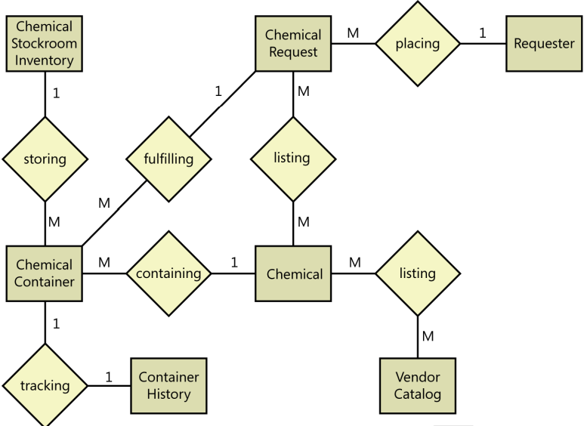
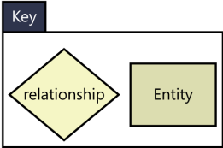
ERD Example
FIGURE 13-1 Partial entity-relationship diagram for the Chemical Tracking System.

Slide 8

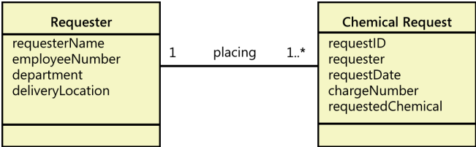
ERD: Other notations
FIGURE 13-2 One alternative notation for an entity-relationship diagram.
FIGURE 13-3 Portion of a UML class diagram for the Chemical Tracking System.

Slide 9
The data dictionary
A data dictionary is a collection of detailed information about the data entities used in an application.
The data dictionary collects the information about composition, data types, allowed values, and the like into a shared resource identifies the data validation criteria.
It helps developers write programs correctly, and minimizes integration problems.
Notes:
Composition: Thành phần

Slide 10
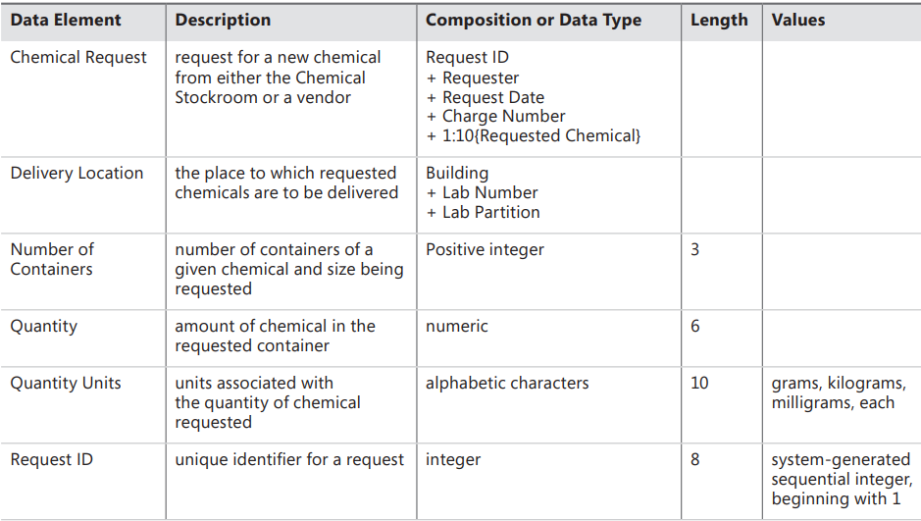
The data dictionary - Example
FIGURE 13-4 Partial data dictionary for the Chemical Tracking System.

Slide 11
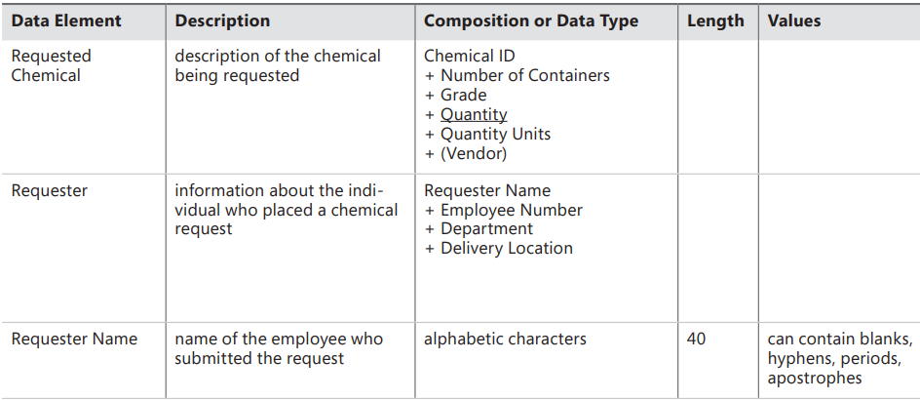

Slide 12
Data analysis
When performing data analysis, you can map various information representations against one another to find gaps, errors, and inconsistencies.
The entities in your entity-relationship diagram are likely defined in the data dictionary
The data flows and stores in your DFD are probably found somewhere in your ERD, as well as in the data dictionary.
The display fields found in a report specification also should appear in the data dictionary

Slide 13
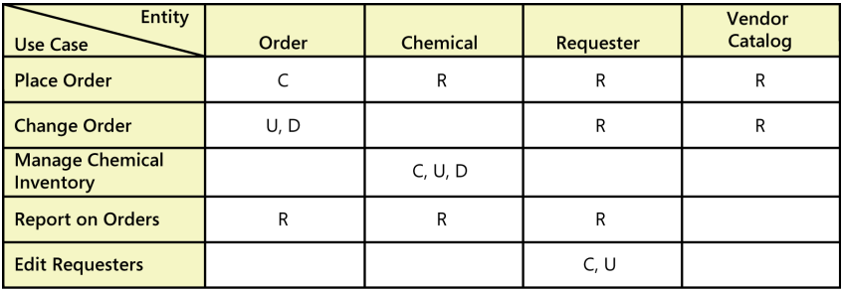
Data analysis
A CRUD matrix is a rigorous data analysis technique for detecting missing requirements (which issue can be found in fig 13.5?)
CRUD stands for Create, Read, Update, and Delete
FIGURE 13-5 Sample CRUD matrix for the Chemical Tracking System.

Slide 14
Specifying reports
Many applications generate reports from one or more databases, files, or other information sources.
Reports can consist of traditional tabular presentations of rows and columns of data, charts and graphs of all types, or any combination
Exploring the content and format of the reports needed is an important aspect of requirements development.
Eliciting reporting requirements:
Questions about the context for the reports and its usage: name, purpose, how to generate, the frequency, sizes, formats, how to dispose, how about security and privacy…
Questions elicit the reports information: sources of data, parameters, calculations, how to sort…

Slide 15
Specifying reports
Report specification considerations
Consider other variations
Find the data
Anticipate growth
Look for similarities
Distinguish static and dynamic reports
Prototype reports
A report specification template – next slide: page 255

Slide 16
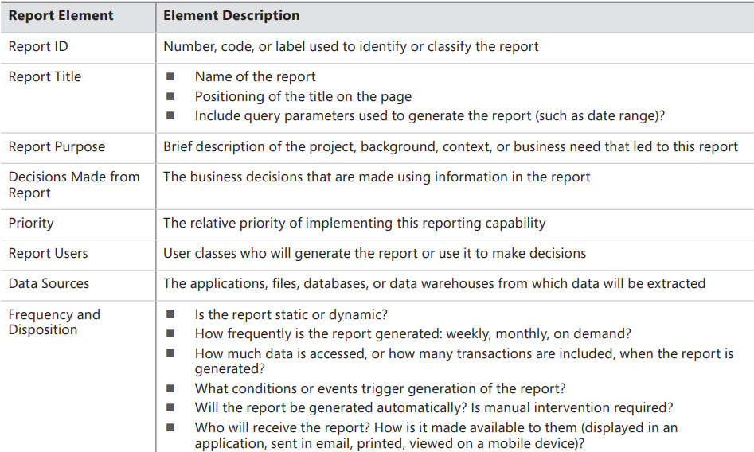
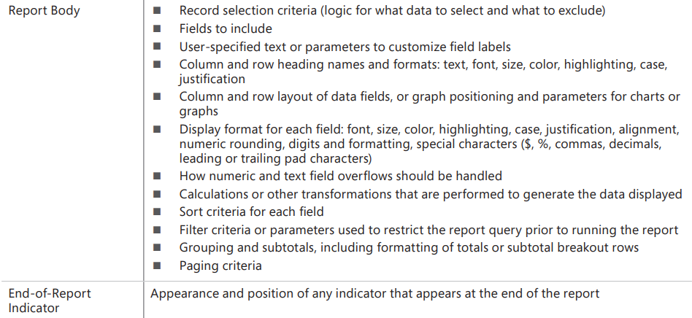
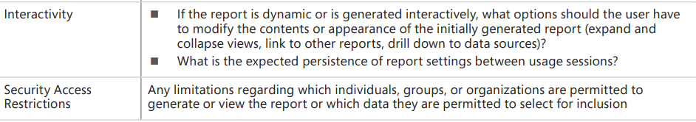
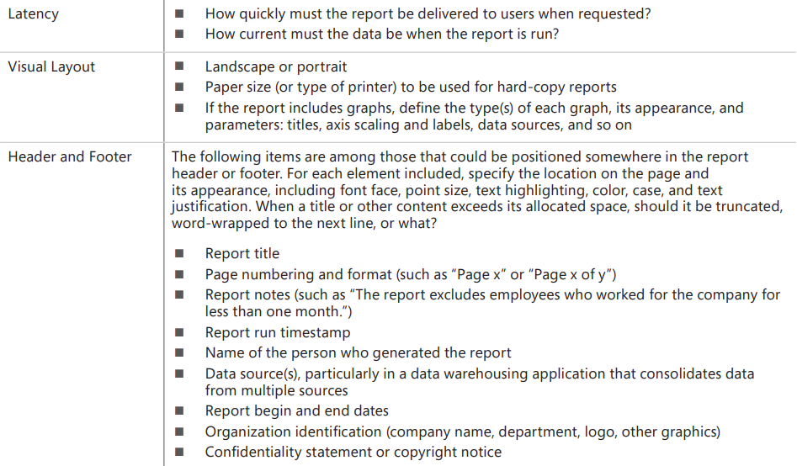
A report specification template
FIGURE 13-6 A report specification template.

Slide 17
Dashboard reporting
Definition: A dashboard is a screen display or printed report that uses multiple textual and/or graphical representations of data to provide a consolidated, multidimensional view of what is going on in an organization or a process. Companies often use dashboards to pull together information about sales, expenses, key performance indicators (KPIs) etc.
How to build:
Determine what information need for dashboard users
Consider each information is a “mini-report”
Consider the most appropriate display techniques for each “mini-report” included the display patterns (colors…)
Prototyping is an excellent approach

Slide 18
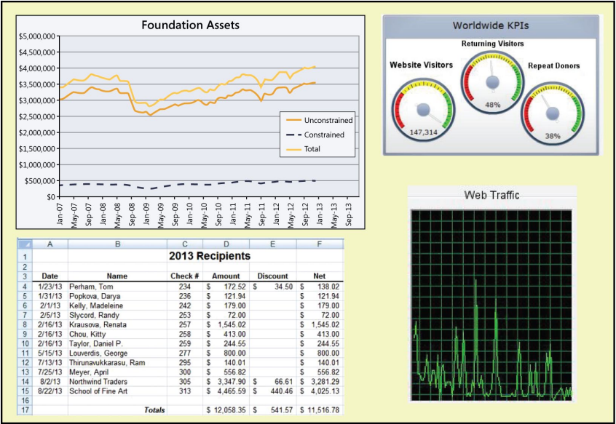
Dashboard reporting
FIGURE 13-7 Hypothetical reporting dashboard for a charitable foundation.

Slide 19
Summary
What do we learn from today lesson?

