Slide 1



Neural Network and Deep Learning
Feed-Forward Backpropagation MLP Neural Network
Full name: Quynh Pham Thi Ngoc
Registration Number: 2501168

Slide 2

Data Detailing
1
2
Partition of data:
Training: 70%
Validation: 15%
Testing: 15%
Processing of data
Data Source: Game collection data: 101384 records
Read data: Iterate through each line of the raw CSV data file. For every record, read and validate the entry: if the record is valid (containing exactly four numerical float values, comprising 2 Inputs and 2 Outputs)
Feature Selection: Input- Index 0, 1 | Output- Index 2, 3
Normalizing data: Scaled both Input and Output data to the range [0,1] with the formular: (Xi-Xmin) / (Xmax-Xmin)
Using sigmoid function as activate function for all the layers, consistent with the [0, 1] normalized output range.

Slide 3


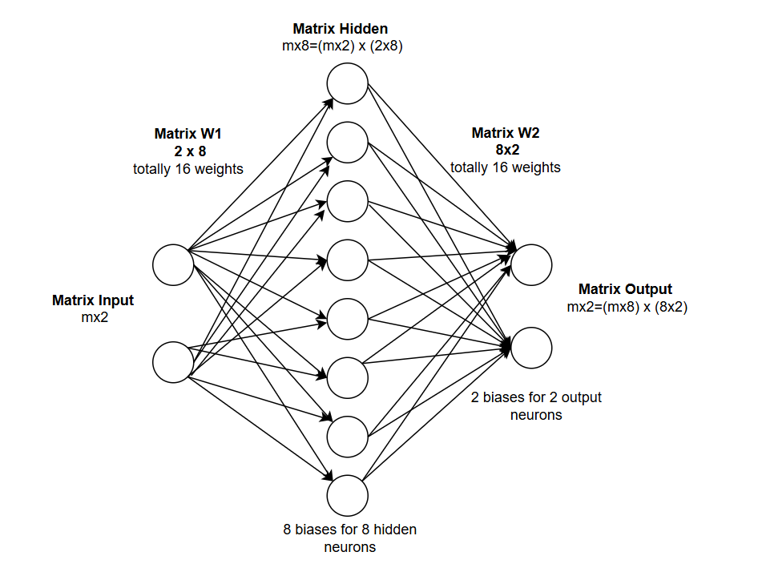
Designing Choice
Architecture Choice
Network Architecture
Input Layer: 2 neurons ~ 2 features: X position to target and Y position to target
Hidden Layer: 8 neurons: Large enough to capture the necessary non-linear mapping (simultaneous thrust and turning decisions) yet small enough to maintain low computational time per epoch.
Output Layer: 2 neuron: : Lander thruster, Lander turning

Slide 4
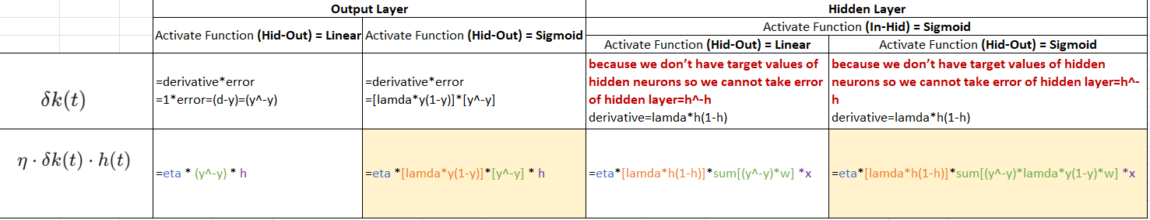
Designing Choice
Architecture Choice
2. Activate Function: Sigmoid for all layers
Reason: the output is normalized to [0,1] so the Sigmoid function constrains the prediction within that bounds.
3. Foundations for Computing Fine-Tuned Backpropagation (based on the Lecture of NN (lecture 4-5))
This table was compiled from the professor’s lecture, and I rewrote the formulas to make them easier to remember. In this task, the model uses the two fine-tuning formulas highlighted in yellow, meaning that the sigmoid activation function is applied to both layers.

Slide 5
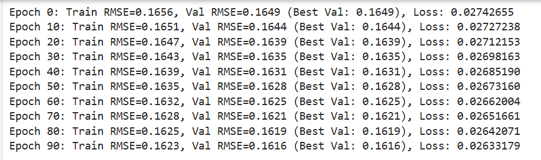
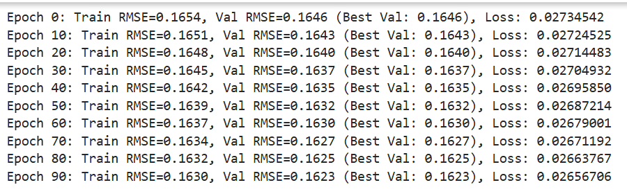
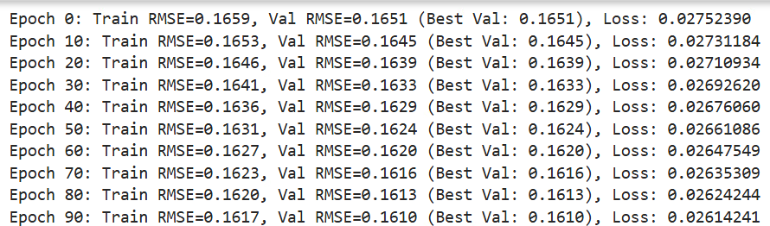
Designing Choice
The Size comparisons
8 neurons: Test RMSE: 0.1628
4 neurons: Test RMSE: 0.1636
12 neurons: Test RMSE: 0.1622

Slide 6

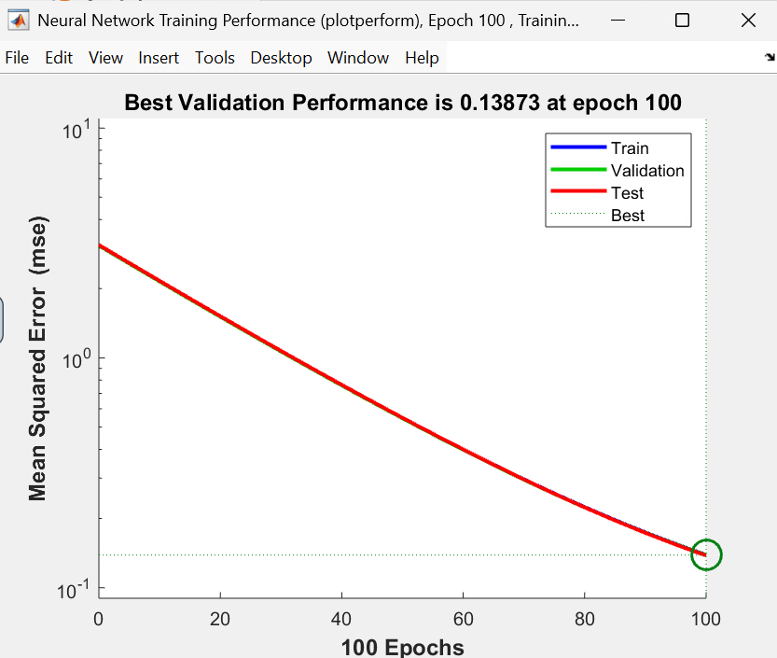
Momentum ($\mu=0.9$) helps the model escape local minima and accelerates convergence in consistent directions.
Hyper Parameter Choice
Hyper Parameter Choice
Learning Rate (Eta): 0.01
Momentum Rate: Momentum =0.01
Epoch: 100
How to choose them: Using matlab to choose hyper parameters in order to:
Achieve a low MSE
The training, validation, and testing curves converge to avoid overfitting

Slide 7
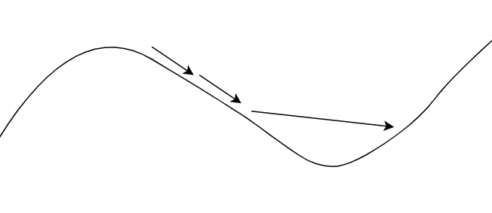
Hyper Parameter Choice
How they influent model:
Learning Rate (Eta): 0.01
To find the minimum of the loss function, the learning rate acts like the step size taken when descending a slope to locate the lowest point. If the steps are too large, the model may overshoot the minimum and the loss will increase; whereas if the steps are too small, the learning process will be extremely slow.
Momentum Rate: Momentum =0.01
To get rid of local minimum
Epoch: 100

Slide 8
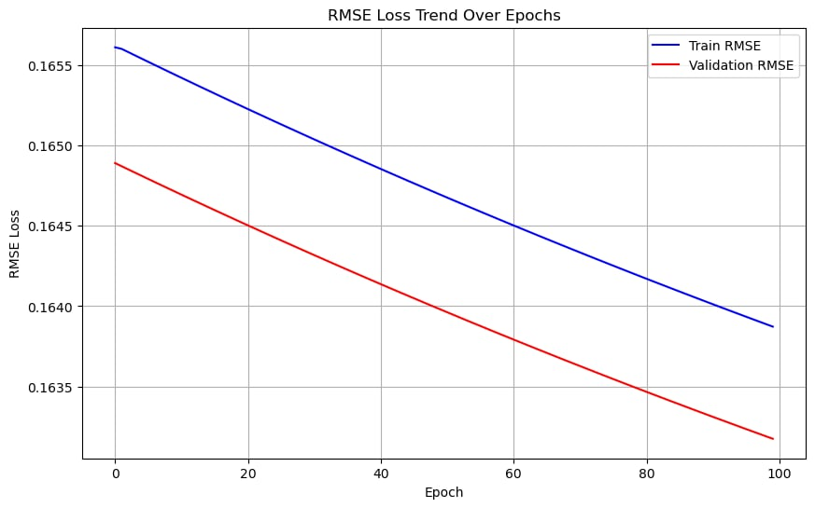
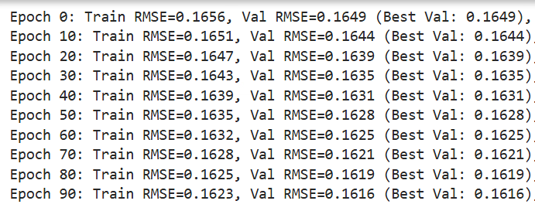
RMSE and Early Stopping Criteria
Final Test RMSE: 0.1628
The fact that this value (0.1628) did not suddenly spike above the train RMSE trend indicates that the model is not overfitting.

Slide 9
RMSE and Early Stopping Criteria
2. Early Stopping
Looking at the three curves, the validation loss didn't spike but remained consistent with the training and test loss. Since there were no signs of overfitting, so I did not apply early stopping

