Slide 1



Neural Network and Deep Learning
Deep Learning Task
Full name: Quynh Pham Thi Ngoc
Registration Number: 2501168

Slide 2

SECTION 1: PRE-PROCESSING
1. Data Selection & Integration
1
2
3
Data Sources:
train.csv and test.csv: transaction data
store.csv: store information
Integration Method
Left Merge base on Store ID to merge information from store.csv to Train and Test.
Unused Data: Customers. Why?
This variable is not available in the future (Test set)
This task is simpler because the test file already provides the inputs, while real-world problems require the model to extract features before predicting.
Redundancy (Multicollinearity): Customers is highly correlated with historical Sales. Using both creates Multicollinearity and unnecessary complexity.
Information Richness: Historical Sales is a richer feature, as it already includes both the customer count and the average amount spent.

Slide 3
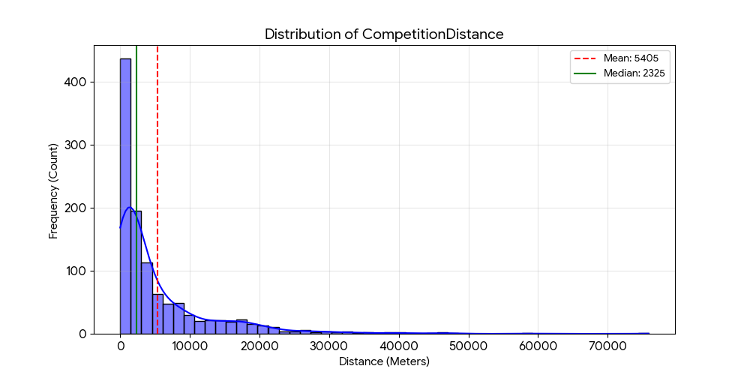
SECTION 1: PRE-PROCESSING
2. Data Cleaning & Feature Engineering
1. Handling Missing Values:
CompetitionDistance: Median? Why
  Max value: 75860 | Min: 20 | Mean ~ 5404 → Median is better than Mean ( because of outliers)
Competition/Promo2 Dates: 0 ((Assume no information = no competitors/promotions).
Open (in Test): 1 (Assume stores are open to avoid loss of forecast data).

Slide 4
SECTION 1: PRE-PROCESSING
2. Data Cleaning & Feature Engineering
2. Feature Engineering
Time Decomposition: Change Date to Year, Month, Day, DayOfWeek, WeekOfYear so that the model can capture cyclicality/seasonality.
"Ah, it seems like every December Sunday brings in tons of customers!“
CompetitionOpen: Calculate the time (number of months) since competitors opened to measure competitive pressure.
3. Target Transformation
Apply Log (1+x) (Natural Logarithm) to the Sales column.
Helps the distribution of sales become more standard, helping the Neural Network converge faster and more stably. For Example…….

Slide 5
SECTION 1: PRE-PROCESSING
2. Data Cleaning & Feature Engineering
Example:
Store A: Actual 100, Predicted 110 (Error: 10 units, but 10% deviation).
Store B: Actual 100,000, Predicted 100,010 (Error: 10 units, but only 0.01% deviation).
Treating these errors equally is unfair. The Log transformation compresses the scale,
forcing the model to minimize the percentage difference rather than the absolute difference,
ensuring fairness across both small and large stores.
Numerical Stability (log1p): We use log(sales + 1) instead of log(sales) to handle cases where Sales = 0.

Slide 6
SECTION 1: PRE-PROCESSING
3. Robust Encoding Strategy
The Problem: Automatic Label Encoding (cat.codes) causes a phase difference between Train and Test (For example, August in Test is misunderstood as January in Train). Whatever appears first gets assigned 0, so we need to perform manual mapping.
The Solution: Manual Fixed Mapping:
Set up manual mapping dictionaries for: StateHoliday, StoreType, Assortment, PromoInterval.
Normalize Year, Month, Store ID to integer form starting from 0 (Zero-based indexing).
Normalization:
Use StandardScaler for continuous variables (CompetitionDistance, Day, etc.) to bring them to the same scale (mean=0, std=1), optimizing for Gradient Descent.

Slide 7
SECTION 2: DEEP NEURAL NETWORK ARCHITECTURE
Why this Architecture?
Model Type: Feed-Forward Neural Network (FFNN) combined with Entity Embeddings.
Why Entity Embeddings?
High Cardinality: The dataset contains categorical variables with many unique values (e.g., 1115 Stores, 7 Days, 12 Months).
Efficiency: Standard One-Hot Encoding would result in a highly sparse and computationally expensive matrix.
Latent Relationships: Embedding Layers allow the model to learn dense vector representations that capture the "personality" of each store and the relationships between temporal features (like days of the week) in a multi-dimensional space.
Framework: TensorFlow / Keras.

Slide 8
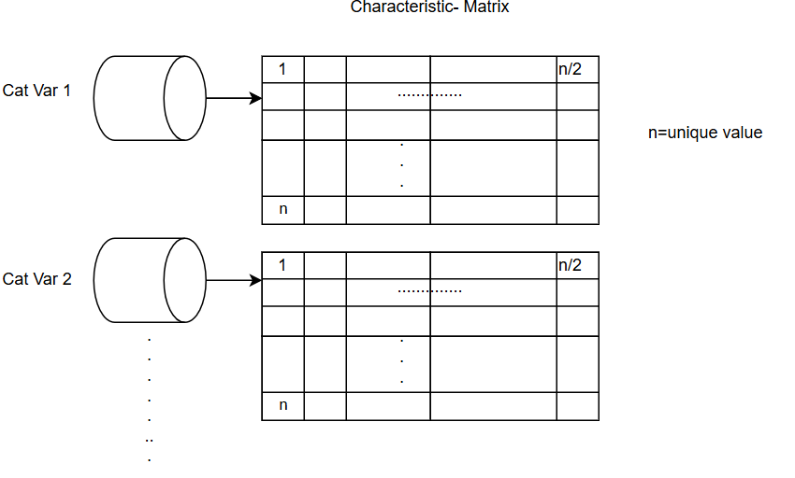
SECTION 2: DEEP NEURAL NETWORK ARCHITECTURE
Network Topology
Input Layer:
Categorical Inputs: 9 separate branches (Store, DayOfWeek, Month, etc.) feeding into 9 distinct Embedding Layers.
Continuous Inputs: 8 numerical variables feeding into a standard Input layer.
Embedding Layers: Vector Size Rule: Determined by the rule of thumb: min (50, vocab_size/2)
Integration: Outputs are flattened and concatenated with the continuous variables.

Slide 9
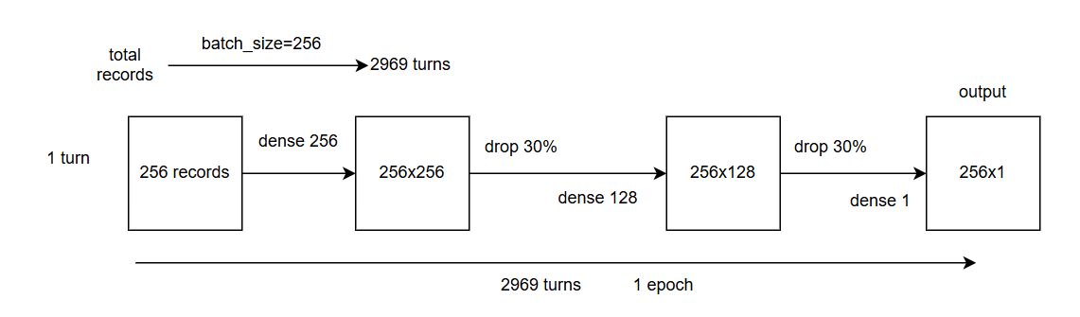
SECTION 2: DEEP NEURAL NETWORK ARCHITECTURE
Network Topology
Hidden Layers (Deep Architecture):
Layer 1: 256 Neurons + ReLU Activation.
Layer 2: 128 Neurons + ReLU Activation
Regularization (Preventing Overfitting):
BatchNormalization: Stabilizes the learning process by normalizing inputs between layers.
Dropout (0.3): Randomly deactivates 30% of neurons during training to force the network to learn more robust, generalized features.
Output Layer: 1 Neuron (Linear Activation) to predict the target value (Log Sales).

Slide 10
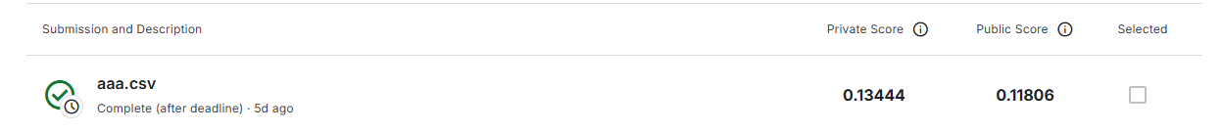
SECTION 3: RESULTS
Kaggle Submission Results
Evaluation Metric: RMSPE (Root Mean Square Percentage Error).
Achieved Score: 0.11718

