Slide 1

Lession 1
Introduction & Install Odoo

Slide 2
Introduction
PATERS

Slide 3

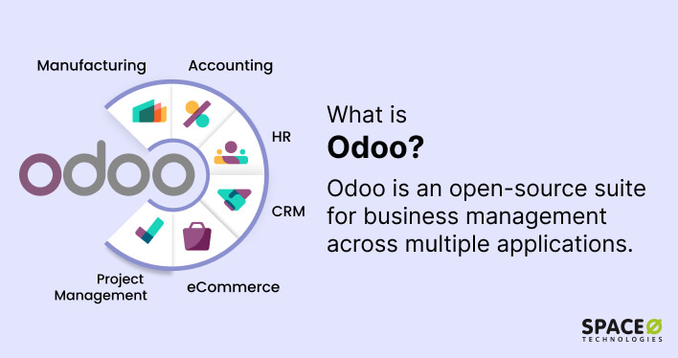

What is Odoo
Odoo (formerly known as OpenERP) is one of the open source ERP software, integrating many basic applications and modules such as CRM, POS, HRM, WMS... into a single software.

Slide 4
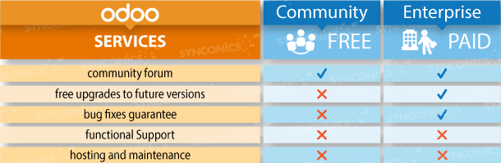
What is Odoo

Slide 5
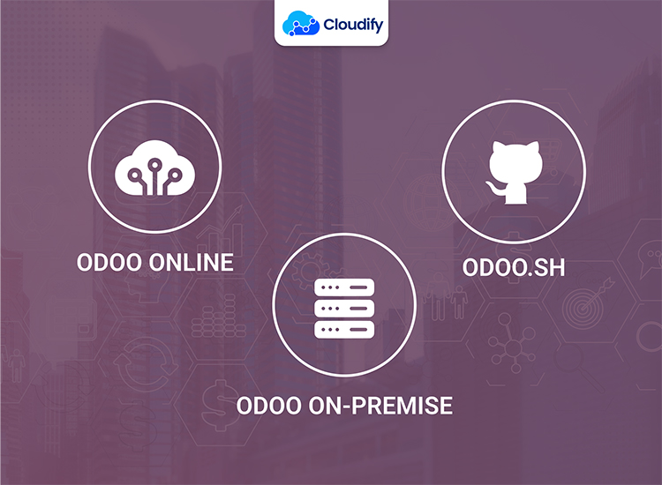
What is Odoo

Slide 6
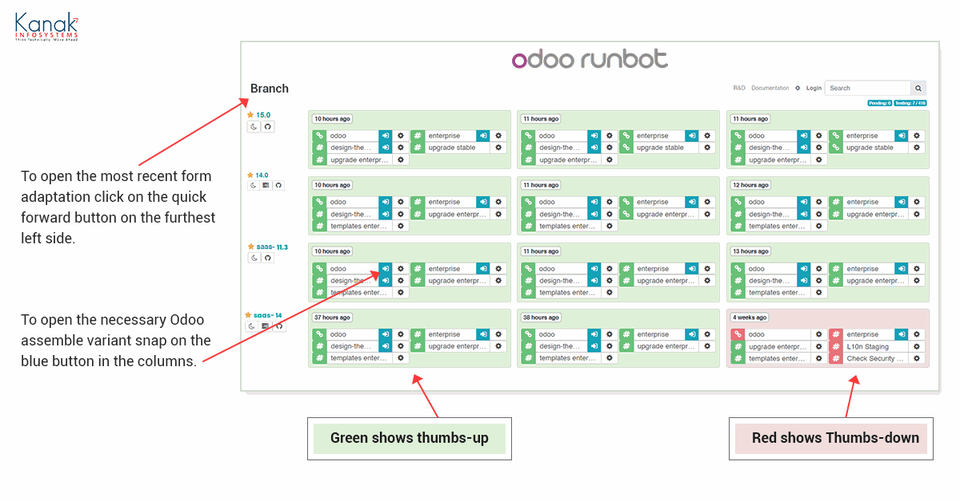
What is Odoo
https://runbot.odoo.com

Slide 7
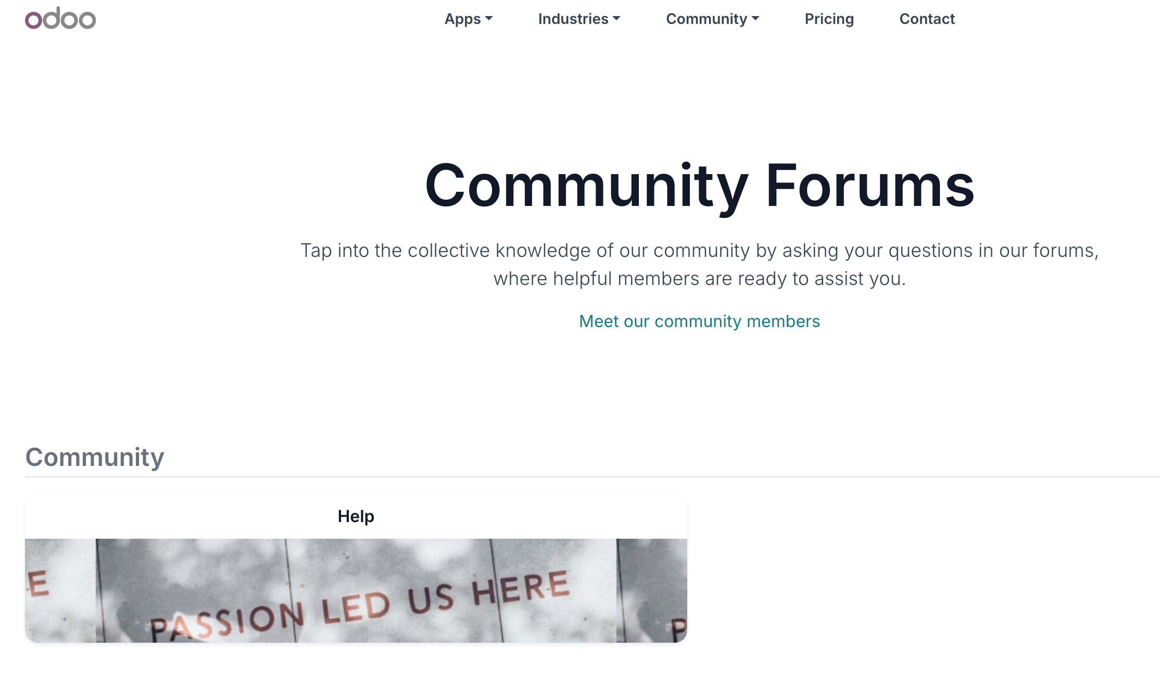
What is Odoo
https://www.odoo.com/forum

Slide 8
Install
PATERS

Slide 9
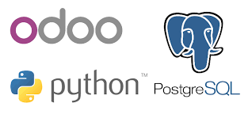

Slide 10

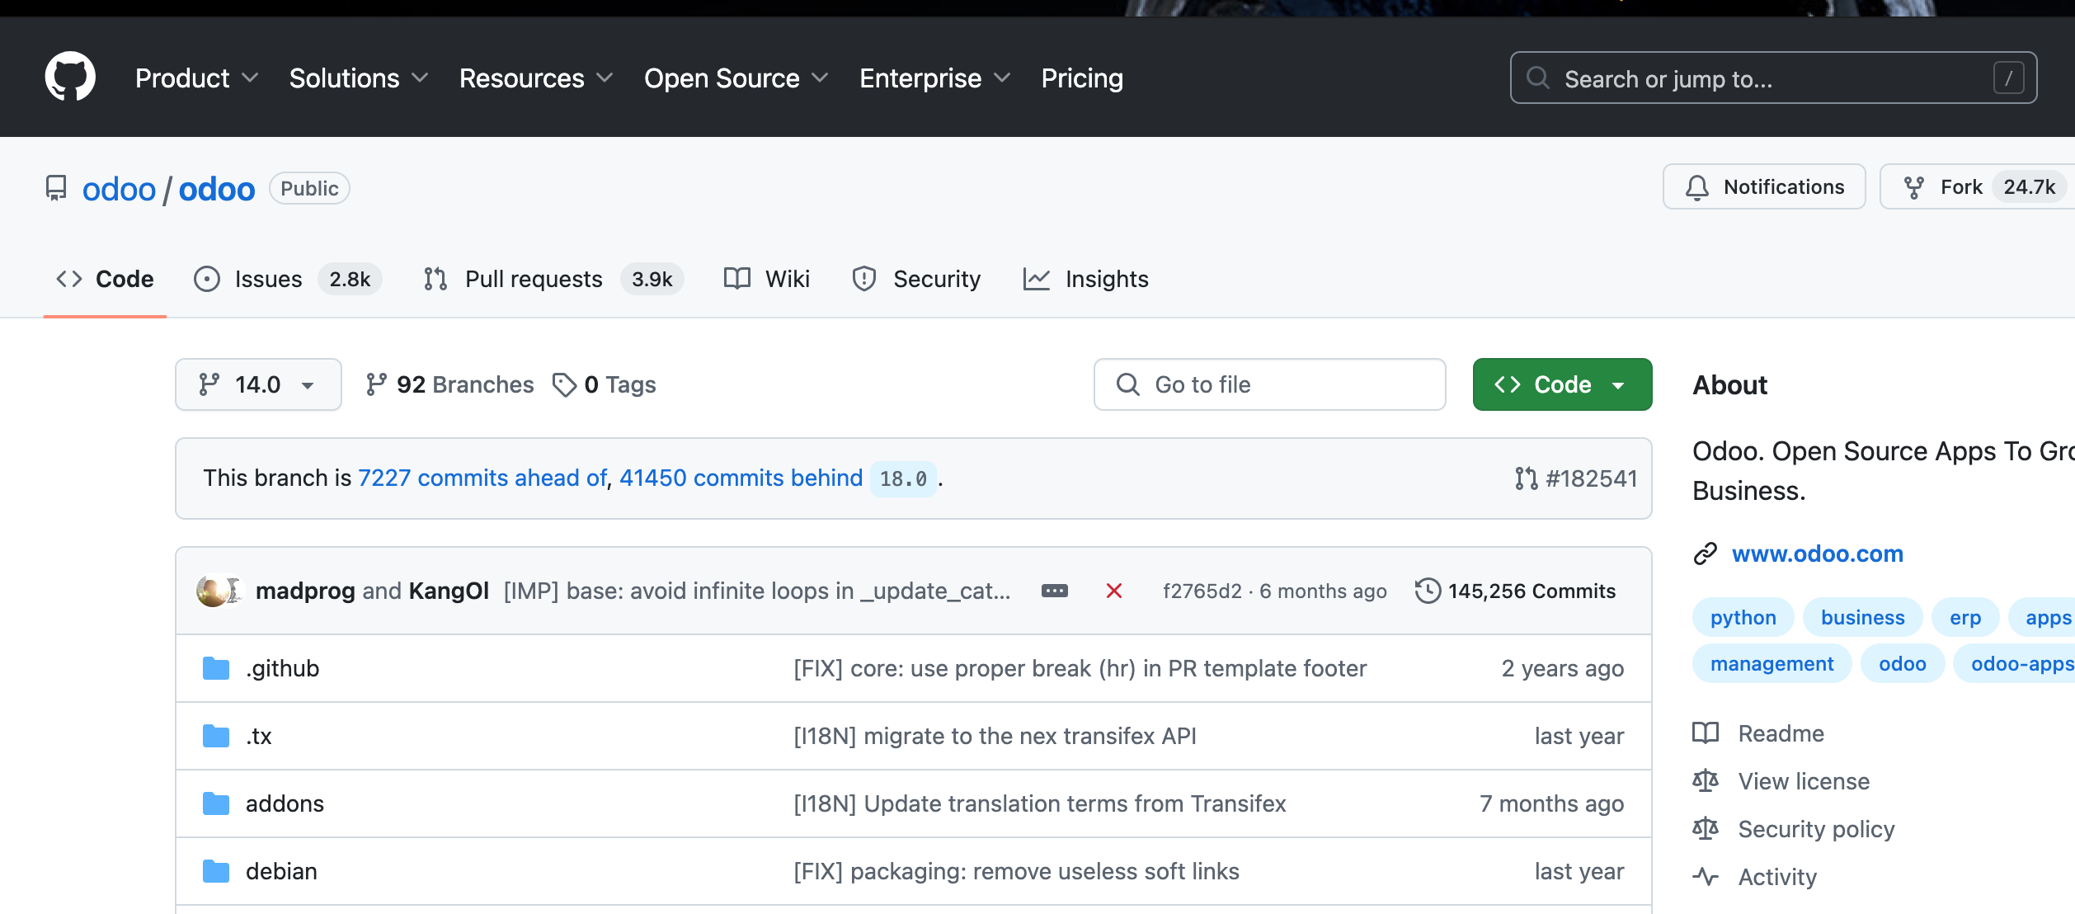
Source Odoo
https://github.com/odoo/odoo/tree/14.0

Slide 11

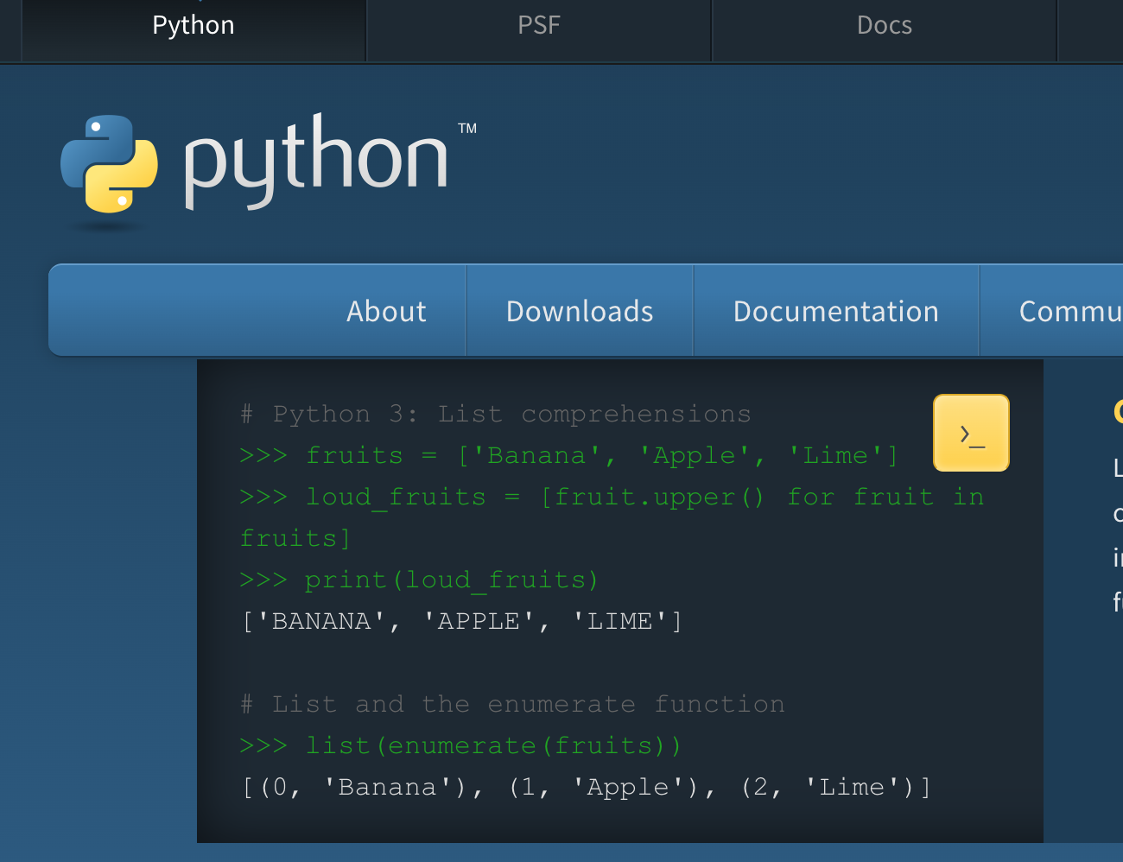
Python
Odoo 14 requires Python 3.7 or later to run
https://www.python.org

Slide 12
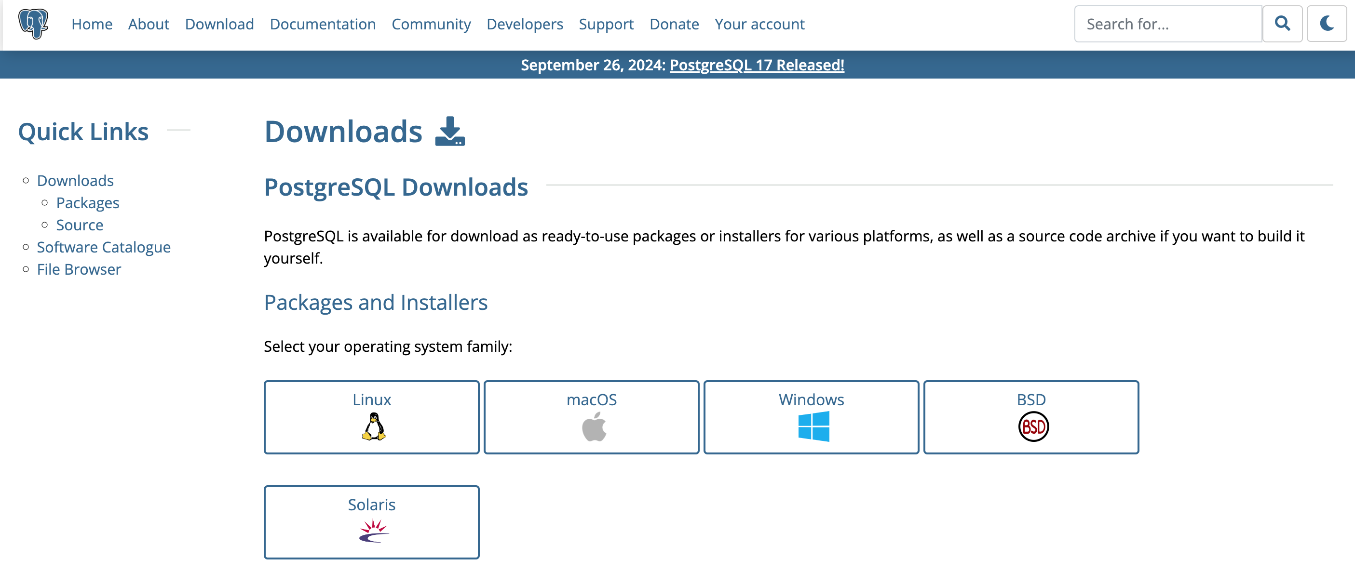
Postgres
https://www.postgresql.org/download/

Slide 13

Build Odoo App
Link install Odoo 14
https://www.odoo.com/documentation/14.0/administration/install/source.html
Link config Odoo 14
https://www.odoo.com/documentation/14.0/administration/install/deploy.html

Slide 14



Exercise
1) Download/Clone srource code odoo version 14
Lession1
Build odoo app
2) Download & Install Python version 3.7
3) Download & Install Postgres version 12 or 13
4) Create/Active virtualenv Python
python -m venv <directory>
source <directory>/bin/activate
5) Install library Python
pip3 install -r requirements.txt
6) Create config file and run odoo App

