Slide 1

Campaign Marketing
GROUP 10
Teacher: M.S. Quách Đình Hoàng

Slide 2
Big Data Applications: Machine Learning at Scale
Group 10
01
Đinh Quang Ngọc 18133034
02
Lâm Hoàng Việt 18133062
03
Phạm Việt Thắng 18133052
Teacher: M.S. Quách Đình Hoàng

Slide 3
Dataset Introduction
01

Slide 4
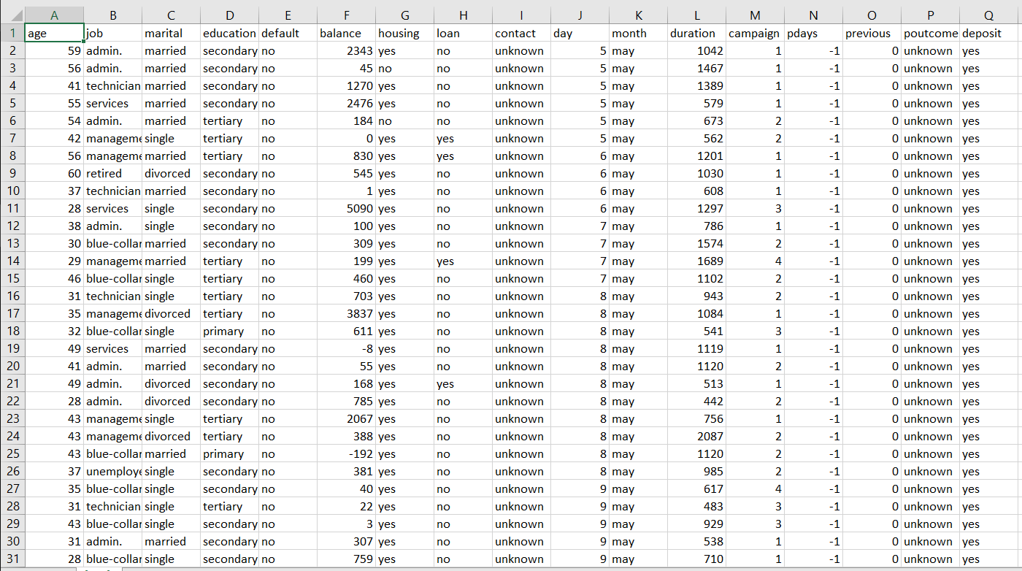
Project Information
Project: Campaign Marketing
We will use the dataset and it is related to direct marketing campaigns (phone calls) of a Portuguese banking institution. The classification goal is to predict whether the client will subscribe (Yes/No) to a term deposit
The dataset includes 17 attribute and about 11163 record.

Slide 5
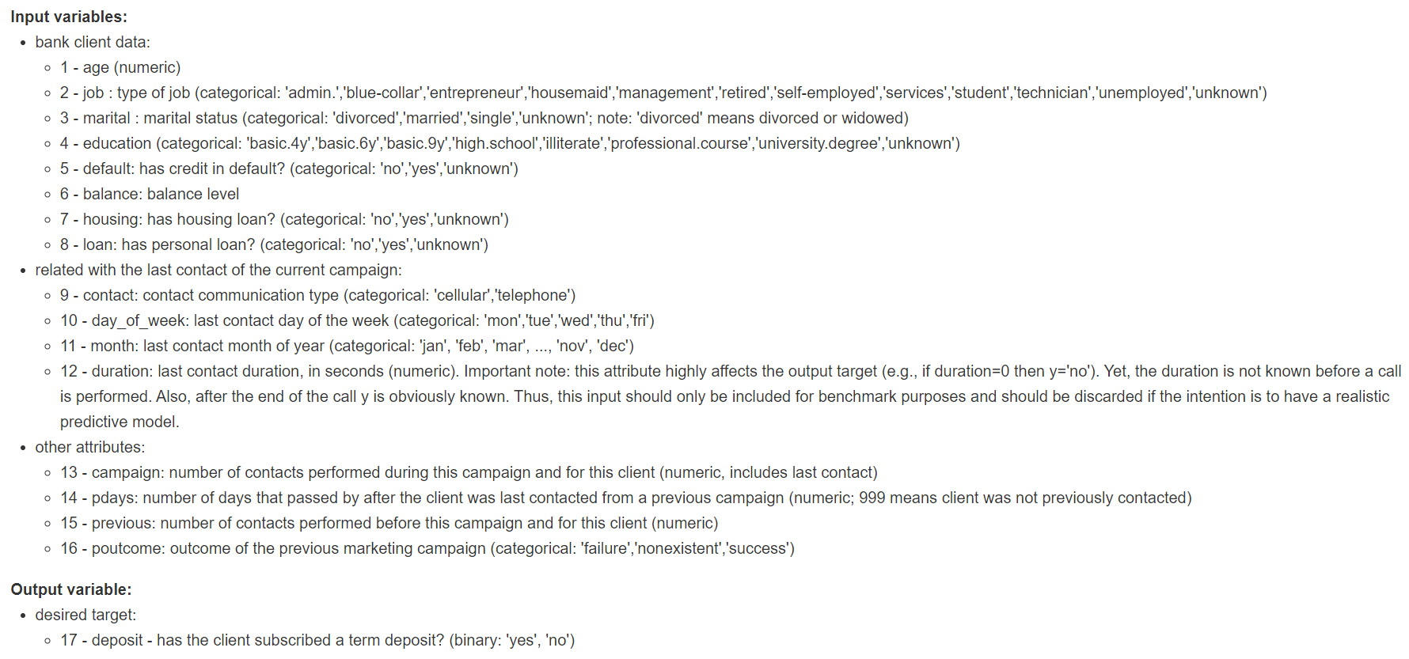
Attribute Information

Slide 6
Data Exploration
02

Slide 7
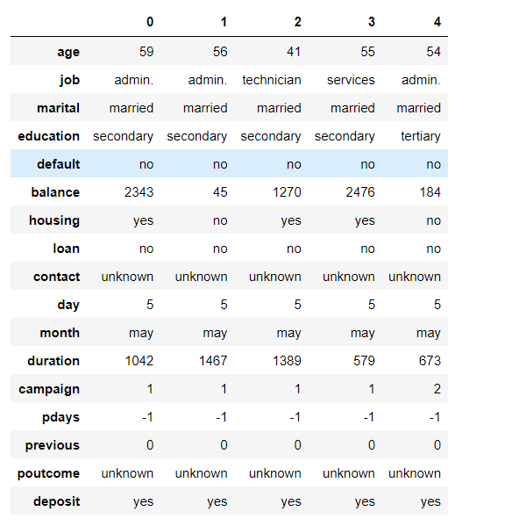
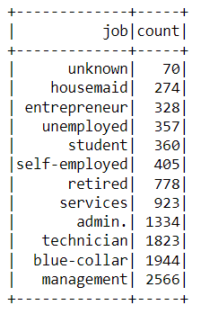
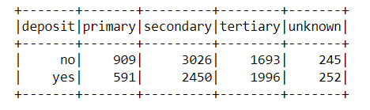
Dataset Exploration

Slide 8
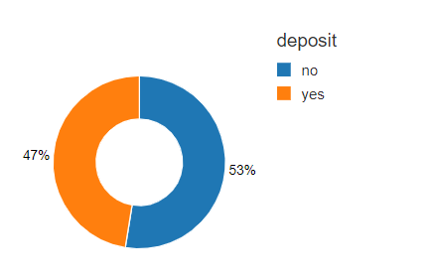

Dataset Exploration

Slide 9
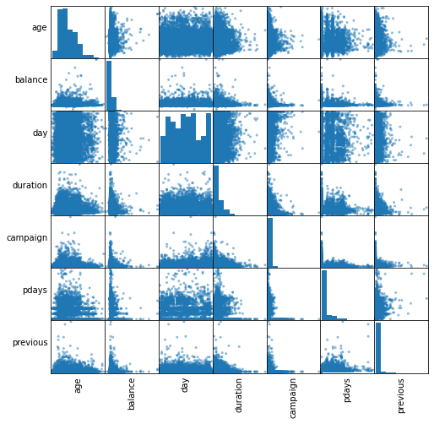
Correlations between independent variables

Slide 10
Fit and evaluate models
03

Slide 11
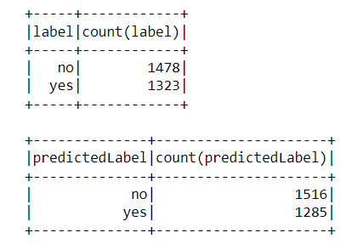
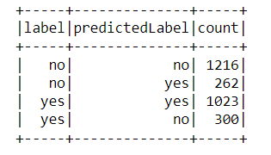
Logistic Regression

Slide 12
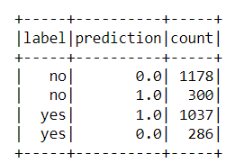
Decision Tree

Slide 13
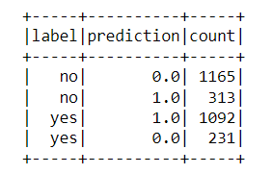
Random Forest

Slide 14
Conclusion
04

Slide 15
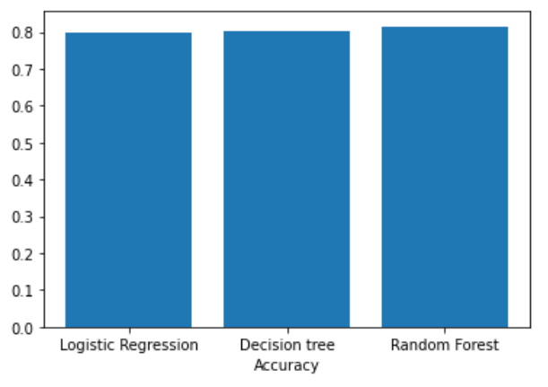
Accuracy
Logistic Regression: 79,93 %
Decision Tree: 80,11%
Random Forest: 81,54%

Slide 16
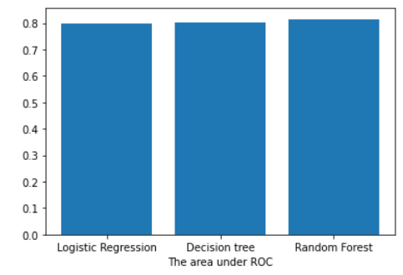
The area under ROC
Logistic Regression: 0,79
Decision Tree: 0,8
Random Forest: 0,82

Slide 17
Conclusion
Three main algorithm classifiers are tested which are Logistic regression, Decision trees and Random forest
=> Random Forest achieved the best results after we tried tuning this model with the Hyperparameter using cross validation

Slide 18


