Slide 1
Kafka A Distributed Commit Log
By NgocTD
Notes:
A distributed, partitioned, replicated commit log service

Slide 2




Publish/Subscribe Messaging
Subscriber
Publisher
Subscriber
Publisher
Subscriber
Notes:
- concept of pub/sub and why it is a critical component of data-driven application
- Pub/sub messaging is a pattern that is characterized by the sender (publisher) of a piece of data (message) not specifically directing it to a receiver. Instead, the publisher classifies the message somehow, and that receiver (subscriber) subscribes to receive certain classes of message.

Slide 3






Messages and Batches
The unit of data is called a message
A batch is a collectoin of messages
A message is an array of bytes
Latency and throughput
Key is an optional
Batches compressed
Notes:
The unit of data within Kafka is called a message. You can think of this as similar to a row or a record.
A message if simply an array of bytes.
A message can have an optional piece of metadata, which is referred to as a key.
Messages are written into Kafka in batches.
Trade-off between latency and throughput: more messages can be handled per unit of time.
Batches are also typically compressed.

Slide 4
Topics
● Named container for similar events
● Append only
● Can only seek by offset, not indexed
● Immutable
● Durable storage for some period of time or disk size
Notes:
Messages in Kafka are categorized into topics. The closest anologies for a topic are a database table.
Partitions are also the way that Kafka provides redundancy and scalability. Each partition can be hosted on a different server, which means that a single topic can scaled horizontally across multiple servers to provide performance far beyond the ability of a single server.

Slide 5
Partitions
● Why-Where?
● Distributed system, limit read write on one node
● Ability of Apache Kafka to scale
● Live on a separate node in the Kafka cluster
● How?
● Write to partition strategy

Slide 6
Partitions: Round Robin and Sticky Partitioner (Demo)
Broker1/Partition1
Broker2/Partition2
Broker3/Partition3
Notes:
Round robin for version less than or equal 2.3
- If a message has no key, subsequent messages will be distributed round-robin among all the topic’s partitions
Sticky Partitioner (kafka >= 2.4)
- It is a performance goal to have all the records sent to a single partition and not multiple partitions to improve batching
The producer sticky partitioner will:
- Stick to a partition until the batch is full or linger.ms has elapsed
- After sending the batch, change the partition that is sticky

Slide 7
Partitions: Key (Demo)
1
1
5
Broker1/Partition1
1
Broker2/Partition2
2
5
4
3
2
3
3
4
4
4
Broker3/Partition3
Notes:
With key
- If the message does have a key, then the destination partition will be computed from a hash of the key (murmur2)
- Use case of key: guarantee that messages having the same key always land in the same partition and therefore are always in order
- For example, if you are producing events that are all associated with the same customer, using the customer ID as the key guarantees that all of the events from a given customer will always arrive in order.

Slide 8

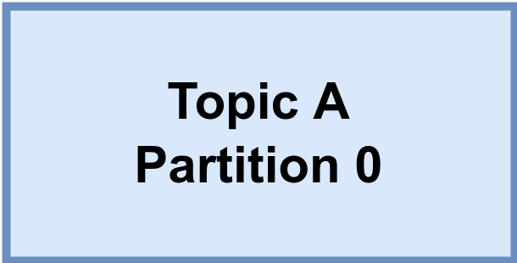
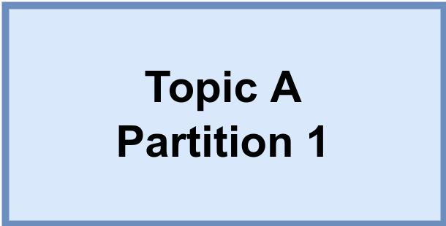
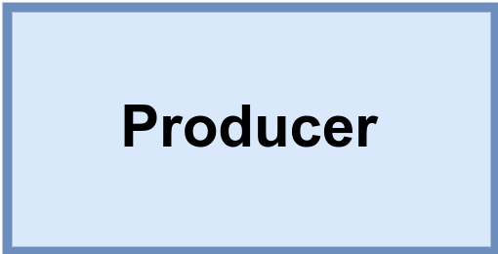
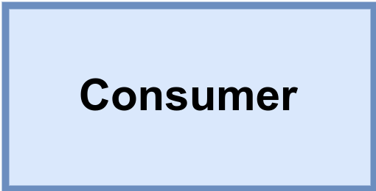

Brokers and Clusters
Kafka cluster
Messages
for A/0
Messages
from A/0
Leader
Replicate
A/0
Replicate
A/1
Messages
for A/1
Messages
from A/1
Leader
Notes:
- A single Kafka server is called a broker
- The broker receive message from producers, assigns offsets to them, and writes the messages to storage on disk.
- Services customers, responding to fetch requests for partitions and responding with the messages that have been published.
- A partition is owned by a single broker in the cluster, and that broker is called the leader of the partition.
- A replicated partition is assigned to additional brokers, called followers of the partition.
- All producers must connect to the leader in orther to publish messages, but consumers may fetch from either the leader on one of the followers.

Slide 9
Kafka Producers: Writing Messages to Kafka
Topic A
Partition 0
Batch 0
Batch 1
ProducerRecord
Batch 2
Topic
Kafka broker
Send()
[Partition]
Serializer
Partitioner
[Key]
Topic B
Partition 1
Value
Batch 0
When successful,
return metadata
include topic, partition
and the offset
If can’t retry,
throw
exception
Batch 1
Retry?
Fail?
Notes:
- Once we send the ProducerRecord, the first thing the producer will do is serialize the key and value objects to byte arrays so they can be sent over the network.
- Next, if we didn’t explicity specify a partition, the data is sent to a partitioner. The partitioner will choose a partition for us, usually based on the ProducerRecord key. Once a partition is selected, the producer knows which topic and partition the record will go to. It then adds the record to a batch or records that will also be sent to the same topic and partition.
- When the broker receives the messages, it sends back a response.
- When the producer receives an error, it may retry sending the message a few more times before giving up and returning an error.

Slide 10
Sending messages
● Fire-and-forget
● Synchronous Send
● Asynchronous Send
Notes:
Messages in Kafka are categorized into topics. The closest anologies for a topic are a database table.
Partitions are also the way that Kafka provides redundancy and scalability. Each partition can be hosted on a different server, which means that a single topic can scaled horizontally across multiple servers to provide performance far beyond the ability of a single server.

Slide 11
Acks (demo)
● acks = 0
● acks = 1
Notes:
- When acks = 0 producers consider messages as “written successfully” the moment the message was sent without waiting for the broker to accept it at all. Pros: the network overhead is minimized, cons: If the broker goes offline or an exception happens, we won’t know and will lose data.
- When acks = 1 producers consider messages as “written successfully” when the message was acknowledged by only the leader (replication is not a guarantee). If an ack is not received, the producer may retry the request. Pros: the network overhead is minimized. Cons If the leader broker goes offline unexpectly but replicas haven’t replicated the dat yet, we have a data loss

Slide 12
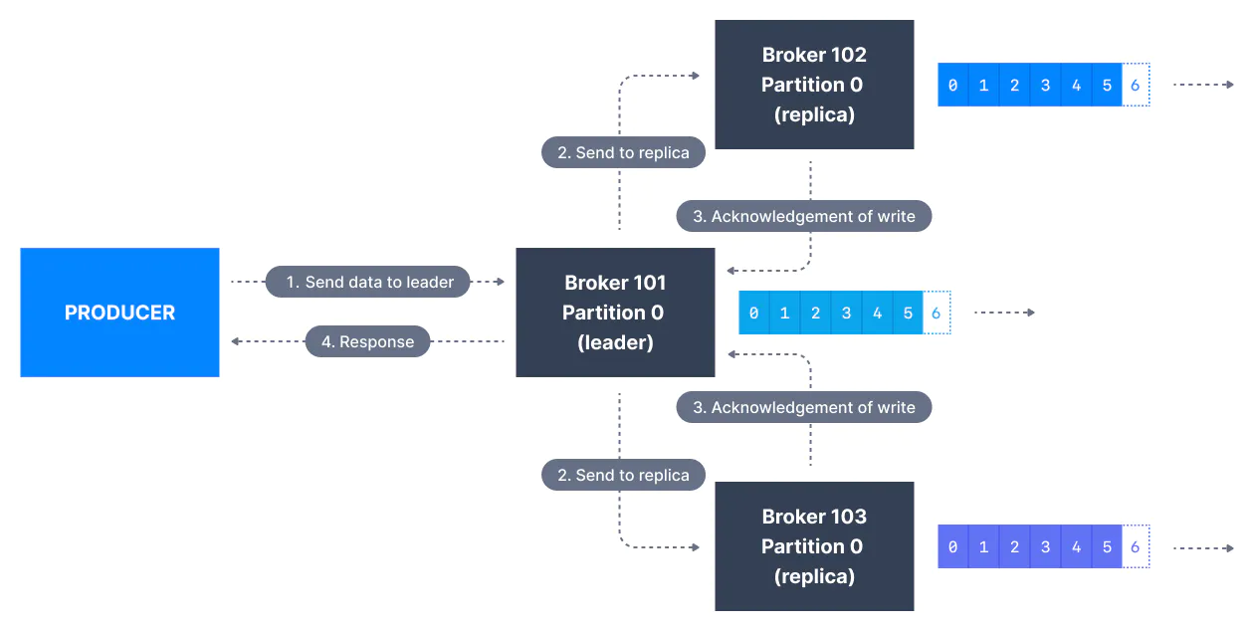
Acks (demo)
● acks = all, min.insync.replicas = 2
Notes:
- When acks = all, producers consider messages as “written successfully” when the message is accepted by all in-sync replicas (ISR). The leader replica for a partition checks to see if there are enough in-sync replicas for safely writing the message (controlled by the broker setting min.insync.replicas)

Slide 13
Acks
● Trade-off reliability versus producer latency
● Mis-understood producer latency versus end-to-end latency
Notes:
- End-to-end latency is mesured from the time a record was produced until it is avaiable for consumers to read and is identical for all three acks options.
- In order maintain consistency, Kafka will not allow consumers to read records until they are written to all in sync replicas.
- If you care about end-to-end latency, rather than just the producer latency, there is no trade-off to make. You will get the same end-to-end latency if you choose the most reliable option.

Slide 14
Durability & Availability
● Durability: N replicas - lose up to N-1 can still recover your data
● Availability
● Read
● Write
Notes:
- Replication is at the heart of Kafka’s architecture
- Kafka is organized by topics. Each topic is paritioned, and each partition can have multiple replicas. Replicas are stored on brokers.
- All produce requests go through the leader to guarantee consistency.
- Unless configured otherwise, followers don’t serve client requests; their main job is to replicate messages from the leader and stay up-to-date with the most recent messages the leader has. If a leader replica for a partition crashes, one of the follower replicas will be promoted to become the new leader for the parition.

Slide 15
Producer Retries
● retries
● deliver.timeout.ms
● retry.backoff.ms

Slide 16
Problem with Retries: Guaranteed order of messages (hard in distributed)
● max.in.flight.requests.per.connection

Slide 17
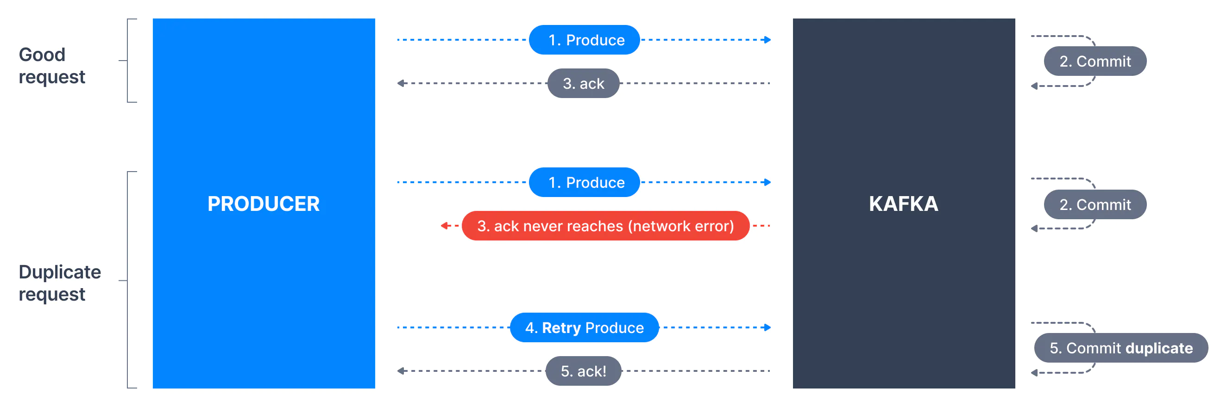
Problem with Retries: Duplicate

Slide 18
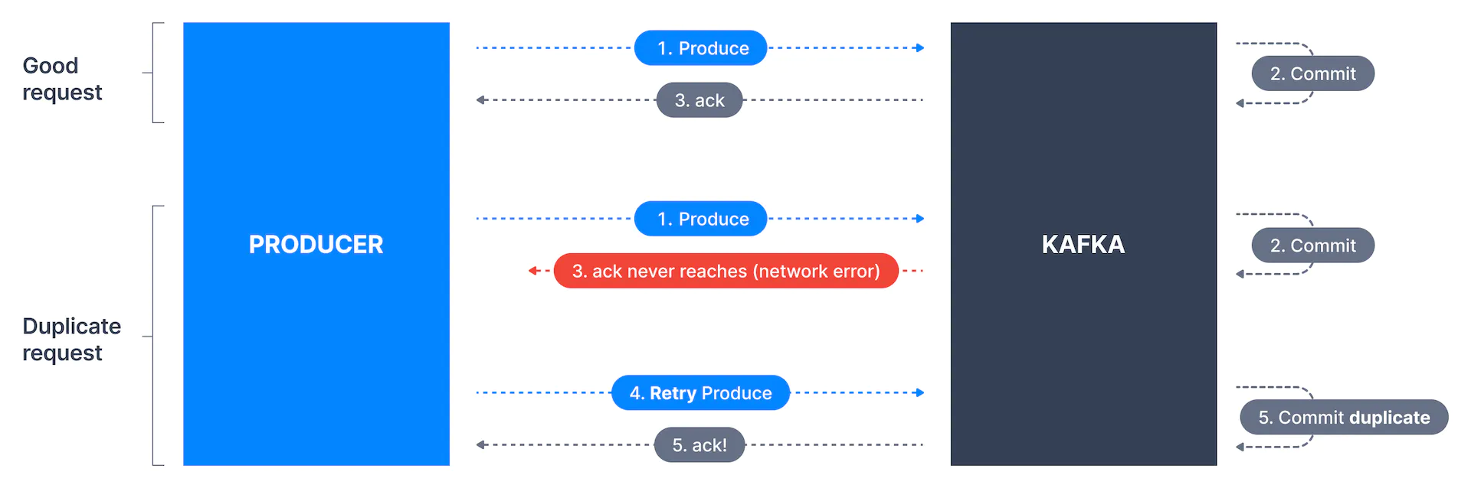
Problem with Retries: Duplicate

Slide 19
Batching (Demo)
● batch.size
● linger.ms
● pros and cons
Notes:
- When multiple records are sent to the same partition, the producer will batch them together.
- batch.size controls the amount of memory in bytes (not messages) that will be used for each batch.
- pros reduce network overhead, apply compression
- cons more RAM (decompression)

Slide 20
Message Delivery Time
● Control how long will it take until a call to send() will succeed or fail
max.block.ms
linger.ms
retry.backoff.ms
request.timeout.ms
send()
Batching
Notes:
- max.block.ms:
- linger.ms controls the amount of time to wait for additional messages before sending the current batch. KafaProducer sends a batch of messages either when the current batch is full or when the ligher.ms limit is reached. Overhead per message is much lower and compression.
- request.timeout.ms: how long the producer will wait for a reply from the server when sending data.
- retries and retry.backoff.ms
- batch.size: when records are sent to the same partition, the producer will batch them together

Slide 21
Consumers and Consumer Groups
● Why-Where?
● Distributed system, producer on many node
● Unable to keep up with the rate of incoming message

Slide 22
Kafka Consumers: Reading Data from Kafka
Topic T1
Consumer group 1
Partition 0
Consumer 1
Partition 1
Consumer 2
Partition 2
Consumer 3
Partition 3
Consumer 4
Consumer 5

Slide 23
Kafka Consumers: Reading Data from Kafka
Topic T1
Consumer group 1
Partition 0
Consumer 1
Partition 1
Consumer 2
Partition 2
Consumer 3
Partition 3
Consumer 4
Consumer group 2
Consumer 1
Consumer 2

Slide 24
Produce and Consume Data By Example
Brokers | Partitions | Replicas | Consumer Groups | Producing interval | Consume interval
1 | 1 | 1 | 1(1A) | 1 | 2
1 | 1 | 1 | 2(2A) | 1 | 2
1 | 2 | 1 | 2(2A) | 1 | 2
2 | 2 | 1 | 2(2A) | 1 | 2
2 | 2 | 1 | 3 (2A-1B) | 1 | A2-B1
Notes:
- 1. Unable to keep up with the rate of incoming message
- 2. Consumer 2 do nothing
- 3. Work
- 4. Work
- 5. Work

Slide 25
Delivery Semantics for Kafka Consumers
● At Most Once Delivery
● At Least Once Delivery
● Exactly Once Delivery
Notes:
- Offsets are committed as soon as a message batch is received after calling poll()

Slide 26
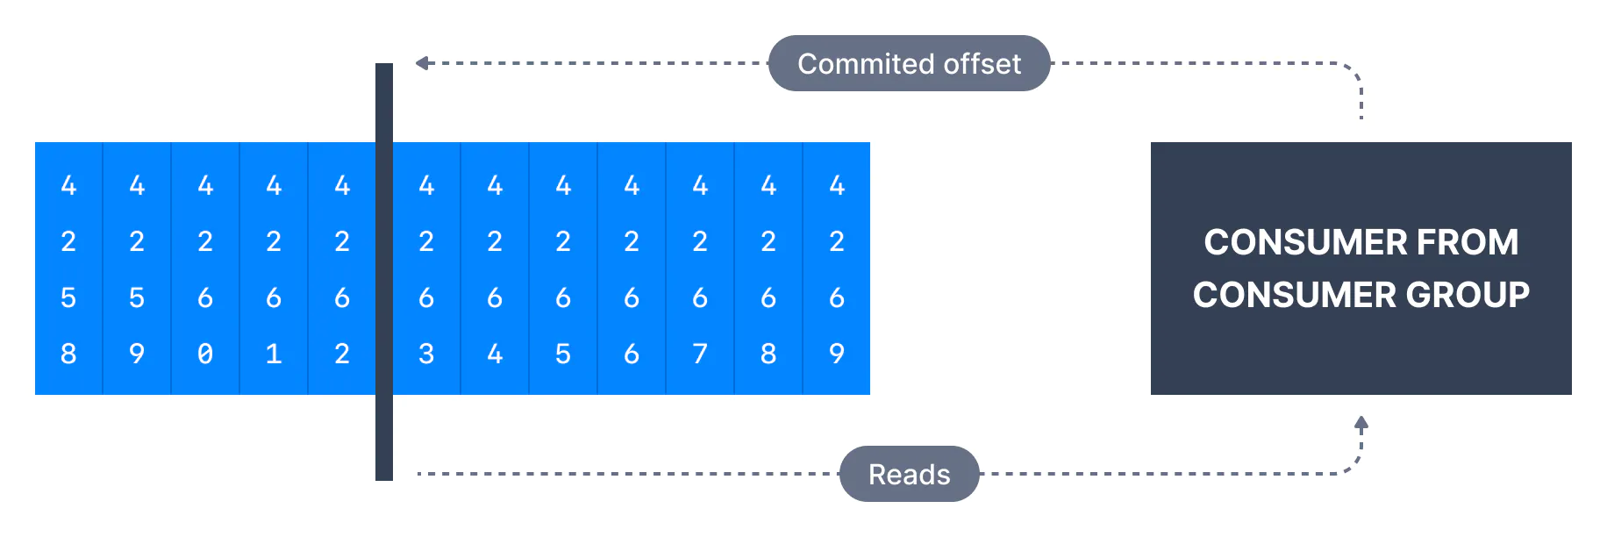
Commits and Offsets
Notes:
- We call the action of updating the current position in the partition an offset commit.
- Miss message

Slide 27
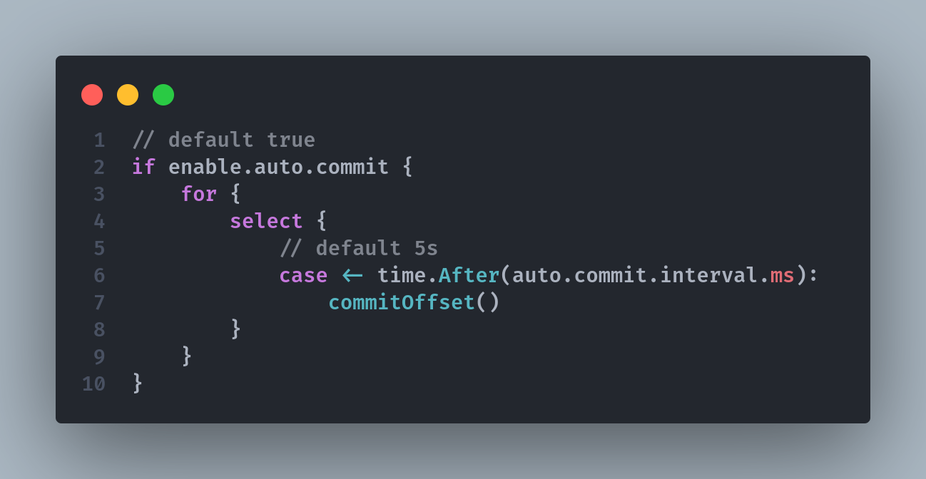
Commit Strategy - Auto Commit
Notes:
- We call the action of updating the current position in the partition an offset commit.
- Miss message

Slide 28
Commit Strategy - Manually Commit
Notes:
- We call the action of updating the current position in the partition an offset commit.
- Miss message

Slide 29
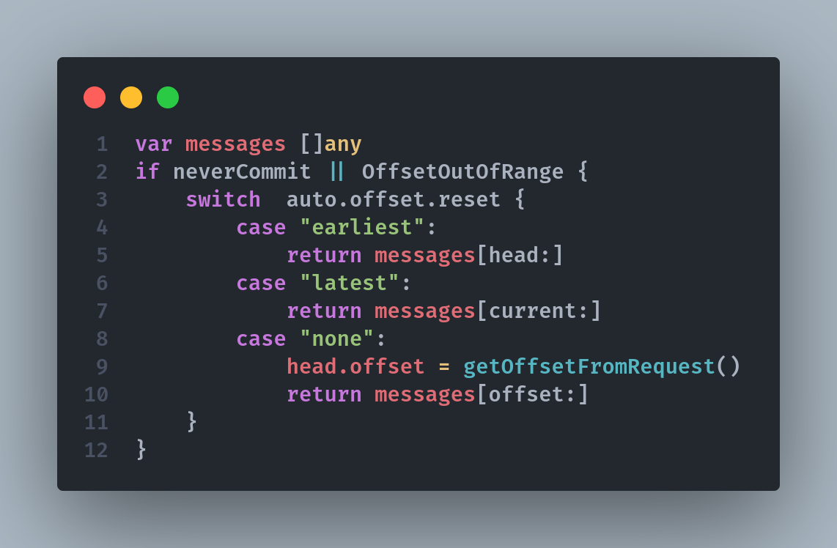
Consumer Auto Offsets
Notes:
- We call the action of updating the current position in the partition an offset commit.
- Miss message

Slide 30
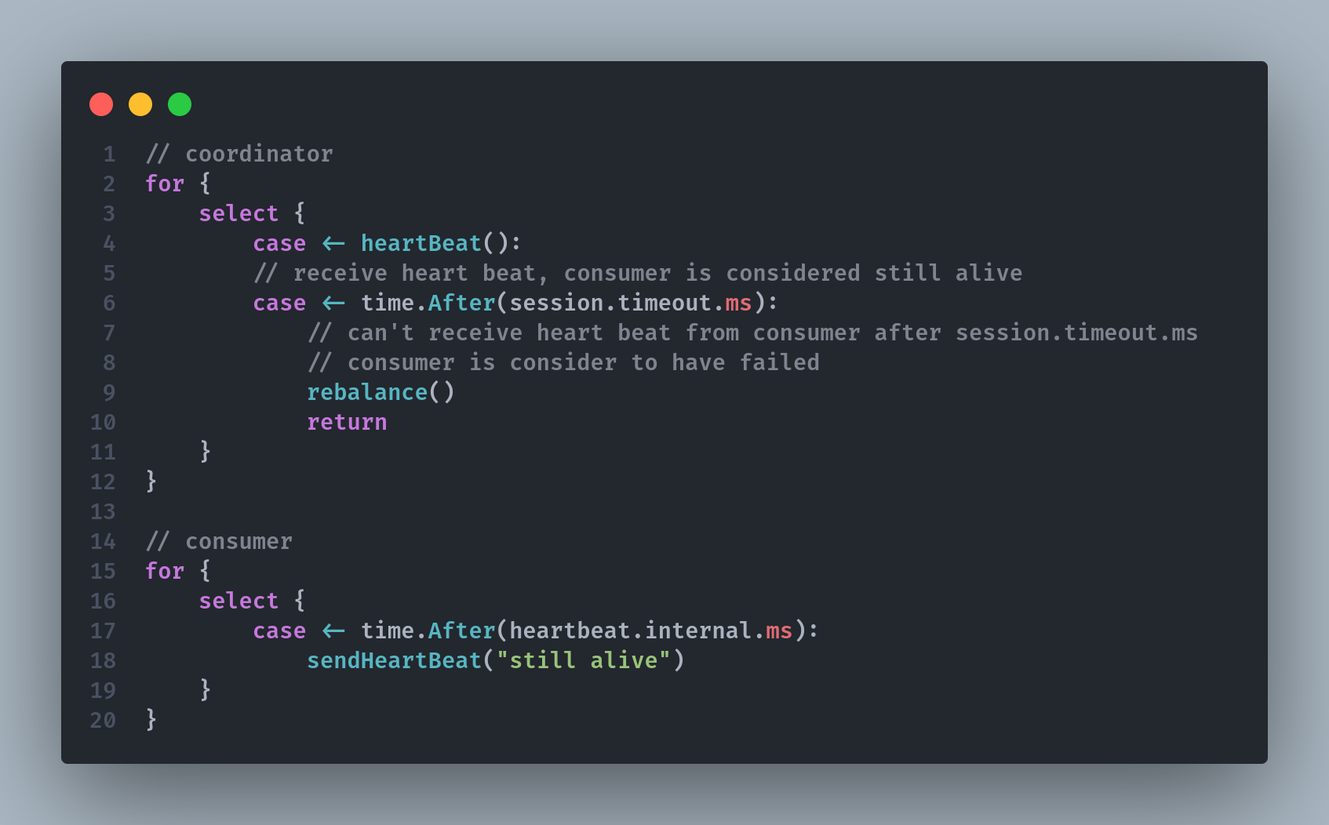
Consumer heartbeat
Notes:
- We call the action of updating the current position in the partition an offset commit.
- Miss message

Slide 31
Why Kafka Fast - Sequential Access
● Kafka stores data on disk why it is fast?
● Data Access Patterns
Notes:
- There’s a common misconception that disk access is slow compared to memory access, but this largely depends on data access patterns.
- On Disk, random access slow
- Kafka append only log. Access pattern is sequential

Slide 32

Why Kafka Fast - Data Transfer Through Zero Copy
Application Context
Kernel Context
CPU copy
DMA copy
1
2
Read buffer
Application buffer
4
3
Socket buffer
NIC buffer
Notes:
- The application does nothing other than cache the data and transfer it back to the socket buffer
- Socket buffer: a socket is your app’s interface to one TCP (or UDP) connection. You app doesn’t r/w data to the NIC, it goes through the kernel’s network stack.

Slide 33
Why Kafka Fast - Data Transfer Through Zero Copy
Application Context
Kernel Context
CPU copy
DMA copy
1
Read buffer
Application buffer
2
NIC buffer

Slide 34
References
Concept | Resource
Zero copy | https://developer.ibm.com/articles/j-zerocopy/
Why Kafka so fast | https://www.youtube.com/watch?v=UNUz1-msbOM

