Slide 1
Kafka A Distributed Commit Log
By NgocTD
Notes:
A distributed, partitioned, replicated commit log service

Slide 2




Publish/Subscribe Messaging
Subscriber
Publisher
Subscriber
Publisher
Subscriber
Notes:
- concept of pub/sub and why it is a critical component of data-driven application
- Pub/sub messaging is a pattern that is characterized by the sender (publisher) of a piece of data (message) not specifically directing it to a receiver. Instead, the publisher classifies the message somehow, and that receiver (subscriber) subscribes to receive certain classes of message.

Slide 3






Messages and Batches
The unit of data is called a message
A batch is a collectoin of messages
A message is an array of bytes
Latency and throughput
Key is an optional
Batches compressed
Notes:
The unit of data within Kafka is called a message. You can think of this as similar to a row or a record.
A message if simply an array of bytes.
A message can have an optional piece of metadata, which is referred to as a key.
Messages are written into Kafka in batches.
Trade-off between latency and throughput: more messages can be handled per unit of time.
Batches are also typically compressed.

Slide 4
Topics
● Named container for similar events
● Append only
● Can only seek by offset, not indexed
● Immutable
● Durable storage for some period of time or disk size
Notes:
Messages in Kafka are categorized into topics. The closest anologies for a topic are a database table.
Partitions are also the way that Kafka provides redundancy and scalability. Each partition can be hosted on a different server, which means that a single topic can scaled horizontally across multiple servers to provide performance far beyond the ability of a single server.

Slide 5
Partitions
● Why-Where?
● Distributed system, limit read write on one node
● Ability of Apache Kafka to scale
● Live on a separate node in the Kafka cluster
● How?
● Write to partition strategy

Slide 6
Partitions: Round Robin and Sticky Partitioner (Demo)
Broker1/Partition1
Broker2/Partition2
Broker3/Partition3
Notes:
Round robin for version less than or equal 2.3
- If a message has no key, subsequent messages will be distributed round-robin among all the topic’s partitions
Sticky Partitioner (kafka >= 2.4)
- It is a performance goal to have all the records sent to a single partition and not multiple partitions to improve batching
The producer sticky partitioner will:
- Stick to a partition until the batch is full or linger.ms has elapsed
- After sending the batch, change the partition that is sticky

Slide 7
Partitions: Key (Demo)
1
1
5
Broker1/Partition1
1
Broker2/Partition2
2
5
4
3
2
3
3
4
4
4
Broker3/Partition3
Notes:
With key
- If the message does have a key, then the destination partition will be computed from a hash of the key (murmur2)
- Use case of key: guarantee that messages having the same key always land in the same partition and therefore are always in order
- For example, if you are producing events that are all associated with the same customer, using the customer ID as the key guarantees that all of the events from a given customer will always arrive in order.

Slide 8

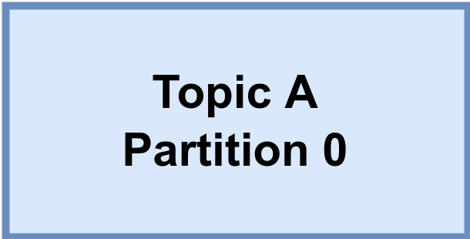
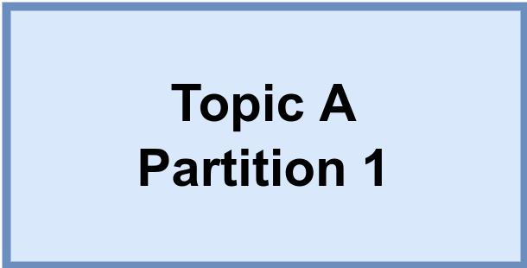
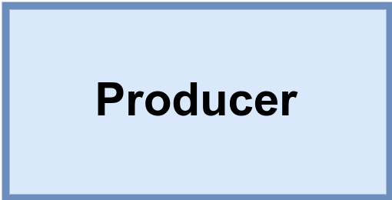
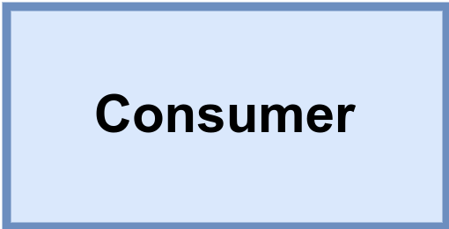

Brokers and Clusters
Kafka cluster
Messages
for A/0
Messages
from A/0
Leader
Replicate
A/0
Replicate
A/1
Messages
for A/1
Messages
from A/1
Leader
Notes:
- A single Kafka server is called a broker
- The broker receive message from producers, assigns offsets to them, and writes the messages to storage on disk.
- Services customers, responding to fetch requests for partitions and responding with the messages that have been published.
- A partition is owned by a single broker in the cluster, and that broker is called the leader of the partition.
- A replicated partition is assigned to additional brokers, called followers of the partition.
- All producers must connect to the leader in orther to publish messages, but consumers may fetch from either the leader on one of the followers.
- Connect to 2 brokers => connect to cluster

Slide 9
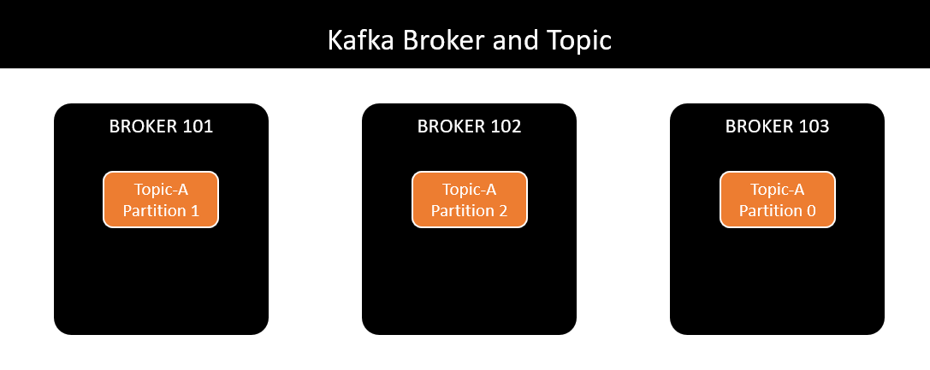
Brokers and Clusters
Notes:
- Kafka auto distribute partition on brokers

Slide 10
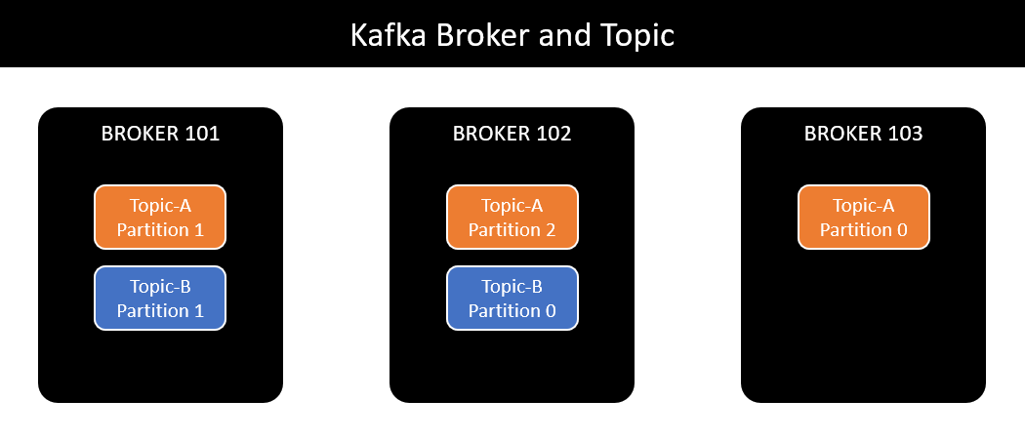
Brokers and Clusters

Slide 11
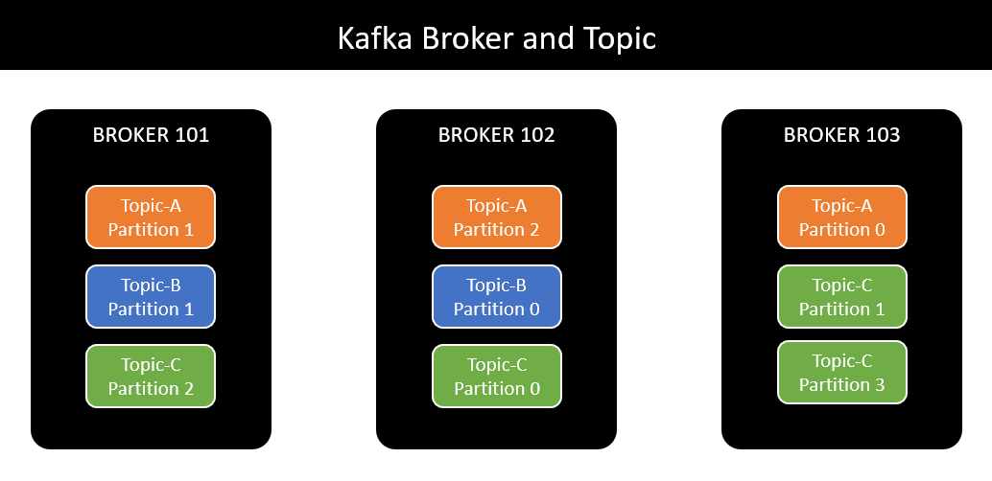
Brokers and Clusters

Slide 12
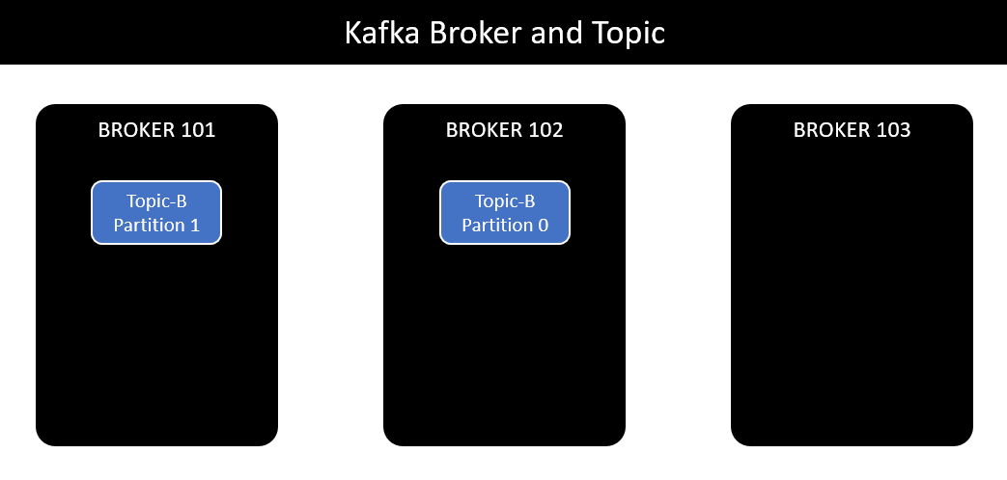
Topic replication
Notes:
- Broker 103 die => ok
- Broker 101 or 102 die => loss message

Slide 13
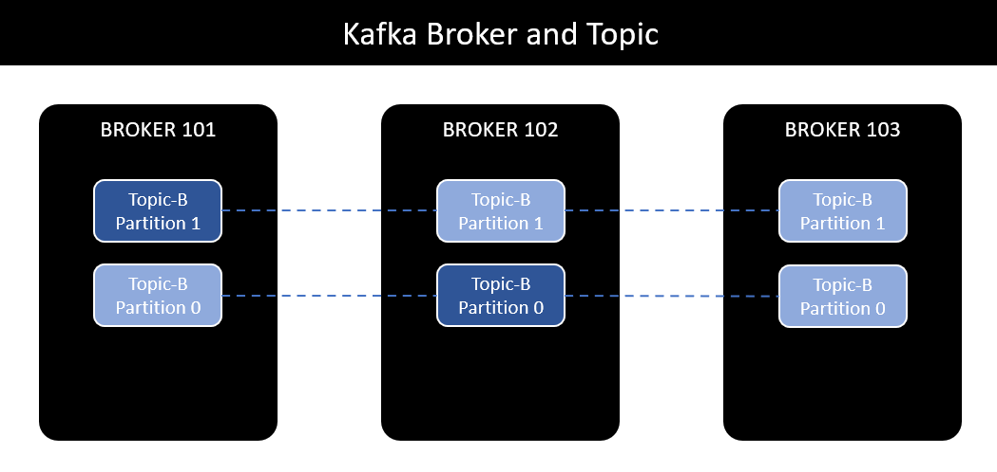
Topic replication
Notes:
- replica factor = 3
- replica factor cannot be larger than brokers

Slide 14
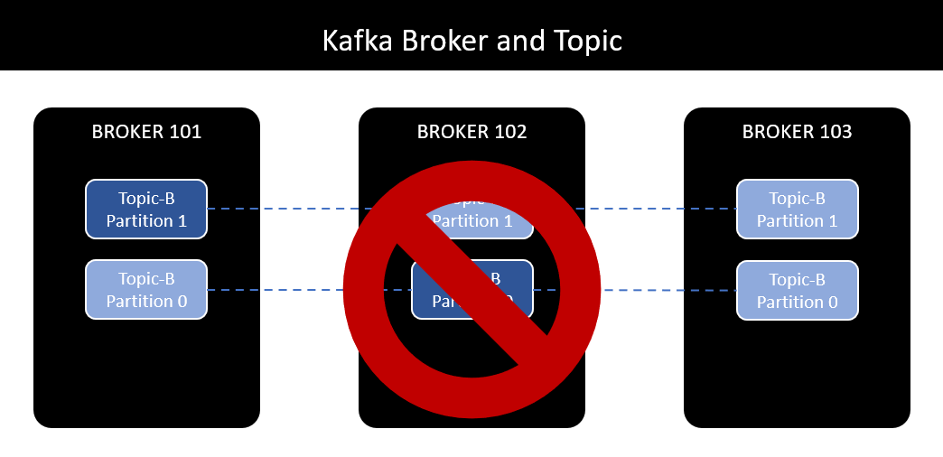
Topic replication
Notes:
- Broker 102 die, elect leader broker 103 - topic B partition 0

Slide 15
Kafka broker discovery
Notes:
- Broker 102 die, elect leader broker 103 - topic B partition 0

Slide 16
Kafka Producers: Writing Messages to Kafka
Topic A
Partition 0
Batch 0
Batch 1
ProducerRecord
Batch 2
Topic
Kafka broker
Send()
[Partition]
Serializer
Partitioner
[Key]
Topic B
Partition 1
Value
Batch 0
When successful,
return metadata
include topic, partition
and the offset
If can’t retry,
throw
exception
Batch 1
Retry?
Fail?
Notes:
- Once we send the ProducerRecord, the first thing the producer will do is serialize the key and value objects to byte arrays so they can be sent over the network.
- Next, if we didn’t explicity specify a partition, the data is sent to a partitioner. The partitioner will choose a partition for us, usually based on the ProducerRecord key. Once a partition is selected, the producer knows which topic and partition the record will go to. It then adds the record to a batch or records that will also be sent to the same topic and partition.
- When the broker receives the messages, it sends back a response.
- When the producer receives an error, it may retry sending the message a few more times before giving up and returning an error.

Slide 17
Acks (demo)
● acks = 0
● acks = 1
Notes:
- Ack allow producer know message is write or not.
- When acks = 0 producers consider messages as “written successfully” the moment the message was sent without waiting for the broker to accept it at all. Pros: the network overhead is minimized, cons: If the broker goes offline or an exception happens, we won’t know and will lose data.
- When acks = 1 producers consider messages as “written successfully” when the message was acknowledged by only the leader (replication is not a guarantee). If an ack is not received, the producer may retry the request. Pros: the network overhead is minimized. Cons If the leader broker goes offline unexpectly but replicas haven’t replicated the dat yet, we have a data loss

Slide 18
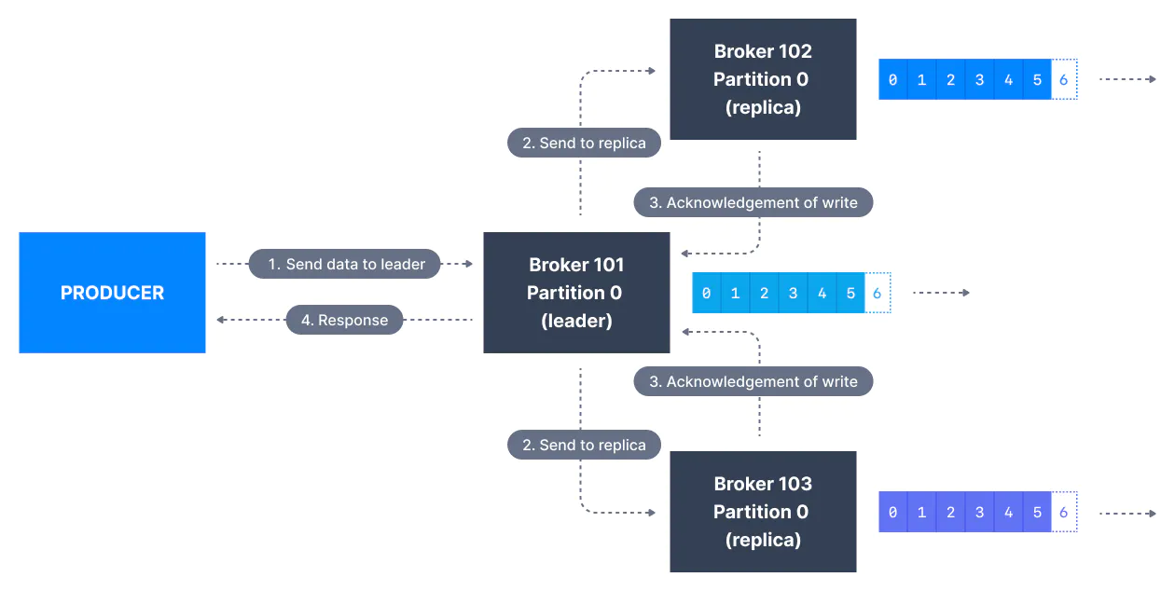
Acks (demo)
● acks = all, min.insync.replicas = 2
Notes:
- When acks = all, producers consider messages as “written successfully” when the message is accepted by all in-sync replicas (ISR). The leader replica for a partition checks to see if there are enough in-sync replicas for safely writing the message (controlled by the broker setting min.insync.replicas)

Slide 19
Acks
● Trade-off reliability versus producer latency
● Mis-understood producer latency versus end-to-end latency
Notes:
- End-to-end latency is mesured from the time a record was produced until it is avaiable for consumers to read and is identical for all three acks options.
- In order maintain consistency, Kafka will not allow consumers to read records until they are written to all in sync replicas.
- If you care about end-to-end latency, rather than just the producer latency, there is no trade-off to make. You will get the same end-to-end latency if you choose the most reliable option.

Slide 20
Durability & Availability
● Durability: N replicas - lose up to N-1 can still recover your data
● Availability
● Read
● Write
Notes:
- Replication is at the heart of Kafka’s architecture
- Kafka is organized by topics. Each topic is paritioned, and each partition can have multiple replicas. Replicas are stored on brokers.
- All produce requests go through the leader to guarantee consistency.
- Unless configured otherwise, followers don’t serve client requests; their main job is to replicate messages from the leader and stay up-to-date with the most recent messages the leader has. If a leader replica for a partition crashes, one of the follower replicas will be promoted to become the new leader for the parition.

Slide 21
Producer Retries
● retries
● deliver.timeout.ms
● retry.backoff.ms

Slide 22
Problem with Retries: Guaranteed order of messages (hard in distributed)
● max.in.flight.requests.per.connection

Slide 23
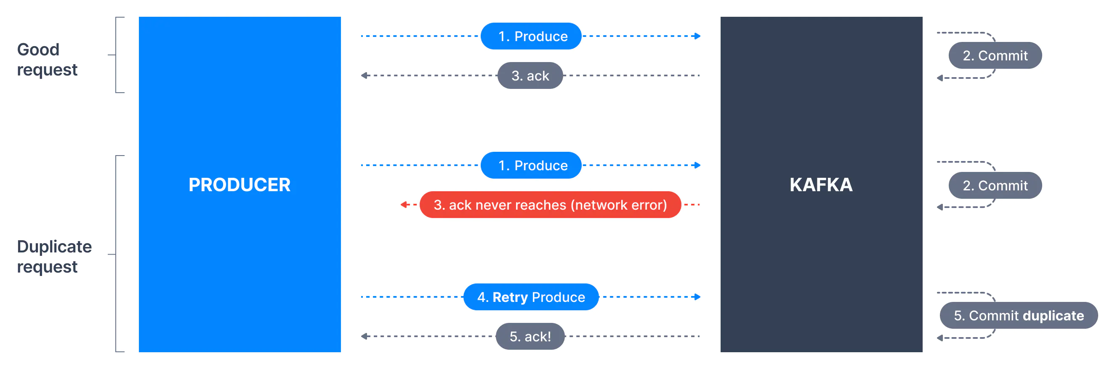
Problem with Retries - Duplicate

Slide 24
Batching (Demo)
● batch.size
● linger.ms
● pros and cons
Notes:
- When multiple records are sent to the same partition, the producer will batch them together.
- batch.size controls the amount of memory in bytes (not messages) that will be used for each batch.
- pros reduce network overhead, apply compression
- cons more RAM (decompression)

Slide 25
Message Delivery Time
● Control how long will it take until a call to send() will succeed or fail
max.block.ms
linger.ms
retry.backoff.ms
request.timeout.ms
send()
Batching
Notes:
- max.block.ms:
- linger.ms controls the amount of time to wait for additional messages before sending the current batch. KafaProducer sends a batch of messages either when the current batch is full or when the ligher.ms limit is reached. Overhead per message is much lower and compression.
- request.timeout.ms: how long the producer will wait for a reply from the server when sending data.
- retries and retry.backoff.ms
- batch.size: when records are sent to the same partition, the producer will batch them together

Slide 26
Consumers and Consumer Groups
● Why-Where?
● Distributed system, producer on many node
● Unable to keep up with the rate of incoming message

Slide 27
Kafka Consumers: Reading Data from Kafka
Topic T1
Consumer group 1
Partition 0
Consumer 1
Partition 1
Consumer 2
Partition 2
Consumer 3
Partition 3
Consumer 4
Consumer 5

Slide 28
Kafka Consumers: Reading Data from Kafka
Topic T1
Consumer group 1
Partition 0
Consumer 1
Partition 1
Consumer 2
Partition 2
Consumer 3
Partition 3
Consumer 4
Consumer group 2
Consumer 1
Consumer 2

Slide 29
Produce and Consume Data By Example
Brokers | Partitions | Replicas | Consumer Groups | Producing interval | Consume interval
1 | 1 | 1 | 1(1A) | 1 | 2
1 | 1 | 1 | 2(2A) | 1 | 2
1 | 2 | 1 | 2(2A) | 1 | 2
2 | 2 | 1 | 2(2A) | 1 | 2
2 | 2 | 1 | 3 (2A-1B) | 1 | A2-B1
Notes:
- 1. Unable to keep up with the rate of incoming message
- 2. Consumer 2 do nothing
- 3. Work
- 4. Work
- 5. Work

Slide 30
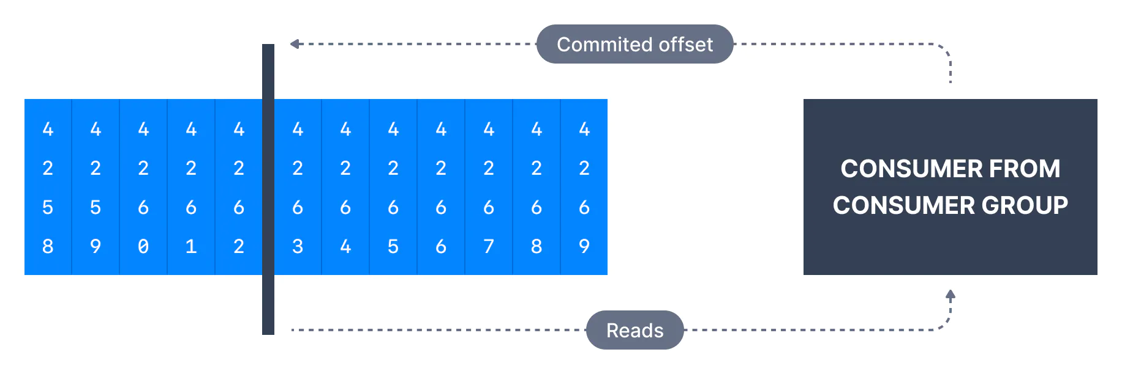
Commits and Offsets
Notes:
- We call the action of updating the current position in the partition an offset commit.
- Miss message

Slide 31
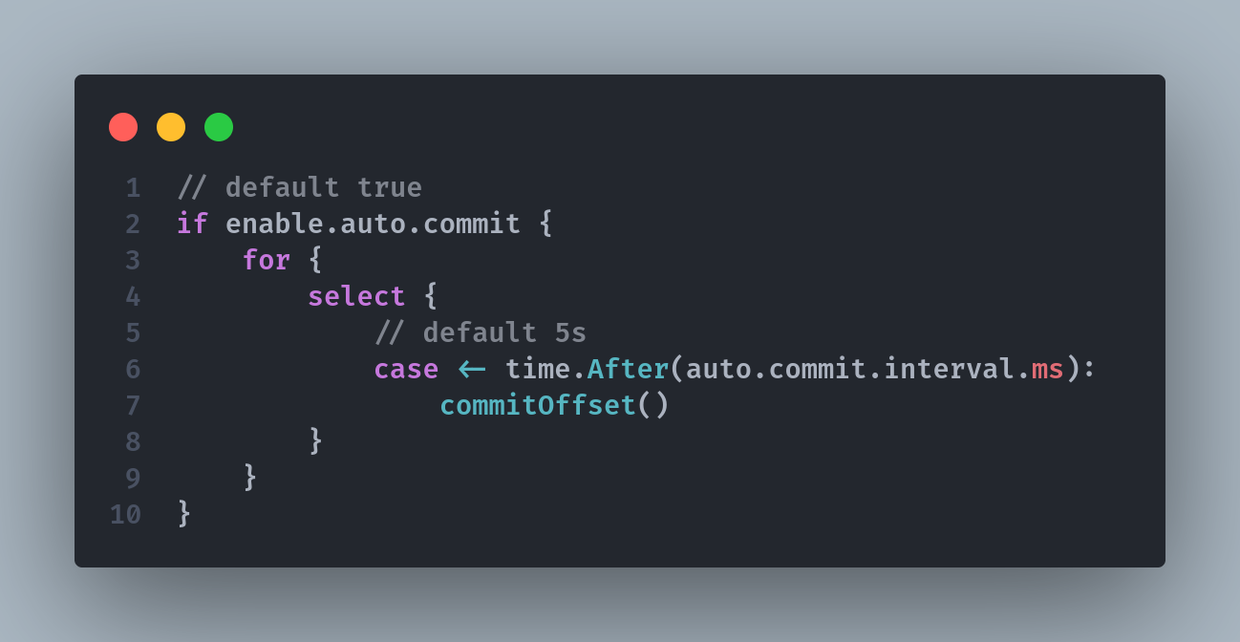
Commit Strategy - Auto Commit
Notes:
- By default enable.auto.commit = true and therefore offsets are committed automatically with a frequency controlled by the config auto.commit.interval.ms (default 5s)

Slide 32
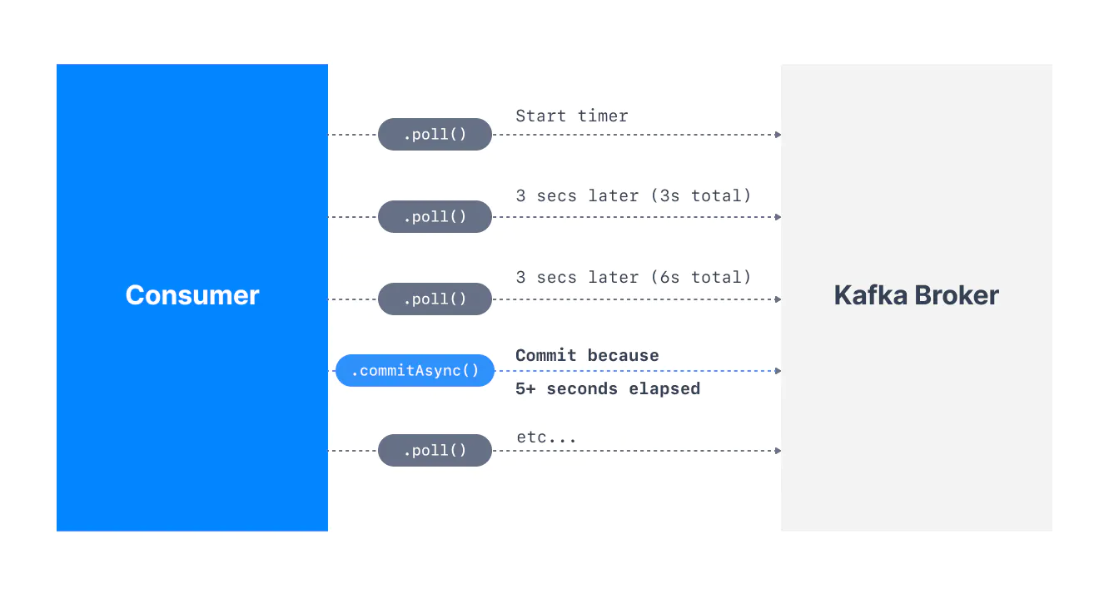
Commit Strategy - Auto Commit
Notes:
- Auto commit will commit the highest offset that was fetched during a poll.
- By default, the property enable.auto.commit = true and therefore offsets are committed automatically with a frequency controlled by the config auto.commit.interval.ms
- The process of committing the offsets happens when: The .poll() function is called, the time between calls to .poll() is greater than the setting auto.commit.interval.ms (5 seconds by default).
- This means that to be in an “at-least-once” processing usecase, you need to ensure all the messages in your consumer code are successfully processed before performing another .poll()
- If this is not the case, the offsets could be committed before the messages are actually processed, therefore resulting in an “at-most once” processing pattern

Slide 33
Commit Strategy - Manually Commit
Notes:
- Auto commit will commit the highest offset that was fetched during a poll.
- By default, the property enable.auto.commit = true and therefore offsets are committed automatically with a frequency controlled by the config auto.commit.interval.ms
- The process of committing the offsets happens when: The .poll() function is called, the time between calls to .poll() is greater than the setting auto.commit.interval.ms (5 seconds by default).
- This means that to be in an “at-least-once” processing usecase, you need to ensure all the messages in your consumer code are successfully processed before performing another .poll()
- If this is not the case, the offsets could be committed before the messages are actually processed, therefore resulting in an “at-most once” processing pattern

Slide 34
Idempotent process
● They can be applied multiple times without changing
the result beyond the initial application (same input).
● Remove item from set
● HTTP GET, DELETE, PUT
Notes:
- At most once delivery: Offsets are committed as soon as a message batch is received after calling poll()
If the subsequent processing fails, the message will be lost. It will not be read again as the offset of those messages have been commited already.
=> lose data.

Slide 35
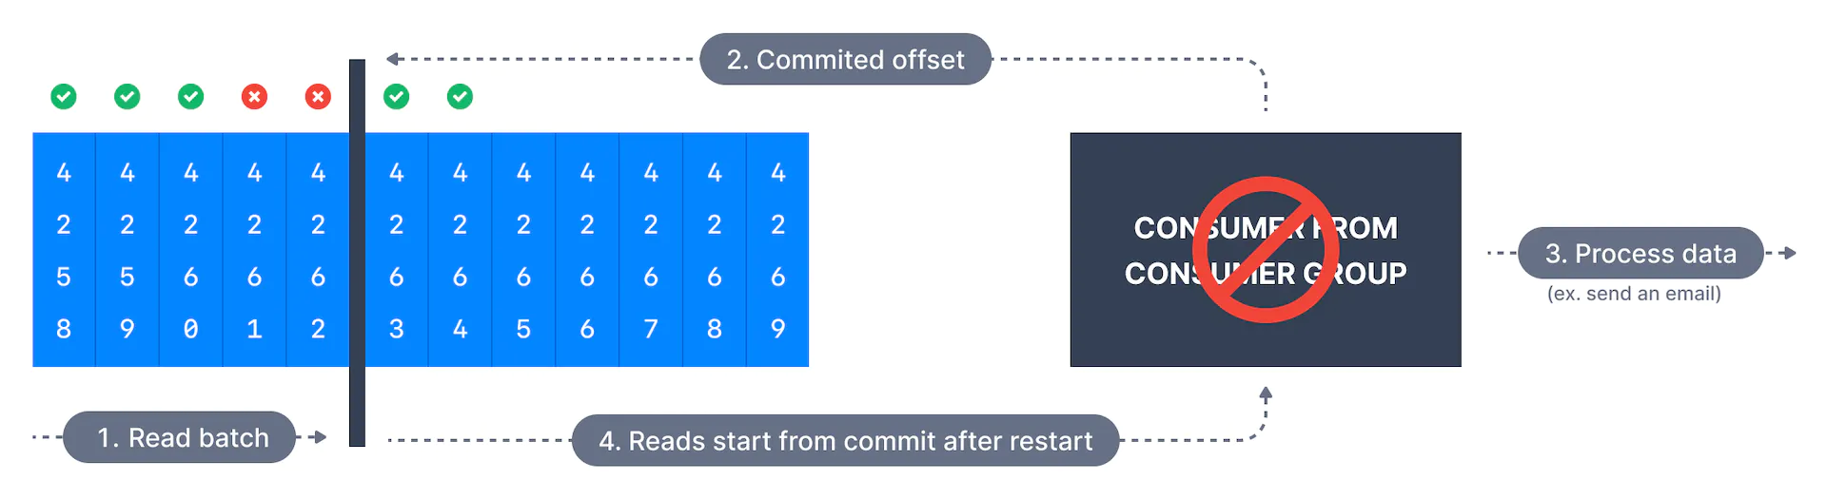
Delivery Semantics - At Most Once Delivery
Notes:
- At most once delivery: Offsets are committed as soon as a message batch is received after calling poll()
If the subsequent processing fails, the message will be lost. It will not be read again as the offset of those messages have been commited already.
=> lose data.

Slide 36
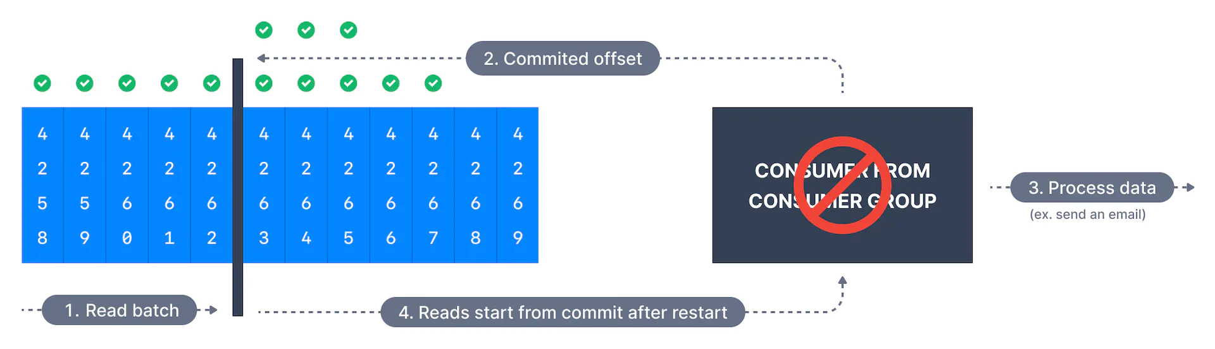
Delivery Semantics - At Least Once Delivery
Notes:
- In at-least-once delivery, every event from the source system will reach its destination, but sometimes retries will caus duplicates, Here, offsets are commited after the message is processed. If the processing goes wrong, the message will be read again. This can result in duplicate processing of messages. This is suitable for consumers that cannot afford any data loss.
- Make sure your process is idempotent (i.e processing again the messages won’t impact your systems)

Slide 37
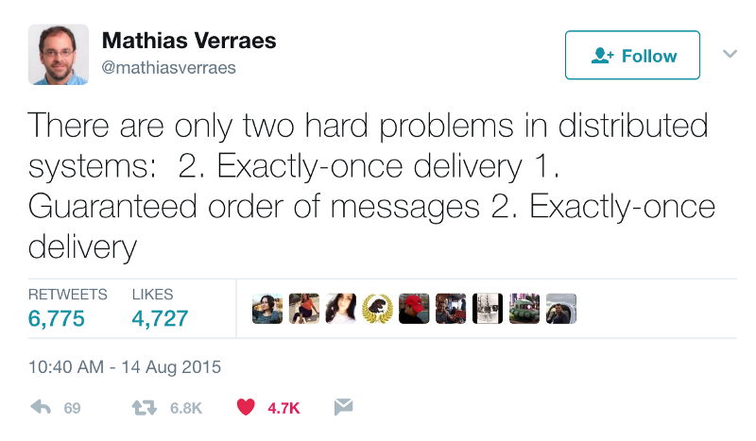
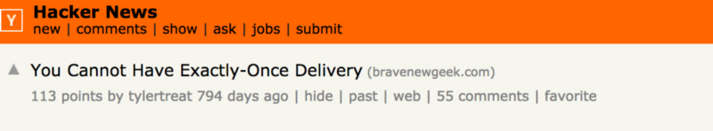
Delivery Semantics - Exactly Once Delivery
Notes:
- Banking problem
- Case transfer from kafka to kafka

Slide 38
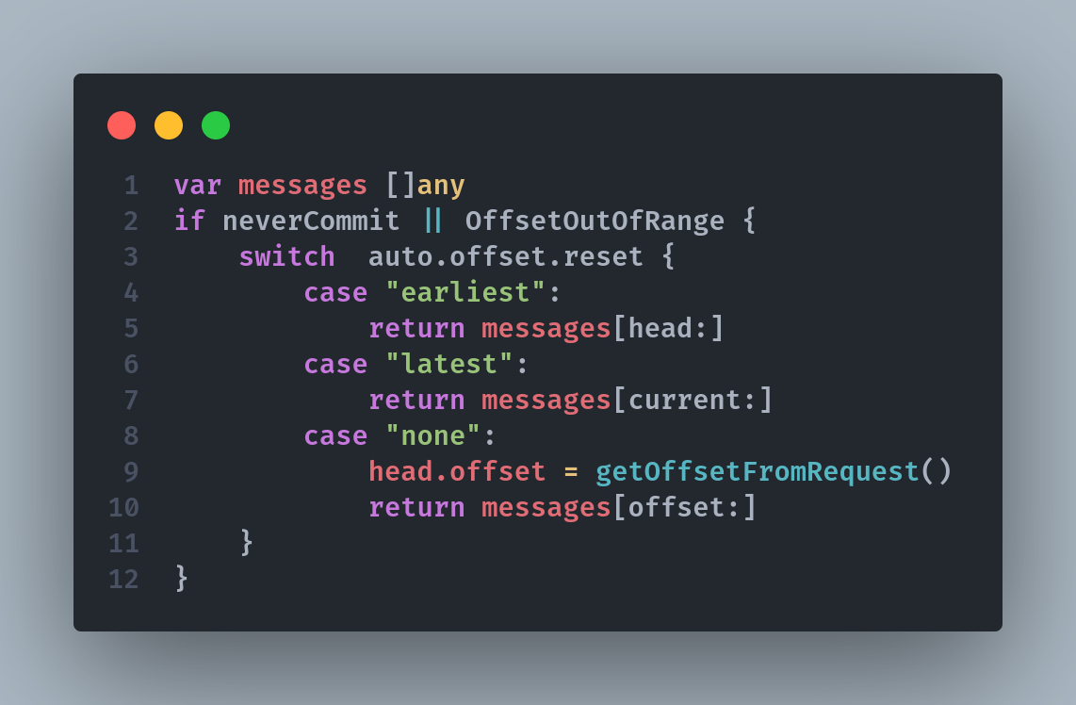
Consumer Auto Offsets (demo)
Notes:
- When neverCommit: never committed, your consumer down time > retention. E.g retention = 1 day, your consumer down time > 1 day, the offsets are invalid as they will be deleted.

Slide 39
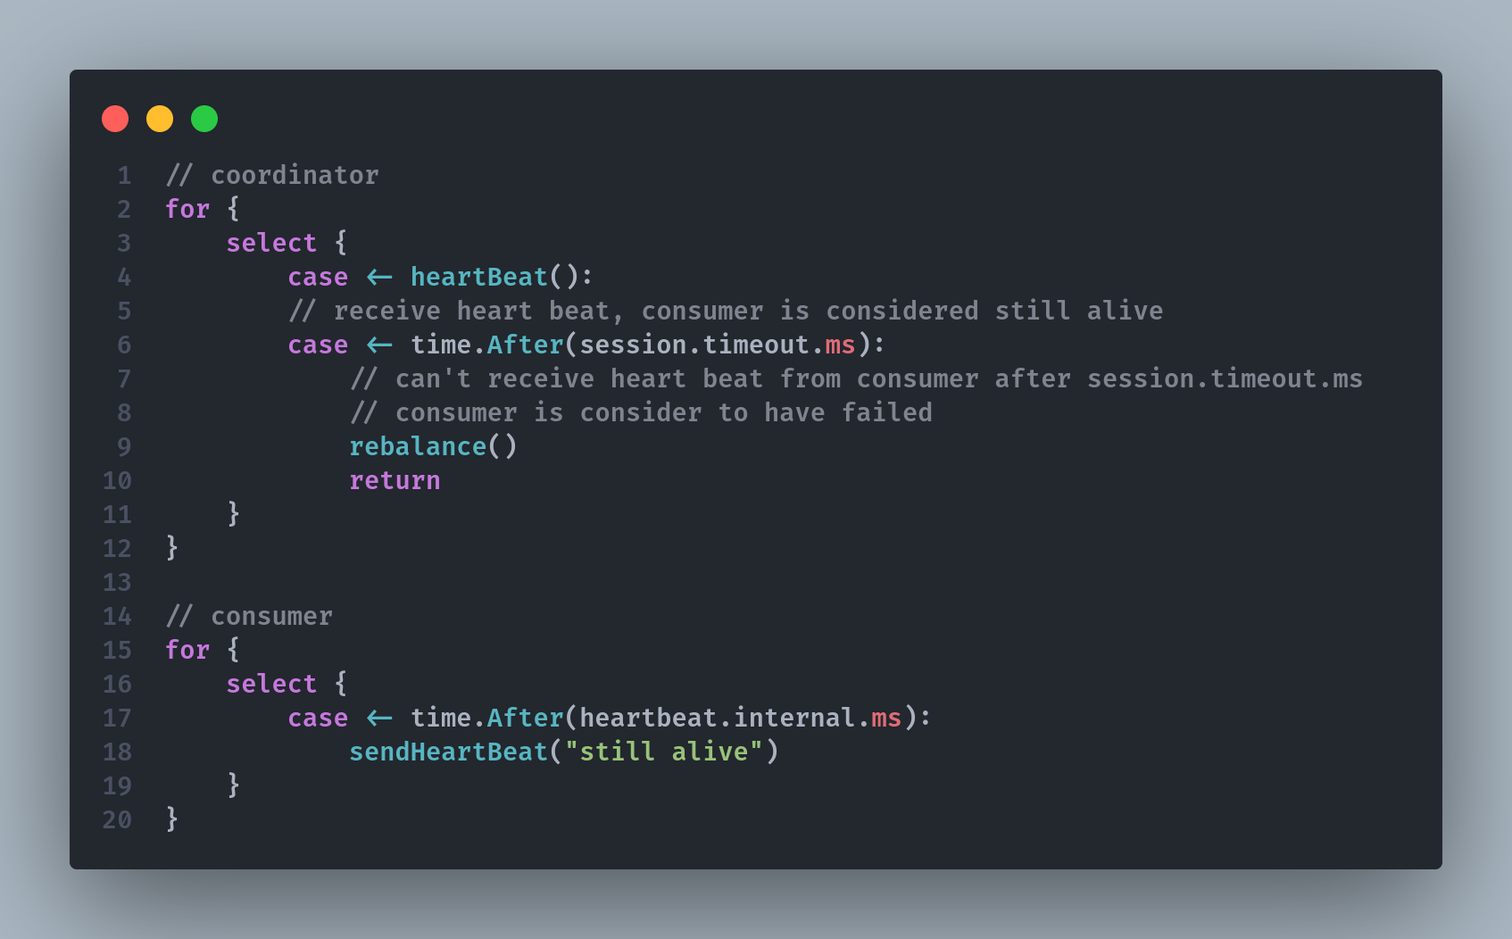
Consumer heartbeat
Notes:
- We call the action of updating the current position in the partition an offset commit.
- Miss message

Slide 40
Commit Strategy - Rebalance
● a consumer leaves the group
● a consumer joins a group
● partitions are added to a topic
Notes:
- Auto commit will commit the highest offset that was fetched during a poll.
- By default, the property enable.auto.commit = true and therefore offsets are committed automatically with a frequency controlled by the config auto.commit.interval.ms
- The process of committing the offsets happens when: The .poll() function is called, the time between calls to .poll() is greater than the setting auto.commit.interval.ms (5 seconds by default).
- This means that to be in an “at-least-once” processing usecase, you need to ensure all the messages in your consumer code are successfully processed before performing another .poll()
- If this is not the case, the offsets could be committed before the messages are actually processed, therefore resulting in an “at-most once” processing pattern

Slide 41
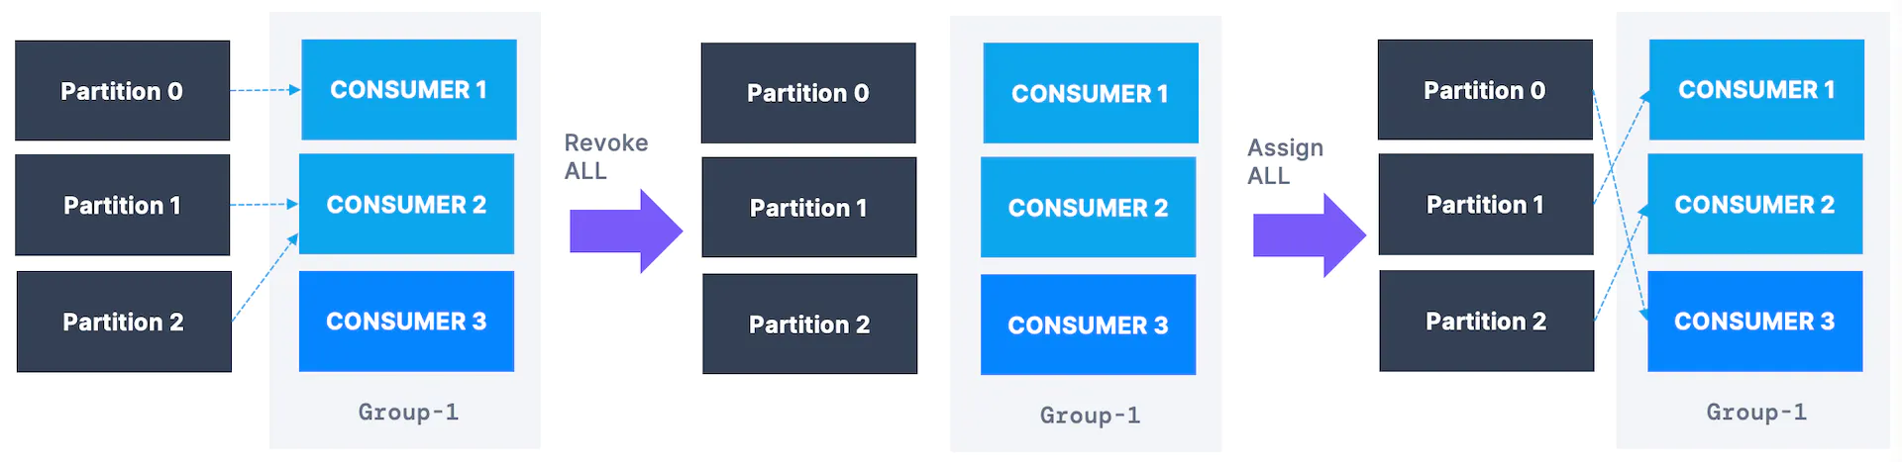
Consumer Eager Rebalancing

Slide 42
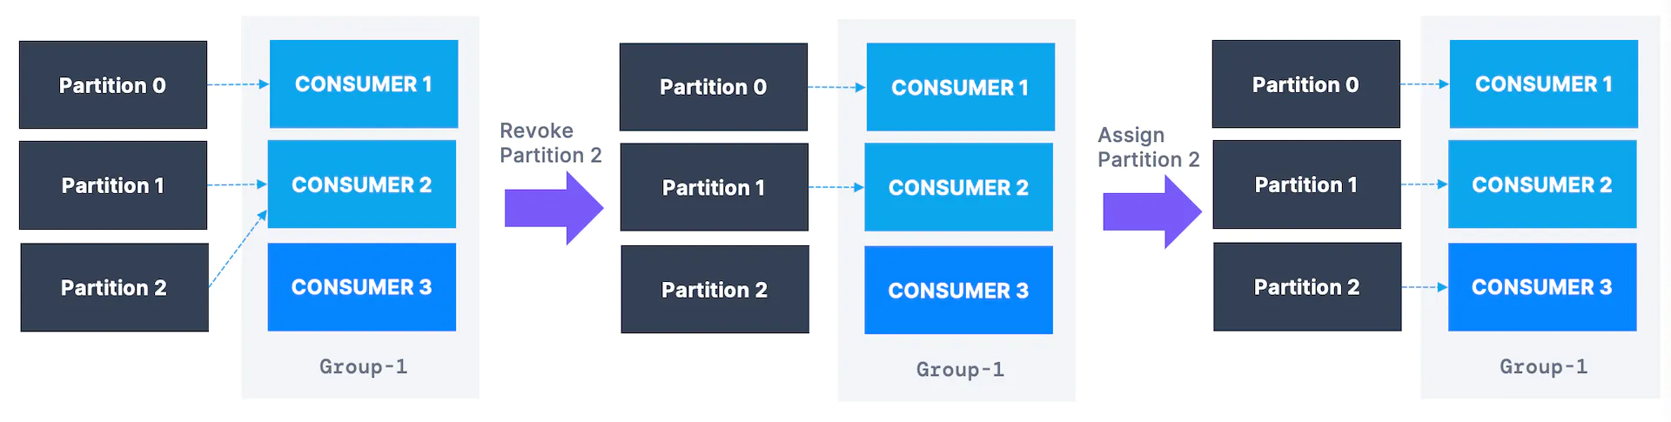
Consumer Cooperative Rebalance

Slide 43
Why Kafka Fast - Sequential Access
● Kafka stores data on disk why it is fast?
● Data Access Patterns
Notes:
- There’s a common misconception that disk access is slow compared to memory access, but this largely depends on data access patterns.
- On Disk, random access slow
- Kafka append only log. Access pattern is sequential

Slide 44

Why Kafka Fast - Data Transfer Through Zero Copy
Application Context
Kernel Context
CPU copy
DMA copy
1
2
Read buffer
Application buffer
4
3
Socket buffer
NIC buffer
Notes:
- The application does nothing other than cache the data and transfer it back to the socket buffer
- Socket buffer: a socket is your app’s interface to one TCP (or UDP) connection. You app doesn’t r/w data to the NIC, it goes through the kernel’s network stack.

Slide 45
Why Kafka Fast - Data Transfer Through Zero Copy
Application Context
Kernel Context
CPU copy
DMA copy
1
Read buffer
Application buffer
2
NIC buffer

Slide 46
References
Concept | Resource
Zero copy | https://developer.ibm.com/articles/j-zerocopy/
Why Kafka so fast | https://www.youtube.com/watch?v=UNUz1-msbOM
Tutorial by conduktor | https://www.conduktor.io/kafka
Exactly once delivery | https://www.confluent.io/blog/exactly-once-semantics-are-possible-heres-how-apache-kafka-does-it/
Apache Kafak từ zero đến one | https://viblo.asia/s/apache-kafka-tu-zero-den-one-aGK7jPbA5j2

