Slide 1
Kafka The First Look
By NgocTD
Notes:
A distributed, partitioned, replicated commit log service

Slide 2




Publish/Subscribe Messaging
Subscriber
Publisher
Subscriber
Publisher
Subscriber
Notes:
- concept of pub/sub and why it is a critical component of data-driven application
- Pub/sub messaging is a pattern that is characterized by the sender (publisher) of a piece of data (message) not specifically directing it to a receiver. Instead, the publisher classifies the message somehow, and that receiver (subscriber) subscribes to receive certain classes of message.

Slide 3






Messages and Batches
Collection of messages
Being produced
to the same topic and partition.
The unit of data.
An array of bytes.
Latency and throughput.
Written to the same partition
By modulo the total number
of partitions in the topic.
Batches compressed.
Notes:
The unit of data within Kafka is called a message. You can think of this as similar to a row or a record.
A message if simply an array of bytes.
A message can have an optional piece of metadata, which is referred to as a key.
Messages are written into Kafka in batches.
Trade-off between latency and throughput: more messages can be handled per unit of time.
Batches are also typically compressed.

Slide 4
Topics
● Named container for similar events
● Append only
● Can only seek by offset, not indexed
● Immutable
● Durable
● Expirable
Notes:
Messages in Kafka are categorized into topics. The closest anologies for a topic are a database table.
Partitions are also the way that Kafka provides redundancy and scalability. Each partition can be hosted on a different server, which means that a single topic can scaled horizontally across multiple servers to provide performance far beyond the ability of a single server.

Slide 5
Partitions
● Why-Where?
● Distributed system, limit read write on one node
● Ability of Apache Kafka to scale
● Live on a separate node in the Kafka cluster
● How?
● Write to partition strategy

Slide 6
Partitions: Round Robin
Broker1/Partition1
Broker2/Partition2
Broker3/Partition3
Notes:
Round robin
- If a message has no key, subsequent messages will be distributed round-robin among all the topic’s partitions

Slide 7
Partitions: Key
1
1
5
Broker1/Partition1
1
Broker2/Partition2
2
5
4
3
2
3
3
4
4
4
Broker3/Partition3
Notes:
With key
- If the message does have a key, then the destination partition will be computed from a hash of the key (murmur2)
- Use case of key: guarantee that messages having the same key always land in the same partition and therefore are always in order
- For example, if you are producing events that are all associated with the same customer, using the customer ID as the key guarantees that all of the events from a given customer will always arrive in order.

Slide 8

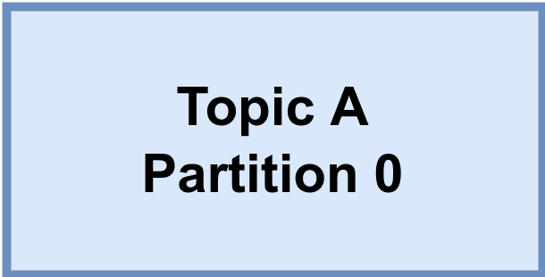
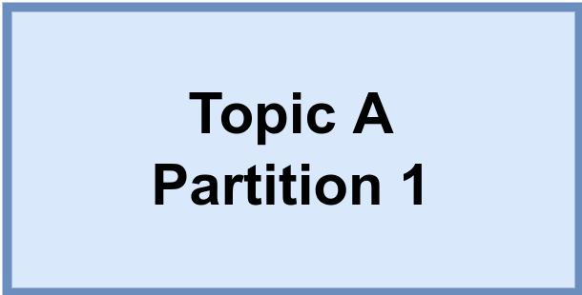
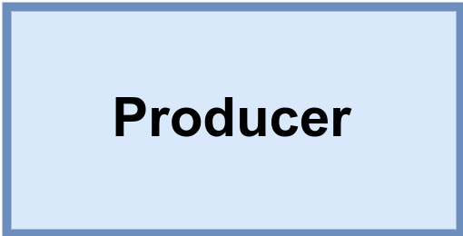
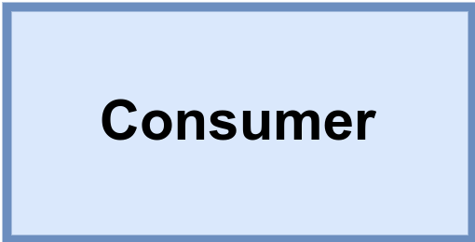

Brokers and Clusters
Kafka cluster
Messages
for A/0
Messages
from A/0
Leader
Replicate
A/0
Replicate
A/1
Messages
for A/1
Messages
from A/1
Leader

Slide 9
Replication: Availability and Durability
● Leader replica
● Follower replica
produce,
consistency
4
1
2
3
Leader
1
2
3
4
Follower
Notes:
- Replication is at the heart of Kafka’s architecture
- Kafka is organized by topics. Each topic is paritioned, and each partition can have multiple replicas. Replicas are stored on brokers.
- All produce requests go through the leader to guarantee consistency.
- Unless configured otherwise, followers don’t serve client requests; their main job is to replicate messages from the leader and stay up-to-date with the most recent messages the leader has. If a leader replica for a partition crashes, one of the follower replicas will be promoted to become the new leader for the parition.

Slide 10
Kafka Producers: Writing Messages to Kafka
Topic A
Partition 0
Batch 0
Batch 1
ProducerRecord
Batch 2
Topic
Kafka broker
Send()
[Partition]
Serializer
Partitioner
[Key]
Topic B
Partition 1
Value
Batch 0
When successful,
return metadata
include topic, partition
and the offset
If can’t retry,
throw
exception
Batch 1
Batch 2
Retry?
Fail?
Notes:
Once we send the ProducerRecord, the first thing the producer will do is serialize the key and value objects to byte arrays so they can be sent over the network.

Slide 11
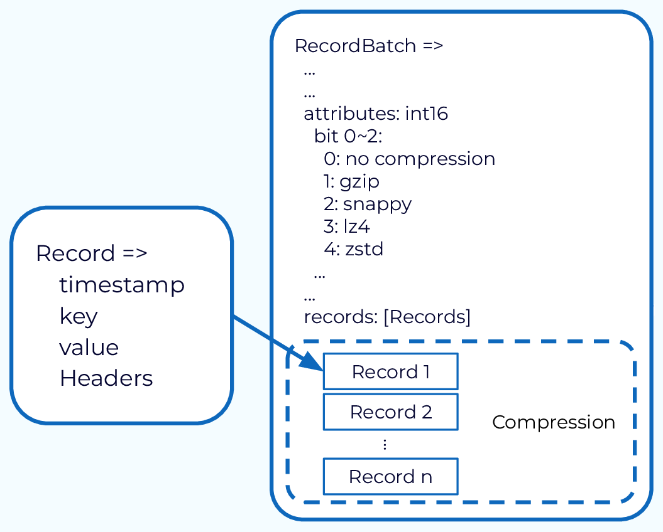
Kafka Producers: Writing Messages to Kafka
Notes:
Once we send the ProducerRecord, the first thing the producer will do is serialize the key and value objects to byte arrays so they can be sent over the network.

Slide 12
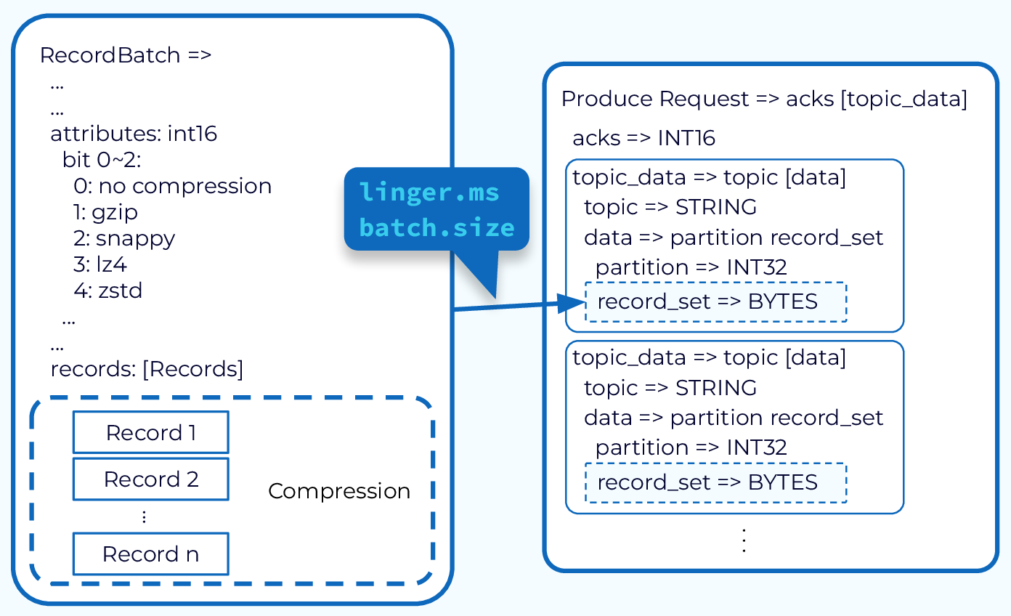
Kafka Producers: Writing Messages to Kafka
Notes:
Once we send the ProducerRecord, the first thing the producer will do is serialize the key and value objects to byte arrays so they can be sent over the network.

Slide 13
Kafka Consumers: Reading Data from Kafka
Topic T1
Consumer group 1
Partition 0
Consumer 1
Partition 1
Consumer 2
Partition 2
Consumer 3
Partition 3
Consumer 4
Consumer 5

Slide 14
Kafka Consumers: Reading Data from Kafka
Topic T1
Consumer group 1
Partition 0
Consumer 1
Partition 1
Consumer 2
Partition 2
Consumer 3
Partition 3
Consumer 4
Consumer group 2
Consumer 1
Consumer 2

Slide 15
Consumer Groups and Partition Rebalance
Notes:
Moving partition ownership from one consumer to another is called a rebalance. Rebalances are important because they provide the consumer group with high availability and scalability

Slide 16
Commits and Offsets
Notes:
- We call the action of updating the current position in the partition an offset commit.
- Miss message

Slide 17

Cluster Membership
Broker
ID 1
Broker
ID 2
Broker
ID 3
Broker
ID 4
/broker/ids
Notes:
- Kafka brokers, the controller, and some of the ecosystem tools subscribe to the /brokers/ids path in ZooKeeper where brokers are registered so that they get notified when brokers are added or removed.

Slide 18
Kafka Manages Data and Metadata Separately
Notes:
- Dupplicate message
- Miss message

Slide 19
Commits and Offsets
Notes:
- Dupplicate message
- Miss message

