Slide 1
C++ MODEL
Apply C++ Model in QML

Slide 2
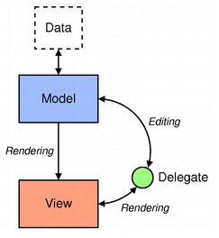
C++ Model
Keep the representation of the data separate from the visualization. (View can be changed but the data is identical)
In QML, the model and view are joined by the delegate
Model provides the data
Each delegate shows the values of each model item to the user. The data is accessible through the delegate use “modelData” or role name
View is to arrange the delegates
Visualize data:
Bind model
Bind delegate
Model-View-Delegate

Slide 3
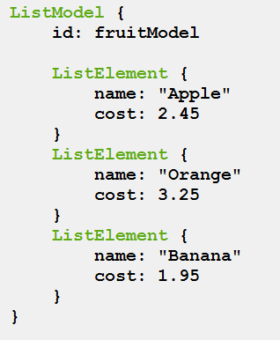
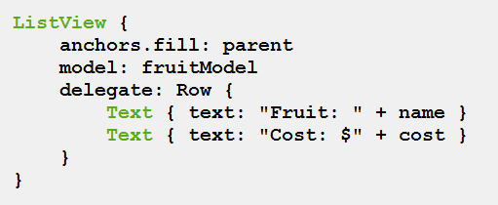
C++ Model
QML Model
Models that do not have named roles will have the data provided via the modelData role. The modelData role is also provided for models that have only one role. In this case the modelData role contains the same data as the named role.

Slide 4

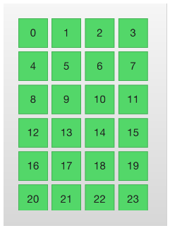
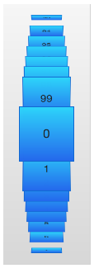
C++ Model
ListView
GridView
PathView
Refer: https://qmlbook.github.io/en/ch06/index.html
Dynamic Views

Slide 5
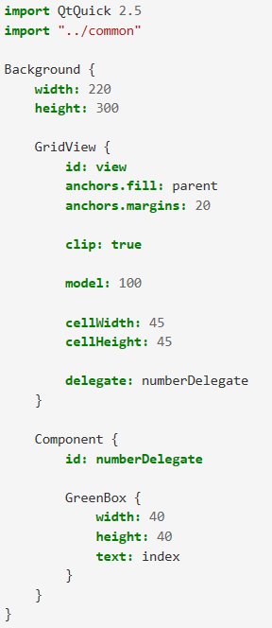
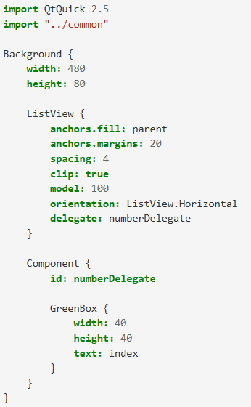
C++ Model
Example
Dynamic View

Slide 6
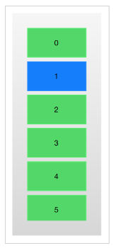
C++ Model
Each item in a the model are visualized through a delegate
Each delegate gets access to a number of attached properties, some from the data model, others from the view
Refer: https://qmlbook.github.io/en/ch06/index.html
ListView
Delegate
Delegate

Slide 7
C++ Model
QAbstractItemModel
QAbstractListModel
QAbstractTableModel
QStringList Model
Qlist<QObject*>
QQmlListProperty
Apply C++ model to QML

Slide 8
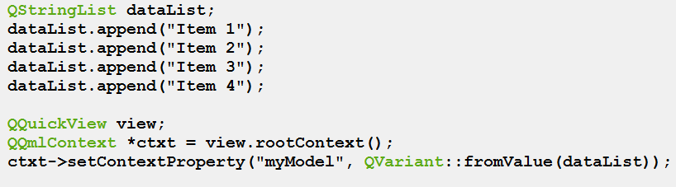
C++ Model
QStringList Model
Apply C++ model to QML

Slide 9
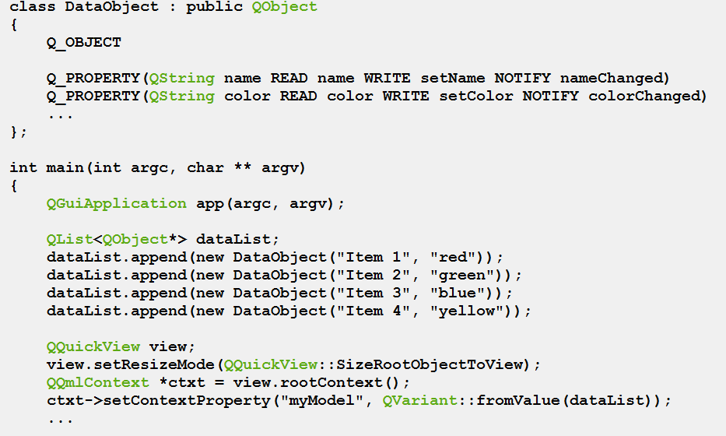
C++ Model
QList<QObject*> Model
Apply C++ model to QML

Slide 10
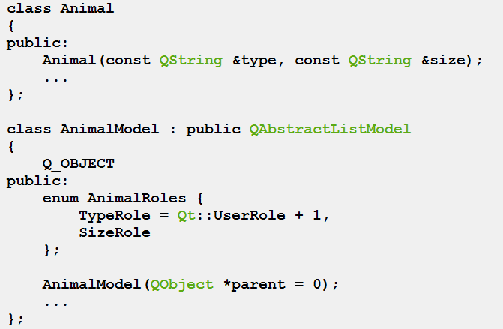
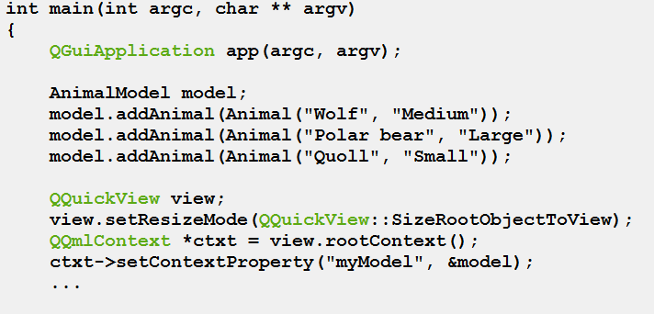
C++ Model
QAbstractItemModel
Apply C++ model to QML
(Checkout code on GIT)

Slide 11
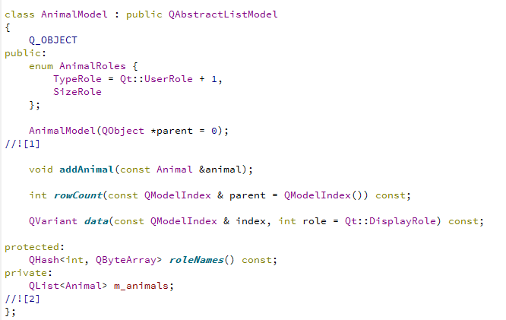
C++ Model
QAbstractItemModel
Apply C++ model to QML
(Checkout code on GIT)

Slide 12
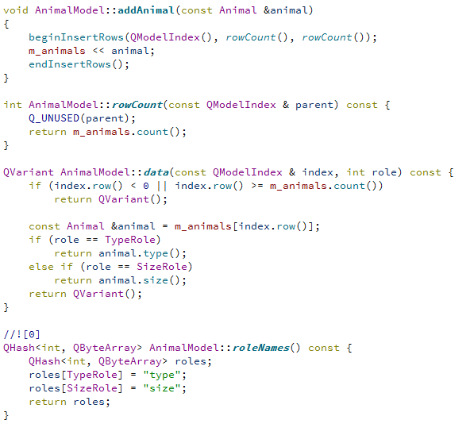
C++ Model
QAbstractItemModel
Apply C++ model to QML
(Checkout code on GIT)

Slide 13
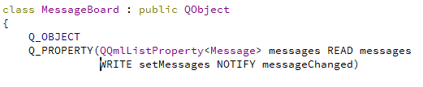

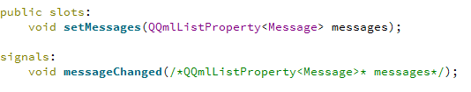

C++ Model
QQmlListProperty
Apply C++ model to QML

Slide 14
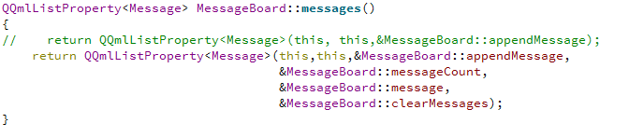
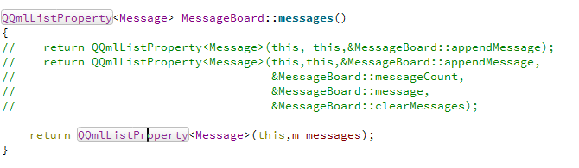
C++ Model
QQmlListProperty
Apply C++ model to QML

Slide 15
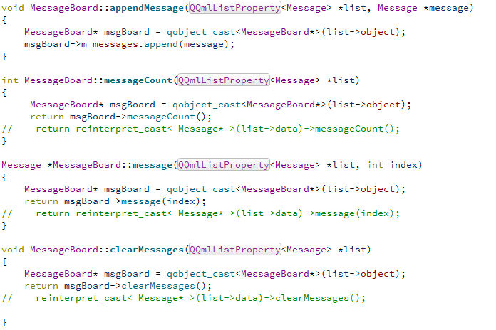
C++ Model
QQmlListProperty
Apply C++ model to QML

