Slide 1
QML-C++
Integration between QML and C++
(tuan1.pham@lge.com)

Slide 2
Integration between QML and C++
Extending QML with C++
Defining QML types from C++
Exposing Attributes of C++ Types to QML
Interacting (QML - C++)
Embbed C++ Object into QML
Interacting with QML Objects from C++

Slide 3
extending QML with C++
attached property
QML Attribute
id
signal
QML Object
property
method
signal handler

Slide 4
extending QML with C++
A QObject-derived class
Registered with the QML type system
Instantiable Object Type: call qmlRegisterType()
Non-Instantiable Object Type:
qmlRegisterType() (with no parameters) registers a C++ type that is not instantiable and cannot be referred to from QML. This enables the engine to coerce any inherited types that are instantiable from QML.
qmlRegisterInterface() registers a Qt interface type with a specific QML type name. The type is not instantiable from QML but can be referred to by its type name.
qmlRegisterUncreatableType() registers a named C++ type that is not instantiable but should be identifiable as a type to the QML type system. This is useful if a type's enums or attached properties should be accessible from QML but the type itself should not be instantiable.
qmlRegisterSingletonType() registers a singleton type that can be imported from QML
Defining QML types from C++

Slide 5
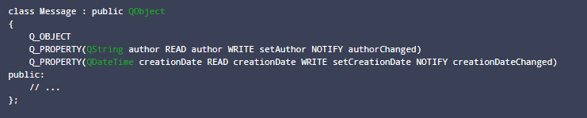
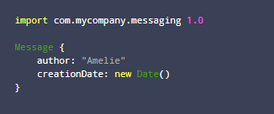
extending QML with C++
Example
Instantiable Object Type:
Defining QML types from C++

Slide 6
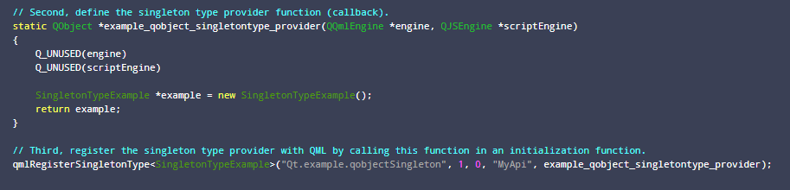
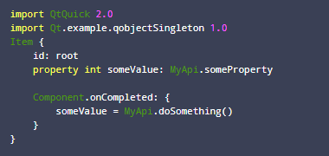
extending QML with C++
Example (Cont)
Non-Instantiable Object Type: (singleton types do not have an associated QQmlContext object)
Defining QML types from C++

Slide 7
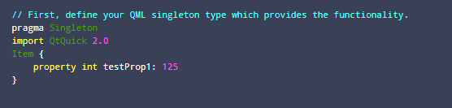

extending QML with C++
Example (Cont)
Additional
Defining QML types from C++

Slide 8
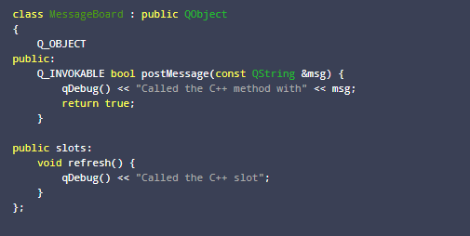
extending QML with C++
Properties
A property can be specified for any QObject-derived class using the Q_PROPERTY() macro
The CONSTANT attribute: for properties whose value is set, and finalized, only in the class constructor. Others that want to be used in bindings should have a NOTIFY signal instead.
Methods (providing they are public slots or flagged with Q_INVOKABLE)
Signals
Exposing Attributes of C++ Types to QML

Slide 9
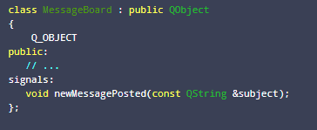

extending QML with C++
Signal(Cont)
The QML engine automatically creates a signal handler for any signal of a QObject-derived type that is used from QML. Signal handlers are always named on<Signal> where <Signal> is the name of the signal, with the first letter capitalized
Connect signal(C++ side) and slot(QML side)
Exposing Attributes of C++ Types to QML

Slide 10
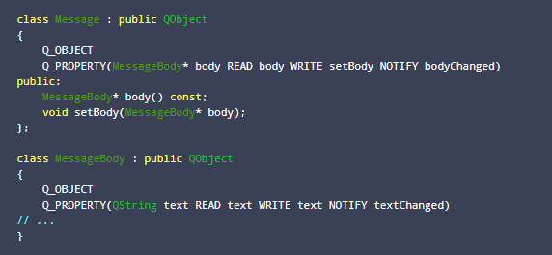

extending QML with C++
Object type property
Exposing Attributes of C++ Types to QML

Slide 11
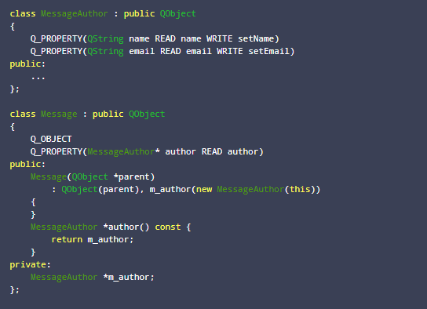

extending QML with C++
Object type property
Read-Only Object
Exposing Attributes of C++ Types to QML

Slide 12
extending QML with C++
Case study: Attached Properties
(http://doc.qt.io/qt-5/qtqml-cppintegration-definetypes.html#property-modifier-types)
Exposing Attributes of C++ Types to QML

Slide 13
Interacting (QML - C++)
QmlContext (root context)
rootContext()->setContextProperty()
QQuickItem (root object)
rootObject()->setProperty()
Declare object in QML
Register singleton type
Embbed C++ Object into QML
View
QmlContext
(root context)
QQuickItem
(root object)
QmlEngine

Slide 14
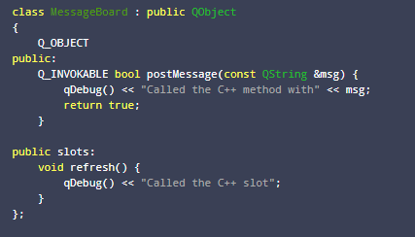
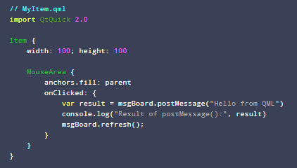
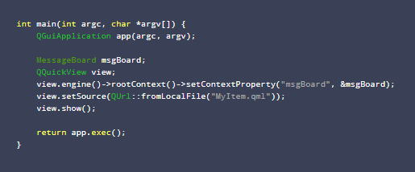
Interacting (QML - C++)
Example
setContextProperty
Embbed C++ Object into QML

Slide 15
Interacting (QML - C++)
Example (Cont)
rootObject()->setProperty()
Independent work
Embbed C++ Object into QML

Slide 16
Interacting (QML - C++)
Loading QML Objects from C++
Accessing Loaded QML Objects by Object Name
Properties
Invoking QML Methods
Connecting to QML Signals
Interacting with QML Objects from C++

Slide 17
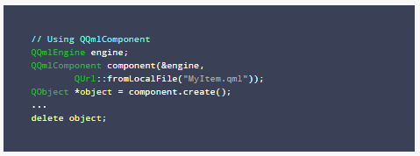
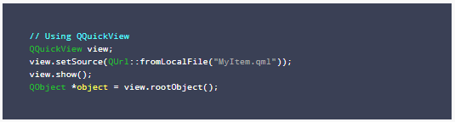
Interacting (QML - C++)
Loading QML Objects from C++
Interacting with QML Objects from C++

Slide 18
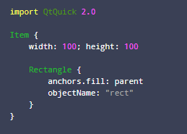
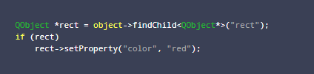

Interacting (QML - C++)
Accessing Loaded QML Objects by Object Name
QML components are essentially object trees with children that have siblings and their own children. Child objects of QML components can be located using the QObject::objectName property with QObject::findChild()
Properties can be set and read using QQmlProperty, or QObject::setProperty() and QObject::property():
Modify the item's properties using QObject::setProperty() or QQmlProperty:
Interacting with QML Objects from C++

Slide 19
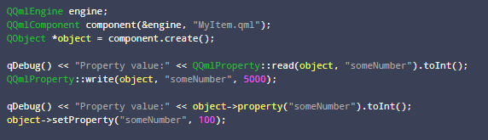
Interacting (QML - C++)
Accessing Loaded QML Objects by Object Name
Properties (Cont)
Read properties
While it is possible to use C++ to access and manipulate QML objects deep into the object tree, we recommend that you do not take this approach outside of application testing and prototyping. One strength of QML and C++ integration is the ability to implement the QML user interface separately from the C++ logic and dataset backend, and this strategy breaks if the C++ side reaches deep into the QML components to manipulate them directly. This would make it difficult to, for example, swap a QML view component for another view, if the new component was missing a required objectName. It is better for the C++ implementation to know as little as possible about the QML user interface implementation and the composition of the QML object tree
Interacting with QML Objects from C++

Slide 20
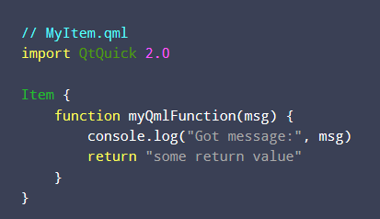
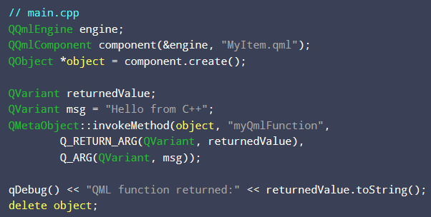
Interacting (QML - C++)
Accessing Loaded QML Objects by Object Name (Cont)
Invoking QML Methods
QMetaObject::invokeMethod(). Method parameters and return values passed from QML are always translated into QVariant values in C++.
Interacting with QML Objects from C++

Slide 21
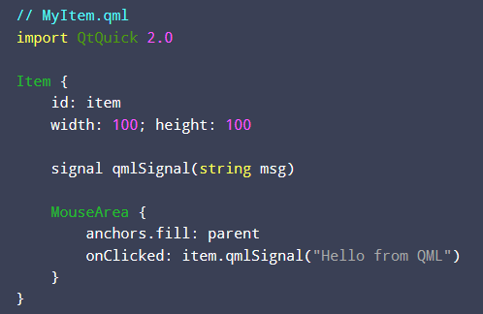
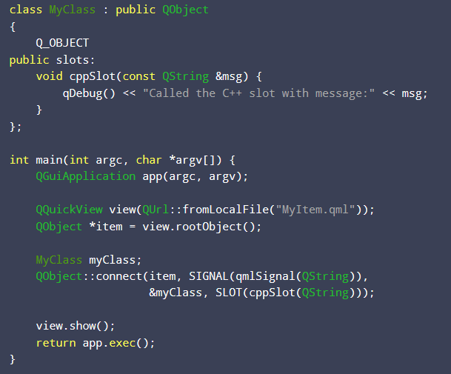
Interacting (QML - C++)
Accessing Loaded QML Objects by Object Name (Cont)
Connecting to QML Signals
Interacting with QML Objects from C++

Slide 22
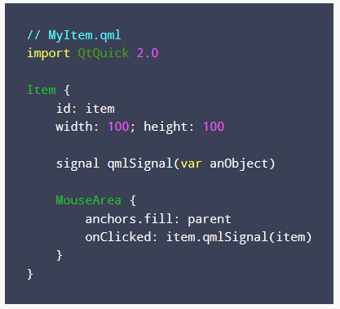
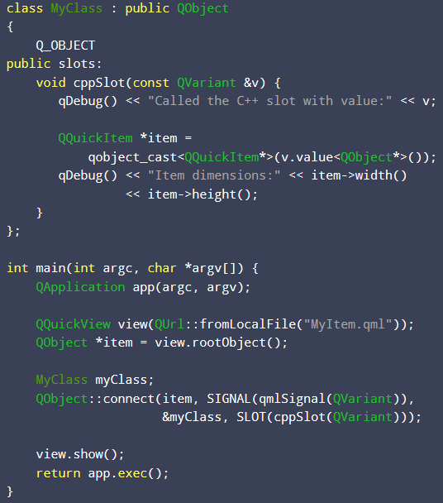
Interacting (QML - C++)
Accessing Loaded QML Objects by Object Name (Cont)
Connecting to QML Signals
QObject type is used as signal parameter
Interacting with QML Objects from C++

Slide 23
Interacting (QML - C++)
QML – C++ integration
Exercise

Slide 24
Interacting (QML - C++)
Connection
Exercise

Slide 25
Interacting (QML - C++)
Binding
Exercise

Slide 26
Interacting (QML - C++)
http://doc.qt.io/qt-5/qtqml-cppintegration-overview.html
http://doc.qt.io/qt-5/qtqml-cppintegration-definetypes.html#property-modifier-types
http://doc.qt.io/qt-5/qtqml-cppintegration-exposecppattributes.html
http://doc.qt.io/qt-5/qtqml-cppintegration-interactqmlfromcpp.html
Qmlbook chapter 15,16
Reference

