Slide 1
QML Application
Contact: tuan1.pham@lge.com
Git Repo: http://10.218.140.31:4000/LGE-SD3-Training/QMLTutorial
Collab: http://collab.lge.com/main/display/IVIDCV/Tutorial

Slide 2
QML Elements
Qt Quick
Qt Quick Control
Qt QML module
C++ Extension
QML Object
Javascript
List and Model
User Input Handler
Visual type
Animation

Slide 3
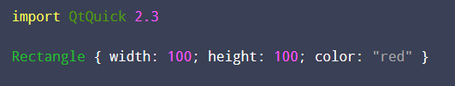
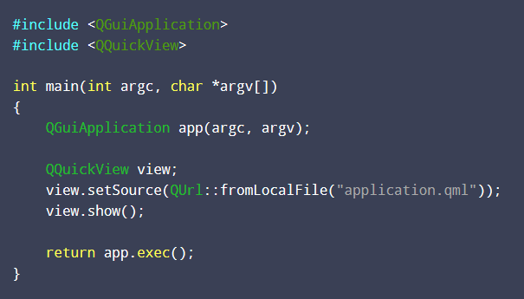
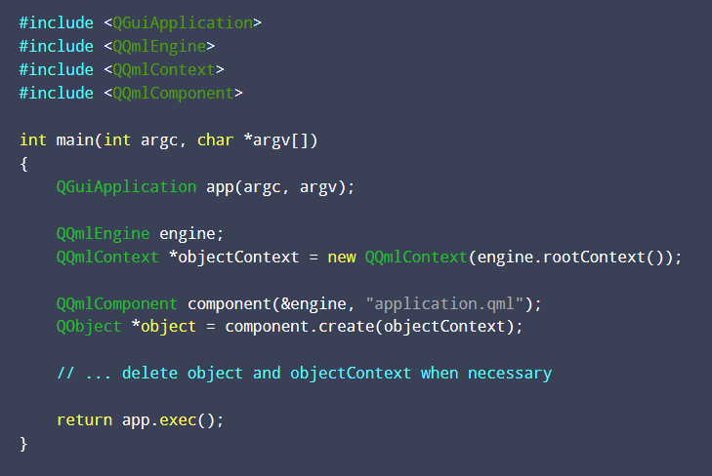
CReATE QML Application
Initializing with QQuickView
Creating a QQmlEngine directly
QT Quick Project

Slide 4
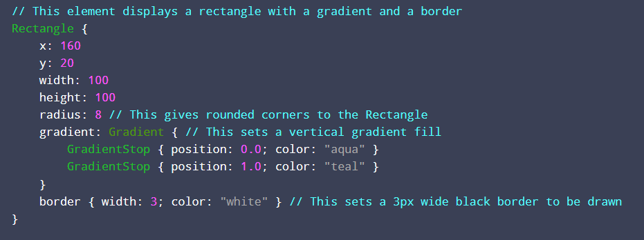
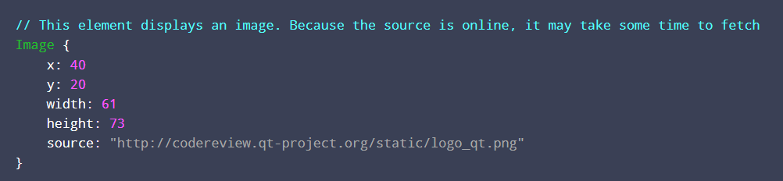
QT QUICK
Rectangle (draw rectangles)
Image (display images)
Visual Type

Slide 5
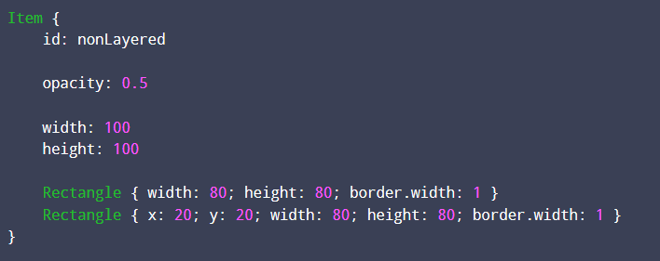
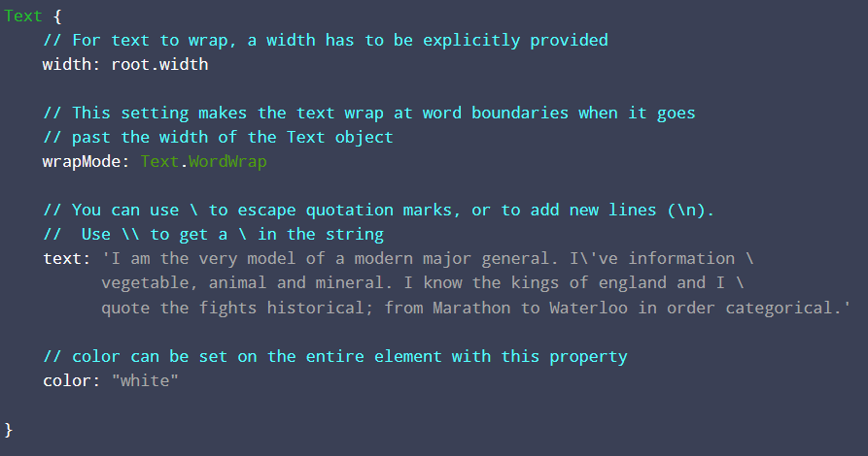
QT QUICK
Item
Base type for all visual items
No visual appearance
Text (display text)
Visual Type

Slide 6
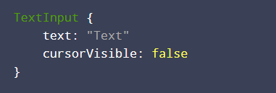
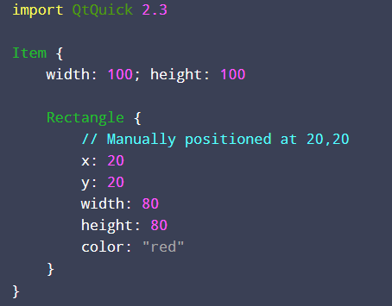
QT QUICK
TextInput/TextEdit
Displays a single line/multi-line of editable plain text.
Layouts
Manual Positioning: Items can be placed at specific x,y coordinates. Position relative to the top left corner of their parent, according to the visual coordinate system rules
Visual type
Case study: Visual Coordinates System (https://doc.qt.io/qt-5/qtquick-visualcanvas-coordinates.html)

Slide 7
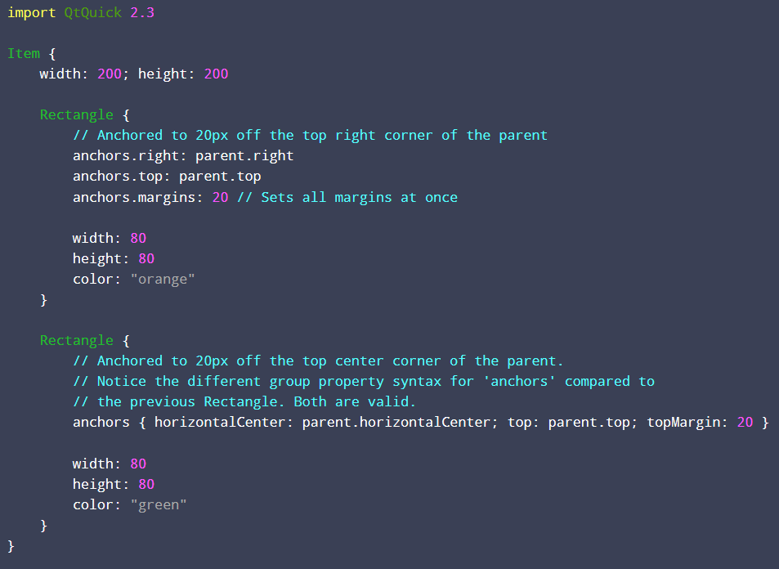
QT QUICK
Layouts (Cont)
Anchors: abilitiy to anchor to other Item types
Visual type
Case study: Visual Coordinates System (https://doc.qt.io/qt-5/qtquick-visualcanvas-coordinates.html)

Slide 8
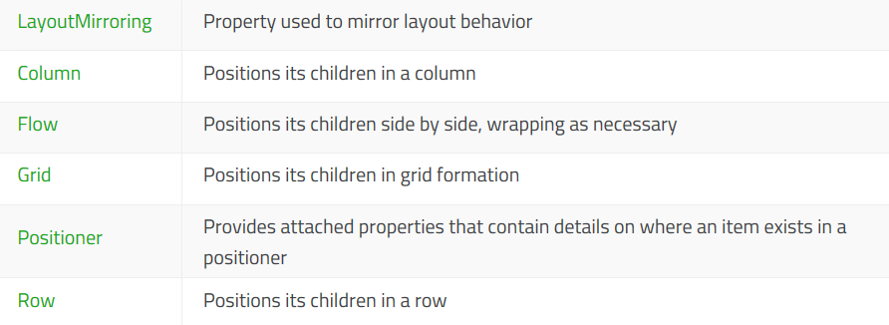
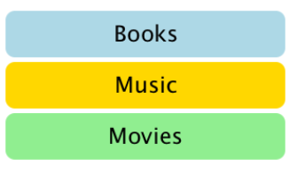


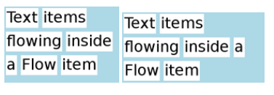
QT QUICK
Layouts (Cont)
Positioners
Visual type
Case study: Visual Coordinates System (https://doc.qt.io/qt-5/qtquick-visualcanvas-coordinates.html)

Slide 9
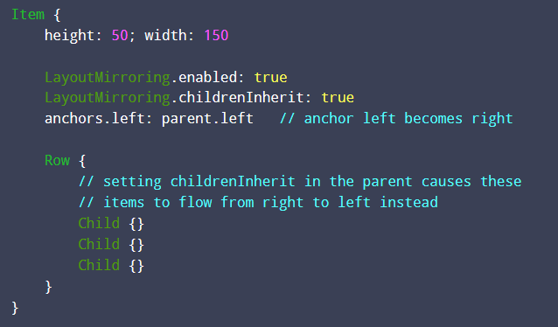
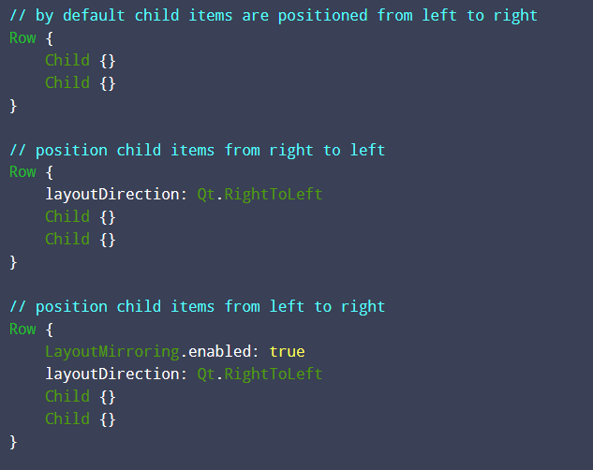

QT QUICK
Layouts (Cont)
Positioners (Cont)
Layout Mirroring (Notice: childrenInherit)
Visual type
Case study: Visual Coordinates System (https://doc.qt.io/qt-5/qtquick-visualcanvas-coordinates.html)

Slide 10
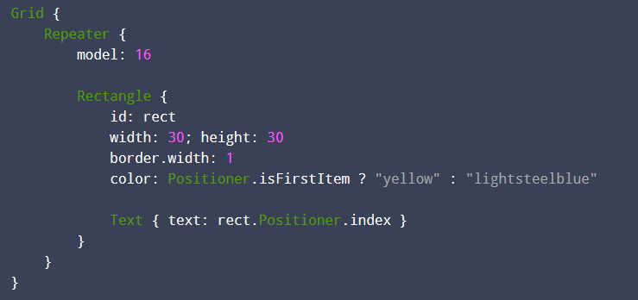
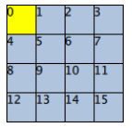
QT QUICK
Layouts (Cont)
Positioners (Cont)
Positioner (contain details on where an item exists in a positioner )
Visual type
Case study: Visual Coordinates System (https://doc.qt.io/qt-5/qtquick-visualcanvas-coordinates.html)

Slide 11
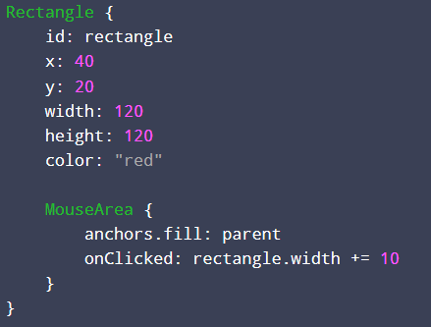
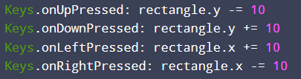
QT QUICK
MouseArea
Allows mouse and touch events to be handled in a QML application
Keyboard and Button Events
User Input Handler

Slide 12
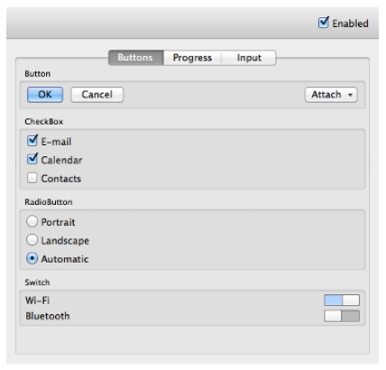
QT Quick
Qt Quick Controls
implements several controls such as buttons, menus, and views.
import QtQuick.Controls 1.2
QT Quick Control
Case Study
Qt Quick Control (https://doc.qt.io/qt-5/qtquickcontrols-overview.html)
Style (https://doc.qt.io/qt-5/qtquickcontrolsstyles-index.html)

Slide 13
QT QUICK
Animation

Slide 14
Qt QML
Component
QtObject
Binding
Connection
Timer
QML Object Type

Slide 15
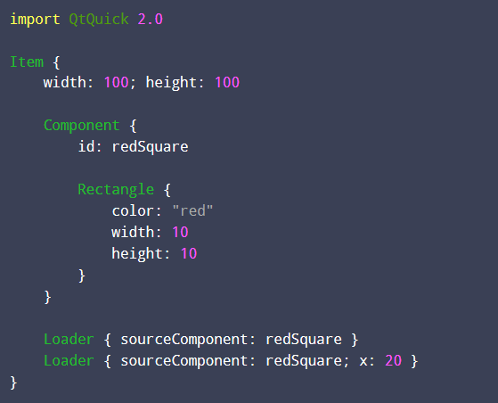
Qt QML
Component
Useful for reusing a small component within a QML file, or for defining a component that logically belongs with other QML components within a file
QML Object Type

Slide 16
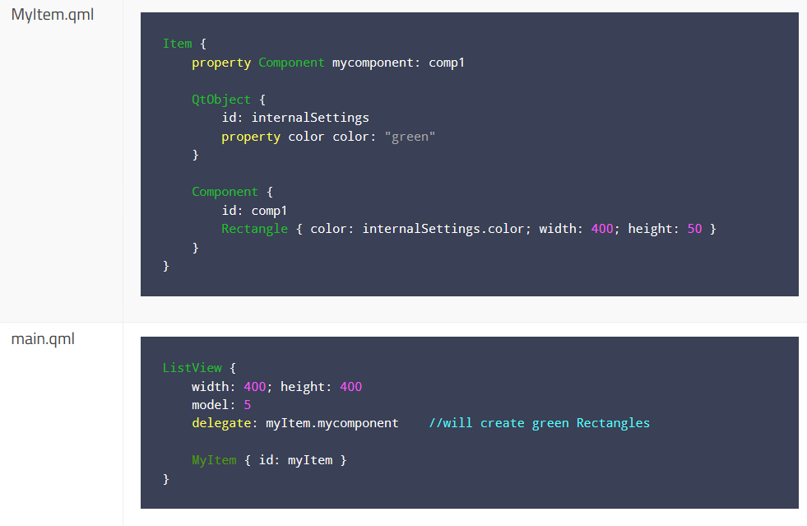
Qt QML
Component (Cont)
QML Object Type

Slide 17
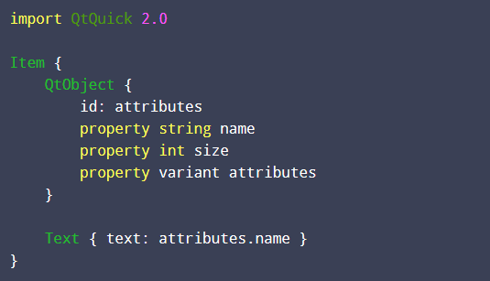
Qt QML
QtObject
Non-visual element which contains only the objectName property
Lightweight type to enclose a set of custom properties
QML Object Type

Slide 18

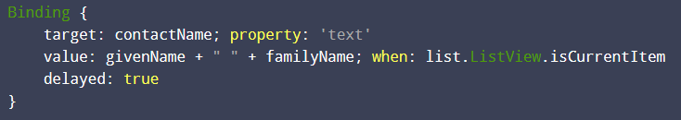
Qt QML
Binding
Bind an object's property to that of another object that isn't directly instantiated by QML, such as a property of a class exported to QML by C++
When the text changed C++ property “enteredText” will update automatically
Conditional Bindings: modify the value of a property when a certain condition is met but leave it unmodified otherwise
QML Object Type

Slide 19
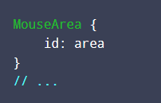
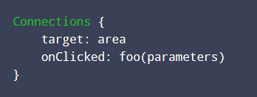
Qt QML
Connection: creates a connection to a QML signal and should use in cases:
Multiple connections to the same signal are required
Creating connections outside the scope of the signal sender
Connecting to targets not defined in QML
QML Object Type

Slide 20
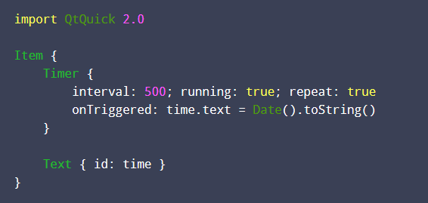
Qt QML
Timer: trigger an action either once, or repeatedly at a given interval
QML Object Type

Slide 21
Qt QML
Delegate Model
ListElement
ListModel
ObjectModel
List and Model

Slide 22
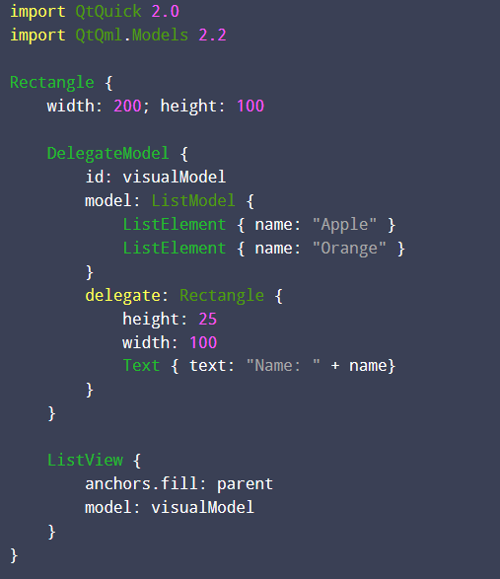
Qt QML
Delegate Model
Encapsulates a model and the delegate that will be instantiated for items in the model
List and Model

Slide 23
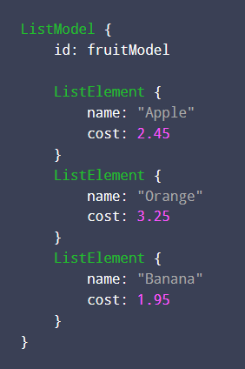
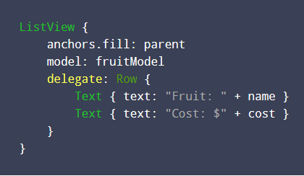
Qt QML
List Element
Defined inside ListModel definitions, and represent items in a list that will be displayed using ListView or Repeater items
List and Model

Slide 24
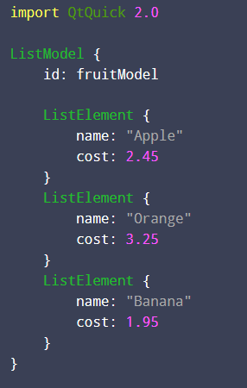
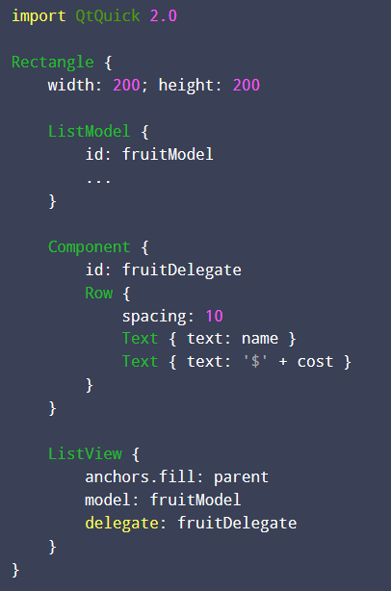
Qt QML
List Model
A simple container of ListElement definitions, each containing data roles. The contents can be defined dynamically, or explicitly in QML
List and Model

Slide 25
Qt QML
Object Model
Case Study
List and Model

Slide 26
QML Attributes
Case study: The QML Reference in Help

