Slide 1
QML ANIMATION

Slide 2
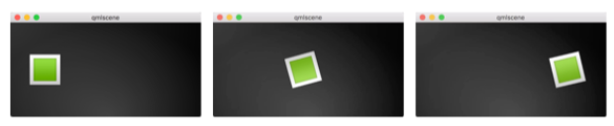
Introduction
Animation: a way that a value of a property not just changes instantly, the value changes over time
Objects has states and each state defines a set of property changes and can be combined with animations on state changes, called transitions
Animations are applied to property changes and when property changes it creates smooth transitions from one value to another

Slide 3
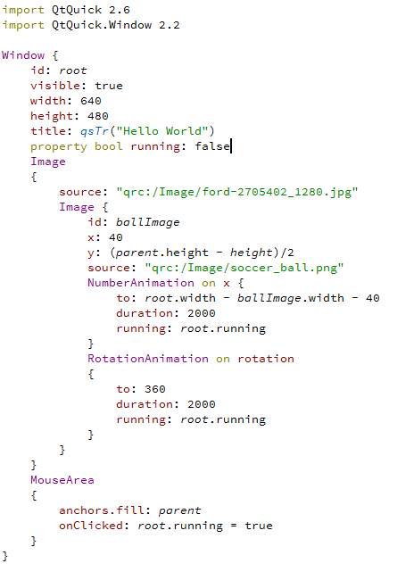
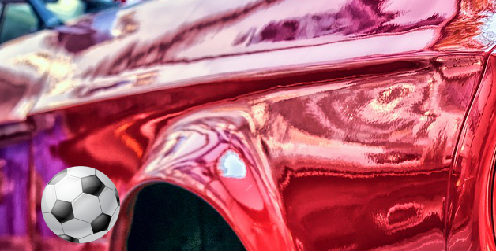
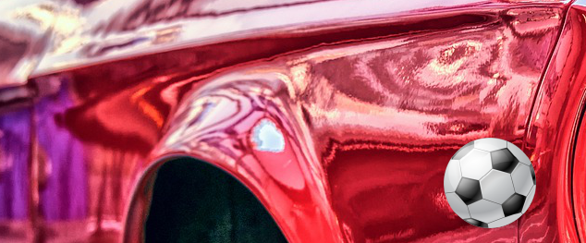
ANIMATION
Example

Slide 4
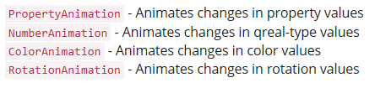
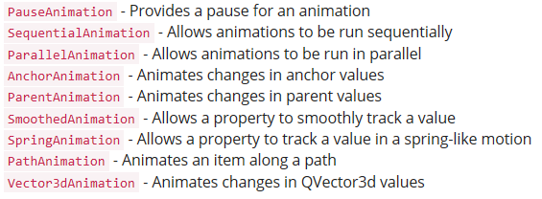
ANImation
Prominent animation
Specialized animations for specific use cases:
Animation Elements

Slide 5
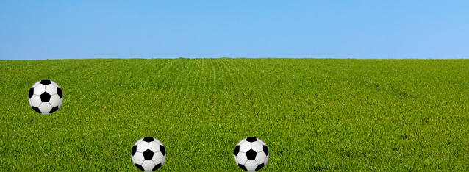
Animation
Animation can be applied in several ways:
Animation on property - runs automatically after element is fully loaded
Behavior on property - runs automatically when the property value changes
Standalone Animation - runs when animation is explicitly started using start() or running is set to true (e.g. by a property binding)
Applying Animation

Slide 6
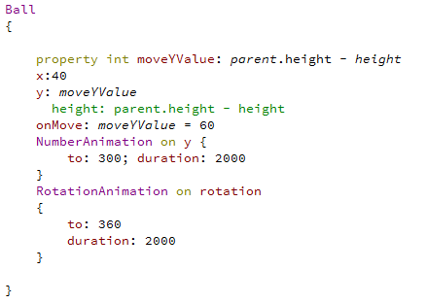
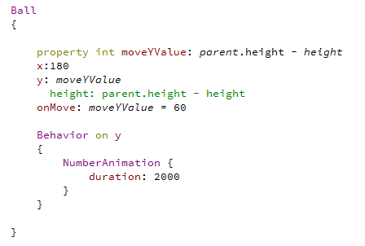
Animation
Animation on Property
Behavior on property
Applying Animation

Slide 7
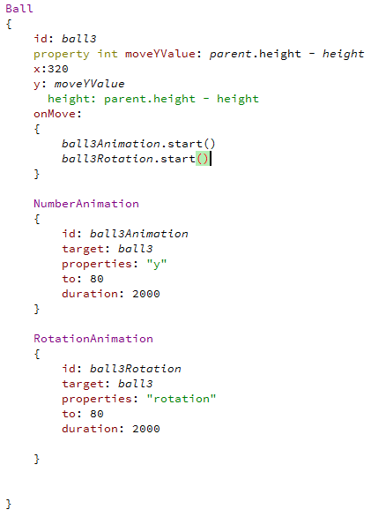
Animation
Standalone Animation
Applying Animation

Slide 8
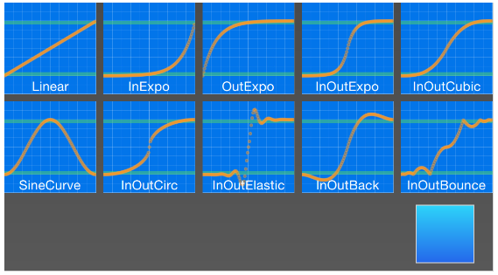
Animation
Easing Curves
All animations we have defined by now use a linear interpolation because the initial easing type of an animation is Easing.Linear
A linear interpolation would draw a straight line from the from value at the start of the animation to the to value at the end of the animation
Easing type defines the curve of change
Easing Curves

Slide 9
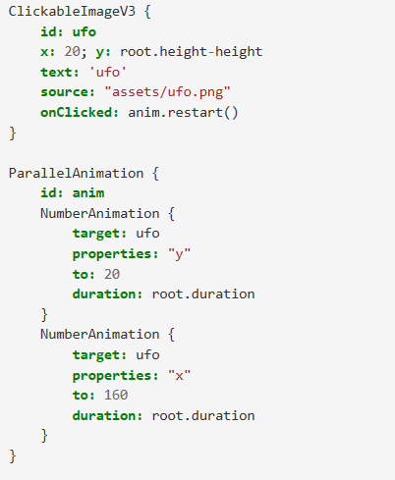
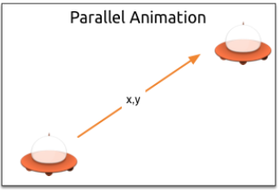
Animation
Grouped Animations
Run several animations at the same time or one after another or even execute a script between two animations
2 ways:
Parallel (ParallelAnimation)
Sequential (SequentialAnimation )
Grouped Animations

Slide 10
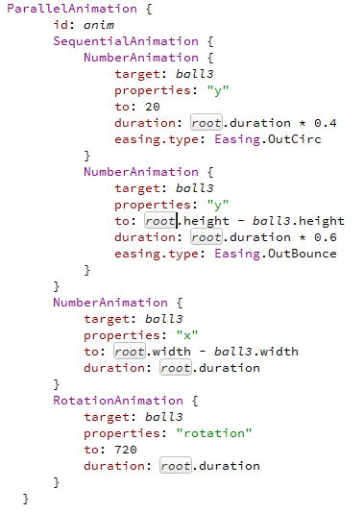
Animation
Animation can be nested:
Grouped Animations

Slide 11
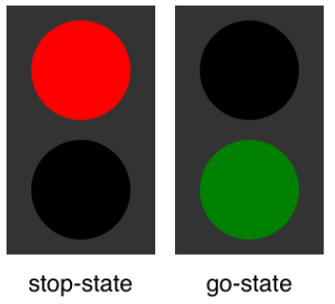
Animation
Study
Traffic light

Slide 12
Animation
Parts of a user interface can be described in states
A state defines a set of property changes and can be triggered by a certain condition
State switches can have a transition attached which defines how these changes should be animated
States and Transitions

Slide 13
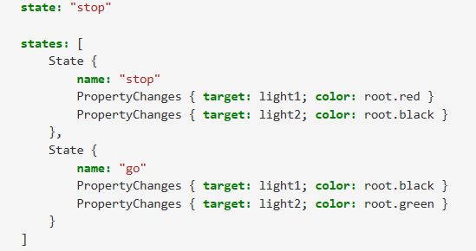
Animation
Define states in QML with the state element, which needs to be bound to the states array of any item element
States

Slide 14
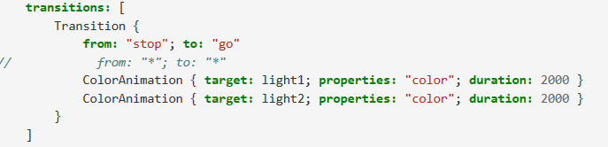
Animation
A transition is executed by a state change
Define on which state change a particular transition can be applied using the from: and to: properties
Use the wild-cast “*” which means “any state”.
Example from:"*"; to:"*" means from any state to any other state and is the default value for from and to, which means the transition is applied to every state switch
Transitions

