Slide 1
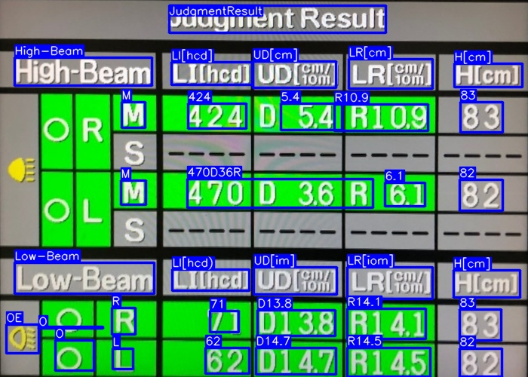


Judgment Result
High-Beam
LI[hcd]
UD[ ]
LR[ ]
H[cm]
cm/10m
cm/10m
O
R
M
395
D 3.4
R1 5.3
46
S
_ _ _ _
_ _ _ _
_ _ _ _
_ _ _ _
O
L
M
500
D 4.0
R 4.7
75
S
_ _ _ _
_ _ _ _
_ _ _ _
_ _ _ _
Low-Beam
LI[hcd]
UD[ ]
LR[ ]
H[cm]
cm/10m
cm/10m
O
R
50
D1 2.8
R1 2.5
88
O
L
71
D1 9.1
R1 3.7
56

Slide 2
Judgment Result
High-Beam
LI[hcd]
UD[ ]
LR[ ]
H[cm]
cm/10m
cm/10m
O
R
M
567
D 8.3
R1 3.2
65
S
_ _ _ _
_ _ _ _
_ _ _ _
_ _ _ _
O
L
M
312
D 4.6
R 5.8
79
S
_ _ _ _
_ _ _ _
_ _ _ _
_ _ _ _
Low-Beam
LI[hcd]
UD[ ]
LR[ ]
H[cm]
cm/10m
cm/10m
O
R
44
D1 8.3
R1 3.9
52
O
L
89
D1 6.9
R1 7.1
49

Slide 3
Judgment Result
High-Beam
LI[hcd]
UD[ ]
LR[ ]
H[cm]
cm/10m
cm/10m
O
R
M
734
D 7.3
R1 8.3
61
S
_ _ _ _
_ _ _ _
_ _ _ _
_ _ _ _
O
L
M
123
D 2.8
R 7.9
81
S
_ _ _ _
_ _ _ _
_ _ _ _
_ _ _ _
Low-Beam
LI[hcd]
UD[ ]
LR[ ]
H[cm]
cm/10m
cm/10m
O
R
56
D1 2.6
R1 5.4
56
O
L
82
D1 5.1
R1 7.4
41

Slide 4
Judgment Result
Judgment Result
High-Beam
LI[hcd]
UD[ ]
LR[ ]
H[cm]
High-Beam
LI[hcd]
UD[ ]
LR[ ]
H[cm]
cm/10m
cm/10m
cm/10m
cm/10m
O
R
M
514
D 1.6
R1 1.4
59
O
R
M
734
D 7.3
R1 8.3
61
S
_ _ _ _
_ _ _ _
_ _ _ _
_ _ _ _
S
_ _ _ _
_ _ _ _
_ _ _ _
_ _ _ _
O
L
M
724
D 8.1
R 1.9
71
O
L
M
123
D 2.8
R 7.9
81
S
_ _ _ _
_ _ _ _
_ _ _ _
_ _ _ _
S
_ _ _ _
_ _ _ _
_ _ _ _
_ _ _ _
Low-Beam
LI[hcd]
UD[ ]
LR[ ]
H[cm]
Low-Beam
LI[hcd]
UD[ ]
LR[ ]
H[cm]
cm/10m
cm/10m
cm/10m
cm/10m
O
R
41
D1 9.4
R1 3.2
48
O
R
56
D1 2.6
R1 5.4
56
O
L
79
D1 7.6
R1 6.5
62
O
L
82
D1 5.1
R1 7.4
41

Slide 5
Judgment Result
High-Beam
LI[hcd]
UD[ ]
LR[ ]
H[cm]
cm/10m
cm/10m
O
R
M
736
D 4.1
R1 1.2
12
S
_ _ _ _
_ _ _ _
_ _ _ _
_ _ _ _
O
L
M
865
D 7.2
R 2.3
91
S
_ _ _ _
_ _ _ _
_ _ _ _
_ _ _ _
Low-Beam
LI[hcd]
UD[ ]
LR[ ]
H[cm]
cm/10m
cm/10m
O
R
54
D1 7.4
R1 4.5
75
O
L
76
D1 3.1
R1 4.8
56

Slide 6
Judgment Result
High-Beam
LI[hcd]
UD[ ]
LR[ ]
H[cm]
cm/10m
cm/10m
O
R
M
424
D 5.4
R1 0.9
83
S
_ _ _ _
_ _ _ _
_ _ _ _
_ _ _ _
O
L
M
470
D 3.6
R 6.1
82
S
_ _ _ _
_ _ _ _
_ _ _ _
_ _ _ _
Low-Beam
LI[hcd]
UD[ ]
LR[ ]
H[cm]
cm/10m
cm/10m
O
R
71
D1 3.8
R1 4.1
83
O
L
62
D1 4.7
R1 4.5
82

