Slide 1

Topic
GROUP: 4
Smart Hospital Patient Triage System
CSD201 - SE2035
A JAVA-BASED TRIAGE SYSTEM THAT PRIORITIZES CRITICAL PATIENTS WHILE PRESERVING FIFO FAIRNESS AMONG EQUAL-PRIORITY CASES.

Slide 2
INTRODUCTION
TEAM MEMBERS
GROUP: 4
SE194852
NGUYỄN HÀ HỮU THUẬN
SE200787
NGUYỄN ĐÌNH THIÊN PHÚC
SE201643
BÙI ĐÌNH LONG
SE190214
DƯƠNG THỊ NGỌC THƠM
INSTRUCTOR:
VŨ THỊ THÙY DƯƠNG

Slide 3

Problem
The Real-World Problem
Same-priority patients are treated fairly by arrival time — organizing records, priority levels, and status updates efficiently & fairly.
Critical patients arriving later must receive priority over first-come, first-served order — urgency determines treatment sequence.

Slide 4




Scope
Patient Registration & Triage
• Register new patients
• Assign triage priority level
• Fast lookup by patient ID
• Maintain accurate records
Scope of the Current System
Priority Queue & Fairness
• Priority-based queue handling
• Arrival-time fairness for equal priority
• Queue display & ordering
• Patient discharge processing
Status Tracking & Re-Triage
• Track patient condition status
• Support condition updates
• Re-triage when needed
• Efficient record management

Slide 5
Users
Receptionist
  Regiser patient
  Search patient
  Update patient
Doctor / Nurse
  Call patient
  View Patient
  Assign triage priority
  ....
Admin
  Discharge patient

Slide 6
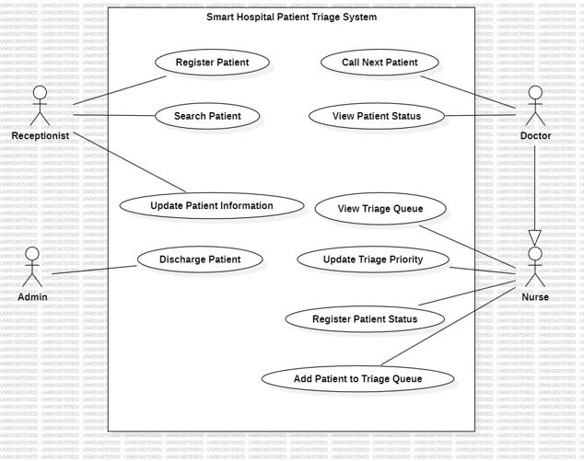
Users

Slide 7
SYSTEM DESIGN
SYSTEM FEATURES & MODULE
The system is divided into 6 independent modules:
1
2
  1. (Patient Record Management Module): Allows register, view, update and search patients records.
  2. (Triage Priority Assignment Module): Automatic assign an initial priority level based on given patient’s medical condition.
  3. (Priority Queue Management Module): Manages the treatment order of patients. Allows update priority if condition becomes worse or improves.
  4. (Patient Status Tracking Module): Tracks the current status of each patient currently in the treatment queue.
  5. (Queue Display Module): Displays the current emergency queue so doctors, nurses, and reception staff can monitor.
  3. (Patient Discharge Module): Allows medical staff to formally discharge a patient once treatment is completed, transferred, or the patient has left the facility.

Slide 8
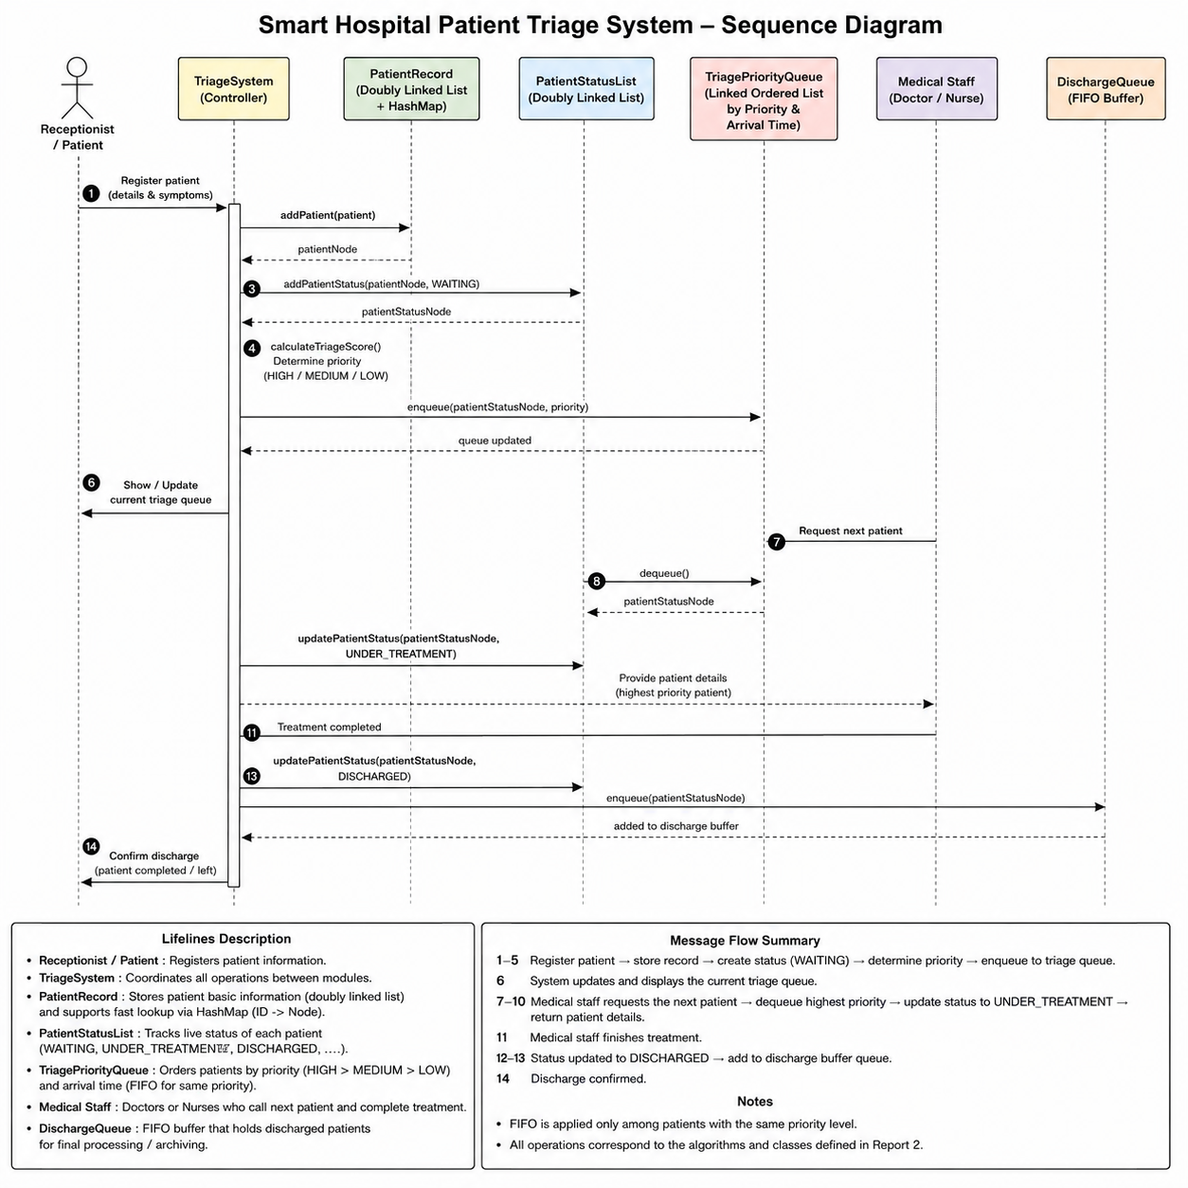
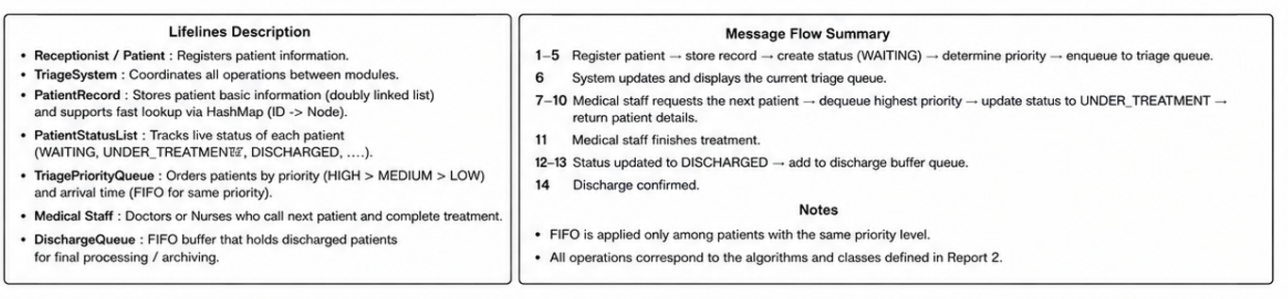
SYSTEM DESIGN
LOGICAL PROCESS FLOW

Slide 9
DATA STRUCTURES USED
  HOME
  SERVICE
  ABOUT US
  CONTACT US
DLL + HashMap
Sorted LL Prio Queue
Linked list & Linked list Queue
Insert
O(1)
Insert
O(1)
Insert
O(1)
Remove
O(1)
Remove
O(1)
Remove
O(1)
Update
O(1)
Update
O(n)
Update
O(1)
Peek
O(1)
Peek
O(1)
Peek
O(1)
Search
O(1)
Search
O(n)
Search
O(n)

Slide 10
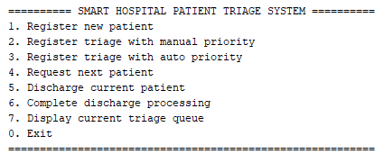
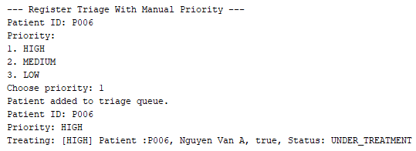
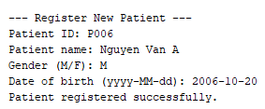

CORE ALGORITHMS
DEMO & TRACE
  HOME
  SERVICE
  ABOUT US
  CONTACT US

Slide 11
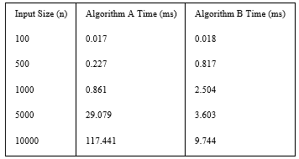
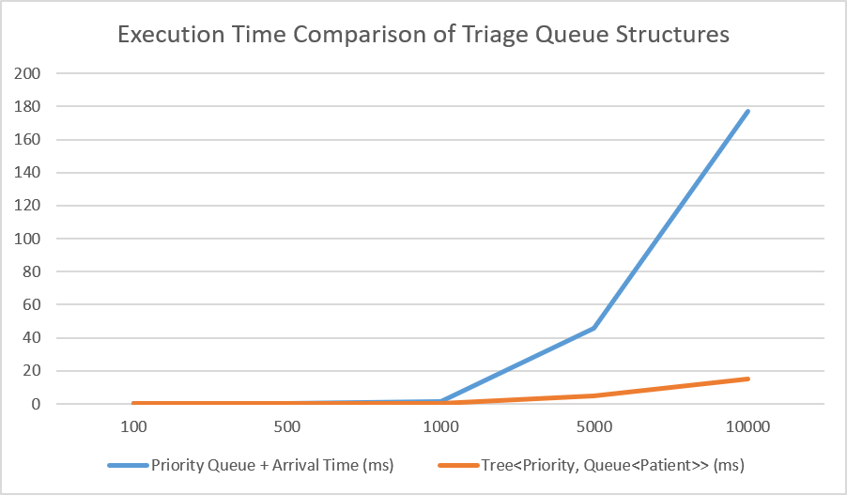
PERFORMANCE
  HOME
  SERVICE
  ABOUT US
  CONTACT US
RESULTS
The results show that Tree<Priority, Queue<Patient>>, was faster than Algorithm A for all input sizes. The gap was small at n = 100, but became much larger at n = 10000, where Priority Queue took 176.848 ms while Tree<Priority, Queue<Patient>> took only 15.293 ms.
This happens because Priority Queue must traverse the sorted linked list to insert patients by priority and arrival time. Tree<Priority, Queue<Patient>> groups patients by priority and uses FIFO queues inside each group, reducing repeated traversal. Both algorithms preserve fairness, but Algorithm B scales better for larger input sizes.
Page 06

Slide 12

ANSWER TO
  HOME
  SERVICE
  ABOUT US
  CONTACT US
RESEARCH QUESTION
The choice of data structure affects efficiency more clearly than fairness. Based on the experiment, Tree<Priority, Queue<Patient>> is more efficient than the Priority Queue with arrival-time tie-breaking, especially for large input sizes. It avoids repeated linked-list traversal by grouping patients by priority, so its execution time grows more slowly.
Both structures preserve FIFO fairness for patients with the same priority. The Priority Queue does this by comparing arrival time when priority is equal, while the Tree structure does this naturally by storing patients in FIFO queues inside each priority group.
For re-triage handling, the Tree<Priority, Queue<Patient>> structure is more suitable when the system has many patients or frequent priority updates. The Priority Queue is simpler to implement and works well for small cases, but it becomes slower as the queue grows. Therefore, the Tree<Priority, Queue<Patient>> design is the better choice for scalability, while the Priority Queue with arrival-time tie-breaking is better for simplicity.
Page 06

Slide 13
AI AUDIT LOG
  HOME
  SERVICE
  ABOUT US
  CONTACT US
HIGHLIGHTS & HUMAN DELTA
AI SUPPORTED THE DESIGN PROCESS, BUT THE FINAL ARCHITECTURE, RESEARCH QUESTION, AND ALGORITHM COMPARISON WERE DECIDED AND VALIDATED BY THE TEAM.
AI Support | Human Delta | Final Impact
Suggested possible queue structures | Team started from a normal queue idea and refined it through discussion | Final RQ compared Priority Queue + arrival-time tie-breaking vs Tree<Priority, Queue<Patient>>
Helped explain data structures and Big-O | Team checked which structures matched hospital triage scope | Final design used Priority Queue, HashMap, Doubly Linked List, and FIFO Queue
Helped review algorithm logic | Team verified fairness, re-triage, and benchmark results | System preserved priority order and FIFO fairness

Slide 14
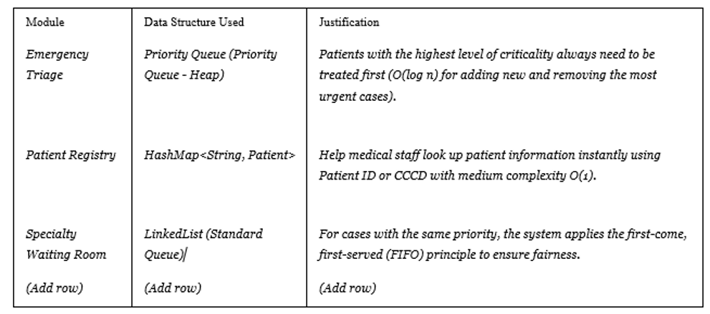
AI AUDIT LOG
  HOME
  SERVICE
  ABOUT US
  CONTACT US
HIGHLIGHTS & HUMAN DELTA
AI SUPPORTED THE DESIGN PROCESS, BUT THE FINAL ARCHITECTURE, RESEARCH QUESTION, AND ALGORITHM COMPARISON WERE DECIDED AND VALIDATED BY THE TEAM.
  INITIAL IDEA: BASIC QUEUE FOR PATIENT WAITING LINE.
  IMPROVED IDEA: PRIORITY QUEUE + ARRIVAL-TIME TIE-BREAKING.
  FINAL COMPARISON: PRIORITY QUEUE VS TREE<PRIORITY, QUEUE<PATIENT>>.

Slide 15
CONCLUSION
  Developed a Smart Hospital Patient Triage System for emergency patient management.
  SUPPORTS:
    PATIENT REGISTRATION
    MANAGE TRIAGE QUEUE
    STATUS TRACKING
    QUEUE DISPLAY
    RE-TRIAGE
    DISCHARGE MANAGEMENT
  Research finding:
    Tree<Priority, Queue<Patient>> is more efficient for larger input sizes.
    Sorted linked-list Priority Queue is simpler and suitable for smaller workloads.
  Both structures preserve FIFO fairness for patients with the same priority.
  Tree is more suitable in large scale system.
Data structure selection directly affects emergency triage queue performance and should match the expected system size and update frequency.

Slide 16
THANK YOU
Q&A

