Slide 1
Robot framework

Slide 2
Agenda
1
Introduction
2
Architecture
3
Libraries
3
Tools, IDE

Slide 3
Introduction:
● Generic test automation framework
– Utilizes the keyword-driven testing approach
– Suitable for both “normal” test automation and ATDD
● Implemented with Python
– Runs also on Jython (JVM) and IronPython (.NET)
– Can be extended natively using Python or Java
– Other languages supported via a remote interface
● Open source
– Hosted on GitHub, Apache 2 license
– Sponsored by Nokia Networks
– Rich ecosystem and very active community

Slide 4
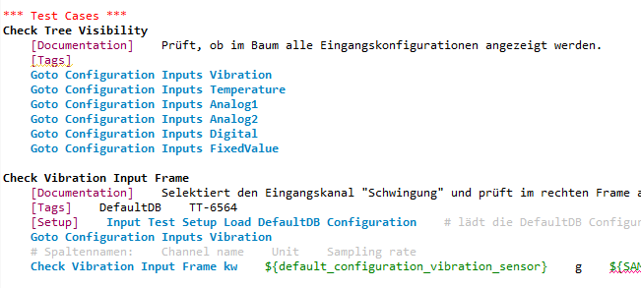
Introduction:
● Enables easy-to-use tabular syntax for creating test cases in a uniform way.

Slide 5
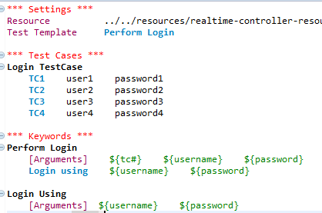
Introduction:
● Supports creating data-driven test cases.

Slide 6
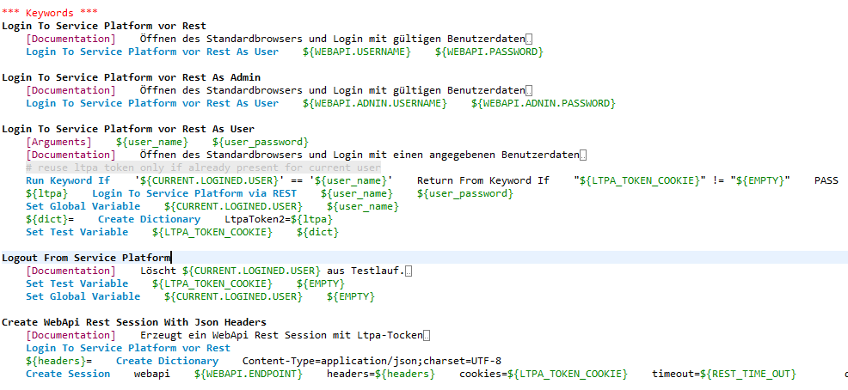
Introduction:
● Provides ability to create reusable higher-level keywords from the existing keywords.

Slide 7
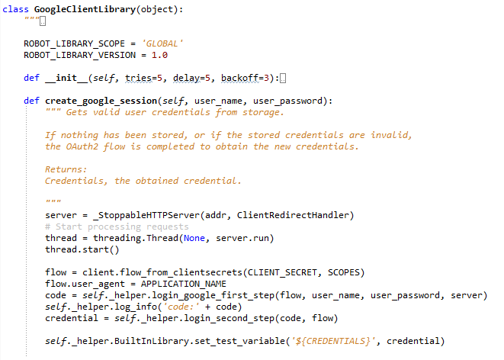
Introduction:
● Provides a simple library API for creating customized test libraries which can be implemented natively with either Python or Java.

Slide 8
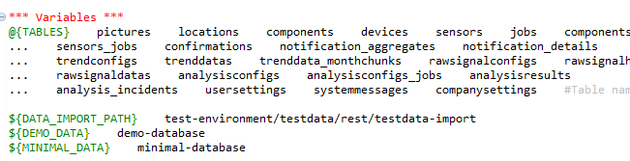
Introduction:
● Has built-in support for variables

Slide 9
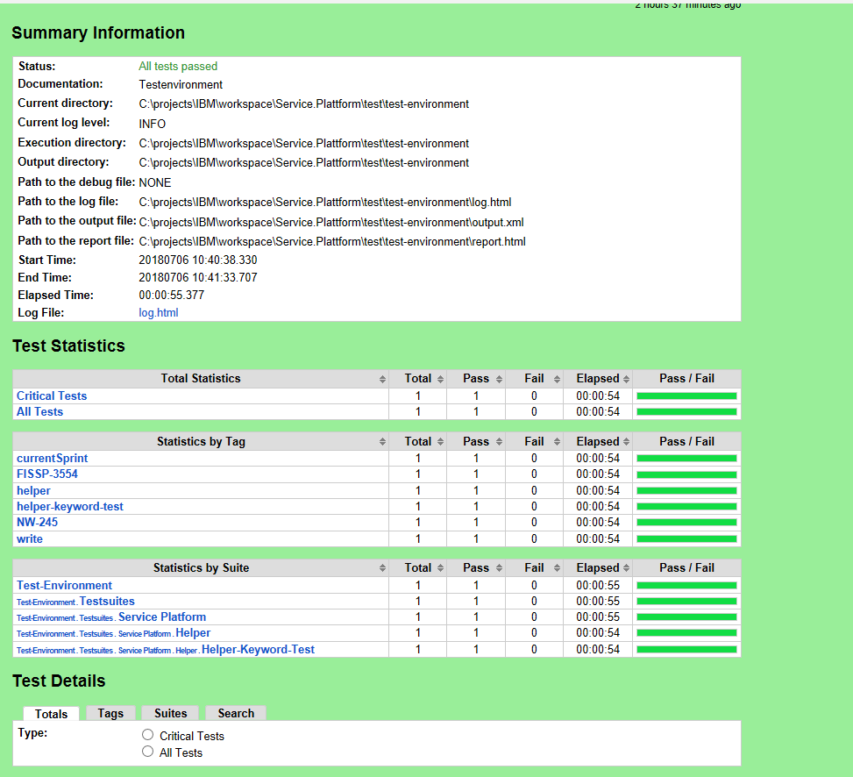
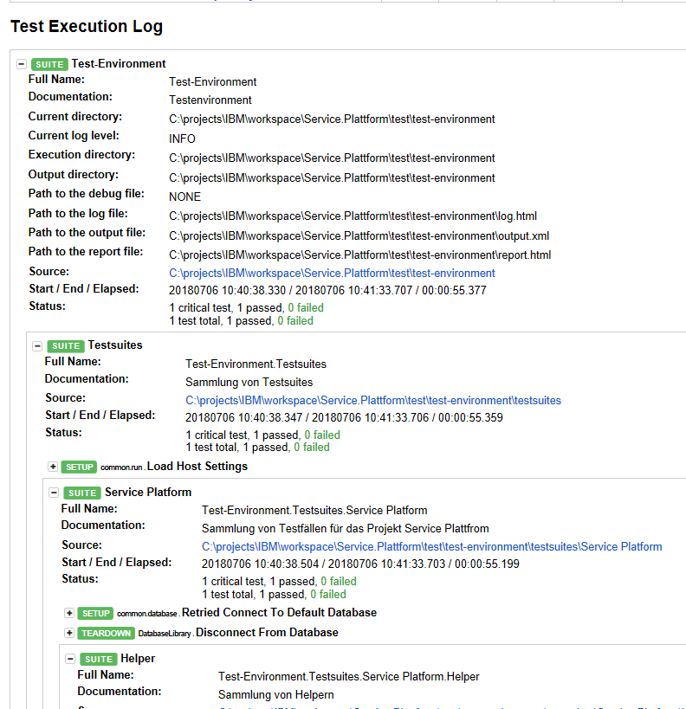
Introduction:
● Provides easy-to-read result reports and logs in HTML format.

Slide 10
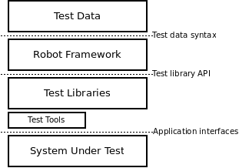
Architecture
High-level architecture
Extension Library,
Implements low lewel Keywords
(Python, Java, .Net)

Slide 11
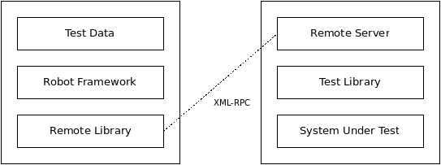
Architecture
Remote library interface
Remote servers are available for folowing platforms:
Python, Java, Ruby, .Net, Perl, node.js, PHP

Slide 12
Available libraries :
● Standard Libraries.
- OperatingSystem, String, Telnet, Xml, Collections,…
● External Libraries.
- Selenium2Library, SSHLibrary, RequestsLibrary, Rammbok, …
● Project and team specific Libraries.
- SmartgwtLibrary, OpenCVLibrary, MTOMLibrary, CANBusLibrary, NumericLibrary, …

Slide 13
Available libraries :
● Standard Libraries.
- OperatingSystem, String, Telnet, Xml, Collections,…
● External Libraries.
- Selenium2Library, SSHLibrary, RequestsLibrary, Rammbok, …
● Project and team specific Libraries.
- SmartgwtLibrary, OpenCVLibrary, MTOMLibrary, CANBusLibrary, NumericLibrary, …

Slide 14
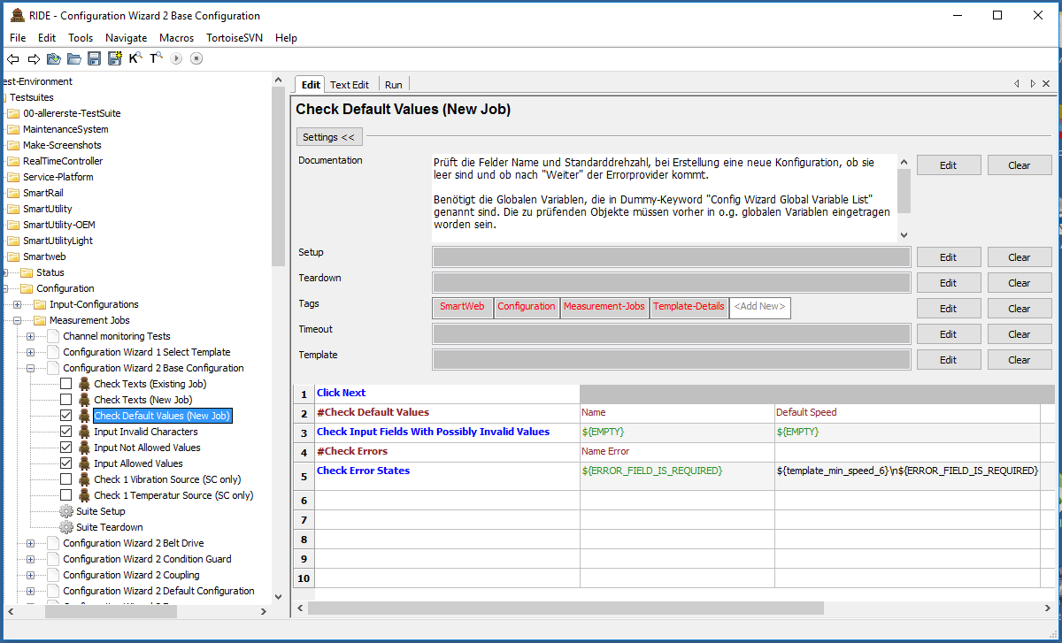
Editors , IDEs:
● RIDE.

Slide 15
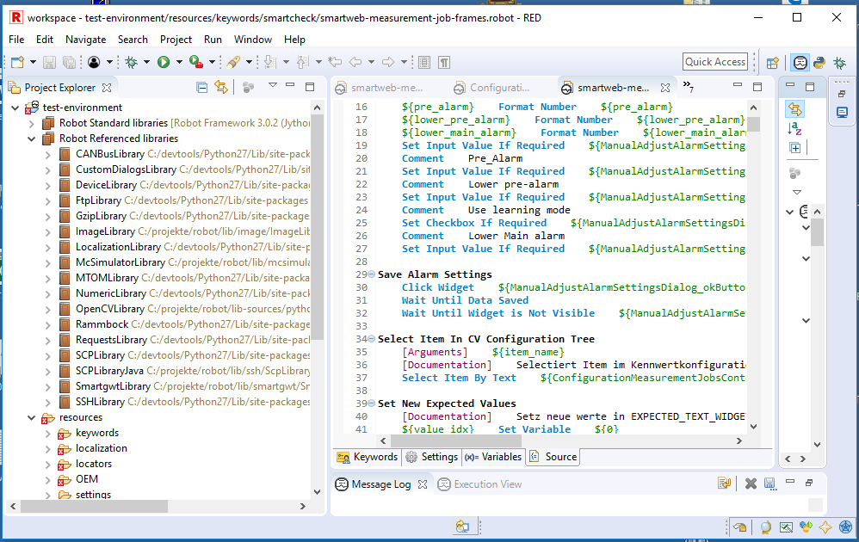
Editors , IDEs:
● RED.
● Plugins for IntelliJ, SubLime, TextMate, Vim, Emacs, Brackets, Atom, …

