Slide 1
Cobalt Database project
Presented by Ngoc Nguyen

Slide 2
1000+ slides review

Slide 3
30+ hours

Slide 4
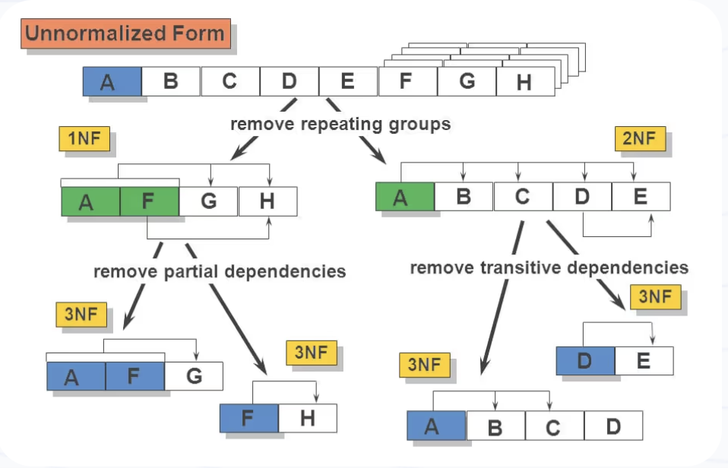
Source: https://galaktika-soft.com

Slide 5
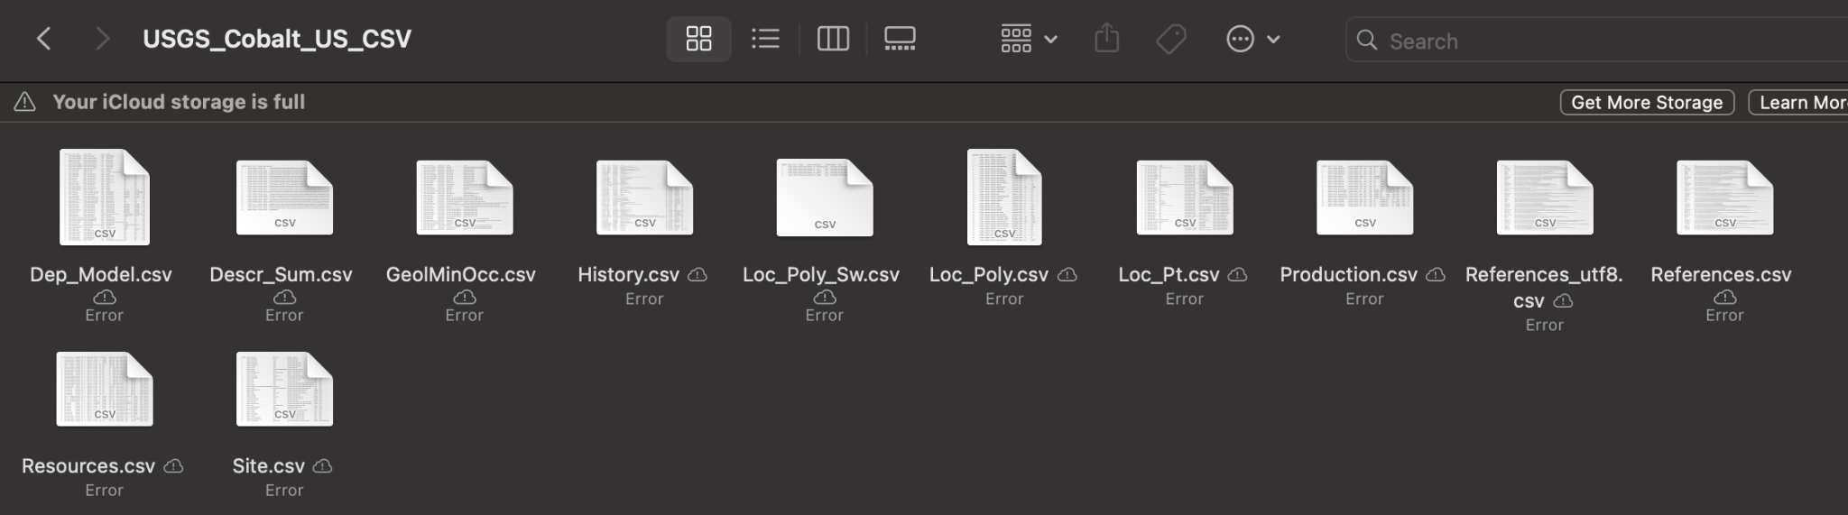
PRIMARY KEY (OrderID),
FOREIGN KEY (PersonID) REFERENCES Persons(PersonID)To
From this

Slide 6
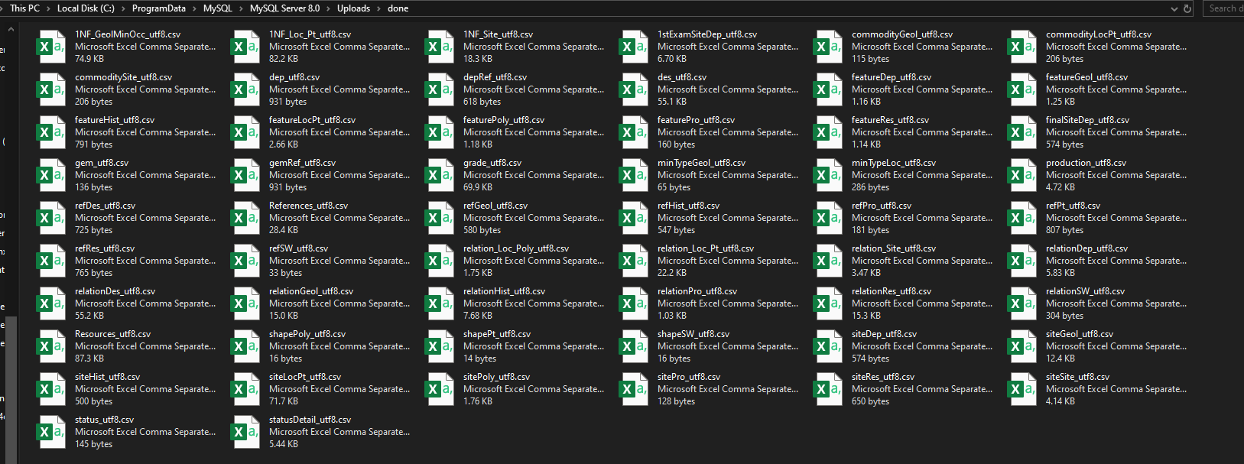
To this…

Slide 7
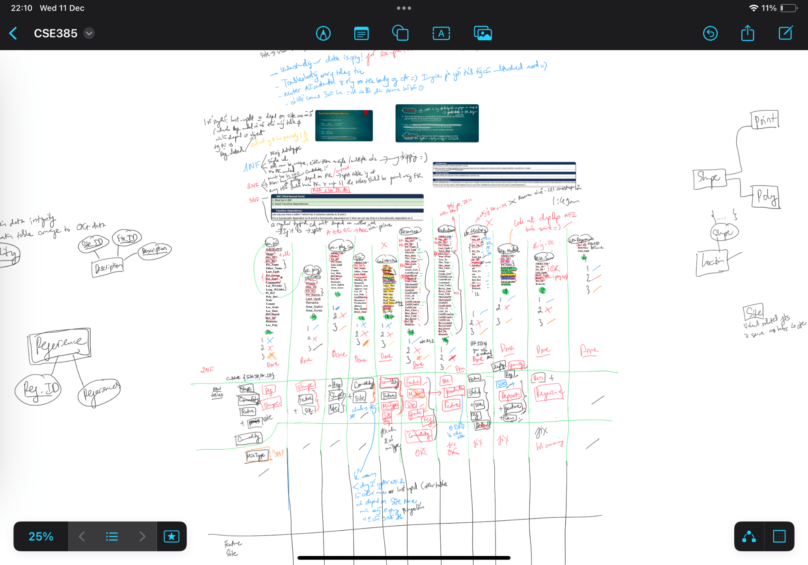

Slide 8
Just a lot of table splitting and relating them together!

Slide 9
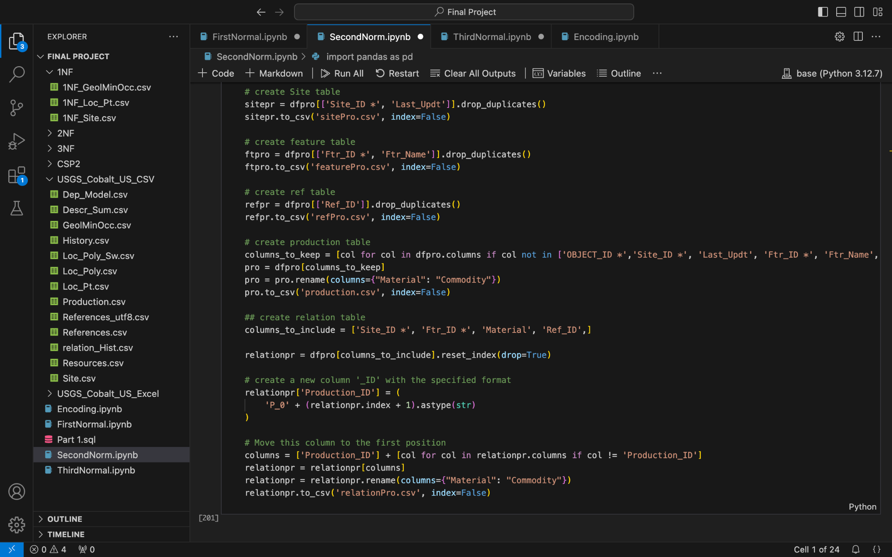

Slide 10
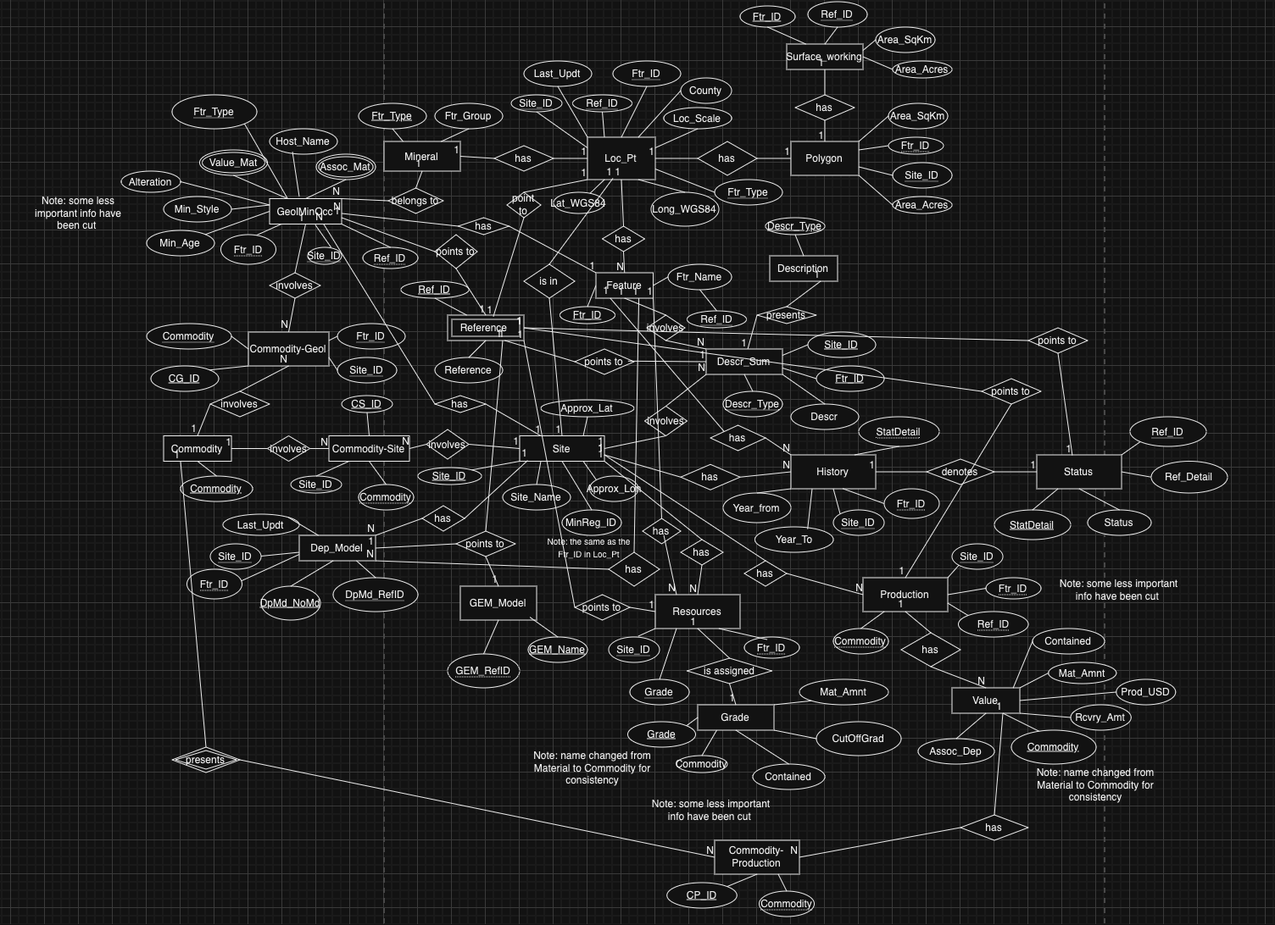
The Result?

Slide 11
Thank you for listening!

