Slide 1

NESTJS BASIC
From zero to clown

Slide 2
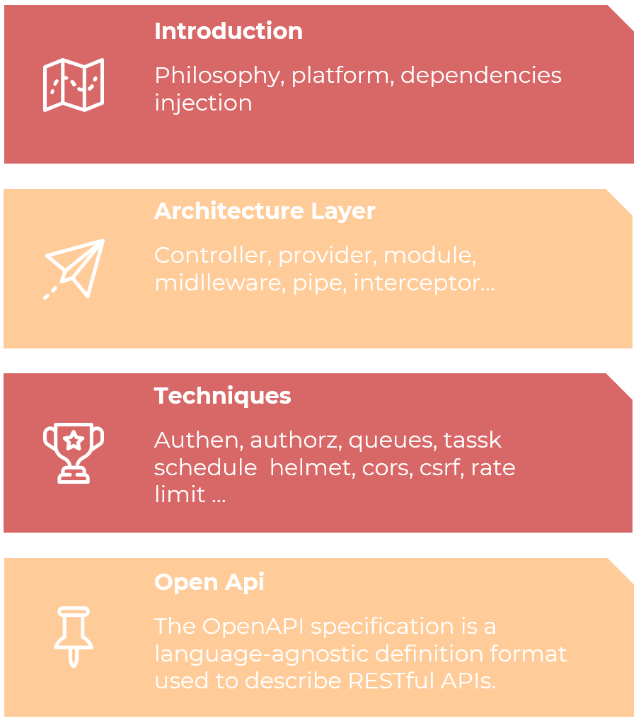

Slide 3
Why Nestjs?
In recent years, thanks to Node.js, JavaScript has become the “lingua franca” of the web for both front and backend applications. This has given rise to awesome projects like Angular, React and Vue, which improve developer productivity and enable the creation of fast, testable, and extensible frontend applications.
However, while plenty of superb libraries, helpers, and tools exist for Node (and server-side JavaScript), none of them effectively solve the main problem of - Architecture.
Nest provides an out-of-the-box application architecture which allows developers to create highly testable, scalable, loosely coupled, and easily maintainable applications. The architecture is heavily inspired by Angular.

Slide 4
Introduction
Nest (NestJS) is a framework for building efficient, scalable Node.js server-side applications. It uses progressive JavaScript, is built with and fully supports TypeScript
Under the hood, Nest makes use of robust HTTP Server frameworks like Express (the default) and optionally can be configured to use Fastify as well!
Nest provides a level of abstraction above these common Node.js frameworks (Express/Fastify), but also exposes their APIs directly to the developer. This gives developers the freedom to use the myriad of third-party modules which are available for the underlying platform.
Notes:
Được xây dựng chuyên dùng cho các ứng dụng doanh nghiệp có quy mô lớn.
Cho phép develop nhanh và hiệu quả hơn.
Khả năng mở rộng tốt, dễ bảo trì ứng dụng.
Là framework Node.js phát triển mạnh nhất trong 3 năm trở lại đây.
Cho phép xây dựng ứng dụng Rest API, MVC, microservices, GraphQL, Web Socket hay CRON job.

Slide 5
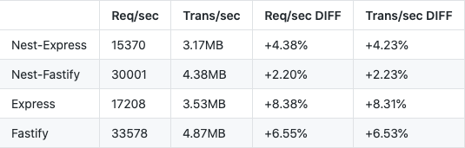
Platform
Platform independence makes it possible to create reusable logical parts that developers can take advantage of across several different types of applications.
Technically, Nest is able to work with any Node HTTP framework once an adapter is created. There are two HTTP platforms supported: express and fastify.
Notes:
FW k phụ thuộc vào nên

Slide 6

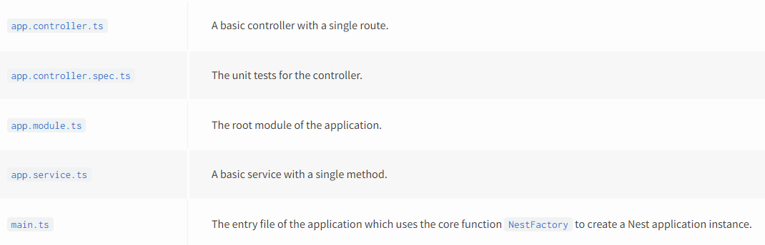
Installation and layers
Node.js (version >= 12, except for v13).

Slide 7
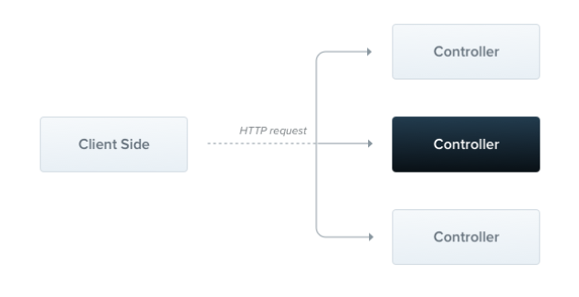
Controllers
Controllers are responsible for handling incoming requests and returning responses to the client.
Notes:
Nhiệm vụ req res
Nơi đặt ác decoracter, để làm swagger
Các bộ decoracter để làm việc vs req

Slide 8
Providers
Providers are a fundamental concept in Nest. (services, repositories, factories, helpers ..)
The main idea of a provider is that it can be injected as a dependency; this means objects can create various relationships with each other, and the function of "wiring up" instances of objects can largely be delegated to the Nest runtime system.
Scope:
DEFAULT
REQUEST
TRANSIENT
Notes:
Provider là nơi cung cấp các serivce, repositories, factories, helpers,... cho controller trong một module sử dụng
Registration provider trong module
Scope:
Single
Từng request, end thì garbage clear
Tạm thời, mỗi chỗ inject là 1 bản chuyên dụng

Slide 9
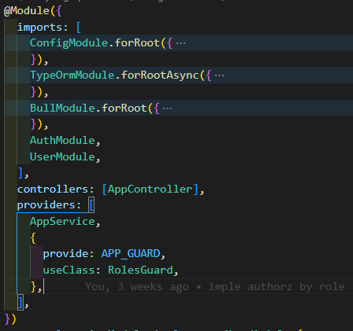
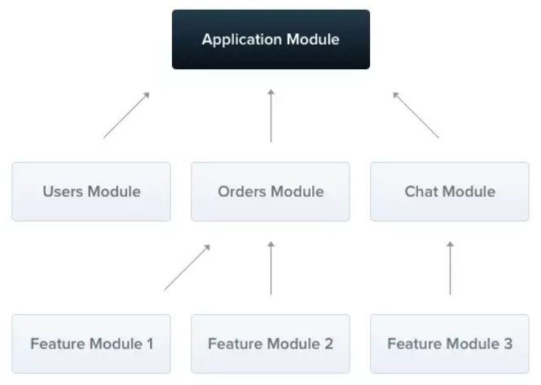
Modules
In Nest, modules are singletons by default, and thus you can share the same instance of any provider between multiple modules effortlessly.
Notes:
Đóng gói tất cả vào 1 module, tiện mang vác module đấy đi cho khác dùng
providers: Có nhiệm vụ khởi tạo và cung cấp các service mà sẽ được controller trong module sẽ sử dụng đến.
controllers: Có nhiệm vụ khởi tạo những controller đã được xác định trong module.
imports: Có nhiệm vụ import những thành phần của một module khác mà module sẽ sử dụng.
exports: Có nhiệm vụ export các thành phần của provider và các module khác sẻ import để sử dụng.

Slide 10
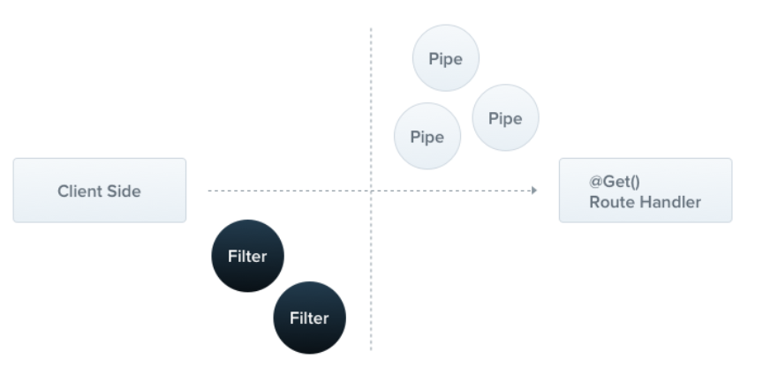
Exception-filters
Nest comes with a built-in exceptions layer which is responsible for processing all unhandled exceptions across an application. When an exception is not handled by your application code, it is caught by this layer, which then automatically sends an appropriate user-friendly response.
Notes:
Khi ta k xử lý exception thì sẽ được lớp excep filter đón và trả ra response than thiện vs ng dùng
Vd fct trc đây validate hay return về obj res, nhưng e sửa thành throw FctError hết, r` xử lý error đấy =>> clean code

Slide 11
Middleware
Middleware is a function which is called before the route handler. Middleware functions have access to the request and response objects, and the next middleware function in the application’s request-response cycle
Middleware functions can perform the following tasks:
execute any code.
make changes to the request and the response objects.
end the request-response cycle.
call the next middleware function in the stack.
if the current middleware function does not end the request-response cycle,
Notes:
Middleware thường dùng cho authen, author, validate, trong nest thì có pipes guards để làm riêng việc authen và validate
Có thể
Khi nào gặp case cụ thể thì biết nên chọn cái nào

Slide 12
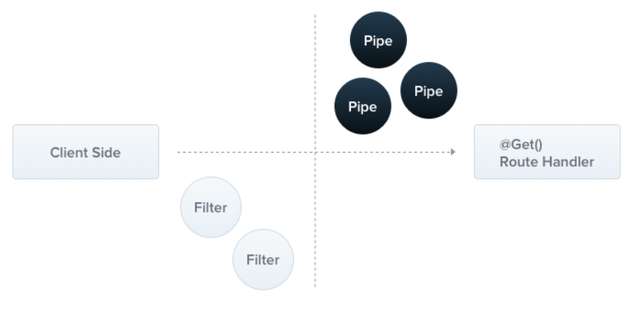
Pipes
Transformation: transform input data to the desired form (e.g., from string to integer)
Validation: evaluate input data and if valid, simply pass it through unchanged; otherwise, throw an exception when the data is incorrect
Notes:
Dùng thư viện pipe sẵn có để lọc :v

Slide 13
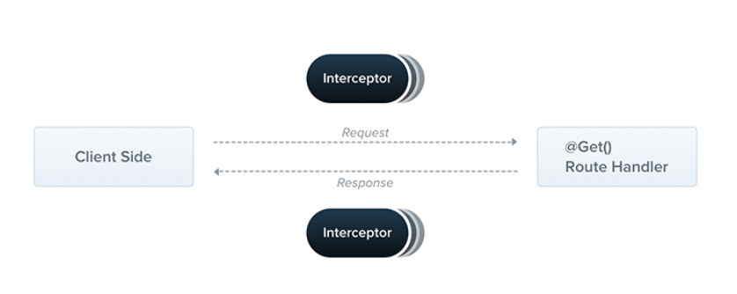
Interceptors
Bind extra logic before / after method execution
Transform the result returned from a function
Transform the exception thrown from a function
Extend the basic function behavior
Completely override a function depending on specific conditions (e.g., for caching purposes)
Notes:
Middleware nhưng can thiệp vào 2 chiều

Slide 14
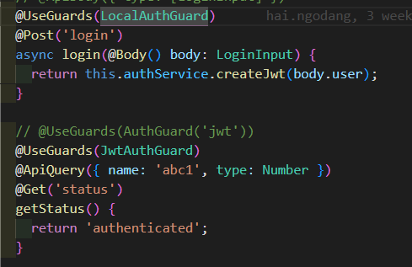
Authorization

Slide 15
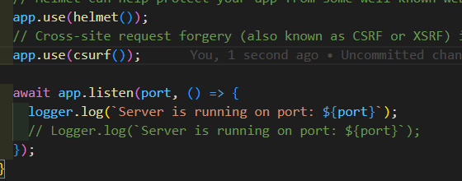
CSRF, Helmet
Cross-site request forgery (also known as CSRF or XSRF) is a type of malicious exploit of a website where unauthorized commands are transmitted from a user that the web application trusts. To mitigate this kind of attack you can use the csurf package.
Helmet can help protect your app from some well-known web vulnerabilities by setting HTTP headers appropriately. Generally, Helmet is just a collection of smaller middleware functions that set security-related HTTP headers (read more).

Slide 16
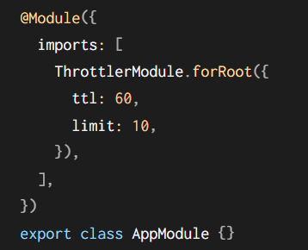
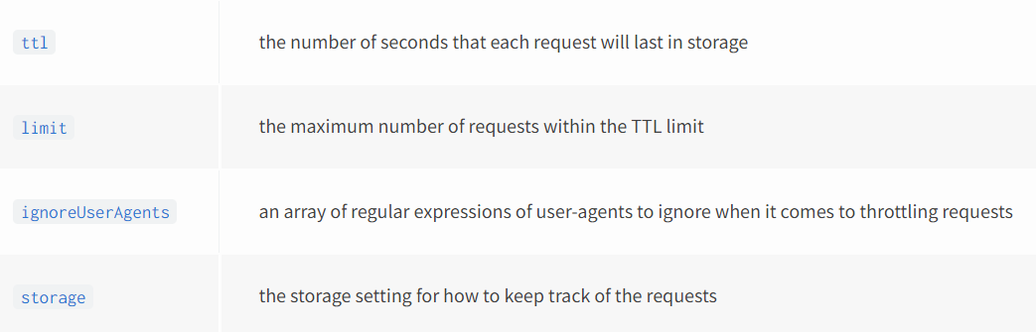
Rate-limiting
A common technique to protect applications from brute-force attacks is rate-limiting.

Slide 17
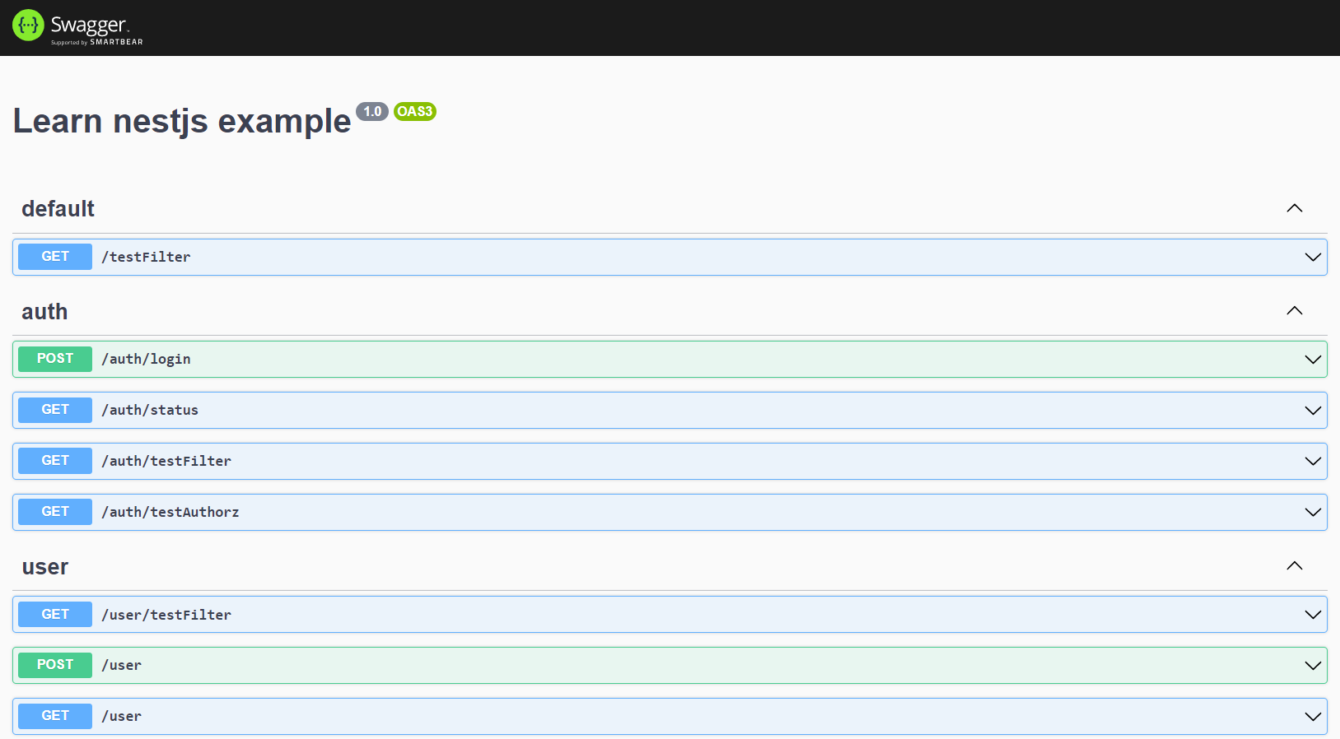
Openapi (swagger)

Slide 18

Whoa!
You guys still here. Thanks for watching

Slide 19
Thanks!
Does anyone have any questions?
addyouremail@freepik.com
+91 620 421 838
yourcompany.com

Slide 20

Introduction
Philosophy, platform, dependencies injection
Architecture Layer
Controller, provider, module, midlleware, pipe, interceptor…
Techniques
Authen, authorz, queues, tassk schedule helmet, cors, csrf, rate limit …
Open Api
The OpenAPI specification is a language-agnostic definition format used to describe RESTful APIs.

