Slide 1
ACOUSTIC SCENE GENERATION
BY: NAMAN GOEL (IIT DELHI)

Slide 2
ACOUSTIC SCENE CLASSICFICATION (asc)
It is the process of automatically categorizing audio recordings into predefined scene categories based on the characteristics of the sound environment.
Steps involved
Data collection
Feature extraction
Feature selection
Classification
Features extracted and selected can be thought of as having projected the signal to a latent phase space. This can be used to characterize the signal and therefore also modelling your own which is “close” to the natural un-synthesized signal in the phase space and then performing inverse operation to generate the signal from it for that particular class label.

Slide 3
Some asc neural network models

Slide 4
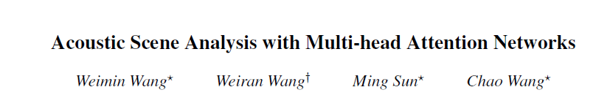
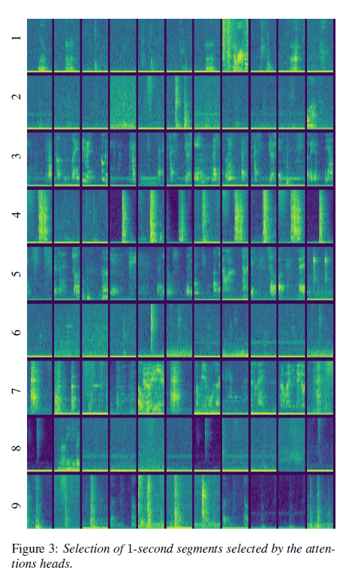
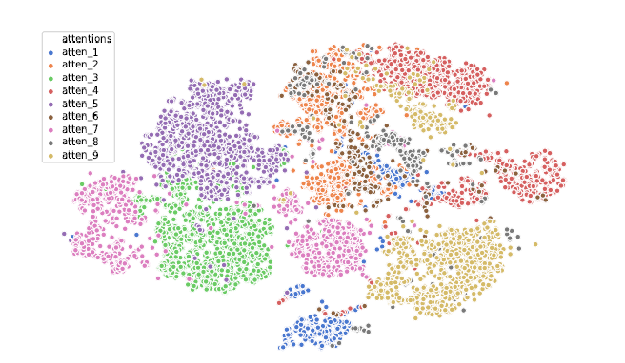
The model proposes a multi-head network to generate attention scores for all heads which are then concatenated to form the representative vector for the input signal.
The input signal is taken frame by frame in time domain on which CNN and LSTM is applied before passing it multi-head network.
T-SNE visualization of input hidden states selected by attention heads
Dataset used: DCASE 2018 Task 5
Published: 2020

Slide 5
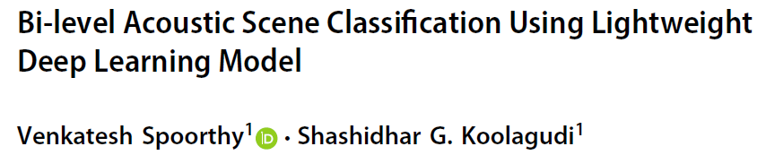
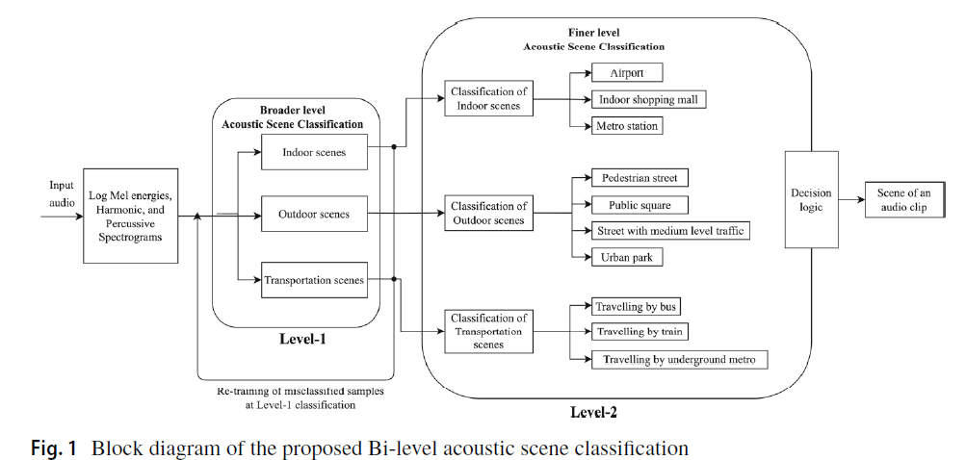
Makes use of time-frequency domain features of the input signal and hierarchical classification
First the signal is classified into broader categories of indoor, outdoor, transport and is then further classified into granular class labels
Combination of MobileNet and SENet networks
Accuracy of 96.9% in classification
Dataset used: DCASE 2020 Task 1B
Published: 12 August 2023

Slide 6
Speech features that can be used to characterize an environmental sound signal
Most of the features that have been used traditionally like MFCC work for structured sound, without noise. Environmental signals can actually appear to be flat and noise-like to these and therefore these features are not very helpful with their classification and characterisation.

Slide 7
Spectrograms
Harmonic: It better captures continuous sound events like rain, tap water running
Percussive: For sudden sound events like clap or gunshot
Mel-spectrogram: Containing entire information about the signal in time-frequency domain obtained by performing STFT on the original signal and converting it to Mel scale for better performance
Decomposition of spectrograms using techniques like CNN can help capture different sound events while retaining data about the signal and the output can be treated as characteristic embedding of input signal
Gammatone Cepstral Coefficient
They better model human auditory system and has been used in some research works for speaker identification, emotion detection
Mel Frequency Cepstral Coefficient (MFCC)
Computed by taking the Fourier transform of short-time windows, mapping the powers of the spectrum onto the mel scale, and applying a discrete cosine transform.

Slide 8
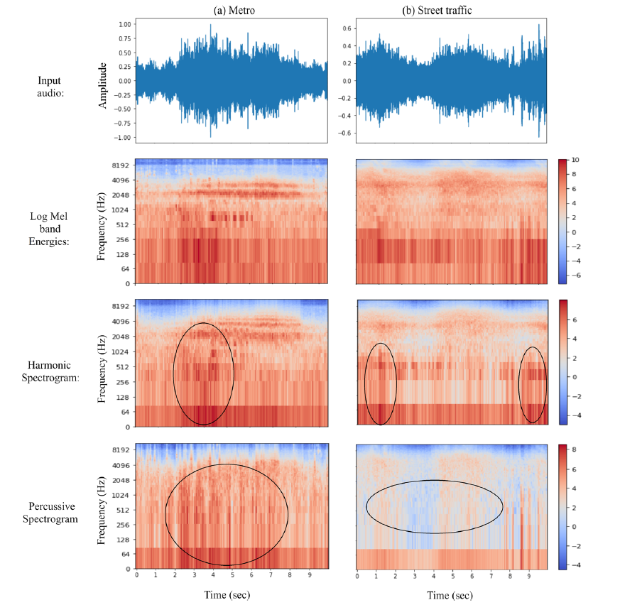

Slide 9
Spectral Centroid: Indicates the brightness of a sound
Spectral Bandwidth: Measures the range of frequencies present in the signal.
Spectral Flatness: Quantifies how noise-like a sound is
Spectral Roll-Off
The frequency below which a specified percentage of the total spectral energy is contained, often set at 95%
Spectral Flux: Measures the change in spectral amplitude between successive frames
Band-Energy Ratio
The ratio of energy in specific frequency bands to the total energy, useful for distinguishing sounds occurring in different frequency ranges
i-vector
A compact representation of audio recordings, widely used in speaker and audio scene recognition tasks. It is derived from a higher-dimensional feature space and provides a fixed-length representation that encapsulates the characteristics of an audio segment. The i-vector is a low-dimensional representation obtained by projecting the supervector into the total variability space.
Log Mel Energies
We obviously don’t use all features for characterizing a single signal because it is neither efficient nor practical because it increases the dimensionality unnecessarily and using many features can also lead to decreased performance in classification task.

Slide 10
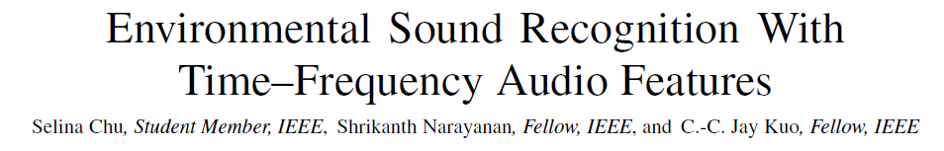
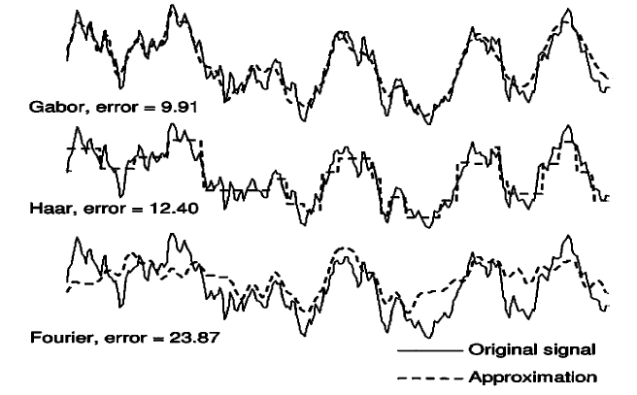

The Matching Pursuit (MP) algorithm is used for feature extraction in the context of environmental sound recognition. The paper describes how MP is utilized to decompose audio signals into a series of basis vectors selected from a dictionary of atoms, specifically Gabor atoms. This approach helps to obtain time-frequency features that are more effective in classifying environmental sounds compared to traditional frequency-domain features
Dictionary of Atoms: MP uses an overcomplete dictionary of atoms (functions) to represent the audio signal. The dictionary in this study consists of Gabor atoms, which provide joint time-frequency localization.
Sparse Representation: The goal is to achieve a sparse representation of the signal by selecting a few significant atoms that capture the essential characteristics of the audio signal.
MP features are more robust to background noise and therefore more suitable for modelling environmental sounds

Slide 11
Thank you

