Slide 1
Version Control - Git
作成日: 2015/07/02
作成者： Tran Vu Quan

Slide 2
Content (1)
Version Control
Why Version Control?
Acronym/Lingo
Case-study
Checkin
Checkout and Editing
Diffs
Branching
Merging
Conflicts
Tagging

Slide 3
Content (2)
Git
What is Git?
Setting up a repository
Adding a remote repository
Fetching a remote
Saving changes
Undoing changes

Slide 4
1. Why Version Control? (1)
The purpose of “Save as”?
You want the new file without obliterating the old one.
Solution:
Make a single backup copy (Document.old.txt).
If we’re clever, we add a version number or date: Document_V1.txt, DocumentMarch2007.txt
We may even use a shared folder so other people can see and edit files without sending them over email. Hopefully they relabel the file when they save it.

Slide 5
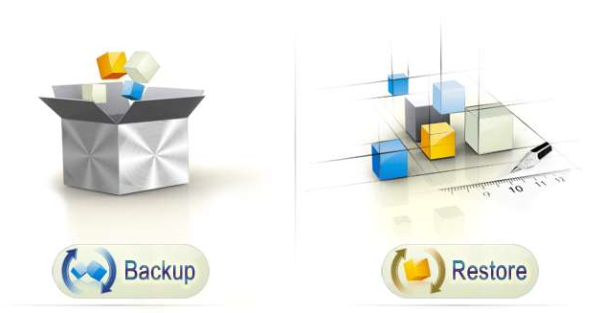
1. Why Version Control? (2)
Backup and Restore. Files are saved as they are edited, and you can jump to any moment in time. Need that file as it was on Feb 23, 2007? No problem.
Short-term undo. Monkeying with a file and messed it up? (That’s just like you, isn’t it?). Throw away your changes and go back to the “last known good” version in the database.
Long-term undo. Sometimes we mess up bad. Suppose you made a change a year ago, and it had a bug. Jump back to the old version, and see what change was made that day.

Slide 6


1. Why Version Control? (3)
Synchronization. Lets people share files and stay up-to-date with the latest version.
Track Changes/Ownership. As files are updated, you can leave messages explaining why the change happened (stored in the VCS, not the file). This makes it easy to see how a file is evolving over time, and why.

Slide 7
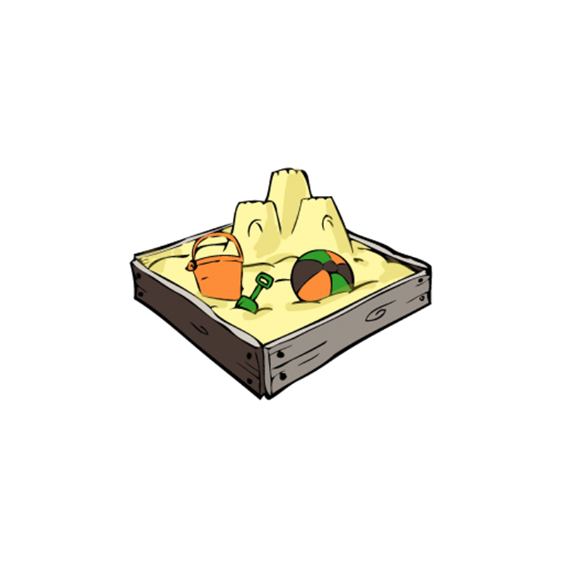
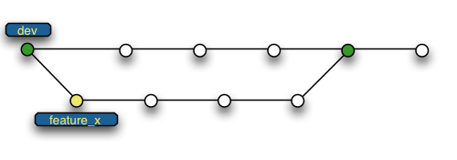
1. Why Version Control? (4)
Sandboxing. You can make temporary changes in an isolated area, test and work out the kinks before “checking in” your changes.
Branching and merging. A larger sandbox. You can branch a copy of your code into a separate area and modify it in isolation (tracking changes separately). Later, you can merge your work back into the common area.

Slide 8
2. Acronym/Lingo (1)
Basic Setup:
Repository (repo): The database storing the files.
Server: The computer storing the repo.
Client: The computer connecting to the repo.
Working Set/Working Copy: Your local directory of files, where you make changes.
Trunk/Main: The primary location for code in the repo. Think of code as a family tree — the trunk is the main line.

Slide 9
2. Acronym/Lingo (2)
Basic Actions:
Add: Put a file into the repo for the first time, i.e. begin tracking it with Version Control.
Revision: What version a file is on (v1, v2, v3, etc.).
Head: The latest revision in the repo.
Check out: Download a file from the repo.
Check in/Commit: Upload a file to the repository (if it has changed). The file gets a new revision number, and people can “check out” the latest one.
Check in/Commit Message: A short message describing what was changed.
Changelog/History: A list of changes made to a file since it was created.
Update/Sync: Synchronize your files with the latest from the repository. This lets you grab the latest revisions of all files.
Revert: Throw away your local changes and reload the latest version from the repository.

Slide 10
2. Acronym/Lingo (3)
Advanced Actions:
Branch: Create a separate copy of a file/folder for private use (bug fixing, testing, etc). Branch is both a verb (“branch the code”) and a noun (“Which branch is it in?”).
Diff/Change/Delta: Finding the differences between two files. Useful for seeing what changed between revisions.
Merge (or patch): Apply the changes from one file to another, to bring it up-to-date. For example, you can merge features from one branch into another. (At Microsoft this was called Reverse Integrate and Forward Integrate)
Conflict: When pending changes to a file contradict each other (both changes cannot be applied).
Resolve: Fixing the changes that contradict each other and checking in the correct version.
Locking: Taking control of a file so nobody else can edit it until you unlock it. Some version control systems use this to avoid conflicts.
Breaking the lock: Forcibly unlocking a file so you can edit it. It may be needed if someone locks a file and goes on vacation (or “calls in sick” the day Halo 3 comes out).
Check out for edit: Checking out an “editable” version of a file. Some VCSes have editable files by default, others require an explicit command.

Slide 11
3. Case-study
Peter adds a file (list.txt) to the repository.
Alice checks it out, make a change (puts “milk” on the list), and checks it back with a checkin message (“Added required item.”).
The next morning, Bob updates his local working set and sees the latest revision of list.txt, which contains “milk”. He can browse the changelog or diff to see that Alice put “milk” the day before.

Slide 12
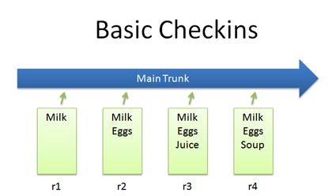
3.a. Checkins
The simples scenario is checking in a file (list.txt) and modifying it over time.

Slide 13
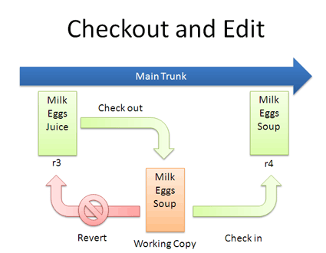
3.b. Checkout and Editing
In reality, you might not keep checking in a file. You may have to check out, edit and check in. The cycle looks like this:
If you don’t like your changes and want to start over, you can revert to the previous version and start again.
When checking out, you get the latest revision by default. If you want, you can specify a particular revision.

Slide 14
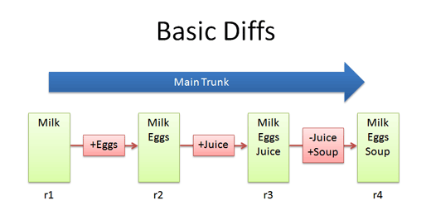
3.c. Diffs
The trunk has a history of changes as a file evolves. Diffs are the changes you made while editing:
Most version control systems store diffs rather than full copies of the file.

Slide 15
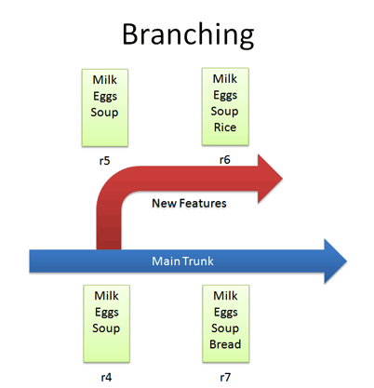
3.d. Branching
Branches let us copy code into a separate folder so we can monkey with it separately:
Since we’re in a separate branch, we can make changes and test in isolation, knowing our changes won’t hurt anyone.
Our branch history is under version control.

Slide 16
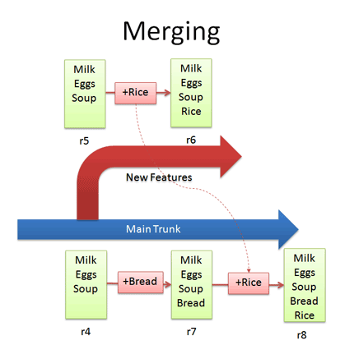
3.e. Merging
Apply the changes that happened in one branch to another branch.

Slide 17
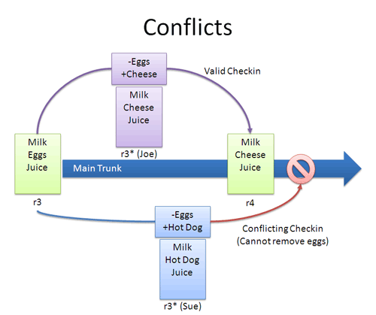
3.f. Conflicts (1)
Many times, the VCS can automatically merge changes to different parts of a file.
Conflicts can arise when changes appear that don’t gel:

Slide 18
3.f. Conflicts (2)
How to resolve:
Re-apply your changes. Sync to the the latest version (r4) and re-apply your changes to this file: Add hot dog to the list that already has cheese.
Override their changes with yours. Check out the latest version (r4), copy over your version, and check your version in. In effect, this removes cheese and replaces it with hot dog.

Slide 19
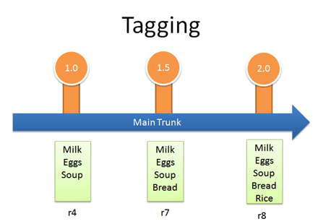
3.g. Tagging
Tags are just branches that you agree not to edit; they are around for posterity, so you can see exactly what your version 1.0 release contained.

Slide 20

1. What is Git?
Git is a distributed version control system originally developed to manage Linux source codes.

Slide 21
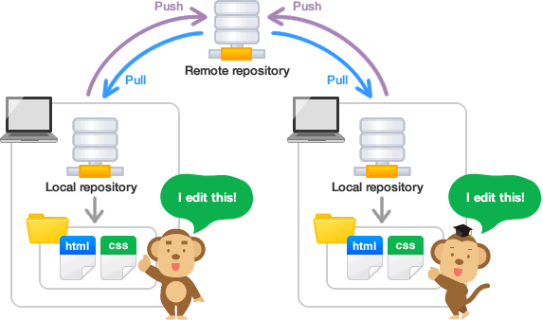
2. Setting up repository (1)
Two types of Git repositories:
Remote repository: Repository that resides on a remote server that is shared among multiple team members
Local repository: Repository that resides on a local machine of an individual user.

Slide 22
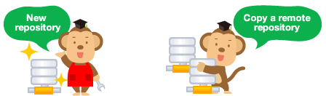
2. Setting up repository (2)
Two ways to create a local repository on your local machine:
Create a brand new repository
git init //Transform the current directory into a Git repository
git init <directory> //Create an empty Git repository in the specified directory
Cloning an existing remote repository onto your local machine
git clone <repo> //Clone the repository located at <repo> into the local machine
git clone <repo> <directory> //Clone the repository located at <repo> into the folder called <directory> on the local machine

Slide 23
2. Setting up repository (3)
After installing Git, configure your name/email:
# Tell Git who you are
git config --global user.name "John Smith"
git config --global user.email john@example.com

Slide 24
3. Adding a remote repository
cd existing_folder
git init
git remote add origin git@training-lab.altplus.vn:intern02/minhdd.git
git push –u origin master

Slide 25
4. Fetching a remote
git fetch: retrieve new work done by other people.
git fetch <remotename>
git merge: merging combines your local changes with changes made by others.
git merge <remotename>/<branchname>
git pull: a convenient shortcut for completing both git fetch and git merge in the same command
git pull <remotename> <branchname>

Slide 26
5. Saving changes
git add: tells Git that you want to include updates to a particular file in the next commit.
git add <file> //Stage all changes in <file> for the next commit
git add <directory> //Stage all changes in <directory> for the next commit
git commit: commits the staged snapshot to the project history.
git commit
git commit –m “<message>”

Slide 27
5. Saving changes (2)
git push: push your local source code to a remote repository.
git push <remotename> <branchname>
git push origin master

Slide 28
6. Undoing changes
git checkout: checkout a branch or paths to the working directory.
git checkout <branchname> //Return to the branch
git checkout <commit> <file> //Check out a previous version of a file
git checkout <commit> //Update all files in the working directory to match the specified commit

Slide 29
7. Others
git status: displays paths that have differences between the index file and the current HEAD commit, paths that have differences between the working tree and the index file, and paths in the working tree that are not tracked by Git
git log: Shows the commit logs.
git branch -a: shows all (both local and remote) branches.

