Slide 1
The last passenger -OOP Project
CS360 - Group 4
Nguyen Dai Thang – 1584535
Ngô Hoàng Minh – 1586005
Trần Thế Minh – 1584527
Nguyễn Hữu Thắng – 1575397

Slide 2
Introduction
The last passenger game includes a 3x5 matrix, each row’s member will have either the color green, yellow or red.
A player selects one color then try to select the correct colored matrix member of each row, gaining one point per correct choice and end their game once said player selects the wrong colored matrix member.
There are 4 players with the objective of reaching the maximum score of 5 according to the above rules.

Slide 3
Contents
Our programs features:
Show the initial matrix
Change the initial matrix
Play
Show results
Show the player who has the highest score
Show the player who has the lowest score
Quit the program

Slide 4
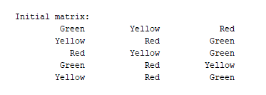
Contents:1
Option 1. is showing us the color of each matrix members. Initial matrix is built in the class GroupProject in the program.
This 3x5 matrix’s member color can be changed with option 2.
The program’s limitation only shows colors as black text.

Slide 5
Contents:2
Option 2. allows us to change a member’s color by choosing their row and column number then choosing which new color we want to change the member into.
Another member with the new color in the same row will exchange color with the member we selected.
After changing member color, the program will output the edited matrix.
The user can choose to keep continuing option 2 after finish changing color.

Slide 6
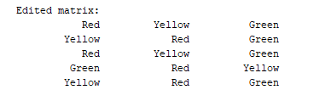
Contents:2
In the picture example we choose row 1, column 1 then choose the Red color. The program then switches the color of 1x1 Green member with the 3x1 Red color member.
The program outputs the new edited matrix.
1x1 |  | 3x1

Slide 7
Contents:3
The programs ask the user to enter the name of Player 1, then the color Player 1 selects and the user play “The last passenger” as Player I.
Repeat with Player 2 until 4 players have ended their game.

Slide 8
Contents:4
The program show player names , selected player colors and their scores, ordered by their turn.
Lượt chơi | Người chơi | Màu lựa chọn | Điểm
1 | Ngo Hoang Minh | Vàng | 4
2 | B | Vàng | 0
3 | Ca | Đỏ | 3
4 | Thang | Vàng | 2

Slide 9
Contents:5
The program show the highest scored player’s turn, name and score.
1 | Ngo Hoang Minh | 4

Slide 10
Contents:6
The program show the lowest scored player’s turn, name and score.
2 | B | 0

Slide 11
Contents:7
The program ends.

Slide 12
Thank you for watching!

