Slide 1
Business Case Study: New restaurant in Hanoi, Vietnam
Ngo Huong Ly – December 2020

Slide 2
Presentation of Business ideas
VIETNAM IS A COUNTRY IN SOUTH EAST ASIA AND IS KNOWN AS 15TH MOST POPULOUS COUNTRIES IN THE WORLD.
VIETNAM ATTRACTS TOURISTS ALL AROUND THE WORLD BY ITS DIVERSE CULTURES, PEOPLE AND BY NUMEROUS FAMOUS DESTINATIONS TO VISIT.
MY IDEA IS TO OPEN A NEW RESTAURANT IN ONE OF THE MOST DEVELOPPED CITIES IN VIETNAM. MY STUDY WILL FOCUS IN TWO BIG CITIES: HANOI AND HO CHI MINH CITY. I WANT TO USE THIS PROJECT TO CLARIFY WHICH CATEGORY OF RESTAURANT SHOULD I OPEN AND WHICH LOCATION.
THIS STUDY DOES NOT TAKE INTO ACCOUNT THE INVESTMENT FUNDING AND TURN OVER… PLEASE CONSIDER MY PRESENTATION AS THE BEGINNING TO THE IDEA.

Slide 3
MY SOURCES OF DATA
Wikipedia
Foursquare api
Geocode

Slide 4
ALL CATEGORIES OF RESTAURANTS
BELOW ARE ALL THE CATEGORIES OF RESTAURANTS THAT I HAVE FOUND. THIS IS VERY IMPORTANT AND THE RESULTS SHOW ME THAT I CAN HAVE A LOT OF CHOICE AND PEOPLE ARE VERY OPEN TO TRY DIFFERENT TYPES OF FOOD.
Italian Restaurant', 'Pizza Place', 'Vietnamese Restaurant', 'Coffee Shop', 'Steakhouse', 'Sandwich Place', 'Bistro', 'BBQ Joint', 'Noodle House', 'Hotel Bar', 'Beer Bar', 'Vegetarian / Vegan Restaurant', 'French Restaurant', 'Fast Food Restaurant', 'Café', 'Japanese Restaurant', 'Beer Garden', 'Modern European Restaurant', 'Asian Restaurant', 'Korean Restaurant', 'Indian Restaurant', 'Bar', 'German Restaurant', 'Thai Restaurant', 'Whisky Bar', 'Sushi Restaurant', 'Burger Joint', 'Convention Center', 'Food Court', 'Ramen Restaurant', 'Tapas Restaurant', 'Middle Eastern Restaurant', 'Chinese Restaurant', 'Breakfast Spot', 'Hotpot Restaurant', 'Mexican Restaurant’.
I HAVE CLASSIFIED ALL THE ABOVE TYPES OF RESTAURANTS INTO DIFFERENT GROUPS:
EURO
ASIAN
LATINO
AMERICAN
CAFÉ
BAR

Slide 5
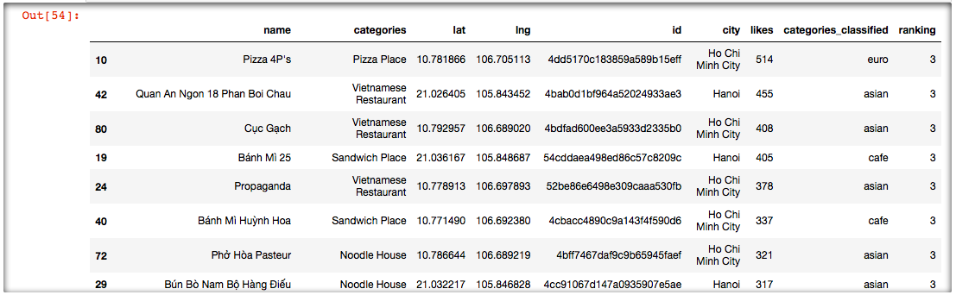
BY USING FOURSQUARE API, I TRIED TO FIND THE RESTAURANTS WHICH HAVE THE MOST LIKES IN HANOI AND HO CHI MINH CITY:
IT IS NOW VERY EASY TO SEE THAT RESTAURANTS IN Ho chi minh city HAVE A LOT MORE VISITS AND WERE REVIEWED MORE THAN RESTAURANTS IN Hanoi.
FISRT DECISION: I SHOULD OPEN A RESTAURANT IN HO CHI MINH CITY

Slide 6
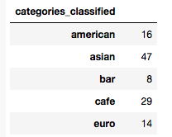
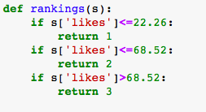
I decide to study 100 restaurants which have the most likes. The below shows us that asian restaurants are still popular and get most likes.
I want to try to put the restaurant categories into different bins :

Slide 7
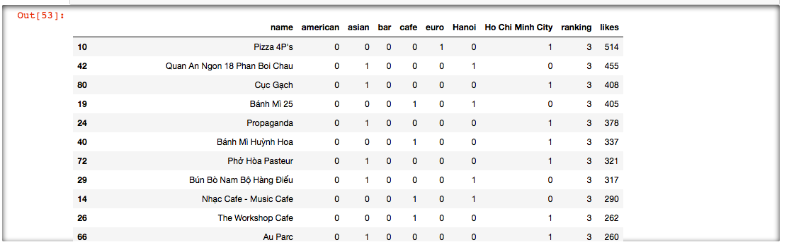
THE BELOW SHOWS US RESTAURANTS WITH MOST LIKES IN BOTH CITIES AND THEIR CATEGORIES:
SECOND DECISION: I SHOULD OPEN AN ASIAN RESTAURANT

Slide 8
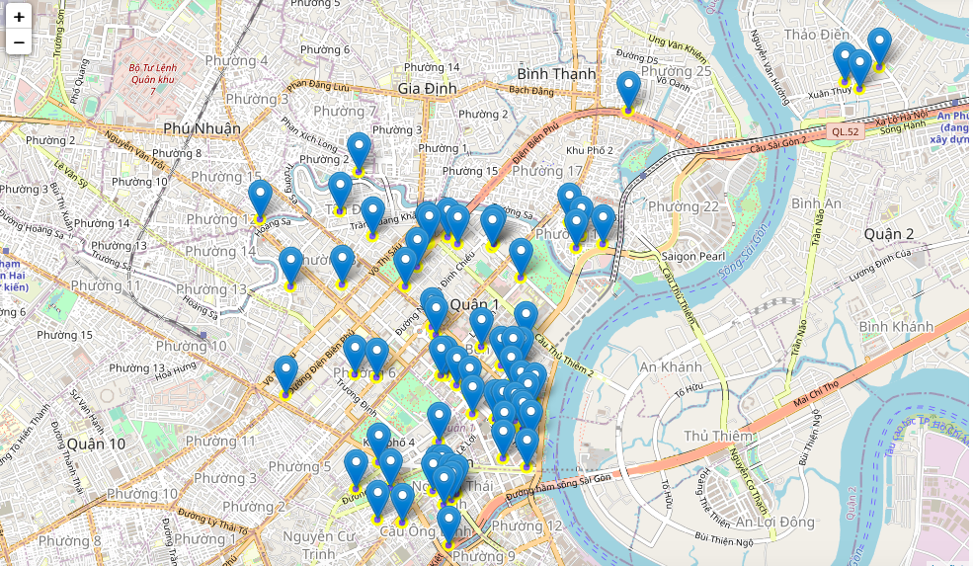
We now try to create a map of ho chi minh city with location of the list of restaurants that we have:
Most of restaurants locate in the 1st district. And this gave us another business decision: open the restaurant in 1st district, which is also the most dynamic district in ho chi minh city.

