Slide 1
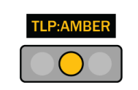
Modern Information Security
Lessons learned and improvements made 2020-2025
Notes:
Rob Arnold, CISSP
rarnold@children.org
TLP:AMBER – you may share this inside your organization, but other disclosure is limited.

Slide 2
What does Modern security mean?
Classical
Go slow to stay safe
Defend the castle
Infosec team solely responsible
Hardening
Prevent breach
Avoid risks
Modern
Go fast (automation)
There is no perimeter to defend
DevSecOps
Resilience
Assume breach
Manage risks
Notes:
Quick level set—short talk track
Modern is a vibe—what we have done for decades doesn’t prevent bad outcomes. Let’s change our thinking

Slide 3
Topic agenda
Overview of our environment & threat model
Defending identity: Multifactor authentication
Modern endpoint provisioning with Intune
Endpoint protection with Defender XDR
Network protection with Cloudflare WARP/Project Galileo
SOC automation with Sentinel
WLAN improvements using Fortinet products

Slide 4
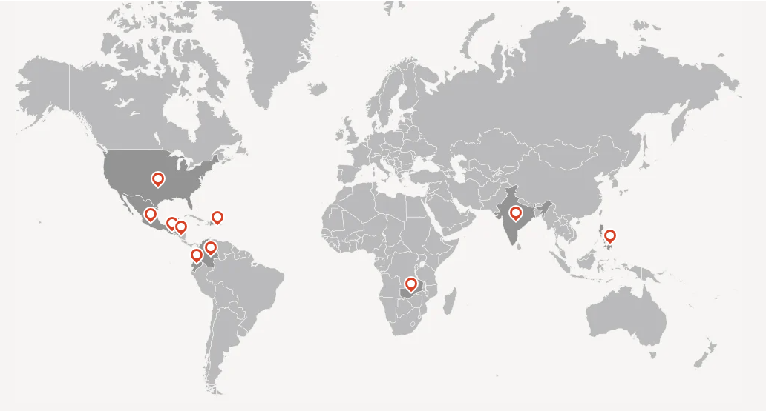
1,100 people in ten countries
We are federated
Around 70 locations
HQ in USA
LATAM is a region
Asia/Africa is a region
Notes:
Key points:
Substantial local budget autonomy even though tech is largely centrally-provided
They buy local to get better deals than we could
Equipment
Internet connections
HQ is just another location
Equipment uniformity in 2025 – WLAN first, cloud managed via Fortinet

Slide 5
Threat environment
Not in conflict areas generally
Governments not on my list of adversaries
Increasingly decentralized
Not just the operating model
Also the work location
Service Delivery Points: our services closer to where kids/families are
Partner organizations increasingly important
Notes:
I’m glad not to have to defend against Gov adversaries – Mossad not in my threat model
Decentralization matters a lot to the design of protective controls
Protection needs to go with you to where you work
Whole new set of problems to solve as we expand our reliance on partners to do our work

Slide 6
Threat environment—attacker profile
Commodity malware
Motivated largely by financial gain
Phish, fraud emails targeting my exec team
Not seeing the signs of “Advanced Persistent Threat” actors (APT)
Notes:
I grew up working in Financial services—a very different attacker profile and risk tolerance
Basic cyber hygiene is the sweet spot—advanced topics are not good use of resources for us

Slide 7

Key takeaway
Turning up all the knobs on your tools may not make you “more secure”
Notes:
Strong MFA example – requiring the highest strength MFA could impede our people in areas where smartphone use is less prevalent
We make strong MFA available without requiring it (yet)
We make sure we can demonstrate the effectiveness of MFA
All security choices are tradeoffs, often against convenience: work has to get done
Location restriction example – blocking signins from countries we don’t operate in can “strand” our staff without access to their work email during travel
We do block a short list of “out of bounds” countries, but we’ve loosened that over time rather than tightening it
Look at analytics daily about this

Slide 8
First pillar: Multifactor Auth
From
13 Active Directory domains
On-site domain controllers
No standard onboard/offboard
To
1 Entra ID tenant
Cloud managed
Automated onboard/offboard
Notes:
13 domains means 13 policies, audit logs, configurations to audit, etc.
We ran in hybrid mode for a few years—passwords synced between the cloud and the on-prem
Used Conditional access policy to enforce MFA
Started with every method as an option
Quickly removed device flow codes because they are super weak/exploitable
Later removed SMS with certain exceptions
Process matters a lot – looking at our enrollment for MFA stats taught us where we had problems to address
ex. Zambia is an area where toll fraud is prevalent, so the “phone call” step of MFA enrollment was not an available option there
We chose to allow personal email in ZM only as a second method to establish ID
Attained cloud native in 2025
Bonus key learning: SSPR and MFA enrollment used to be separate, MSFT converged these in 2025 sometime, creating a few new problems
Learning to audit your MFA enrollment is productive

Slide 9
Value of MFA+SSPR
Attack disruption
Credential theft mitigation
Faster response in successful cred theft incidents (revoke session)
Can be risk-based, with self-remediation
Cornerstone of Identity protection
Notes:
MFA means rarely do you get successful phish
Self-remediation is really valuable: if Entra thinks your signin right now is especially risky, you could see an MFA challenge.
Passing the MFA challenge reduces your risk score
Self-service password rest is now closely tied to MFA in Entra, because you register for both at the same time, which did not used to be true.

Slide 10
Entra ID reports of vital interest
Registration methods in use Authentication methods - Microsoft Entra admin center
Identities not capable of SSPR User registration details - Microsoft Entra admin center
Identities capable of SSPR User registration details - Microsoft Entra admin center
Notes:
In Zambia toll fraud is enough of a thing that Microsoft won’t allow us to use the phone call MFA method. We had to tailor a policy for that area that lets folks get registered.
These reports were what we used to get our heads around the issues and whether our solutions were effective.

Slide 11
Second Pillar: Desktop Resilience
From
Inconsistent to no standards
Image-based build (Desktop Central)
Manual effort/high-touch
Run past EOL
To
One global standard
Leverage Intune automation
< 1 hour from reset to productive
Staying current with autopatch
Notes:
This story is one I did an entire conference talk about, but you get the short version.
I want everyone to know that industrializing your desktop management pays off. We used Intune, it’s not the only way.
Consistency and standards that are enforced, those seem like self-evident good things, but prepare for resistance. I thought I was being conservative estimating this to take us 6 months, I was super optimistic.

Slide 12
People were harder than process or technology
Desktop support was a large part of how the support teams spent time
White-glove service seen as valuable by both supply/demand side
Notes:
Changing people’s jobs is a special kind of friction.
People cling to what they know.
That impulse is often magnified if it was super hard to get in the first place.

Slide 13
Huge value in fast, low-touch reset process
Reset it if I don’t trust it
Can scale effectively
Ransomware (classic) not much of a concern
Notes:
But the benefits are so compelling.
If building a machine is a painful event you need to not avoid it, you need to industrialize it and do it a lot more frequently.

Slide 14
High-value standards
IntuneLAPS – users are not admins of their machines
Attack Surface Reduction Rules
Folder redirection (M365/OneDrive)
Automated push/install/update of standard software
Document your shop standards, and keep it up-to-date
Notes:
I’m not here to pretend it’s simple—there are hundreds of configuration items you need to consider.
A few that really count are shown here.
Folder redirection is essential to the shortest time to recovery when you reset machines.
Standard software can be loaded automatically, and we use a “app store” that lets people self-serve optional items curated for their job role.

Slide 15
Third pillar: Endpoint protection
From
Trend Micro Apex One
Not integrated
Several inconsistent policies
To
Microsoft Defender XDR
Integrated
One global configuration
Notes:
I’ll spend most of the time talking about what integrated means.
When I had Trend Micro, it didn’t have any ability to look into other parts of the protection stack. It did very well at blocking malware if it knew the signature, but the total journey to “remediation” might involve researching where the thing came from, how many folks got it but didn’t click it just yet, and left quite a bit of manual work that needed several consoles to accomplish.
The X part of Defender XDR is really the pre-built integrations between the parts of the stack, which all save time and energy spent remediating or investigating.
Real-world example: attacker sends my CFO a spear phish link, successfully evading email filters. The link has more than one time-of-click protection mechanism though. So after it gets clicked, it is assessed as malicious. Defender XDR as part of the out-of-box behavior, will subsequently undeliver any mail containing that malicious link. The parts of the stack work together without you wiring them up for that.

Slide 16
Value in process streamlining
Antivirus either remediates issues automatically, or can’t
If I have low trust in the integrity of the endpoint, resetting is extremely attractive option
< 1 hour to known good state
Local support staff coordinate more than they run the process
Notes:
Take the fast road that leads to nuke & pave.
I get pretty solid descriptions of the malware capability from the detection alerts. Usually, we are looking at commodity malware that is easily blocked. But occasionally you can encounter nastier stuff.
If I think there’s even a small likelihood attackers have defeated a protection or accomplished persistence—it’s an easy call to rest the box where I saw it. And the process scales. If I had to reset hundreds, I have confidence that can be done. I used this option twice in 2025.

Slide 17
Defender reports of vital interest
Devices with malware detections - Microsoft Defender
Device Health - Microsoft Defender
You may choose to use the content filtering features of Defender—I chose to implement that using Cloudflare
Web Protection - Microsoft Defender
Notes:
The console is giving you feedback about how well your collection of endpoints is tracking the constantly-changing set of configs and signatures. Assuming it’s all healthy is hazardous—this needs ongoing attention.

Slide 18
Fourth pillar: Network Protection
From
SonicWall content filtering
Location-bound
Locally-tailored policies
Locally managed, with an overlay
To
Cloudflare WARP client ($0)
Location-independent
One global content policy
Cloud-managed
Notes:
When talking about this before we built it, I appealed to the idea that the protection needs to go with us to where the work is happening.
Most Modern thing: Relying on a sheet metal box in your closet to protect you does not reflect the modern work environment for many of us.
Project Galileo from Cloudflare provided us state-of-the-art protection tools for zero dollars. Run and apply if you have not done so yet.

Slide 19
Value in content filtering
3 specific goals of the policy set:
Restrict web traffic to “school-safe”
Enforce safe search on search engines
Enforce YouTube restricted mode
Bonus: blocking new domains easily
Bonus: DNS-based implementation, agentless coverage
Notes:
Child safeguarding is at the core of what we do. We use this state-of-the-art tech from Cloudflare to protect kids from being exposed to inappropriate content online when they work with us.
The malware protection is a powerful side benefit. Blocking new domains is a superpower.

Slide 20
WARP reports of vital interest
DNS query analytics - Cloudflare One
Digital experience - Cloudflare One
Notes:
The trap for a lot of shops is to set the tools up and never really inspect the outputs to confirm you are getting the desired outcomes. Pertinent questions we assess ongoing include:
What are we blocking?
Do we see legitimate apps being blocked?
How does it differ between staff and youth computers?
Is there a service/experience impact to this control?
Bonus value in Digital Experience (DEX) tests
How much would it help you if you could understand the peak (95%ile) and average (50%ile) load across a selection of resources you rely on? Isolate effects by geography?

Slide 21
Fifth pillar: SOC automation
From
Disparate tools
Inconsistent logging
Unknown retention
No analytics
To
M365 fully highly leveraged
Key services log to Sentinel
Defined retention
172 analytics rules, 37 tuned
Notes:
Without appealing to the two-vowel buzzword that is so very popular, there are tremendous opportunities to streamline and then automate your incident response actions.
Log analytics is the pivot for all that work. When you can analyze events in the log, rules can fire when conditions are met or thresholds are exceeded. This focuses your scarce attention on the weird stuff, not the routine stuff. Between M365, Entra, Dynamics 365, and Cloudflare we log

Slide 22
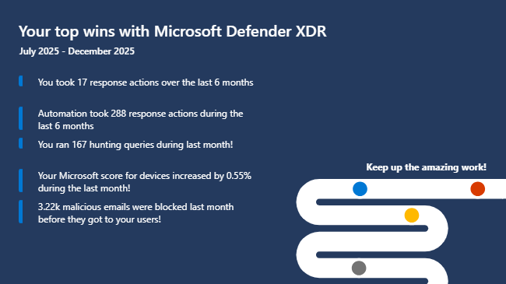
Value in automating incident response
Log -> alert -> incident -> remediation -> report can be automated
Notes:
About 5% of the time remediation actions are taken, that is me acting.
If I look at any situation that I consider an “investigation” I use the case feature to document my findings for my team (which right now is me). An example would be the events leading to a decision to reset an endpoint computer.

Slide 23
SOC reports of vital interest
Value Reflection - Microsoft Defender
Workbook - Microsoft Defender (SOC Efficiency Sentinel Workbook)
Cases - Microsoft Defender (not really a report, but I’ll list it here anyhow)
Notes:
Think of security operations as the entire set of processes you have limiting the adverse consequences of attacks. Classically this has been seen as an outsource/MSP opportunity.
You ought to be asking how can we use automation to get the work done with fewer people.

Slide 24
Sixth pillar: WLAN protections
From
Nothing centrally provided
Inconsistent logging
Various implementations
Basic segmentation
To
Fortinet +cloud management
Log to Fortianalyzer
Single Sign On with Entra
Microsegmentation
Notes:
Biggest two value points for us: Since WARP is handling network protection, the Fortinet stuff has a vastly reduced job:
Hand out DHCP
NAT
Balance two upstream internet connections
One globally-managed service with 72 service instances
Fortianalyzer is more operations-critical (is service impaired) than security critical because of that design
Microsegmentation is a huge value point – consequence of a modernized design construct: the security being factored off into the WARP client allows Fortianalyzer to orient at proactive service notifications

Slide 25
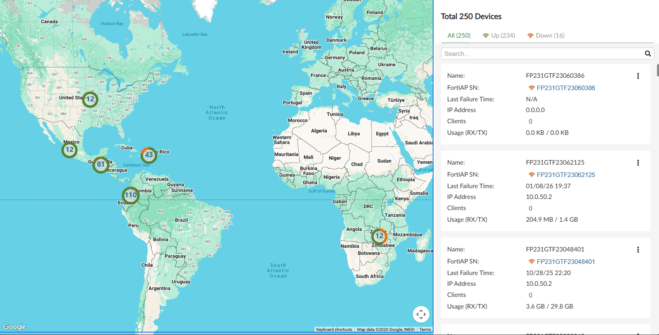

Slide 26
Value from including security requirements in infrastructure projects
Design efficiencies since we could size the appliances modestly
Really robust client isolation
Picked a vendor based on the integration with Entra
Uniform, location-independent signins
Streamlined sign-in process after deploy using Entra logs
Notes:
Easy to highlight the value of the robust, well-managed infrastructure, I’m skipping all the good dashboards showing this stays up and alerts us when it doesn’t, etc.
Factoring network security away (TYVM Cloudflare) let us buy much smaller gear, saving $ to use for more impact
Entra integration meant that the full power of Sentinel is available when we looked to improve sign-on experience
We had robust analytics
No need to MFA a WLAN sign-in, attackers on the other side of the planet can’t spoof it
Made changes (disabled MFA for WLAN signins) and saw the needle move
Our staff will cheerfully suffer and not let us know about it, so this was compelling

